Slide 1

Predicting Traffic Accident Severity in Bahrain
A Statistical Learning Approach
BDSA 602 - Statistical Data Analysis
M.Sc. in Big Data Science and Analytics
University of Bahrain
December 2025

Slide 2
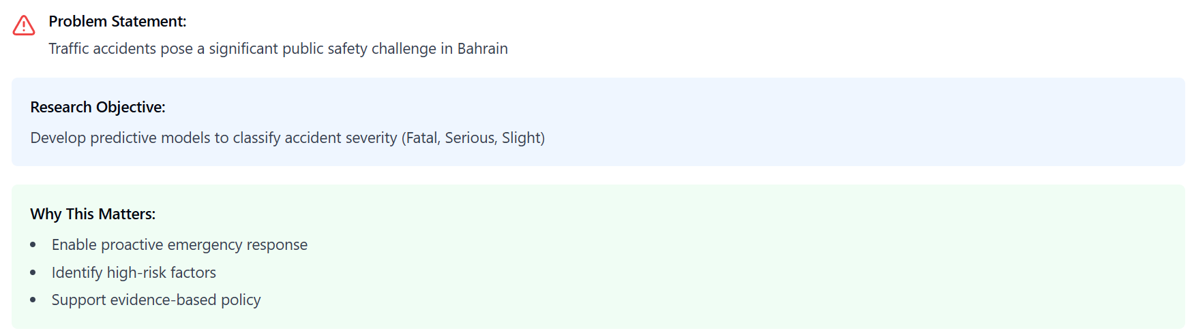
introduction

Slide 3
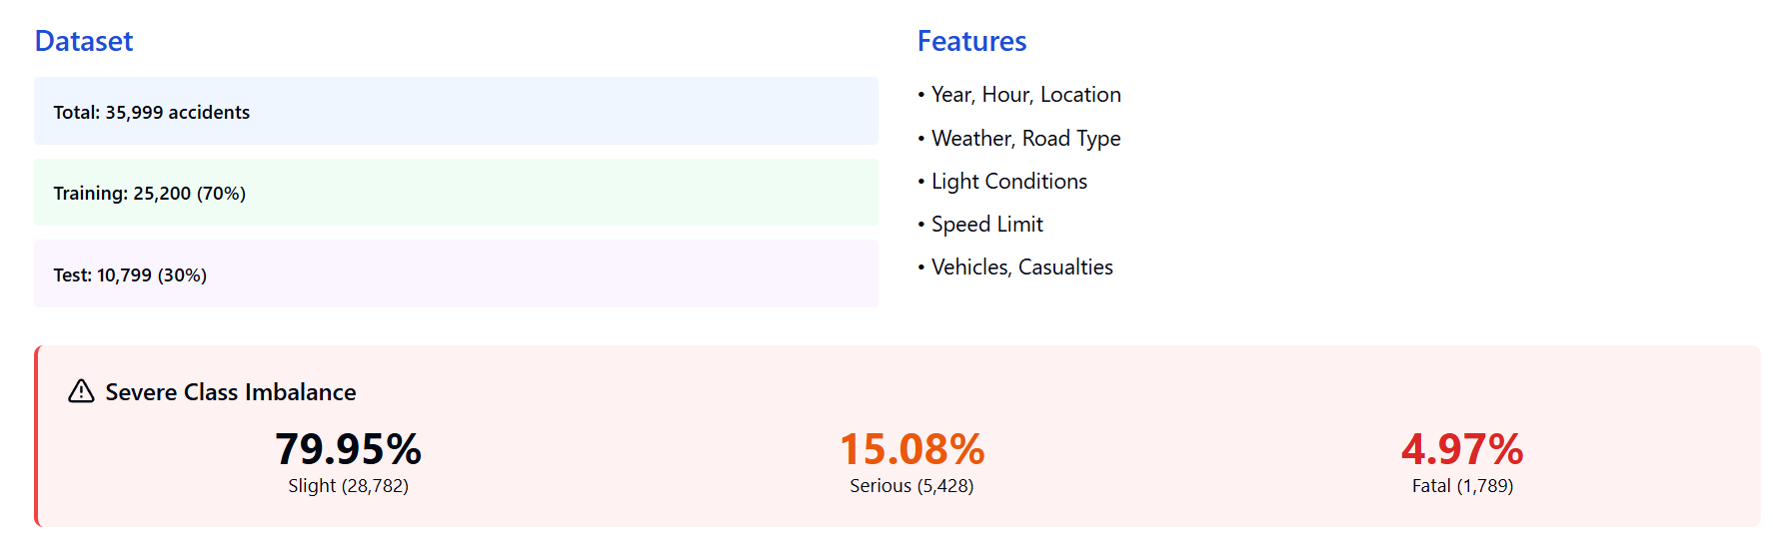
Exploratory Data Analysis

Slide 4
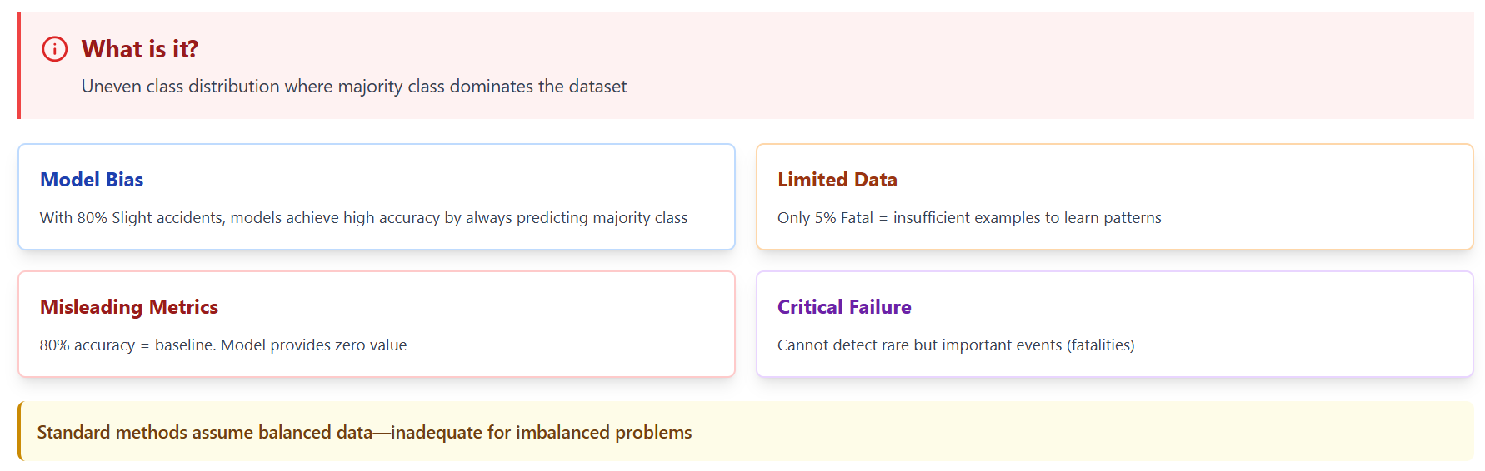
Understanding Class Imbalance

Slide 5
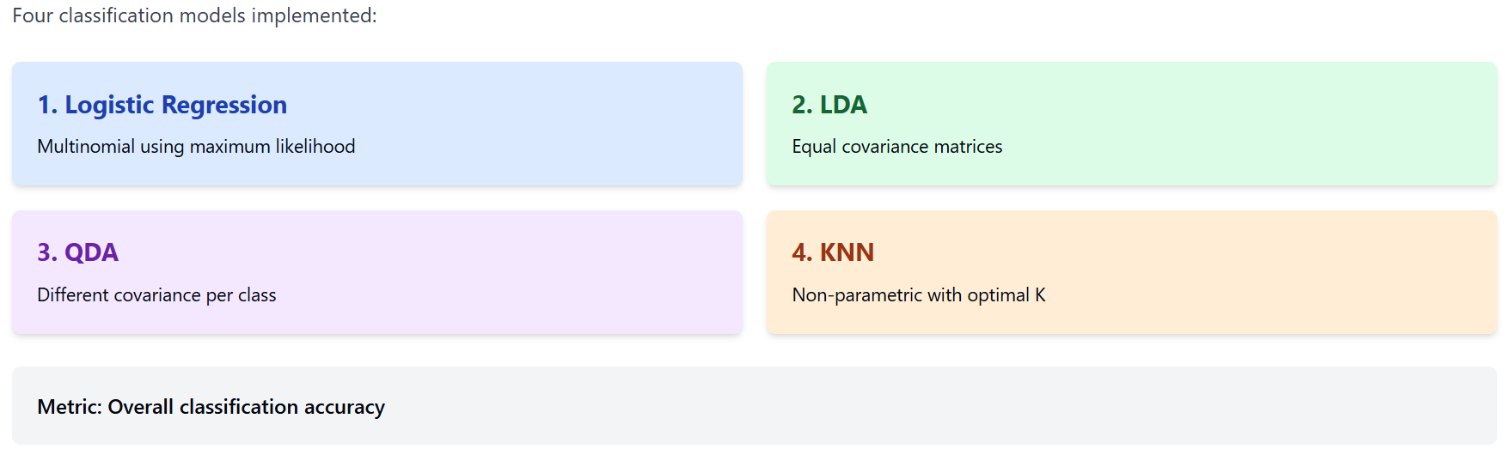
Methodology

Slide 6
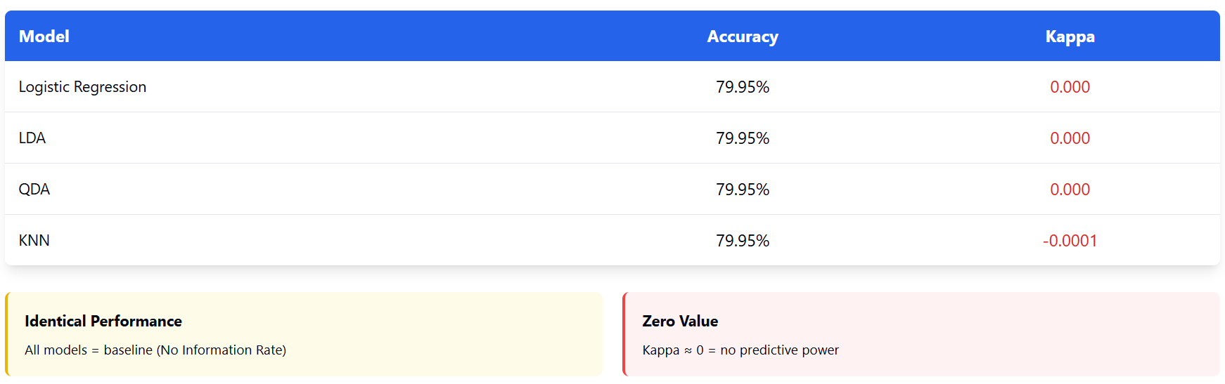
Results

Slide 7
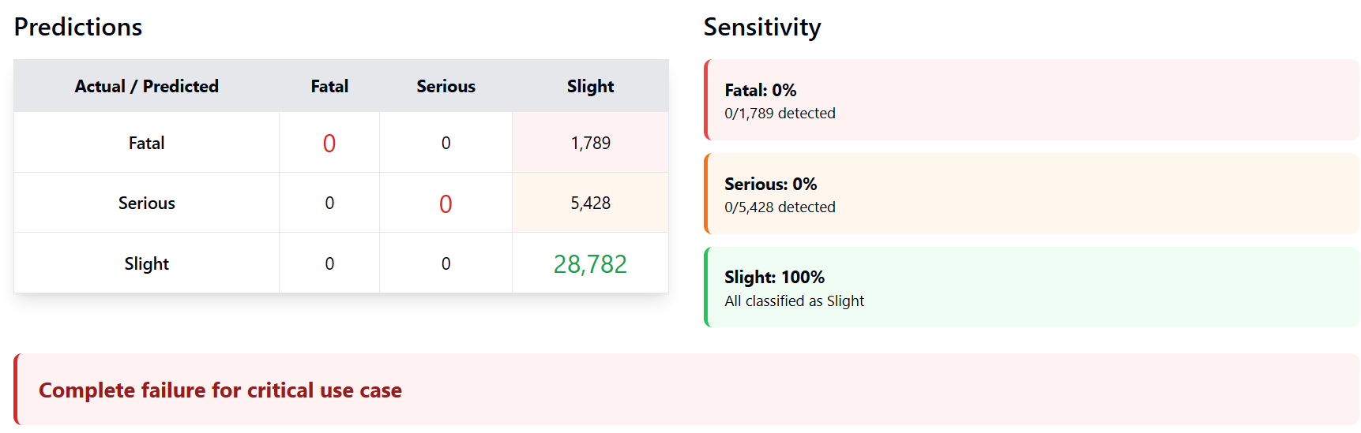
Confusion Matrix

Slide 8
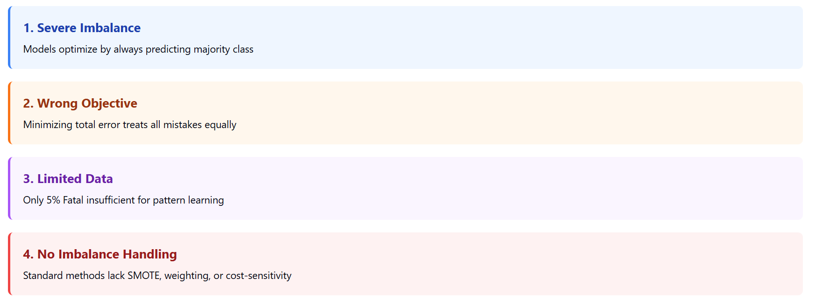
Why This Happened

Slide 9
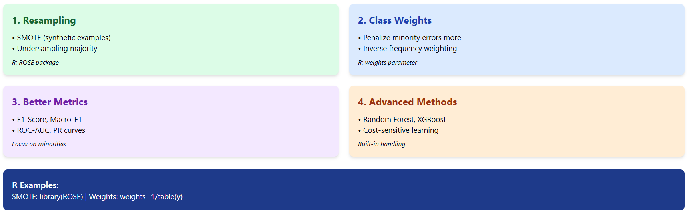
Addressing Imbalance

Slide 10
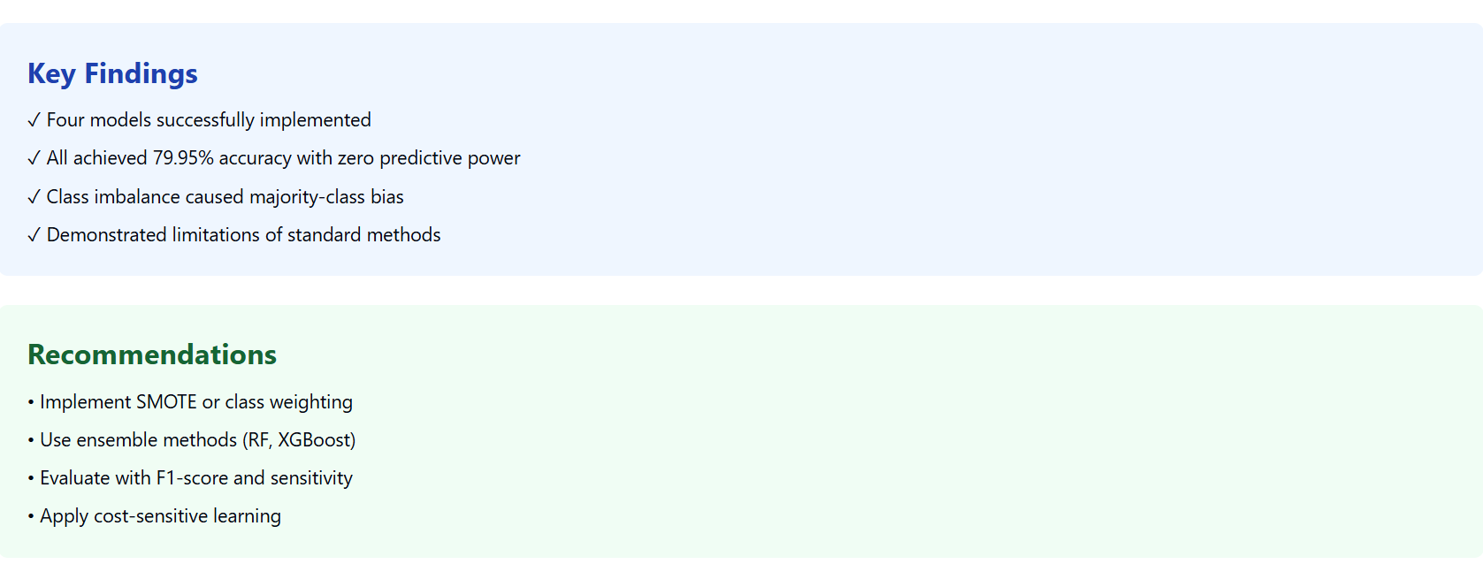
Conclusion

Slide 11
References
  Chawla, N. V., Bowyer, K. W., Hall, L. O., & Kegelmeyer, W. P. (2002). SMOTE: Synthetic minority over-sampling technique. Journal of Artificial Intelligence Research, 16, 321-357. https://doi.org/10.1613/jair.953
2. World Health Organization. (2018). Global status report on road safety 2018. Geneva: WHO. Retrieved from https://www.who.int/publications/i/item/9789241565684
3. Lunardon, N., Menardi, G., & Torelli, N. (2014). ROSE: A package for binary imbalanced learning. R Journal, 6(1), 79-89.
4. Wahab, L., & Jiang, H. (2019). A comparative study on machine learning based algorithms for prediction of motorcycle crash severity. PLoS ONE, 14(4), e0214966. https://doi.org/10.1371/journal.pone.0214966
5. Kumar, S., & Toshniwal, D. (2016). A data mining approach to characterize road accident locations. Journal of Modern Transportation, 24(1), 62-72. https://doi.org/10.1007/s40534-016-0095-5
6. Kuhn, M., & Johnson, K. (2013). Applied predictive modeling. Springer. https://doi.org/10.1007/978-1-4614-6849-3
7. James, G., Witten, D., Hastie, T., & Tibshirani, R. (2021). An introduction to statistical learning with applications in R (2nd ed.). Springer. https://doi.org/10.1007/978-1-0716-1418-1

Slide 12
Thank you
I welcome any questions you may have

