Slide 1

Enrollmate
Online Course Registration System
29th April, 2025

Slide 2
Team Members
Zainab Fatima (22i-1064)
Shayane Zainab (22i-1049)

Slide 3
Introduction
EnrollMate is a course enrollment and registration system designed to streamline the process of enrolling and dropping courses for students
EnrollMate is designed to streamline student registration and course enrollment processes.
Provide a secure, efficient platform for students and administrators to manage academic enrollments.

Slide 4
System Architecture
Current scenario:
Layered Architecture (UI, Business Logic, Data Access)
Modular Components (Authentication, Enrollment, Admin Control)
Brief Description of Layered Architecture:
Layer 1: User Interface (Login screen, dashboard)
Layer 2: Business Logic Layer (Handles operations like registration, enrollment)
Layer 3: Database Layer (Stores users, courses, enrollments)
Communication: Via API calls (Client to Server)

Slide 5
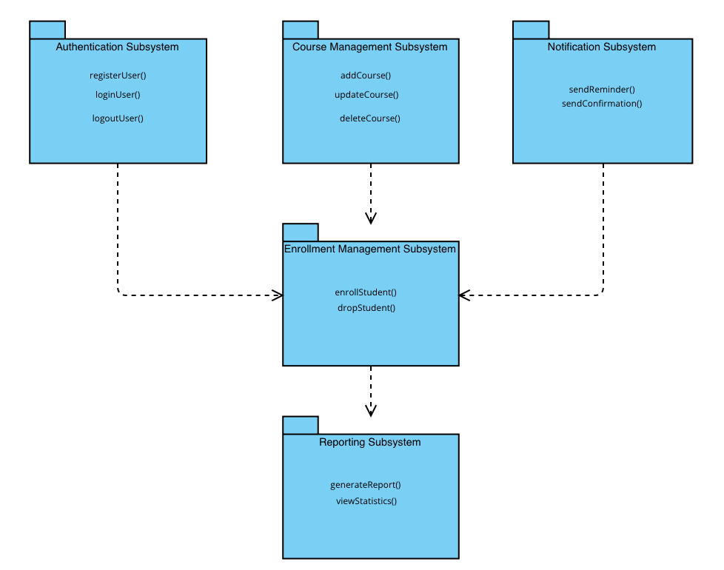
UML Package Diagram
Subsystems
Authentication, Course Management, Enrollment, Notification, Reporting

Slide 6
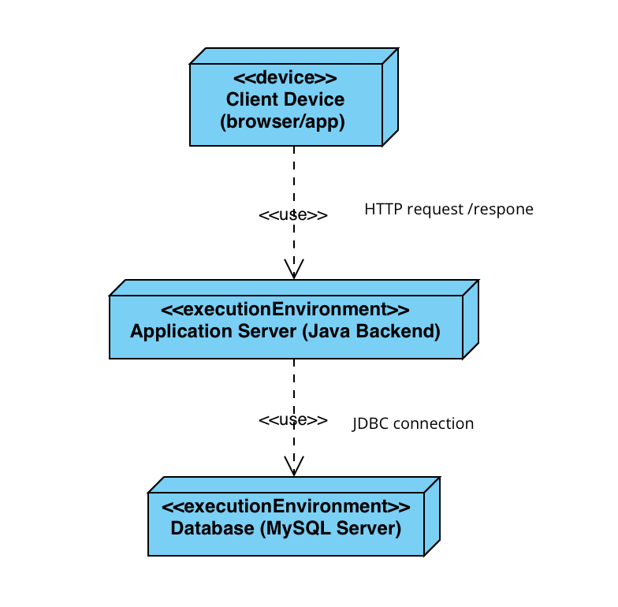
Deployment Diagram
Explanation
Client → Application Server → Database Server
Communication via HTTP + JDBC

Slide 7
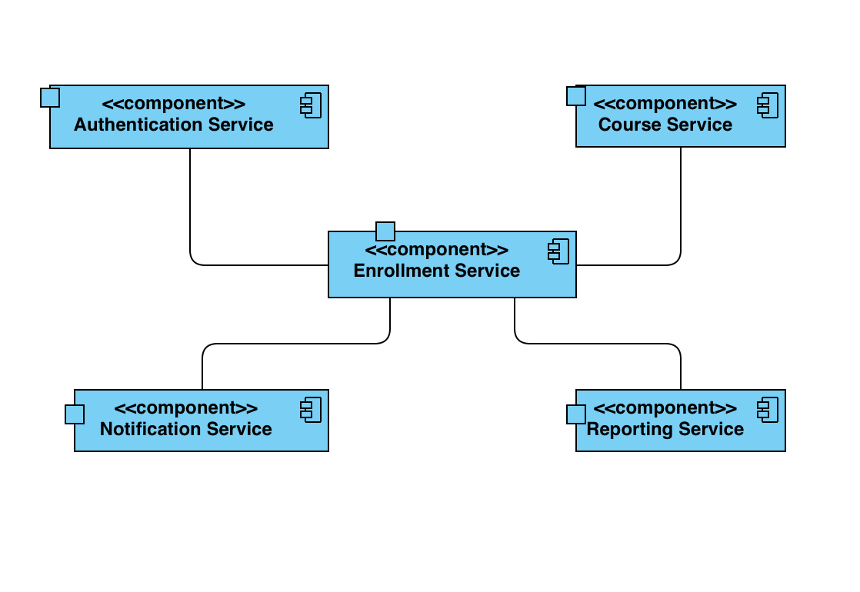
Component Diagram
Explanation
Services: AuthService, CourseService, EnrollmentService, NotificationService, ReportService

Slide 8

Project Planner
Work Breakdown Structure
Gantt chart
Project Management, Requirements, Design, Development, Testing, Deployment, Documentation
Week 1-2: Planning & Requirements
Week 3-4: Design Phase
Week 4-7: Development
Week 7-8: Testing
Week 9-10: Documentation & Finalization
Sprint Planning
Sprint 1: Core functionalities (Registration, Login, Course Handling)
Sprint 2: Dashboard, Notifications, Reports

Slide 9
User Stories
Main User Stories
As a student, I want to view and enroll in courses.
As an admin, I want to add, update, and remove courses.
As a student, I want to receive notifications about enrollment.
Product Backlog Highlights
Prioritized features using story points
Sprint 1 & 2 distribution based on complexity

Slide 10

Lessons Learned
Improved understanding of Agile project management.
Effective use of Trello for sprint tracking.
Practical application of black box and white box testing.
Managing deadlines through Gantt charts.
Better collaboration and communication skills.
Handling database integration and deployment on local servers.
Understanding of architectural designs like layered and modular architecture.

Slide 11
Conclusion
EnrollMate evolved into a robust academic management tool that demonstrates real-world applicability. Throughout its development, we gained practical experience in system design, testing, and collaboration, transforming our initial concept into a scalable, user-friendly solution with real potential for deployment in educational institutions.

