Slide 1
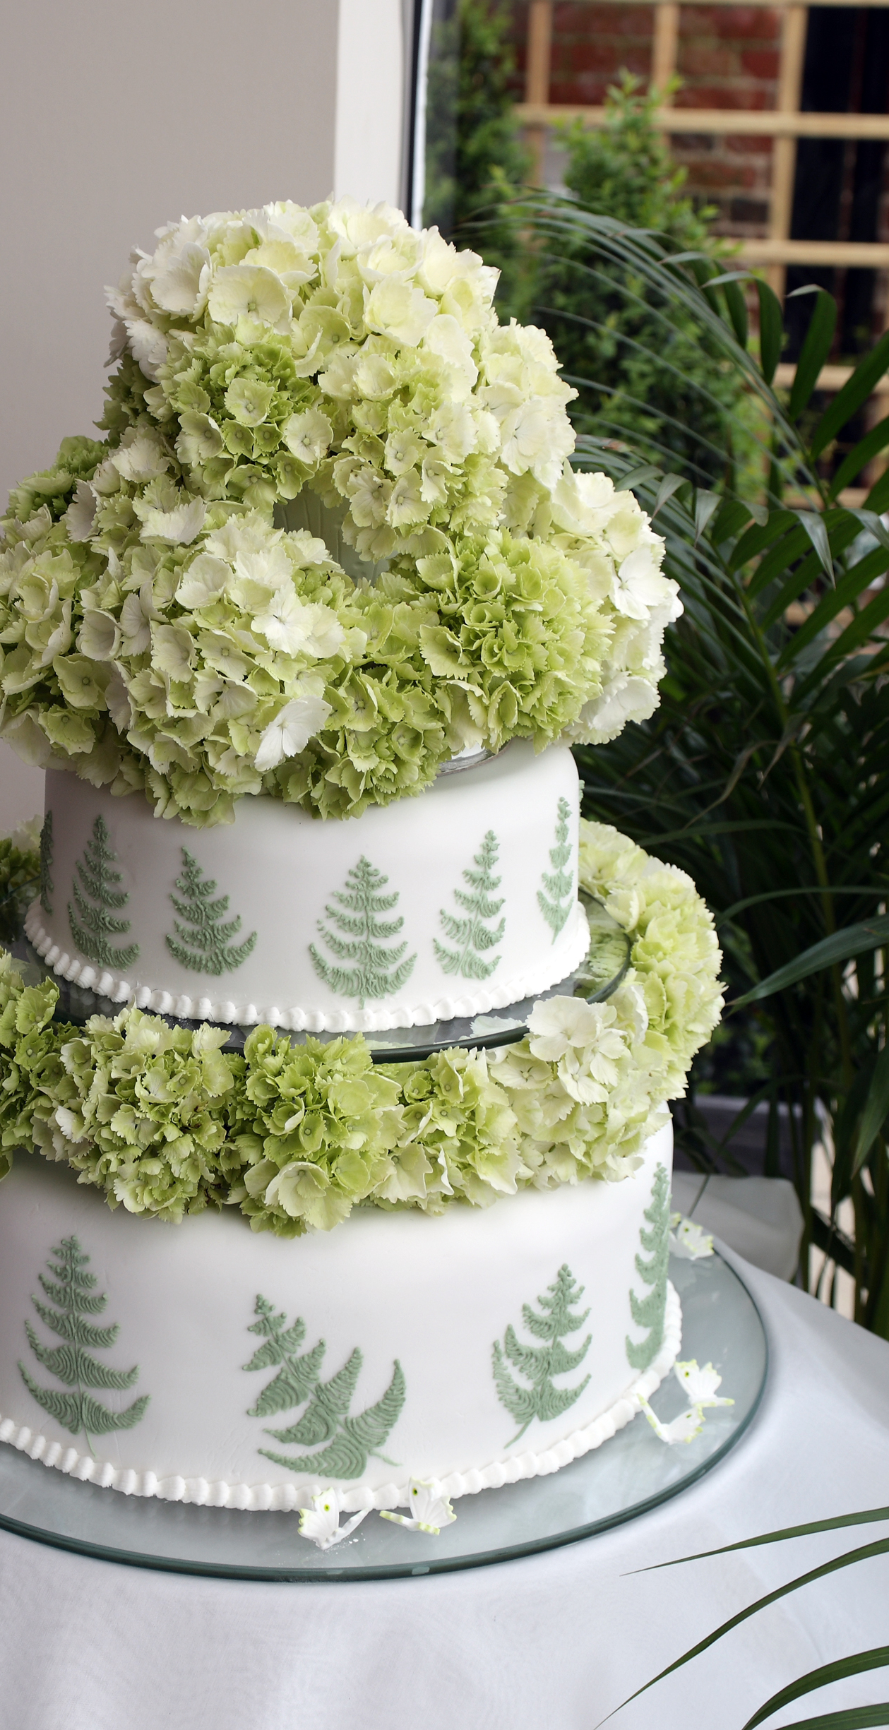
VEGETARIAN and halal BAKERY
This Photo by Unknown Author is licensed under CC BY-SA

Slide 2
MODEL
Products will be lacto-ovo-vegetarian and products with meat will follow Zabiha Halal Standards
Custom products will be made for patients with health conditions
Products will be labeled as vegetarian, dairy-free, egg-free, gluten-free, vegan, lacto-ovo-vegetarian etc. so consumers have more insight about the products
Consumers will be provided information on source of ingredients (plant sourced, animal sourced) understanding consumer needs as opposed to many companies with proprietary information
Profit from this business will be used to build a nonprofit for consumer awareness by increasing awareness and demand to pressurize companies to start labeling products as vegan , vegetarian, gluten-free etc. and ingredients with sources, more awareness about genetically modified foods and on chemicals used on plants linked with harmful diseases such as cancer

Slide 3
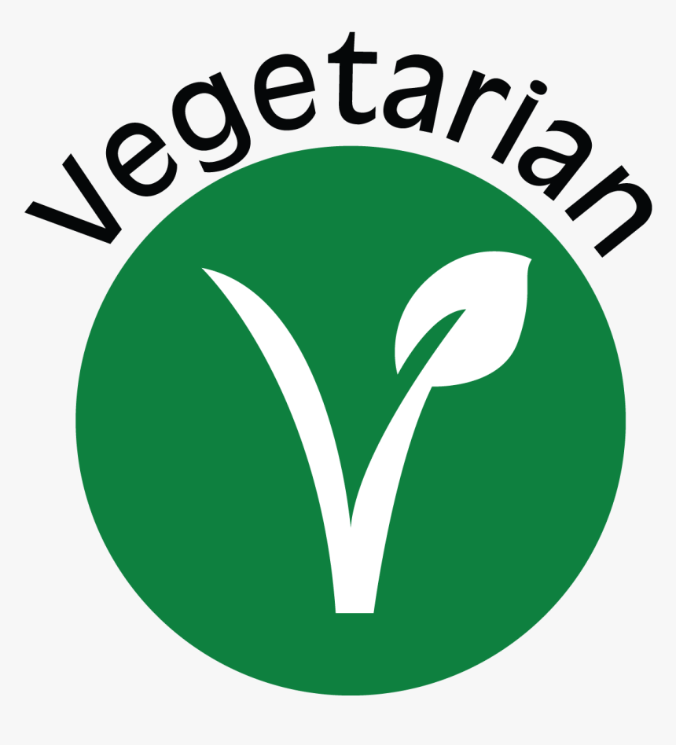

LACTO-OVO-VEGETARIAN
Excludes
meat
fish
poultry
Includes
dairy
eggs
ALSO KNOWN AS LACTO-OVO-VEGETARIAN

Slide 4
HALAL
Mostly Zabiha Halal is consumed
*EXCLUDES : Pork and Alcohol
*INCLUDES: Eggs, Milk, Fish ,Poultry and Meat such as Goat should be according to Zabiha Halal Standards
Humane Treatment - They must be provided with adequate space, proper nutrition, and care to prevent suffering or harm.
Ethical Slaughter- must be performed by a sane, adult Muslim who invokes the name of Allah at the time of slaughter, acknowledging that life is sacred and can only be taken by Allah’s permission.
Health and Purity-The slaughtered animal must be healthy at the time of slaughter, free from any diseases or conditions that could render the meat harmful to consume.
Prohibition of Cruelty-The use of a sharp knife ensures a swift slaughter, reducing the animal’s pain and distress

Slide 5
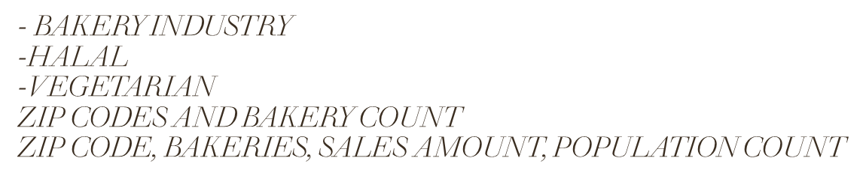
insights

