Slide 1

”Best in PA” Universities/Colleges Category Ensemble Classification
ZA
By: Daisy Aptovska & Zainab Afridi

Slide 2
Project description & Significance
ZA
Ensemble Classifier that predicts the best category for a university-based university name, location, relative location to cities, tuition, region, etc.
Allows for classification of best categorization type for a post-secondary institution
Useful for students to check a specific data entry (a specific university) and how it categorizes
Real-world data-based application with website hosting

Slide 3
data
ZA
3 Datasets from PA gov websites
https://data.pa.gov/Education/Education-Names-and-Addresses-EdNA-Post-Secondary-/dtvt-jb9p/about_data
https://data.pa.gov/Post-Secondary-Education/PA-Higher-Education-Institutions-by-Sector-Current/8u5h-xvus/about_data
https://nces.ed.gov/ipeds/datacenter/Data.aspx?sid=198301ab-196c-4192-87c6-7c03202a8427&rtid=1
After filtering, cleaning, and preprocessing:
1200+ rows
Lots of imputation needed; reduced dataset → reduced imputation needed
Filtered to only universities/colleges but did not include technical programs and admin offices (like in dataset)

Slide 4
Data preprocessing
DA
Feature engineering
Coordinate distance from top 5 largest cities from institution
Manual one-hot encoding on 5 regions of the state based on county classification
Clean through imputation of missing values
Numerical → iterative imputer (15); may lead to more robust imputations than simply mean
Categorical → simple imputer; most frequent value
Encode categorical data
Use feature selector for 15 best features
Scale all data
Split (90% training, 10% testing) → smaller testing sample since dataset is small

Slide 5
Model(s)
DA
Ensemble Classification Model of 6 Classifiers with Soft Voting:
K-Nearest Neighbors
k=20, weights=distance, algorithm=brute
Decision Tree
criterion=log_loss, splitter=best, max_depth=10
Random Forest
n_estimators=200, criterion=log_loss, max_features=6, class_weight=balanced
Logistic Regression
C=0.5, solver=sag, max_iter=1000
Gradient Boosting
n_estimators=300, learning_rate=0.05
AdaBoost
n_estimators=300, learning_rate=0.05

Slide 6
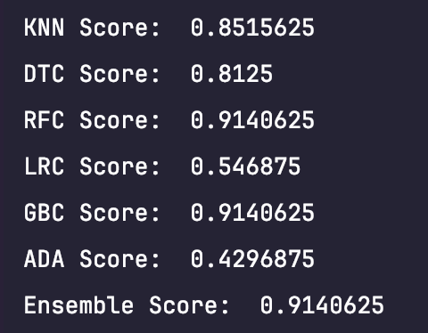
Results (1)
DA
ADABoost did not perform well on our dataset
Logistic Regression → simple model
Random Forest and Gradient Boosting → complex models with error understanding
Accuracy Performance:

Slide 7
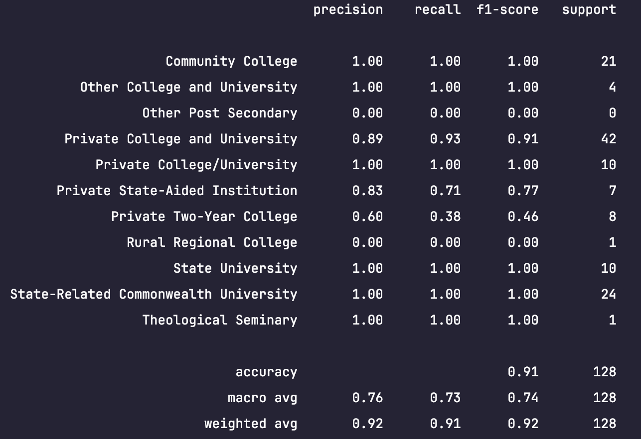
Results (2)
DA
Classification Report:

Slide 8

Live demo Data + Models: https://github.com/daisyapto/CMPSC445_Project2 Deployment: https://github.com/Zainabzz/COMPSC-445_FINAL Website: https://web-production-d9c39.up.railway.app/
ZA

Slide 9
Discussion, limitations, & Conclusion
DA
Discussion:
Dataset research & concatenation was a long process
Lots of data misalignment
Limitations:
Dataset required much imputation
Initial goal: to predict university name; modified goal: to predict university category
Cannot predict university name with high accuracy (consistent results of <50% accuracy) since each data entry was a specific university, thus there were hundreds of classes to predict
Conclusion:
High accuracy & classification reports (due to smaller amount classes to classify from)

Slide 10
Ai usage
ZA
Google search AI Overview
Debugging questions, syntax, improving performance, imputation questions
Gemini
Datasets research and suggestions
Claude
UI debugging and code resource package research

Slide 11
references
https://data.pa.gov/Post-Secondary-Education/PA-Higher-Education-Institutions-by-Sector-Current/8u5h-xvus/about_data
https://catalog.data.gov/dataset?q=pennsylvania
https://github.com/daisyapto/CMPSC445_Project1
https://www.pasda.psu.edu/
https://catalog.data.gov/dataset/?q=resturants&sort=views_recent+desc&ext_location=&ext_bbox=&ext_prev_extent=
https://business.yelp.com/data/resources/open-dataset/
https://data.pa.gov/browse?sortBy=relevance&page=1&pageSize=20
https://data.pa.gov/Post-Secondary-Education/Supply-Demand-Gap-Analysis-2014-2024-State-System-/n3sx-ckrr/about_data
https://en.wikipedia.org/wiki/List_of_counties_in_Pennsylvania
https://scikit-learn.org/stable/modules/ensemble.html
https://scikit-learn.org/stable/modules/generated/sklearn.ensemble.StackingClassifier.html
https://scikit-learn.org/stable/modules/generated/sklearn.impute.SimpleImputer.html
https://scikit-learn.org/stable/modules/generated/sklearn.impute.KNNImputer.html
https://scikit-learn.org/stable/modules/generated/sklearn.neighbors.KNeighborsClassifier.html#sklearn.neighbors.KNeighborsClassifier
https://scikit-learn.org/stable/modules/generated/sklearn.tree.DecisionTreeClassifier.html
https://scikit-learn.org/stable/modules/generated/sklearn.ensemble.RandomForestClassifier.html
https://scikit-learn.org/stable/modules/generated/sklearn.metrics.classification_report.html
https://scikit-learn.org/stable/modules/impute.html
https://scikit-learn.org/stable/modules/generated/sklearn.impute.IterativeImputer.html
https://scikit-learn.org/stable/modules/generated/sklearn.feature_selection.SelectKBest.html#sklearn.feature_selection.SelectKBest
https://colab.research.google.com/drive/17gnNWQZh33lMmOdcHpeg6bP78hJsjtVw?usp=sharing
https://www.collegetuitioncompare.com/compare/tables/?state=PA

