Slide 1





PSL Recognizer
Bridging silence and speech:
AI for Pakistan Sign Language.
FYP-1 DEFENSE PRESENTATION
Supervisor: Dr Anum Qureshi
Group Members:
Zain Baig (Group Leader)
Aarij Ali
Abdur Rehman Khan

Slide 2
TABLE OF CONTENTS
01
Introduction
05
System Architecture
02
Literature review
06
FYP - 1 Goals
03
Motivation
07
Timeline - Gantt Chart
04
Previous Work
08
Thankyou

Slide 3
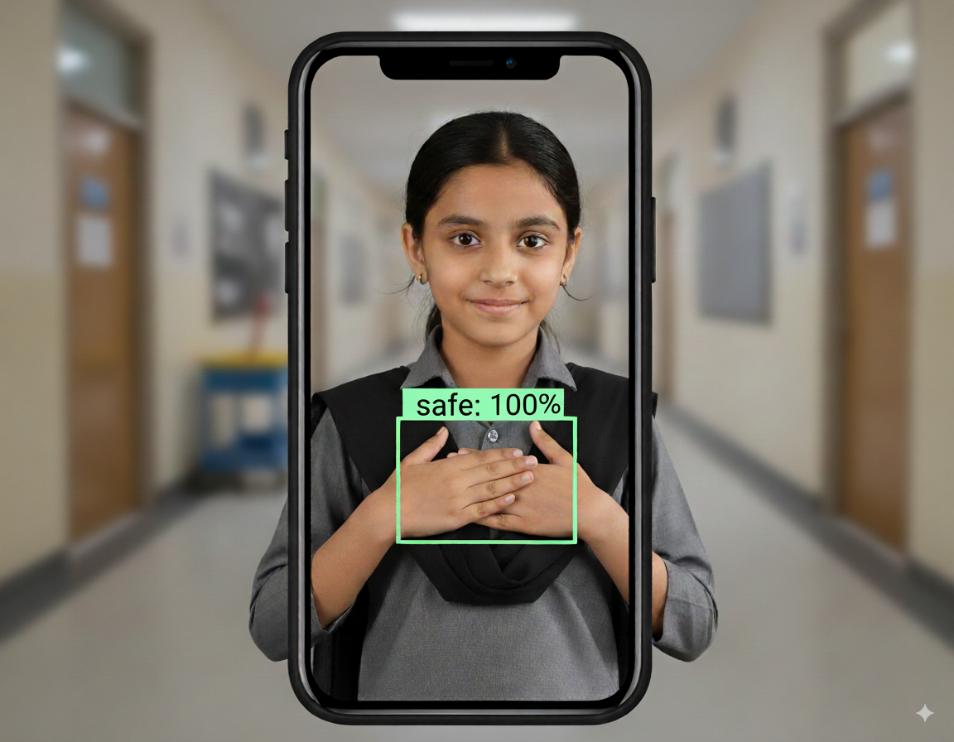
Introduction
Pakistani Sign Language (PSL) recognition plays a vital role in breaking communication barriers for the deaf community in Pakistan, enabling greater inclusion in education, workplaces, and daily life.
Our project builds on prior research work done by the previous group by expanding the existing dataset with new recordings and controlled variations, applying preprocessing and augmentation for robustness, and benchmarking deep learning models for stronger accuracy. In the long run, we aim to progress beyond single-word recognition toward sentence-level translation, taking a meaningful step toward real-time PSL ↔ Urdu/English communication.
Short-Term Goal:
Refine recognition accuracy for isolated words.
Long-Term Vision:
Extend towards sentence-level translation between PSL and Urdu/English.

Slide 4
Literature Review
Paper & Year
Approach
Dataset
Results
Limitation
Arooj et al. 2024
CNN + SIFT for alphabets
Kinect images
98.74% accuracy
Alphabet only, Kinect-dependent
Hamza & Wali
Video-based C3D, I3D, TSM + aug.
PSL Dictionary (2 samples/sign)
Very small dataset, risk of overfit
C3D: 93.3%
Rule-based MT (English→PSL)
Fails on complex sentences
Khan et al.
Small corpora
BLEU=0.78
GRU + Attention NMT
50k synthetic sents
BLEU=0.83, WER=0.17
Limited gloss diversity
Farooq et al
Ghamini et al
MediaPipe + CNN-BiLSTM (mobile)
Benchmarks (not PSL)
>95% accuracy
Not PSL-specific

Slide 5
Previous Work
Dataset Creation
Model Evaluation
Built a PSL dataset of 104 signs (common daily use words) with 6,240 augmented videos.
Evaluated 3 distinct models namely,
ViViT,
ResNet-18 + LSTM, and a 3DCNN + ResidualBlock + BiLSTM hybrid models.
Key conclusions from prior work: dataset scarcity and class richness (104 classes) pose the main challenge; model selection & generalization must account for limited natural samples and large label space.
Key Outcomes
ViViT (Tubelet Embedding): Very high train accuracy (~96%) but large train–val gap (~75%) → strong overfitting.
ResNet-18 + LSTM: Better generalization than ViViT, but validation gap persists.
Proposed 3DCNN + Residual Block + BiLSTM: Most balanced model, achieving best test accuracy of 83.89%.

Slide 6
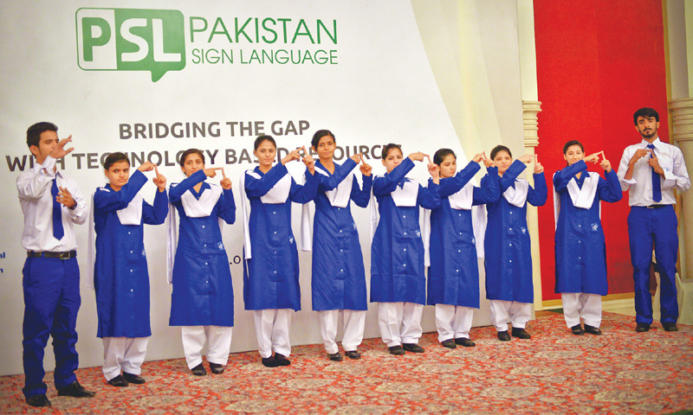

Motivation
For us, this project is more than a technical challenge — it is a human one. Millions of voices in Pakistan’s deaf community remain unheard because of a language gap, limiting access to education, jobs, and social connection.
We chose this project because we believe technology should serve everyone, especially communities that are often overlooked. By building a system that can automatically recognize PSL and translate it into text or speech, we want to create a bridge between the deaf community and the rest of society.
Beyond fulfilling an academic requirement, this project motivates us to apply AI and computer vision for real social impact, while growing as learners. If successful, our work could lay the foundation for future systems that provide equal communication opportunities for the deaf community in Pakistan.
Bridging the communication gap for the deaf community.
Making classrooms, workplaces, and homes more inclusive.
Using AI for real social impact beyond academics

Slide 7
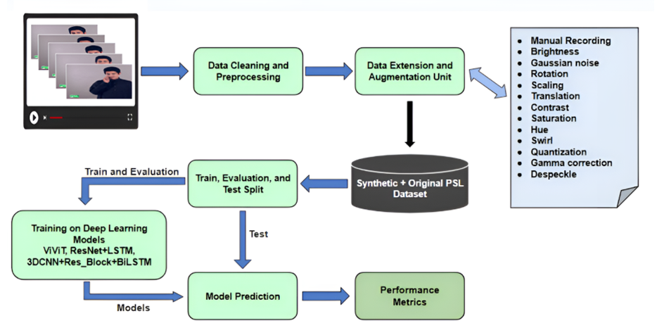
SYSTEM ARCHITECTURE

Slide 8
FYP - 1 Goals
01
02
03
Expand & Diversify Dataset
Improve Recognition Accuracy
Sentence-Level Translation - (FYP-2)
Create 9 new original recordings per label (3 per person) for all 104 labels in varied settings for richer, more representative data.
Total new videos to shoot = 936 vids.
Apply frame-label augmentation to new videos to extend dataset to 97 videos/label.
Re-train, validate and benchmark all three models on expanded data and report scaling curves.
If scaling alone is insufficient to increase accuracies then, refine /design and test improved model families.
Build a modular inference pipeline for live demo.
Lay groundwork for basic word sequence composition aligned with Urdu grammar (FYP-2).

Slide 9
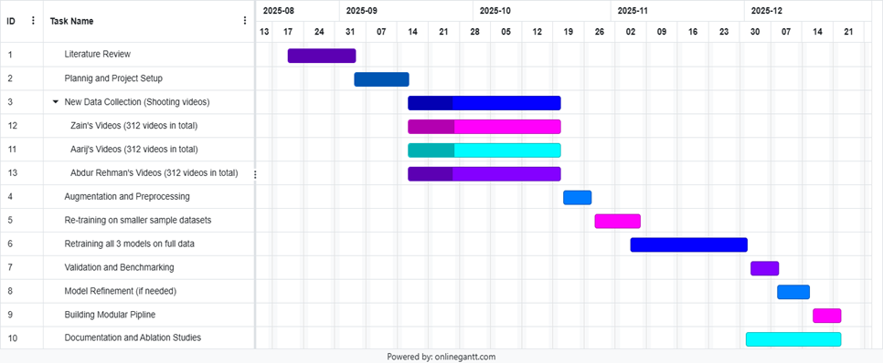
TIMELINE / GANTT CHART

Slide 10
Thank you for your time and attention.
We sincerely thank you for your time and consideration. We hope you liked our FYP idea. If you have any questions, confusions, or suggestions, please feel free to share them with us. We will surely discuss them with our supervisor and carefully consider adding them to our plan. We are truly grateful for your guidance and feedback.
Supervised by: Dr. Anam Qureshi
Zain Baig, Aarij Ali, Abdul Rehman Khan
National University of Computer and Emerging Sciences (FAST), Karachi Campus

