Slide 1






Multimodal video classification for deaf community
Group Members=>
21K4507 Virkha Kumari
21K-4695 Tania Saleh
21K-3371 Agha Fardeen

Slide 2


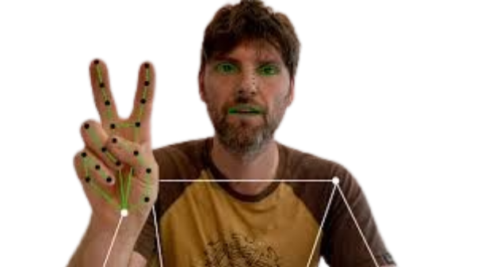
Table Of Contents
Introduction
GOALS OF FYP I
GOALS OF FYP II
Results and Conclusion

Slide 3
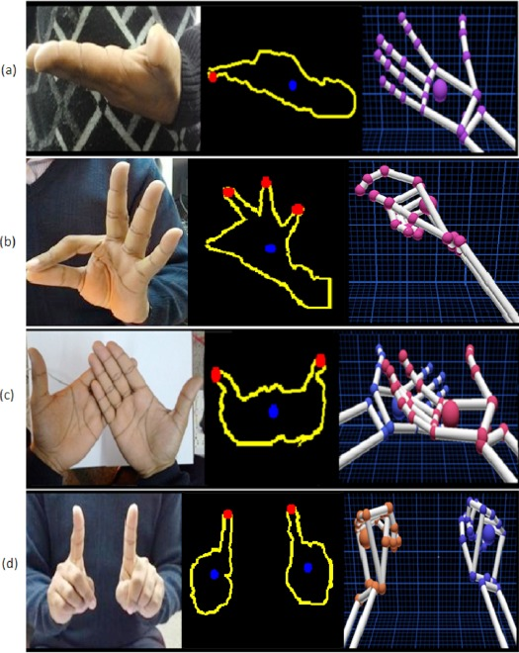
Introduction
The goal of this project is to recognize PSL sign labels from video data using a model, devised for first iteration, combination of spatial-temporal feature extraction (3D Convolutional Neural Networks, 3D-CNN) and temporal sequence modeling (Long Short-Term Memory networks, LSTM). The system processes RGB video frames, extracts features through a 3D-CNN pipeline, and uses an LSTM to capture temporal dependencies, enabling accurate classification of gestures. The model has been trained on pre-processed videos as discussed in next slides.

Slide 4
Literature Review
Paper | Work Done | Year Released
Pakistan Sign Language Recognition: Leveraging deep learning models with limited dataset [1] | proposed a real time system translation system that addresses the challenge of limited PSL dataset,incorporates a data augmentation unit, which synthetically generates new training samples while leaving the testing set unchanged. Tested three models on augmented PSL dataset. I3D model produced best top accuracy with 77.50. | 2023
Combining 3D-CNN and LSTM for Dynamic Hand Gestures Recognition [2] | research highlighted the use of 3D-CNN for spatial feature extraction and LSTM for temporal learning in dynamic hand gesture classification. Achieved 97% testing accuracy on the 20BN-Jester dataset using a lightweight model with 3.7 million parameters. | 2022

Slide 5
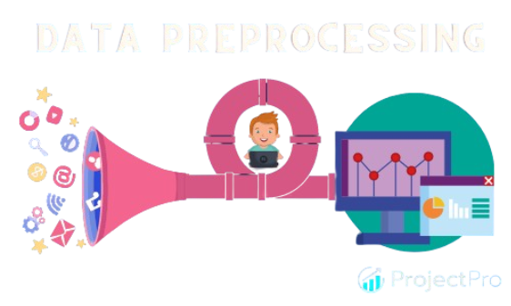
GOALS OF FYP I

Slide 6
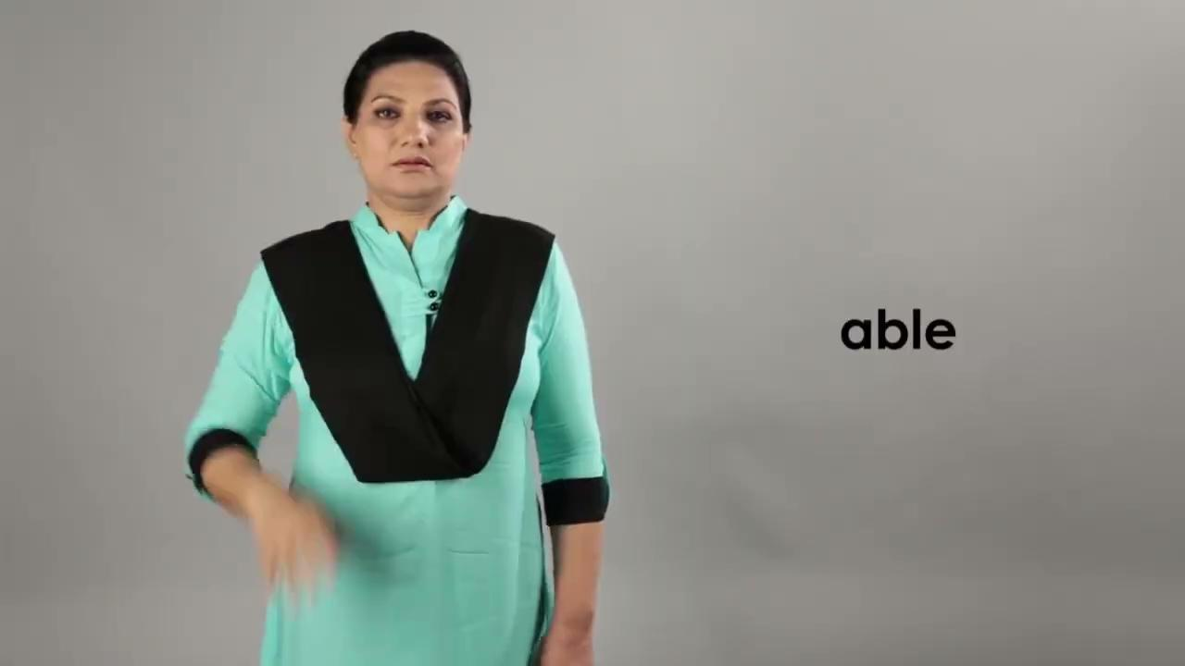
GOAL 1:
DATA COLLECTION
We contacted the NGO Deaf Reach Program for dataset collection.
They provided us with a comprehensive dataset.
This collaboration was crucial for our project.

Slide 7
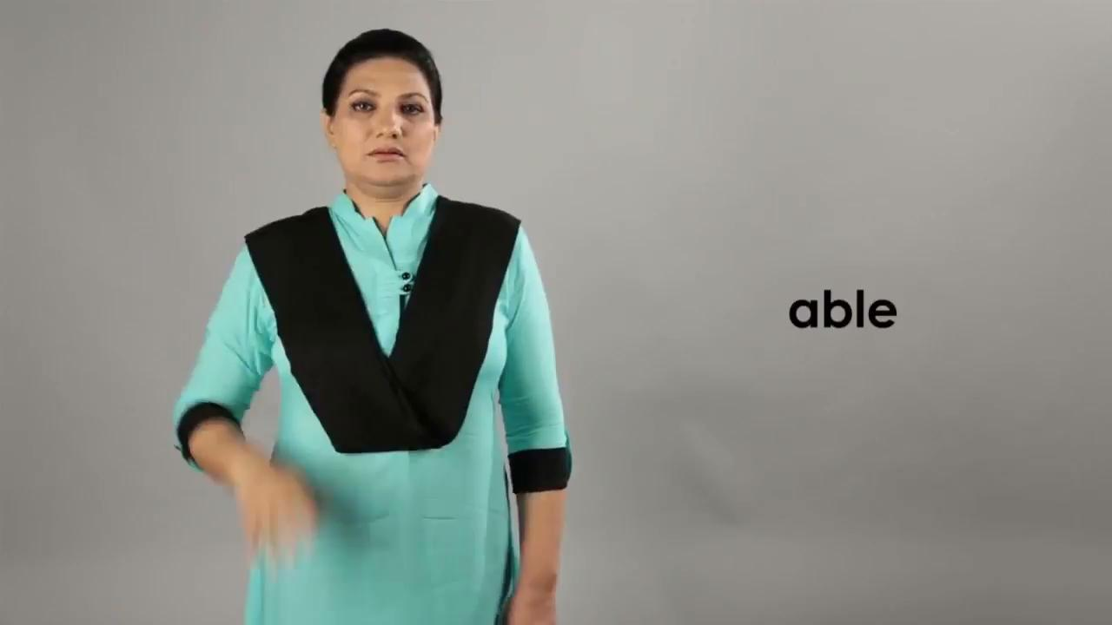

GOAL 2a:
Divide Video into Muted Video and audio

Slide 8
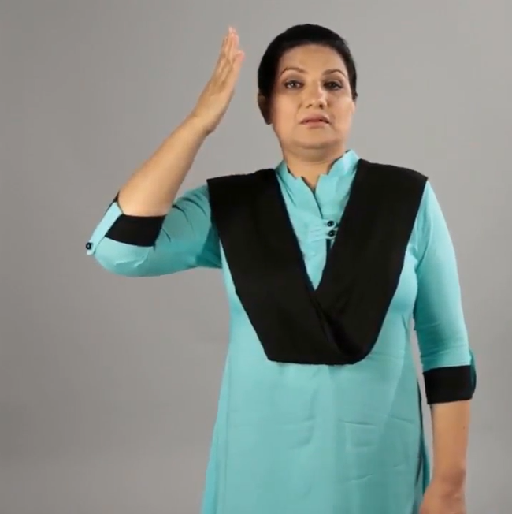
GOAL 2b:
Crop Video to focus on person

Slide 9
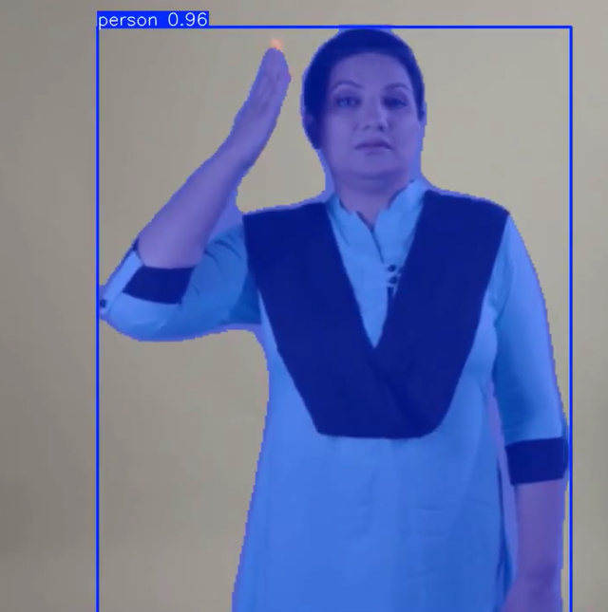
GOAL 2c:
Segmented Video Using Pre-trained Model
Changed Model from SAM-2 to Yolo11-seg.
Efficient dynamic segmentation model: Yolo11-seg [4].

Slide 10
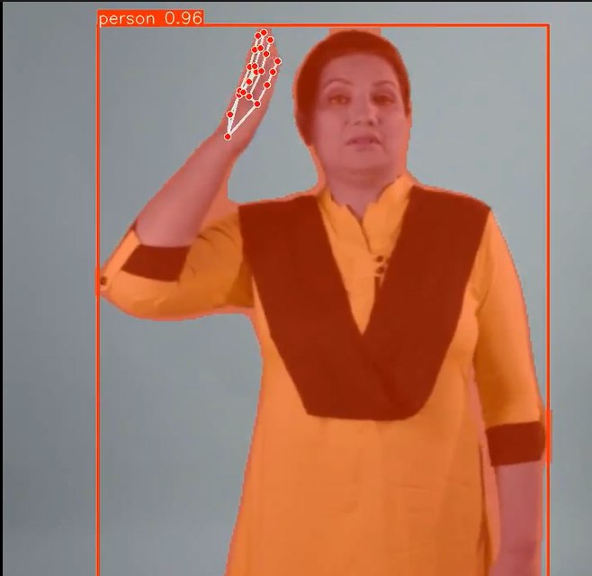
GOAL 2d:
Pre-trained model to focus on Hand Movements
Used Mediaipe by Google [3]
Recognize hand gestures in real time, and provides the recognized the landmarks of the detected hands.

Slide 11
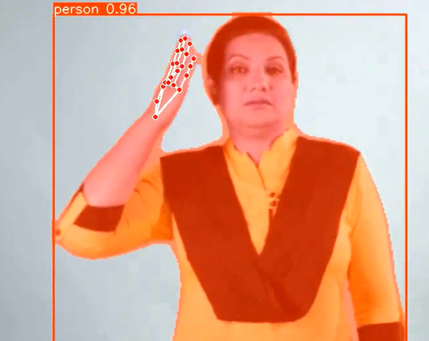
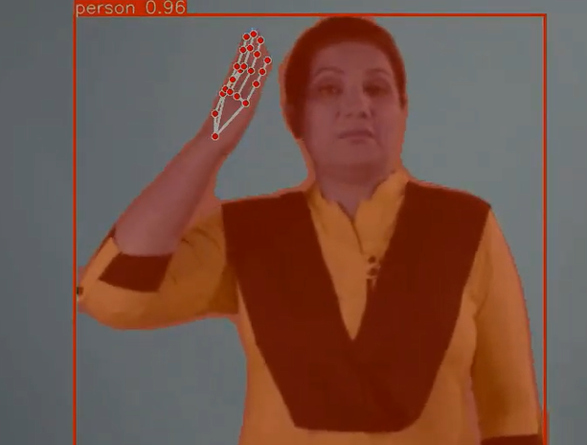
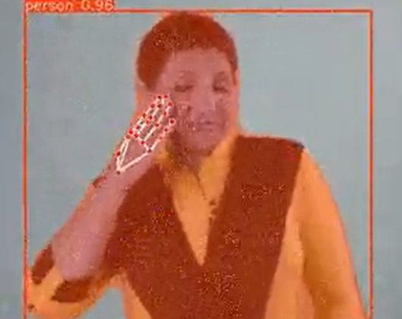
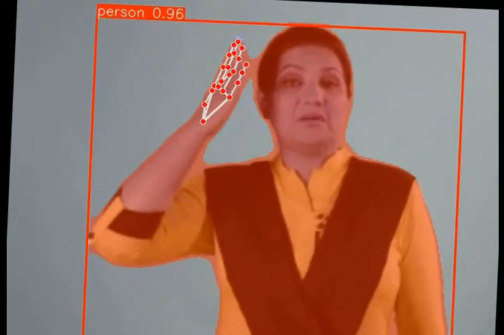

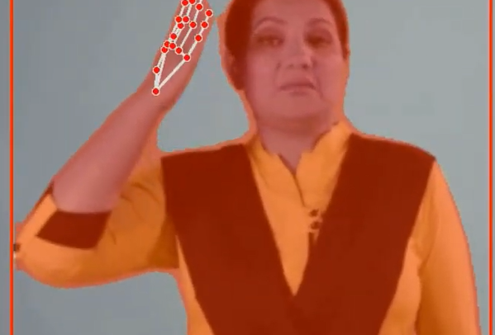
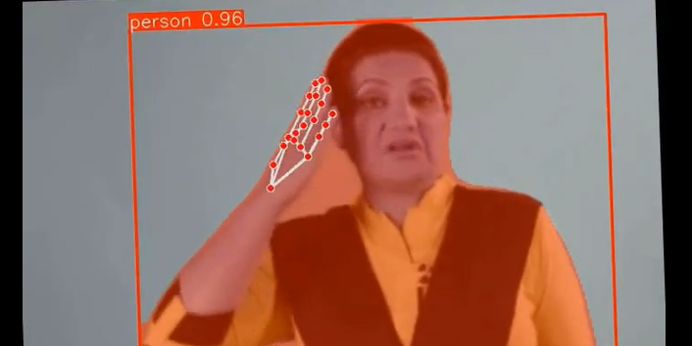
GOAL 2d:
Augmentation of Videos

Slide 12
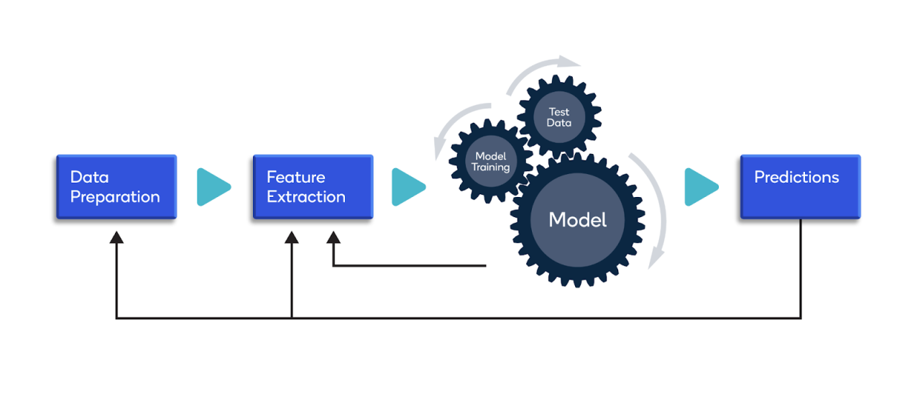
Goal 3: Model Training

Slide 13
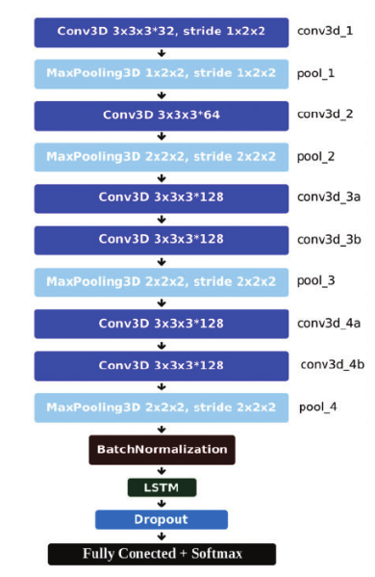
LSTM unit size=512
ReLU activation function between Conv3D and MaxPooling3D layer
Extracts spatial-temporal information from video sequences input
3.7 million training parameters
Hold-out Method for evaluation: 80% training dataset, 20% validation dataset.
3D-CNN network is used to learn spatial information from successive video frames.
For temporal information from video frames and learning the sequence of the time series frames, the LSTM network is used for the classification of PSL.
L2 batch normalization layer.
Dropout layer to avoid overfitting.
As per paper: “Adadelta optimizer with our proposed 3D-CNN+LSTM model achieved the best accuracy”

Slide 14
Iteration 1
Hyperparameters:
frame_size=(112, 112)
num_frames=32
learning rate=0.00001
batch_size=1
num_epochs=10
Dataset Information:
Total labels: 796
Total videos: 11940
Train videos: 10348
Validation videos: 1592
Output
Loss: ~6.6796
Accuracy: 0.12%

Slide 15
Results
Due to quite unsatisfactory results, we tried to implement quite few changes to see that “can there be any change of hyperparameter which can improve results”. The changes were following:
Increase num_frames to 80
Increase batch_size to 4
Introduce “ReduceLROnPlateau” for dynamic change of learning rate w.r.t validation dataset loss
Increase num_epochs
Increase learning rate to 0.001
Still the final loss was “6.266662683542709” which wasn't quite satisfactory; it was found to be approximately 0.4 change in loss due to num_labels change to “Total labels: 526”, at the end.
Therefore, we learned that the model’s architecture can only handle small labels size data. So for now, we decided to decrease “label size to 160”, and we will solve the large label size problem in FYP 2 through advanced Deep Learning techniques.

Slide 16
START OF FYP II

Slide 17
Moving forward to FYP II - decisions
The FYP I was unsuccessful in recognizing PSL signs accurately, and especially high loss and very low accuracy. Due to this, we explored various Sign Language techniques, and made some changes in our approach:
Label Size decreased to 104
New techniques introduced for augmentation [5]
Recorded our own dataset to bring variations in original PSL dataset.
Switched to different advanced deep learning models to determine the effective one for PSL Recognition system.

Slide 18
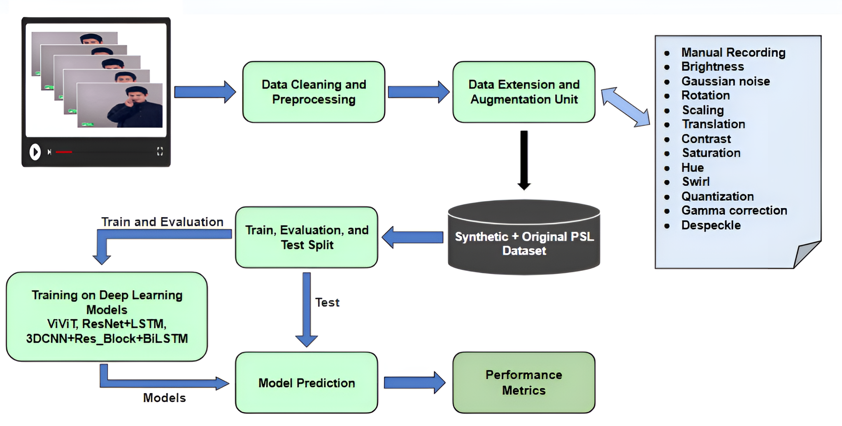
Systematic Diagram defining whole FYP

Slide 19
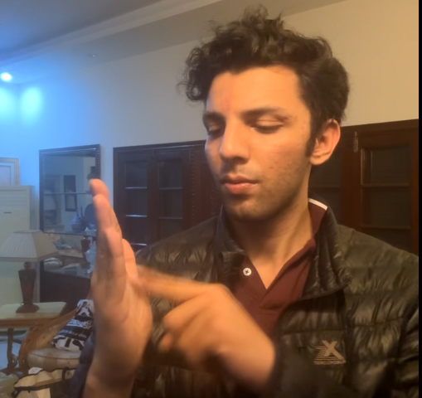
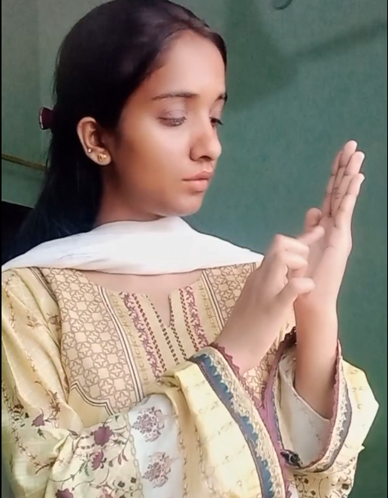
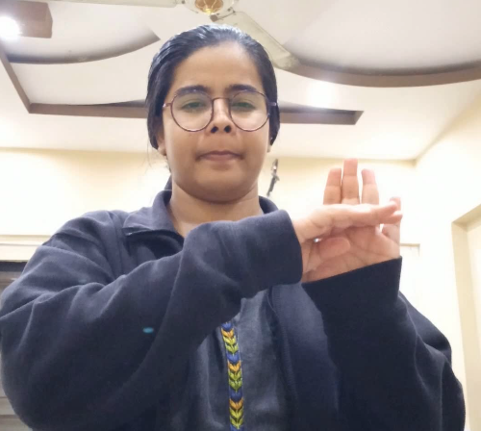
FYP II - Goal 1
We collaborated with PSL deaf community to retrieve PSL original signs.
Each member recorded 3 videos per PSL sign+1 original video, leading to 10 different videos per PSL sign.
Each video recorded in a different manner to introduce variations in PSL dataset

Slide 20
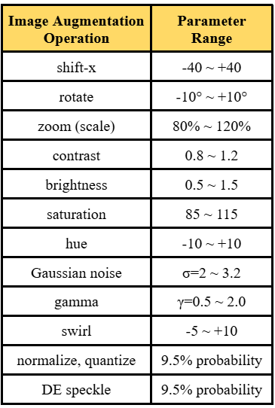
FYP II - Goal 2
To increase the size of dataset and further improve the model’s performance, we performed 11 different augmentation techniques, lead to 60 videos per label.

Slide 21
FYP II - Goal 3
Once the PSL Final dataset was complete, it was split into train, evaluation, and test sets to ensure the effectiveness of deep learning models’s training.
Final Dataset Size
Training: 4,992 examples (80%)
Validation: 832 examples (15%)
Test: 416 examples (5%)

Slide 22
FYP II - Goal 4
We trained three different advanced deep learning models to determine the most effective model for the PSL recognition system:
Video Vision Transformer (ViViT)
ResNet-18 + LSTM
3DCNN + Residual Block + BiLSTM (Proposed Model)

Slide 23
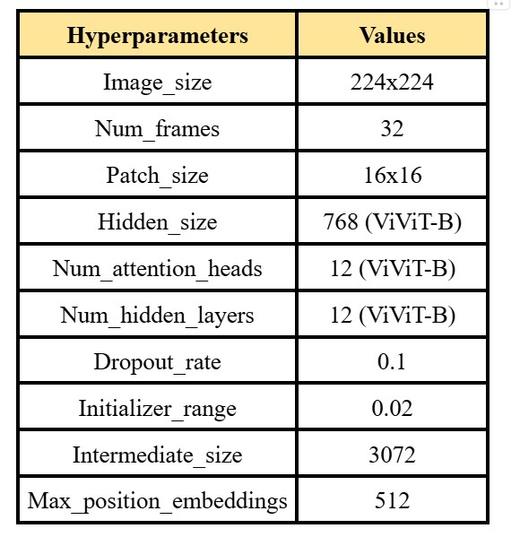
FYP II - Goal 4 (i)
Model 1: Video Vision Transformer (ViViT)
Extends ViT with temporal modeling for video.
Divides input into 32 frames, each split into 16×16 patches.
Combines 2D spatial and 1D temporal embeddings for sequence preservation.
96% training accuracy, 75% evaluation accuracy (21% gap due to overfitting).

Slide 24
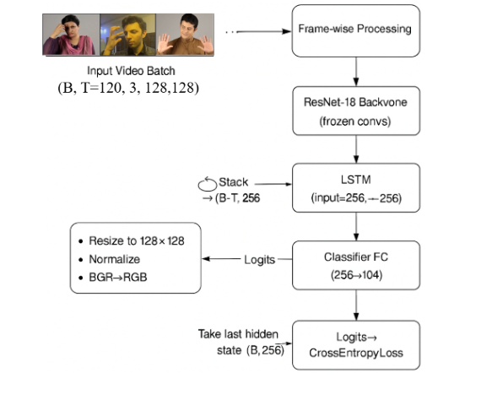
FYP II - Goal 4 (ii)
Model 2: ResNet-18+LSTM
Used re-trained ResNet-18 for spatial feature extraction, combined with a one-layer LSTM.
Single-layer LSTM captures sequential dynamics.
70 epochs, batch size 8, learning rate 1e-4, Cross Entropy Loss with label smoothing.
91% training accuracy, 78% evaluation accuracy – better generalization than ViViT.

Slide 25
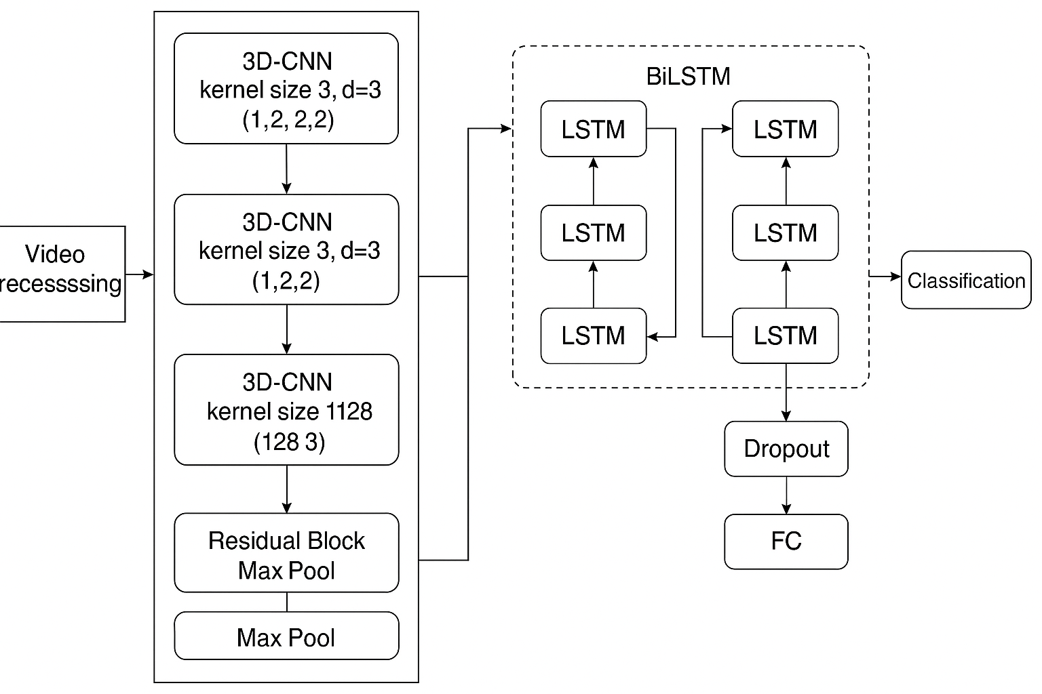
FYP II - Goal 4 (iii)
Model 3: 3DCNN + Residual Block + BiLSTM
3D convolutions for spatial-temporal extraction, residual blocks for deeper learning, and BiLSTM for sequence modeling.
Trained for 10 epochs (batch size 8, LR: 1e-3, 9.3M params).
Achieved 88% training, 84% eval, 83.89% test accuracy.
Precision: 0.88 | Recall: 0.84 | F1 Score: 0.84

Slide 26
FYP II - Goal 5
To evaluate the models’ performance we used four key performance metrics:
Accuracy: Percentage of overall correct predictions, giving us a broad view of model performance.
Precision to evaluate how many predicted signs were actually correct
Recall to check how many actual signs were correctly predicted
F1 score: balancing precision and recall for better fairness.

Slide 27
Result Analysis:
Key Observations:
ViViT: 21% accuracy gap between training and evaluation (overfitting)
ResNet-18 + LSTM: Reduced gap but still underperformed on evaluation
Our proposed model: Best generalization with minimal gap
Model | Training Accuracy | Evaluation Accuracy | Train Precision | Train Recall | Train F1 score
ViViT | 96% | 75% | 0.97 | 0.96 | 0.96
ResNet+ LSTM | 96% | 84% | 0.96 | 0.96 | 0.96
3DCNN + Residual Block + BiLSTM | 87% | 86% | 0.89 | 0.87 | 0.86

Slide 28
Conclusion of our FYP
Developed a comprehensive PSL recognition system to bridge the communication gap for the deaf community in Pakistan.
Created a custom dataset of 104 daily-use PSL signs with extensive frame-level augmentation.
Evaluated ViViT, ResNet18+LSTM, and a proposed 3D CNN+Residual+BiLSTM model.
Proposed model achieved best performance: 83.89% accuracy, F1 score: 0.84 on unseen data.

Slide 29
Future Work
Implement the real-time inference to one of the best deep learning model.
Implement the sentence-wise inference with nano seconds of inference.
Increase the robustness and performance of the trained models, with minimal gap between training, evaluation and test set.

Slide 30



ANY Suggestions?
Thank you!

Slide 31
References
Hamza, H.M., Wali, A. Pakistan sign language recognition: leveraging deep learning models with limited dataset. Machine Vision and Applications 34, 71 (2023). https://doi.org/10.1007/s00138-023-01429-8
Muneeb Ur Rehman, F. Ahmed, M. Attique Khan, Usman Tariq, Faisal Abdul Aziz Alfouzan, Nouf M. Alzahrani, & Jawad Ahmad, Dynamic Hand Gesture Recognition Using 3D-CNN and LSTM Networks, Computers, Materials & Continua (2022). https://www.researchgate.net/publication/357489586_Dynamic_Hand_Gesture_Recognition_Using_3D-CNN_and_LSTM_Networks
Samaan, G. H., Wadie, A. R., Attia, A. K., Asaad, A. M., Kamel, A. E., Slim, S. O., Abdallah, M. S., & Cho, Y.-I. (2022). MediaPipe’s Landmarks with RNN for Dynamic Sign Language Recognition. Electronics, 11(19), 3228. https://doi.org/10.3390/electronics11193228
Z. Doždor, Z. Kalafatić, Ž. Ban and T. Hrkać, "TY-Net: Transforming YOLO for Hand Gesture Recognition", IEEE Access, vol. 11
https://aclanthology.org/W19-6615.pdf
https://www.mdpi.com/2313-433X/10/6/149#:~:text=ResNet%20extracts%20the%20sign%20language,rate%20of%20sign%20language%20actions.

