Slide 1
CASE FILE // 2026.04.30 // CLASSIFIED
PIXELFORGE
UNDER ATTACK
Hunting threats in 125,000 network connections without a single label.
A DATA SCIENCE INVESTIGATION
Network Intrusion Detection with Unsupervised ML

Slide 2
THE SETTING
Meet PixelForge Studios
🎮 PixelForge Studios
👤 OUR ROLES
Industry
Online Multiplayer Gaming
Junior Data Scientists
Security Operations Center (SOC)
Players
12 million daily active users
Flagship Title
Neon Realms (live service MMO)
THE MISSION
Detect intrusions in network traffic logs using only patterns in the data, no labels, no shortcuts, no excuses.
Infrastructure
Global server network, 24/7
Revenue
$2.4M / day in microtransactions

Slide 3
⚠ INCIDENT REPORT
THE BREACH
03:47
Login servers experience 400% traffic spike
04:02
Players report being kicked mid-match
04:15
Database query latency rises from 12ms → 890ms
04:28
SOC triggers manual review of network logs
08:00
You arrive at work. The Slack channel is on fire.
STATUS: 125,973 connections logged overnight. No labels. No idea which are attacks.

Slide 4
THE EVIDENCE
Chapter 1 What's in the logs?
Every connection to PixelForge servers gets logged. 41 features per row. Mix of normal players, bots, scanners, and attackers all blended together.
125,973
41
22
0
CONNECTIONS LOGGED
FEATURES PER ROW
ATTACK TYPES HIDDEN
LABELS PROVIDED
THE CHALLENGE
Without labels, supervised ML is useless. We need unsupervised techniques letting the data reveal its own structure. Find the outliers. Group the suspects. Catch the attackers.

Slide 5
CLEANING THE CRIME SCENE
Chapter 2 Preparing the data for analysis
01
Drop irrelevant column
Removed 'difficulty' describes classification difficulty, not behavior.
02
Verify integrity
Checked for missing values & duplicates. Logs were clean.
03
Encode categorical features
protocol_type, service, flag → one-hot encoded into binary columns.
04
Create binary label
label_binary: 0 = normal traffic, 1 = anomalous (any attack type).
05
Standardize numeric features
StandardScaler → mean=0, std=1. Prevents src_bytes from dominating distance calculations.
→ Result: 41-feature dataset, fully numeric, ready for unsupervised analysis.

Slide 6
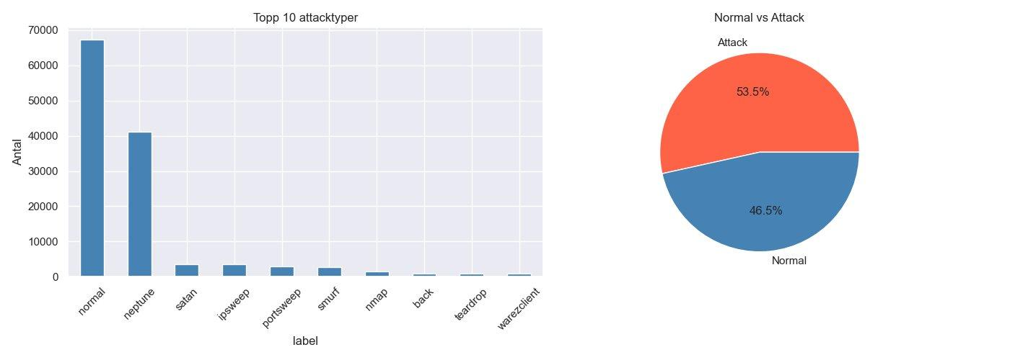
PROFILING THE TRAFFIC
Chapter 3 First look: what does the data say?
53.5% of all connections are malicious. Neptune (DoS) dominates — classic flood attack against the login servers.

Slide 7
THE SUSPECTS
Four families of attacks lurking in our network
💥
🔍
🔓
👑
DoS
PROBE
R2L
U2R
Denial of Service
Reconnaissance
Remote-to-Local
User-to-Root
neptune, smurf, back
satan, ipsweep, nmap
ftp_write, warezclient
buffer_overflow
Overwhelms login servers players can't log in. Lost revenue: ~$10K/min.
Scans ports for vulnerabilities. The recon before a real attack.
Outsiders gaining unauthorized access. Possible data theft.
Privilege escalation. The most dangerous, full system control.

Slide 8
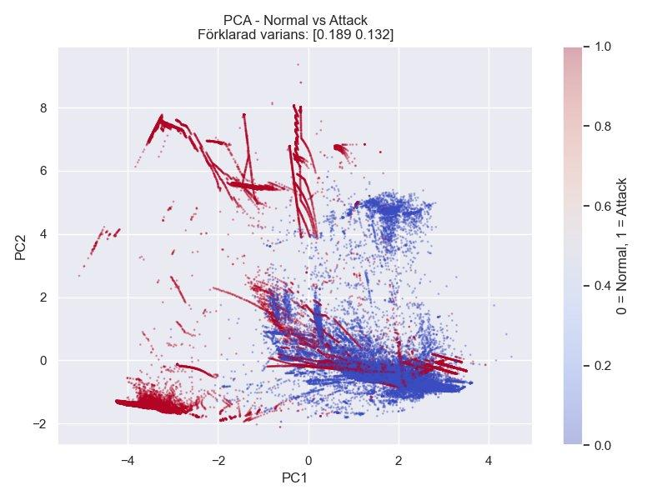
THE FIRST CLUE
Chapter 4 Compressing 41 dimensions into 2 with PCA
🔵 Normal players
Tight cluster on the right. Predictable behavior same servers, same protocols.
🔴 Attackers
Scattered branches. The straight lines? DoS bots firing nearly identical packets.
⚠ Overlap zone
Where attackers blend in. This is where unsupervised ML earns its keep.

Slide 9
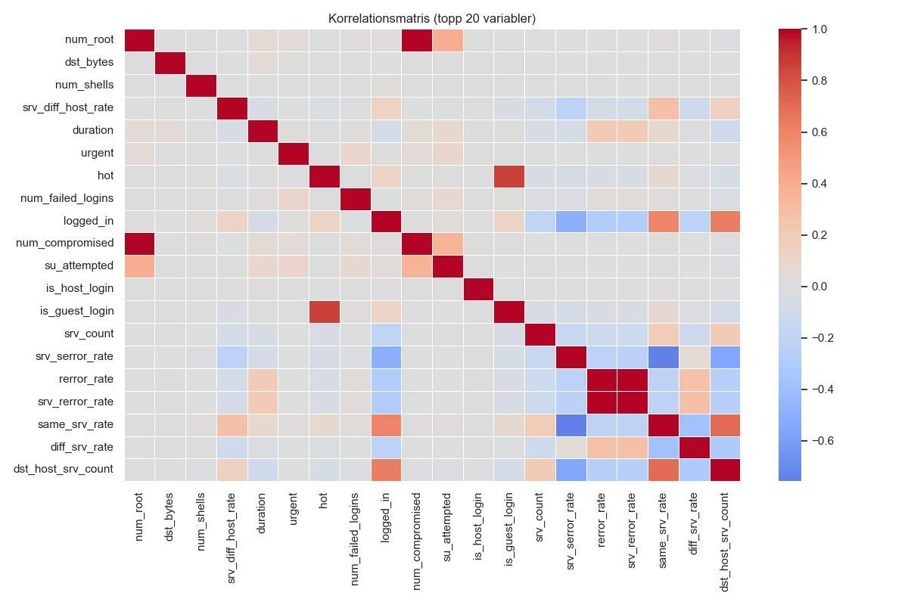
FOLLOWING THE CONNECTIONS
Which features move together? The correlation map.
num_root ↔ num_compromised
Where root access goes, compromised files follow. A privilege-escalation fingerprint.
same_srv_rate ↔ diff_srv_rate
Strongly negative — attackers either focus on one service or sweep many. Rarely both.
logged_in ↔ same_srv_rate
Logged-in users tend to stick to one service. Bots don't.

Slide 10
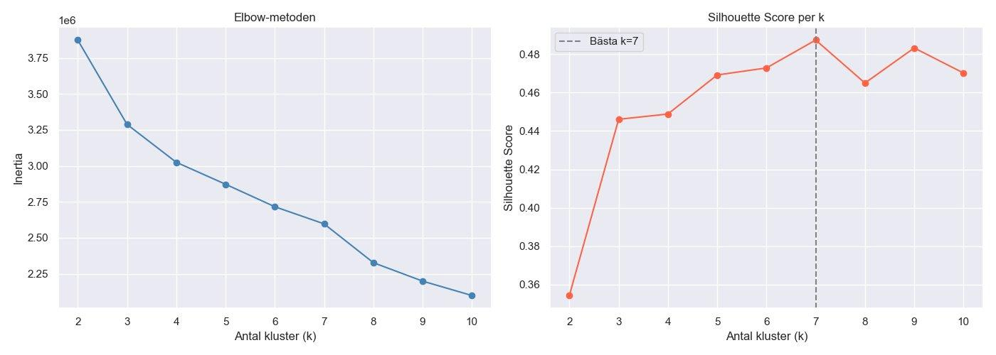
GROUPING THE TRAFFIC
Chapter 5 How many distinct behaviors are hiding in here?
OPTIMAL
k = 7
Silhouette: 0.49
Well-defined
→ Tested k=2 to k=10. k=7 hits the sweet spot distinct groups without over-fragmenting.

Slide 11
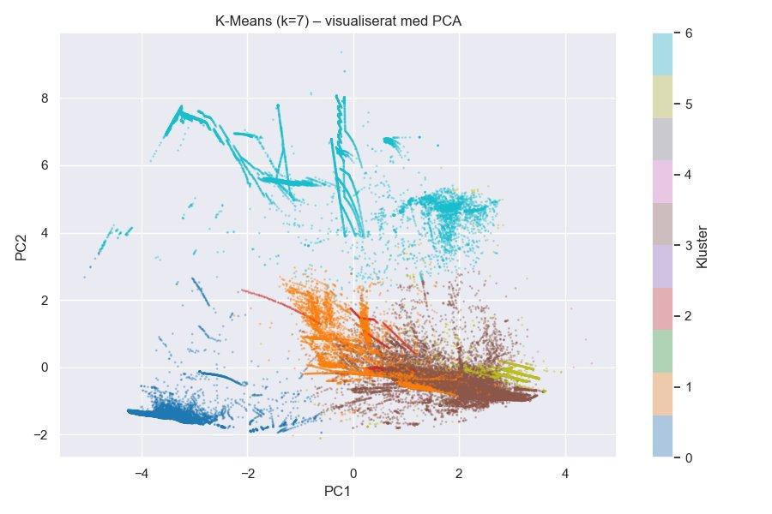
THE LINEUP
Seven distinct behavior profiles emerge from the chaos
Cluster 0
DoS attackers — neptune flood
Cluster 1
Probes — port scanners
Cluster 2
Normal HTTP / game traffic
Clusters 3-6
Niche attack signatures

Slide 12
THE NEURAL DETECTIVE - AUTOENCODER
Chapter 6 Training a network to know what 'normal' looks like
INPUT
41
64
32
16
CORE
32
64
OUTPUT
41
ENCODE → COMPRESS → DECODE
TRAIN
TEST
FLAG
Feed the network only normal traffic. It learns the patterns of legitimate players.
Run all traffic through. Normal = easy to reconstruct. Attacks = high error (MSE).
Anything above the 95th percentile of normal MSE? Anomaly. Investigate.

Slide 13
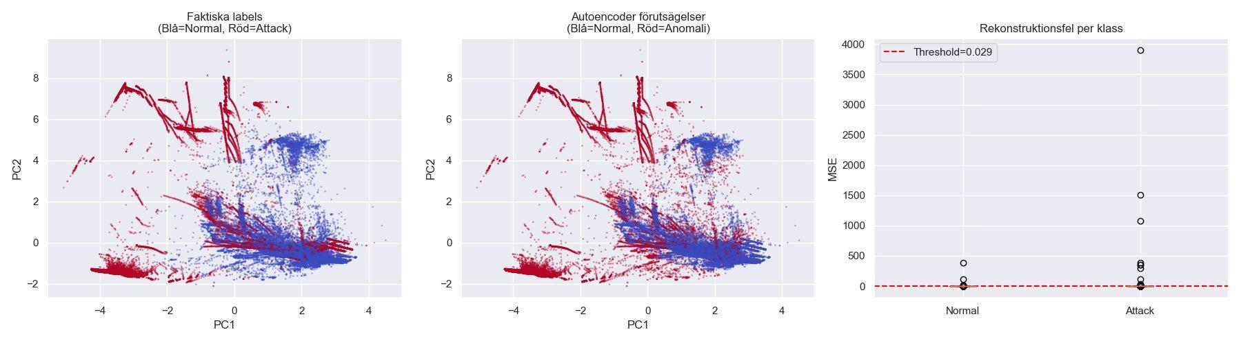
THE VERDICT
Autoencoder catches the unusual but not the obvious
Rare attacks (U2R, R2L) light up with high MSE. But repetitive DoS floods? They look 'normal' to the model, uniform, predictable, easy to reconstruct.

Slide 14
CASE CLOSED
Chapter 7 What we found, what we learned, what's next
K-Means uncovered structure
Autoencoder caught the rare ones
Seven behavioral clusters, DoS bots, scanners, normal players, all neatly separated. Silhouette 0.49.
U2R and R2L attacks lit up with high reconstruction error. Exactly the dangerous ones we'd miss otherwise.
PCA revealed the geography
Lessons for PixelForge
Normal traffic clusters tight; attacks branch out. The visual map alone is a powerful triage tool.
No single technique catches everything. Layer K-Means + Autoencoder for production. Retrain weekly.
PixelForge survives to fight another day.

