Slide 1

Password Pattern Analysis
Machine Learning on the RockYou Dataset
100,000
10
22
Passwords Analyzed
Pattern Classes
Features Extracted
EDA → Feature Engineering → XGBoost → SHAP

Slide 2






General introduction
01
02
The Dataset
Exploratory Analysis
14 million leaked passwords
Length, entropy, character patterns and surprises
03
04
Pattern Classification
Model Training
10 archetypal password patterns we identified
XGBoost with grid-search hyperparameter tuning
05
06
Feature & SHAP Analysis
Takeaways
What actually predicts password patterns?
Security implications and lessons learned

Slide 3
The Dataset
RockYou - the breach that changed password security forever
What is RockYou?
14.3M
Total passwords in leak
→ Leaked in 2009 from the RockYou social app
100K
→ ~14.3 million plaintext passwords
Random sample (seed=42)
→ Used in security research worldwide
100%
→ Represents real-world password behavior
Unique passwords in sample
→ We sampled 100,000 for this analysis
2009
Year of the breach

Slide 4
Exploratory Analysis
Key findings from the RockYou sample = 100,000
8.7
16.3%
7.1%
9.3%
chars
Average password length
Digits-only passwords
Contain special characters
Contain uppercase letter
Length Problem
Low Complexity
Entropy is Skewed
Most passwords cluster at 6–10 characters — well below the 12+ characters recommended today. Only digits account for 16.3% of all entries.
Only 7.1% include special characters. Complexity rules in modern password policies directly target this weakness.
Entropy distribution is bimodal: pure-digit passwords cluster near 0-bit, while mixed passwords spread up to ~3.5 bits per character.

Slide 5
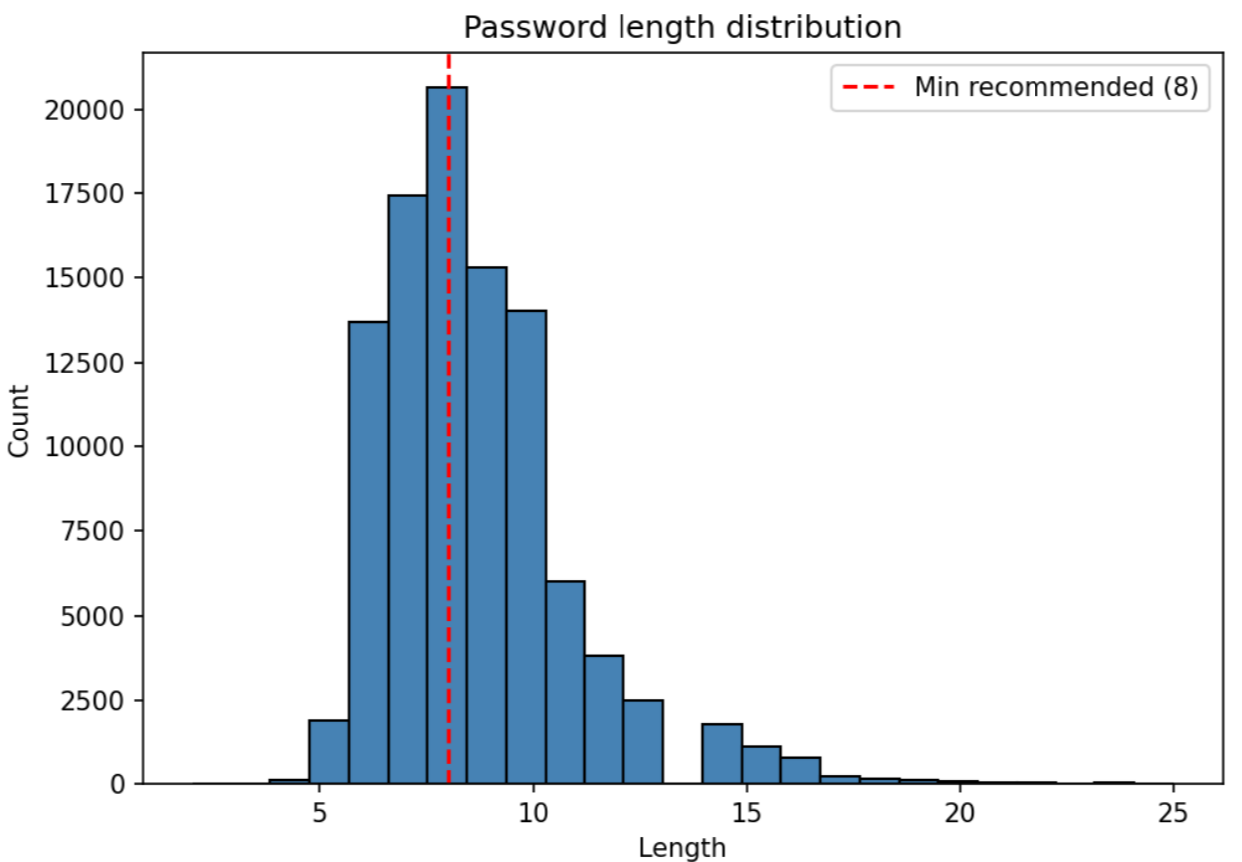
Password Length Distribution
EDA Deep Dive
8 chars
Most common length (28.6%)
8.7%
Mean password length
The red dashed line at 8 chars marks the minimum recommended length, yet the majority of passwords fall at or below it.

Slide 6
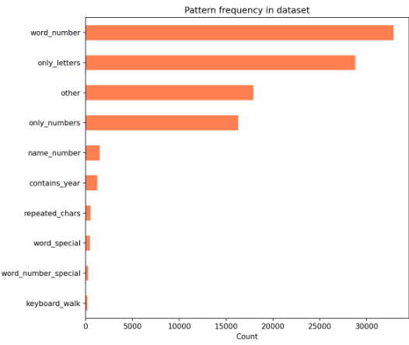
10 Structural Password Classifications
Rule-based regex classification before machine learning
Examples
123456
myP@ssw0rd
sunshine
password123
john1987
Jessica12
aaaaaa1
qwerty123

Slide 7
Model Training
XGBoost multiclass classifier with grid-search hyperparameter tuning
80/20
Train/Test Split
Grid Search
3×3 combos
Best Params
Selected
Final XGBoost
200 trees
→
→
→
Hyperparameter Grid
Best Configuration
max_depth
3, 5, 7
max_depth
7
learning_rate
0.05, 0.1, 0.2
learning_rate
0.05
n_estimators
100 (tune) / 200 (final)
accuracy
~97%

Slide 8
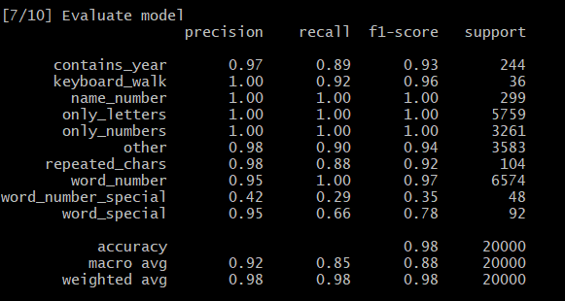
Model Evaluation Results
~98%
Classification report — test set (20,000 passwords)
Overall Accuracy

Slide 9
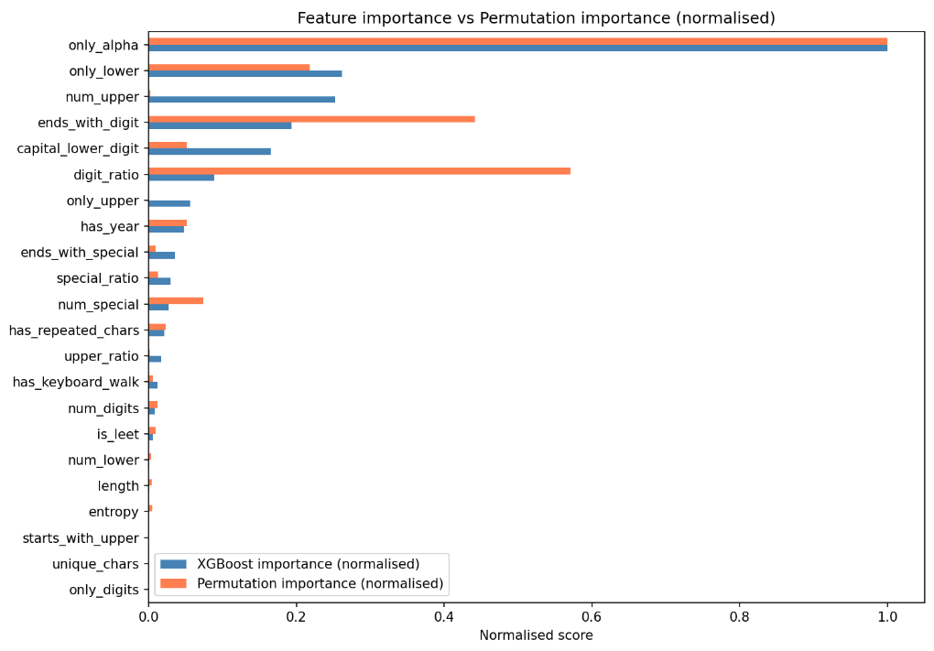
Feature & SHAP Analysis
only_alpha #1
only_alpha almost perfectly separates from other classes — the single strongest signal.
entropy matters
Entropy cleanly separates keyboard walks (near 0) from complex mixed passwords, helping distinguish from the other classes.
SHAP confirms
SHAP analysis across all classes confirms XGBoost and permutation importance agree — almost no ghost features

Slide 10
Takeaways & Implications
Passwords are dangerously predictable
Machine learning identifies patterns instantly
~16% are digits-only and most fall at 6-10 characters. Attackers can cover most of the space with just a few pattern templates.
XGBoost achieves ~98% classification accuracy using 22 simple features no brute-force needed to understand password behaviour.
Entropy + length are the master features
SHAP makes the black box explainable
Two features alone explain most of the classification power. They should be the first metrics any password checker evaluates for overall strength.
XGBoost + SHAP analysis confirms there are almost no redundant features - most features contributes. This validates the feature engineering approach.

