Slide 1
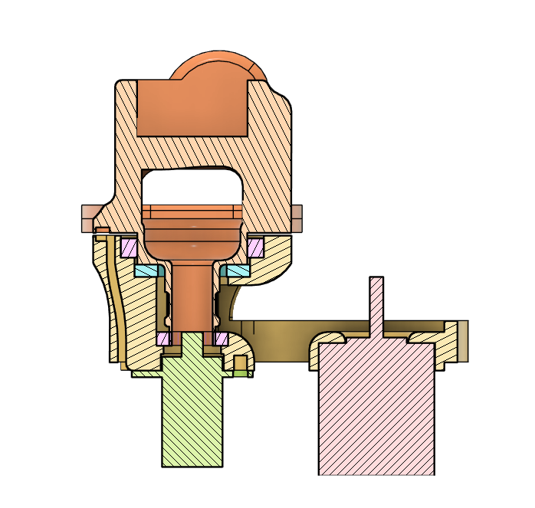
Rotating first axis
Magnet slot
Hollow shaft for routing cables
Rolling bearings
Hall-effect sensor slot with tunel for routing cables
Needle bearing
Hole for brass insert
Slip ring
Stepper motor

Slide 2
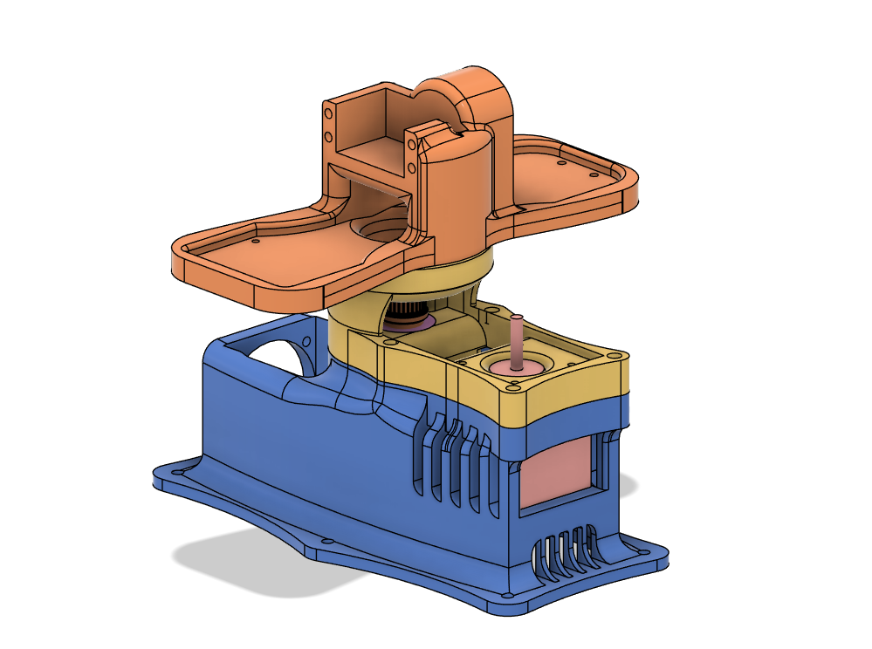

Slide 3
