Slide 1
MEMORY TIERING / CSLab
How hot is a hot page?
M5 Figure 4
Custom pintool: accesses and modeled misses
Iason Zakynthinos
Course research project / NTUA
Iason Zakynthinos / Advanced Computer Architecture 01 / 15
Notes:
40 seconds. This course research project was carried out for Advanced Computer Architecture with CSLab. The target is M5 Figure 4, not a complete implementation of M5. Present the measurement method, discrepancies and controlled extensions.
Sources: docs/methodology.md

Slide 2
MEMORY TIERING / CSLab
The assignment
01 Record memory references with Intel Pin.
02 Use benchmarks from the M5 artifact.
03 Compare the figure for misses and accesses.
Iason Zakynthinos / Advanced Computer Architecture 02 / 15
Notes:
50 seconds. Record memory references, use the artifact benchmarks, reproduce the figure and extend it to accesses. Memstrata and NeoMem also informed the study. Figure 4 concerns spatial coverage, not the hot-page selection accuracy in Figure 3.
Sources: docs/methodology.md

Slide 3
MEMORY TIERING / CSLab
4 KiB = 64 lines x 64 B
U(p,e): distinct lines in page p during window e.
F(N): fraction of observations with 1 <= U <= N.
N = 4, 8, 16, 32, 48.
F(8)=0.40: 40% touched at most 8 lines, not 40% of accesses.
Iason Zakynthinos / Advanced Computer Architecture 03 / 15
Notes:
70 seconds. Count distinct lines for each page and window. The CDF at N is the fraction of observations touching at most N lines. Coverage is not access frequency. Each page-window observation has equal weight; epochs are not weighted equally regardless of population.
Sources: docs/methodology.md

Slide 4
MEMORY TIERING / CSLab
A custom pintool for the measurement
memory operand -> 64 B lines -> cache filter -> masks / counters
Intel Pin supplies the instrumentation framework.
Our C++ code implements the measurement logic.
One execution, three streams. No large full trace.
Iason Zakynthinos / Advanced Computer Architecture 04 / 15
Notes:
70 seconds. Intel supplies the Pin framework. Our C++ implementation instruments memory operands, splits them into lines, filters them through caches and updates masks and counters. It does not retain a full trace. ROI hooks, shared epochs and manifests support validation and reproducibility.
Sources: src/profiler/pintool/hotskew.cpp; counter_table.hpp; paired_observer.hpp

Slide 5
MEMORY TIERING / CSLab
Pin accesses vs device-side traffic
Private L1D/L2 and shared LLC.
Primary setting: 40 MiB / 10 ways.
No coherence, physical slice hashing or hardware prefetching.
These are modeled misses,
not hardware performance counters.
Iason Zakynthinos / Advanced Computer Architecture 05 / 15
Notes:
70 seconds. A cache model is needed as a filter. It has private L1/L2, a shared LLC, writeback/write-allocate, LRU and non-inclusive behavior. It is not an exact Sapphire Rapids simulator. Pin sees virtual user-space operands, not kernel copies or hardware prefetches.
Sources: docs/methodology.md

Slide 6
MEMORY TIERING / CSLab
Shared windows, different streams
Accesses Demand line operands
Fills / misses Demand misses through all cache levels
Total traffic Fills + dirty LLC writebacks
Shared 10M-event windows. Whole ROI reported separately.
Iason Zakynthinos / Advanced Computer Architecture 06 / 15
Notes:
70 seconds. Accesses are demand operands split by line. Fills are demand misses through every modeled cache level. Total traffic adds dirty LLC writebacks. All streams share boundaries in the same execution. The protocol uses 10M memory events, retains the final partial window and reports a separate whole-ROI union. Controls vary only declared factors.
Sources: docs/methodology.md

Slide 7
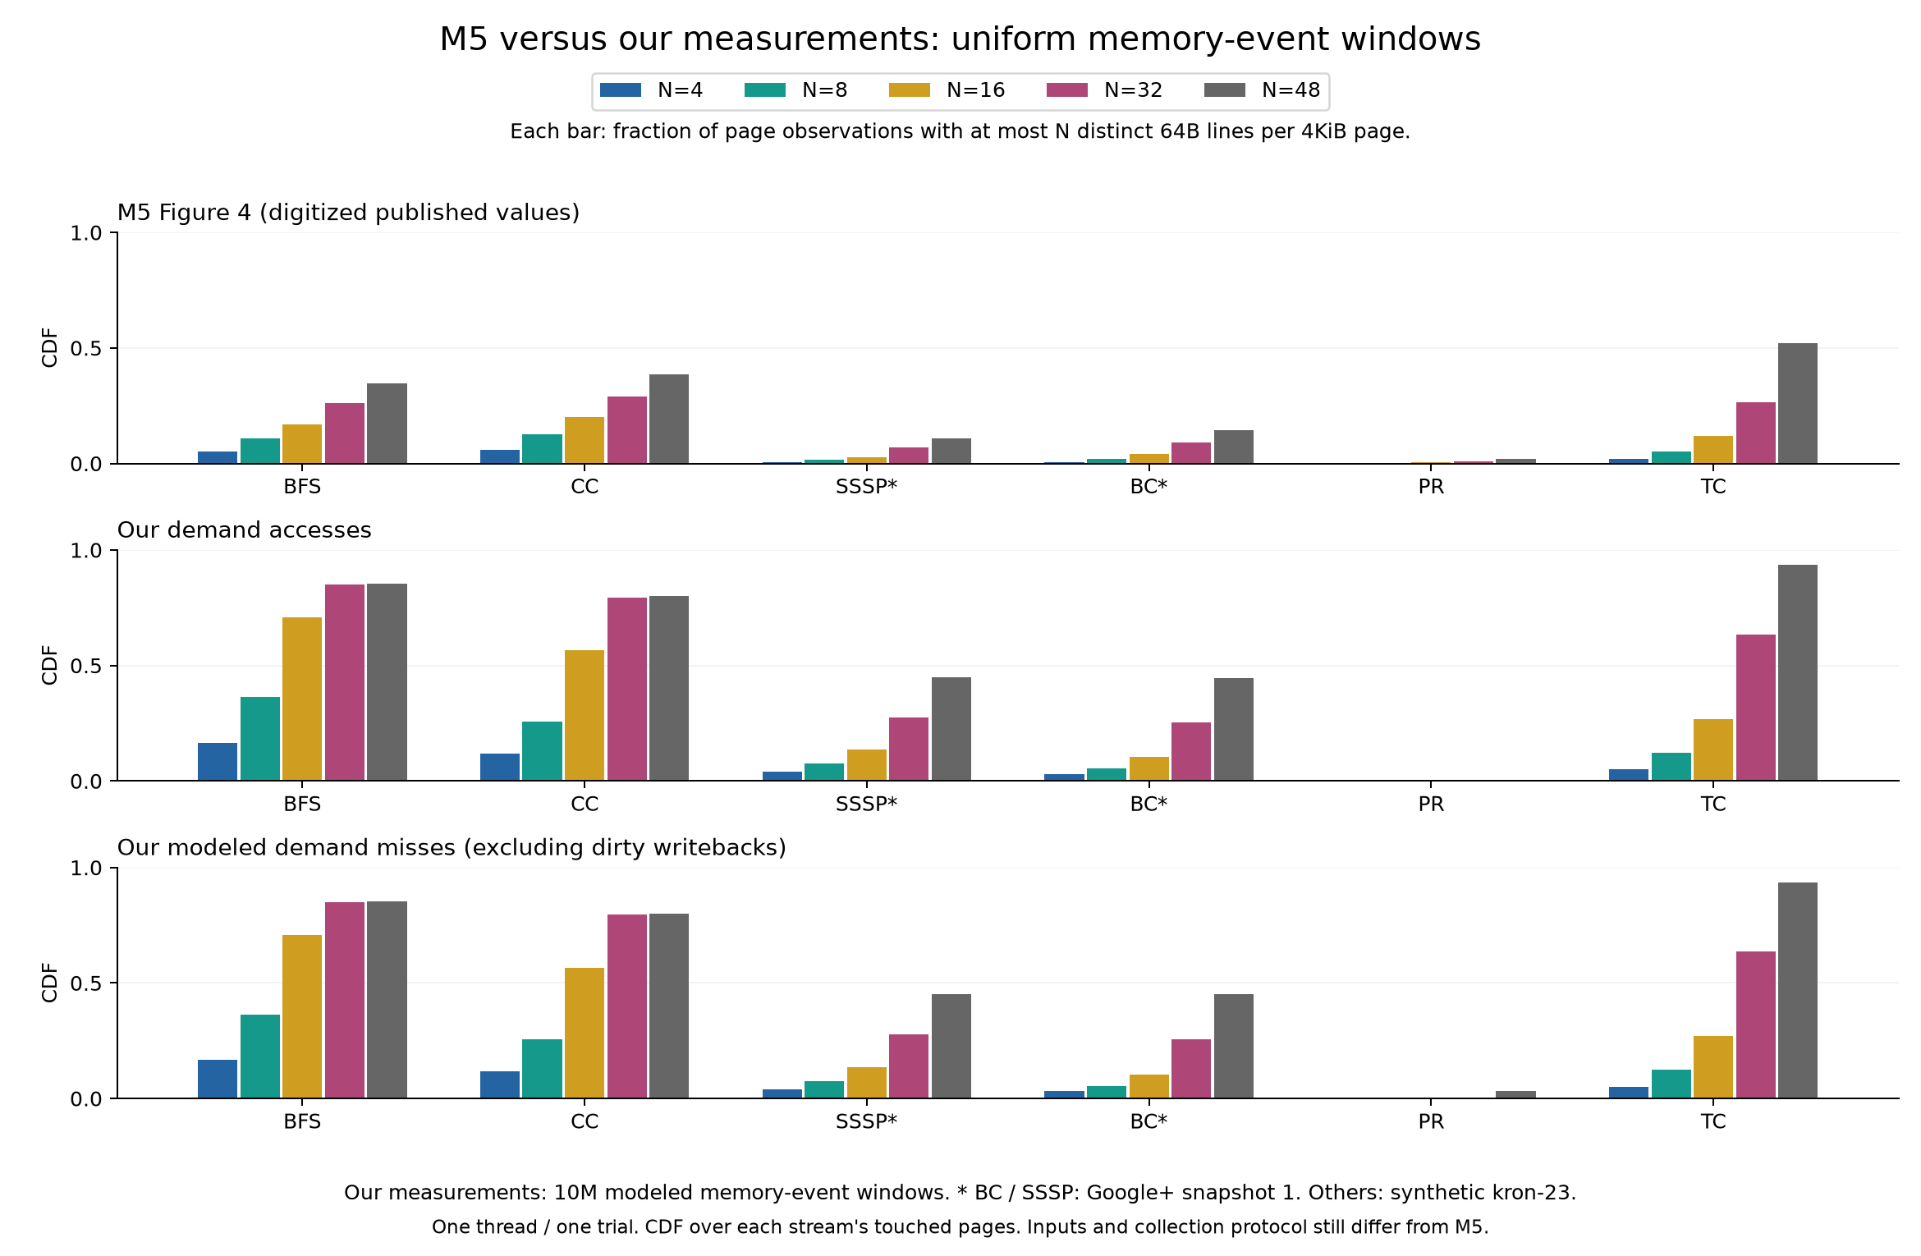
MEMORY TIERING / CSLab
Common baseline: M5 / accesses / misses
Baseline: kron-23; Google+ snapshot 1 for BC/SSSP; 1 thread/trial; digitized M5.
Iason Zakynthinos / Advanced Computer Architecture 07 / 15
Notes:
80 seconds. Top: digitized M5. Below: paired accesses and demand misses under a common protocol. This baseline precedes the new input campaign. It is not full replication. Retain it as the common basis for comparing controls.
Sources: docs/uniform-windows.md

Slide 8
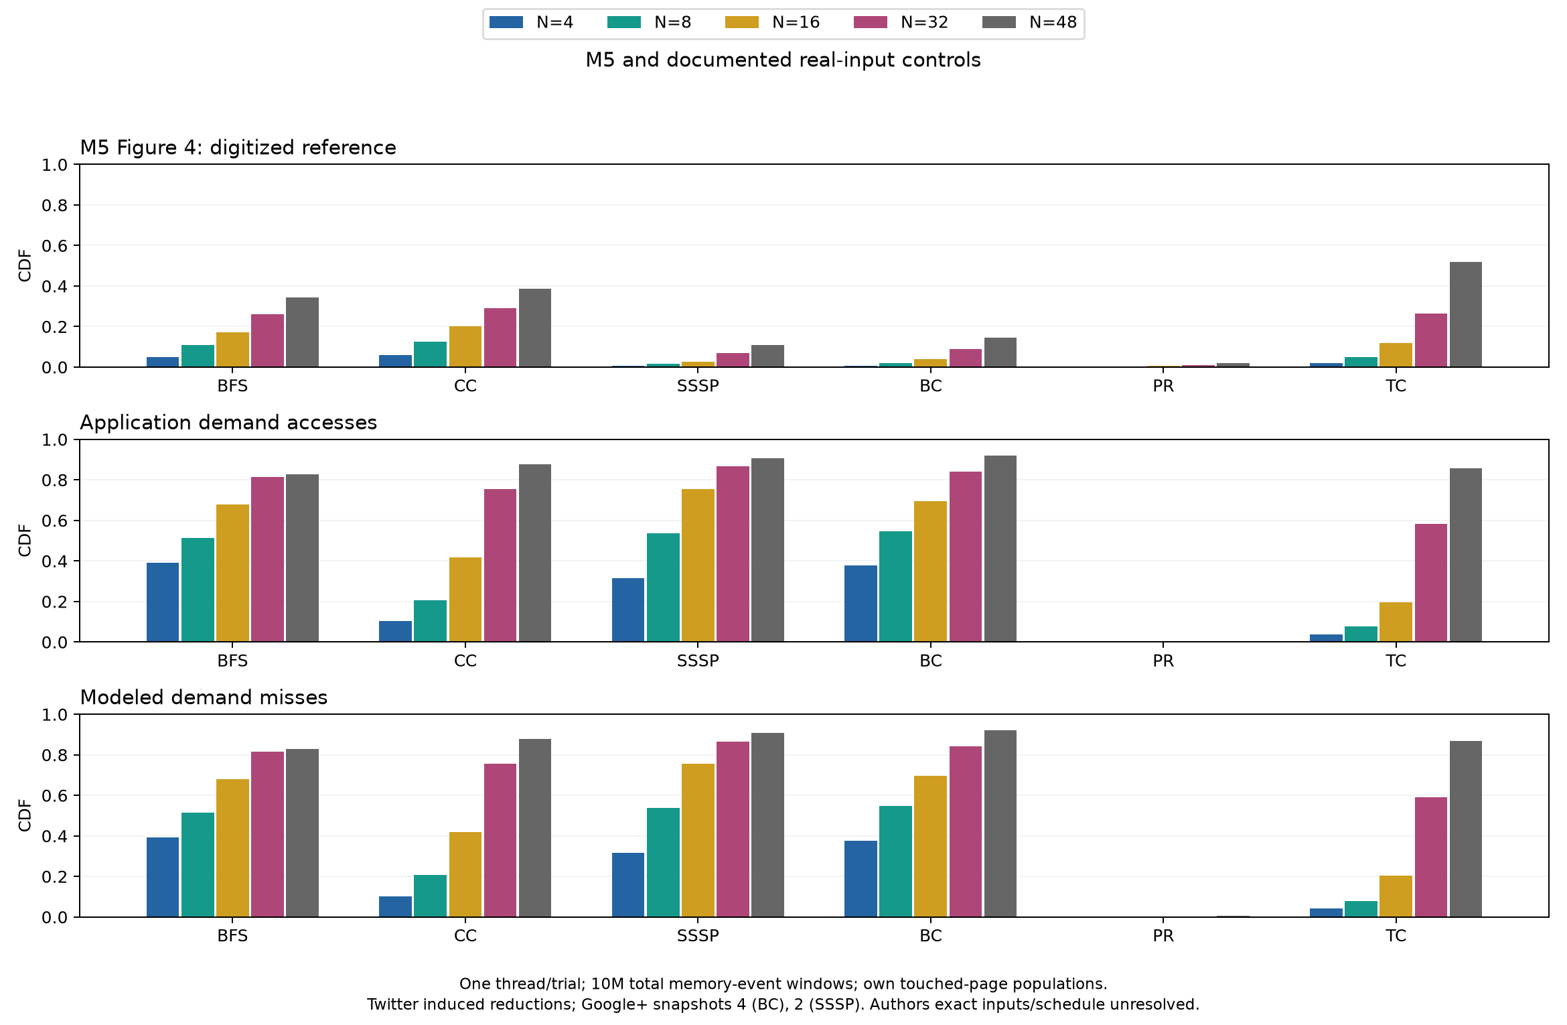
MEMORY TIERING / CSLab
New inputs, unchanged measurement protocol
Twitter induced reductions; Google+ 4/2; exact M5 inputs and Figure 4 schedule remain unavailable.
Iason Zakynthinos / Advanced Computer Architecture 08 / 15
Notes:
70 seconds. The new campaign uses our declared Twitter reductions and Google+ snapshots 4/2. All six runs completed and passed checks. These are not the exact author inputs. Negative results are retained: BC and SSSP disagree more strongly.
Sources: docs/fidelity-followup.md

Slide 9
MEMORY TIERING / CSLab
Agreement did not improve everywhere
Workload | Baseline / pp | New inputs / pp
BFS | 59.1 | 55.6
CC | 50.5 | 49.2
PR | 1.1 | 1.5
TC | 41.6 | 34.9
BC | 30.7 | 77.6
SSSP | 34.0 | 79.6
Pooled demand-fill CDF. Lower means closer, not proof of an equivalent experiment.
Iason Zakynthinos / Advanced Computer Architecture 09 / 15
Notes:
50 seconds. Report the maximum absolute discrepancy across all five N thresholds, not just the tail. Do not substitute whole-ROI results because they look closer. The input campaign tests a hypothesis; it does not establish successful full reproduction.
Sources: results/fidelity-2026-10-27/scores.csv

Slide 10
MEMORY TIERING / CSLab
Why do accesses and misses look alike?
168.8M accesses
7.9M fills
Equal line coverage does not mean equal request counts.
The CDF measures distinct lines, not miss rate.
Iason Zakynthinos / Advanced Computer Architecture 10 / 15
Notes:
60 seconds. Touching a line sets one bit regardless of repeated hits. With cold initial caches, the first demand touch causes a fill, so whole-ROI line coverage can agree. This does not mean caches are ineffective. Baseline BFS has about 168.8M accesses and 7.9M fills.
Sources: docs/methodology.md

Slide 11
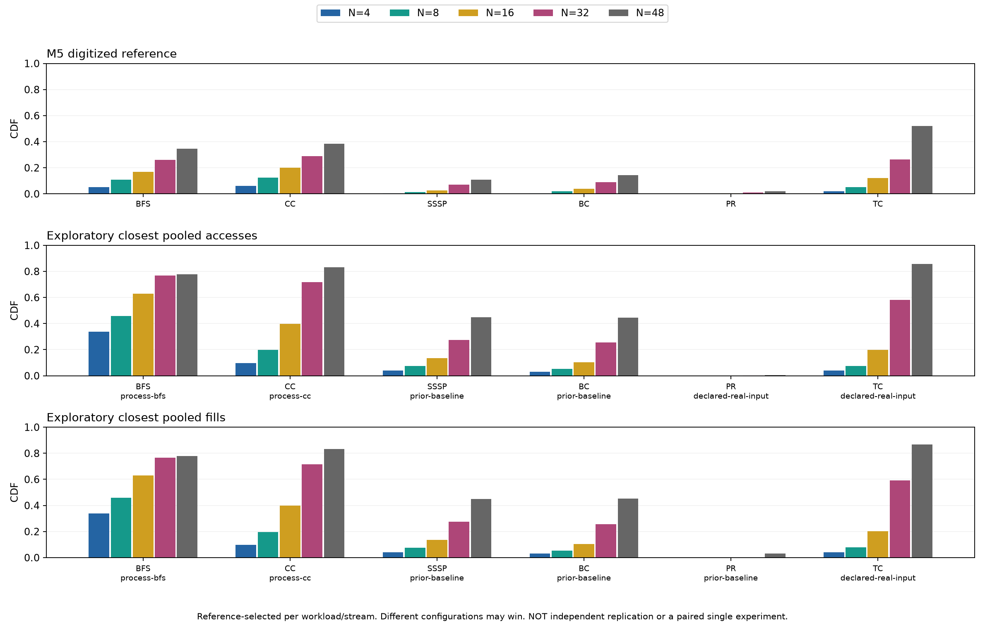
MEMORY TIERING / CSLab
Declared controls and exploratory results
Reference-selected, not independent replication. Steps: 14 / 21. All outcomes retained.
Iason Zakynthinos / Advanced Computer Architecture 11 / 15
Notes:
60 seconds. Do not choose a separate protocol for each workload after inspecting M5. Stage 2 declares full-process collection, real inputs with twenty threads, nine LLC ways and RSS-selected TC. Select the footprint before looking at Pin CDFs. Closest cases are explicitly exploratory.
Sources: docs/pin-stage2-protocol.md
TC native RSS: 8.89 GB; target 5.0 GB. Within tolerance: false. Selection used RSS only. This is not a size-matched reproduction. The completed one-thread control has pooled miss error 53.87 pp, worse than 34.87 pp for the smaller input. The twenty-thread control is a separate experiment.

Slide 12
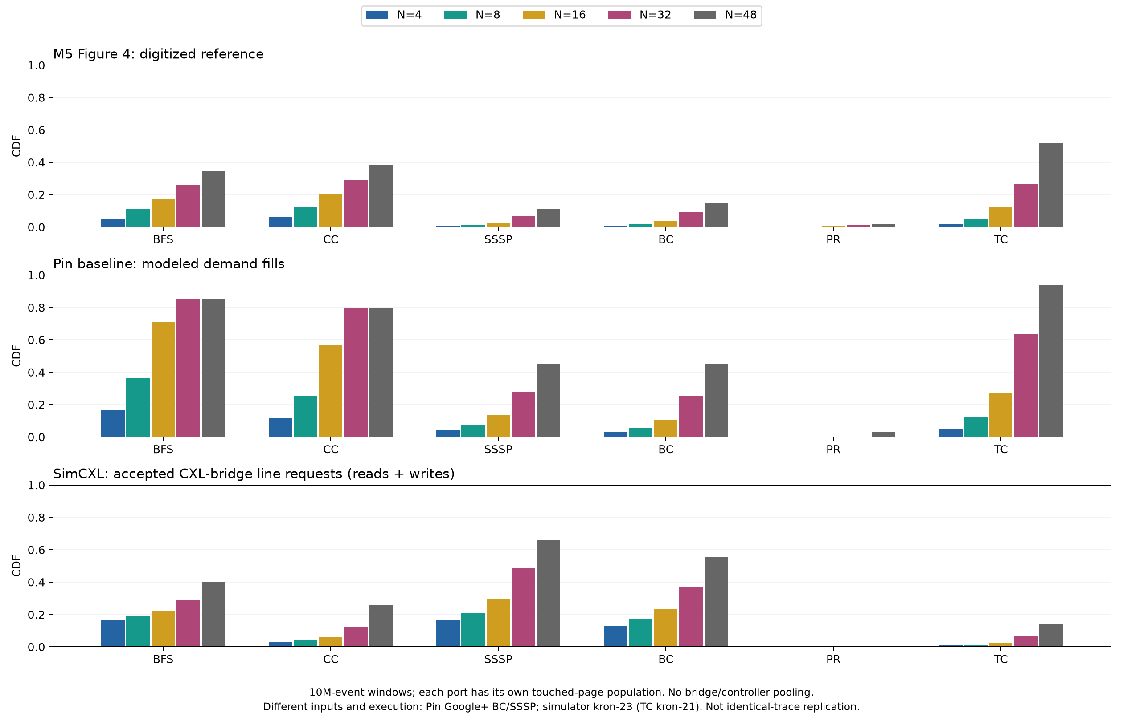
MEMORY TIERING / CSLab
The same comparison in SimCXL
PR: complete · TC: complete · Snapshot resume: bounded validation passed, reboot untested.
Iason Zakynthinos / Advanced Computer Architecture 12 / 15
Notes:
70 seconds. The probe measures physical accepted requests at the CXL bridge. Bridge and controller clocks are independent; never add their observations together. The overview compares different setups, not identical traces. All six graph workloads completed and passed checks. TC: 621,867,320 requests in 63 windows, 31.07 hours, maximum discrepancy 37.78 percentage points. PR is numerically close, but full reproduction is not established. Liblinear and BC window controls remain in the simulator queue.
Sources: docs/simulator-figure4.md

Slide 13
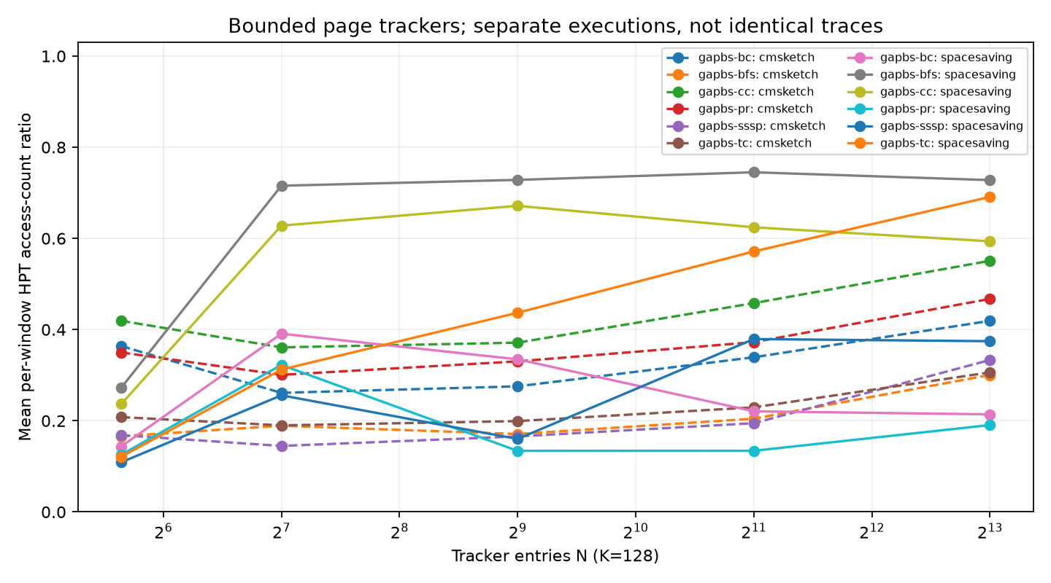
MEMORY TIERING / CSLab
PAC / WAC and bounded trackers
Exact counters:
PAC / WAC
Bounded trackers:
HPT / HWT
Space-Saving
Count-Min + top-K
Iason Zakynthinos / Advanced Computer Architecture 13 / 15
Notes:
60 seconds. Exact page/word counts provide ground truth. HPT/HWT are bounded trackers using Space-Saving and Count-Min plus top-K. Corrected runs completed. This is not the complete M5 hardware or tiering manager. Tracker N is a capacity budget, distinct from N in the CDF thresholds.
Sources: docs/revalidation-2026-10-25.md

Slide 14
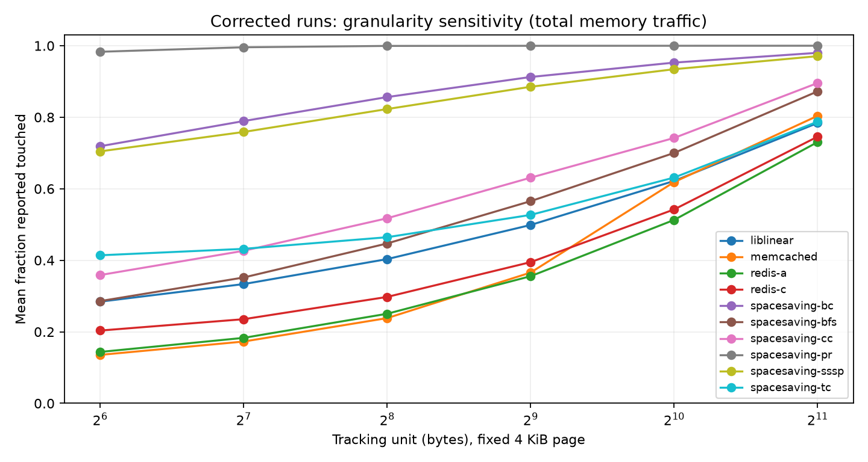
MEMORY TIERING / CSLab
Beyond the original figure
Granularity sweeps
Hot-set turnover
Previous-window placement
Serial cost sensitivity
not measured
application speedup
Iason Zakynthinos / Advanced Computer Architecture 14 / 15
Notes:
50 seconds. Validated extensions cover granularity, turnover and previous-window placement. A coarser tracking unit changes apparent density, not the physical cache-line size. Redis A/C, Memcached and Liblinear are included in the broader study. The serial latency cost model is not measured application speedup.
Sources: docs/revalidation-2026-10-25.md

Slide 15
MEMORY TIERING / CSLab
What exact reproduction still requires
Exact reduced graphs, weights and vertex ordering.
WAC resets, region collection and aggregation.
Comparable scope and page population.
Retain improvements alongside negative results
and unresolved limitations.
Iason Zakynthinos / Advanced Computer Architecture 15 / 15
Notes:
50 seconds. Correct implementation of our counters does not recover the exact reference procedure. We still need the reduced graphs, WAC collection schedule and page population. Controls continue, but the objective is to explain discrepancies without selecting attractive bars after the fact.
Sources: docs/m5-parameter-evidence.md

