Slide 1


Controlling Usage and Security Risks of OSS in Applications Ecosystems
Stan Zajdel, Independence Health Group, Philadelphia, USA
Diego Elias Costa, LATECE Lab, Univ. Québec à Montréal, Canada
Hafedh Mili, LATECE Lab, Univ. Québec à Montréal, Canada

Slide 2
The good
What we said 30 years ago | Today’s reality
“… in spite of its promise, software reuse has failed to become standard practice for software construction” [Krueger,1992] | Between 90% and 93% of businesses are using OSS in their applications
“… For a reuse technique to be effective, it must be easier to reuse the artifacts than it is to develop the software from scratch” [Krueger, 1992] | Thank god for the internet and Google
A major obstacle to reuse is the NIH (Not Invented Here) syndrome | Say what?

Slide 3
The bad
Open source software (OSS) is
In theory | In practice
Developed by a large number … | Most OSS packages are created and maintained by one or two people
Of highly competent, sophisticated | Who knows?
altruistic | Some are malignant
… intensive users | Many occasional ones
… whose contributions are vetted by yet more competent, sophisticated and altruistic users | No vetting process for the overwhelming majority
Good quality because of inherently large test coverage | Security vulnerabilities are a different beast

Slide 4
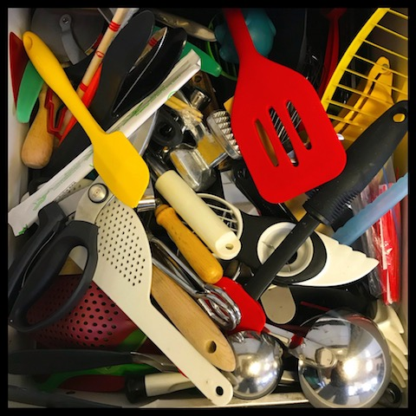
The ugly
Color and Faker
Disgruntled maintainer introduced an infinite loop
node-ipc:
Political protest
Log4shell
The kitchen drawer syndrome: a framework that does a lot more than:
You need
It should

Slide 5
Approach: DevOps ➔DevSecOps
People:
Don’t interfere with their « creative workflow »
Validate after the fact
Educate them on the security risks of unfettered reuse
Tools:
Source Composition Analysis (SCA) early in the DevOps pipe
Read/Query a vulnerability database
Flag or block problematic builds
Processes
Software vetting process for populating the vulnerability database
Research, categorize, reduce
People
Tools
Process

Slide 6
Outline
The tools
Preliminary results
What next

Slide 7
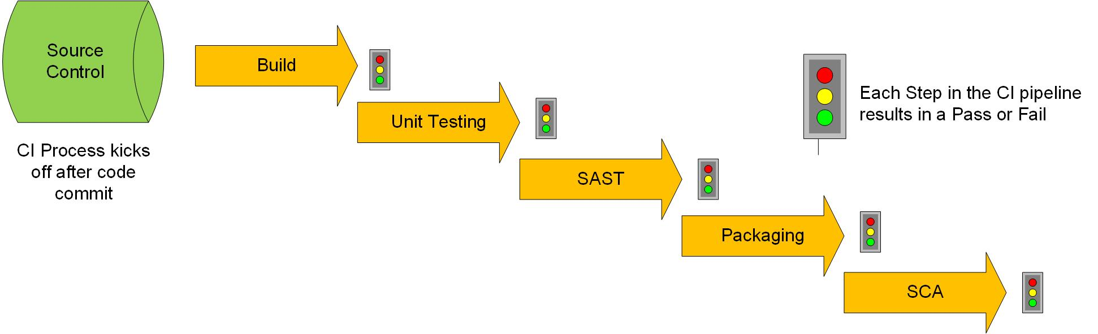
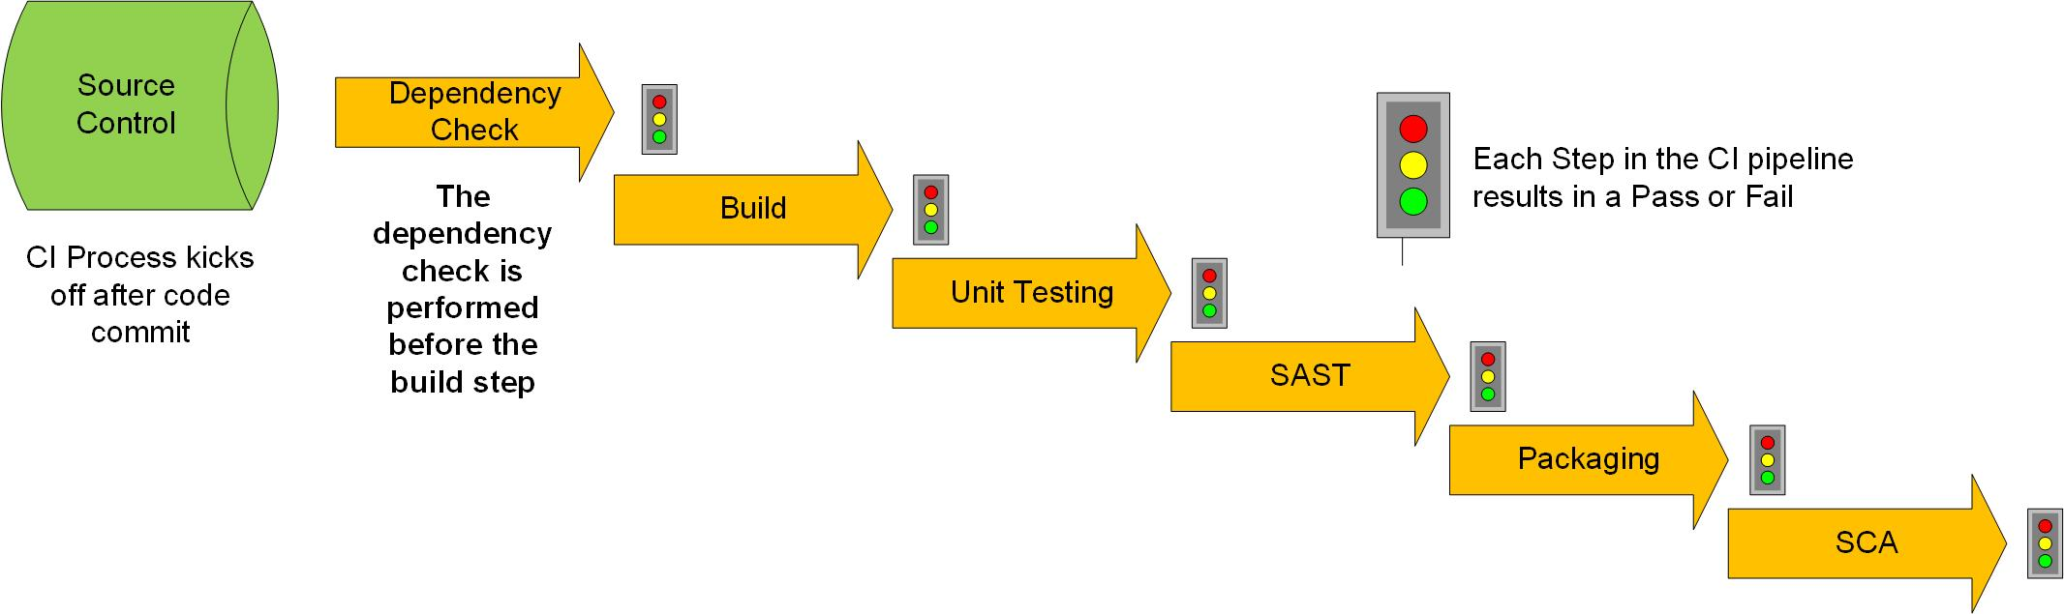
The Tools
Traditional DevOps automation pipeline
Our DevSecOps automation pipeline

Slide 8
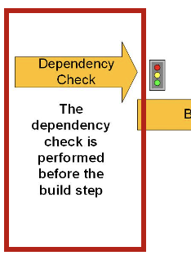
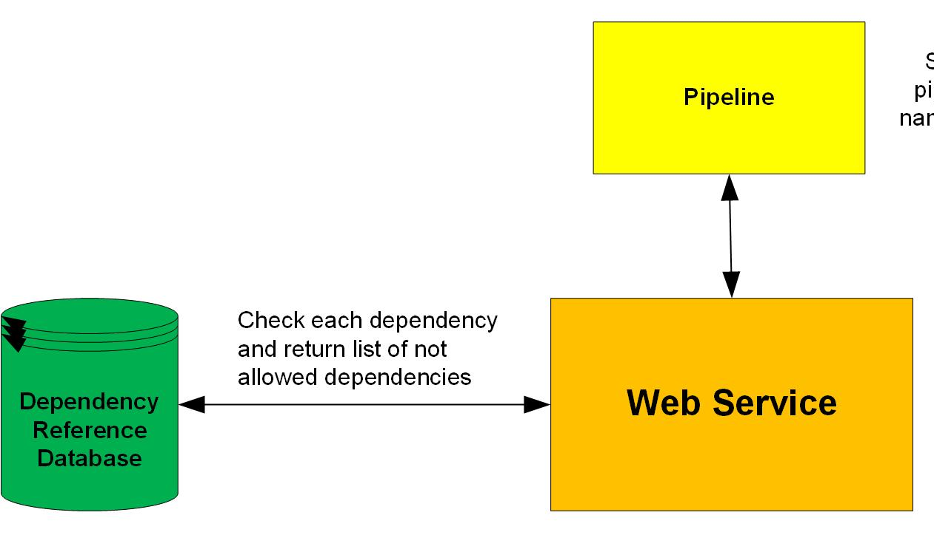
The dependency check
Upon commit, a web service call with repo name
Web service:
Checks build type to locate build config file
Invokes config file specific parser to extract direct dependencies
Package/library
Version
Queries Dependencies Reference Database

Slide 9
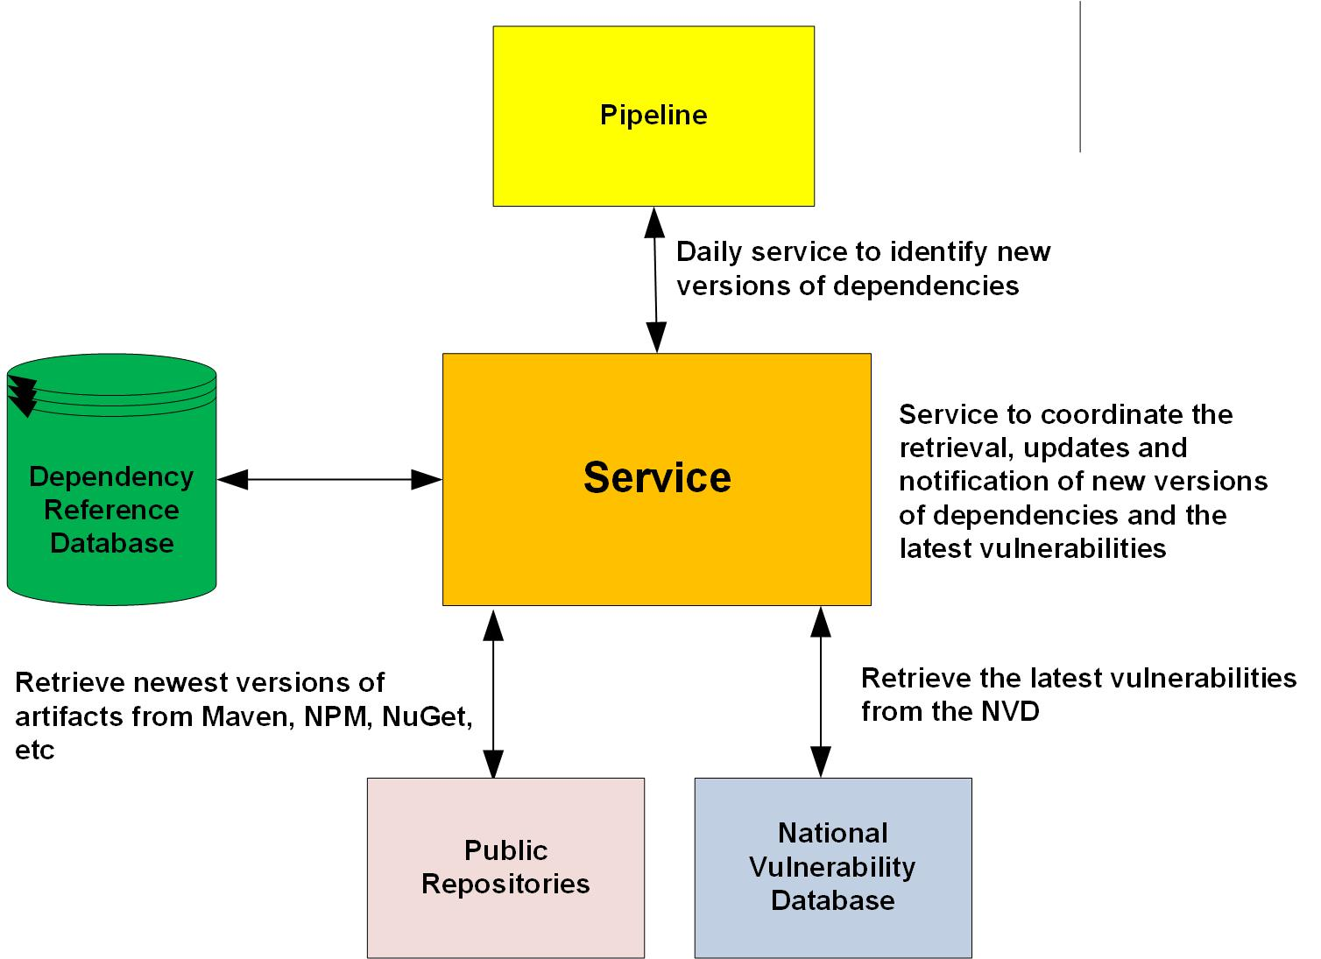
Updating the Dependency Reference Database
Different versions of libraries may be used by different teams, or at different times
New (versions of) libraries appear regularly in builds
Ideally/ultimately:
New libraries/versions are put on probation until properly vetted
Builds involving libraries with documented critical vulnerabilities fail after a grace period

Slide 10
Outline
The tools
Preliminary results
What next

Slide 11
Preliminary results
Basic metrics
How bad is it?
≈ 400 developers
780 code repositories:
527 Java repositories
211 .Net repositories
42 Javascript repositories
527 Java repositories
1986 unique direct dependencies on Java libraries/versions

Slide 12
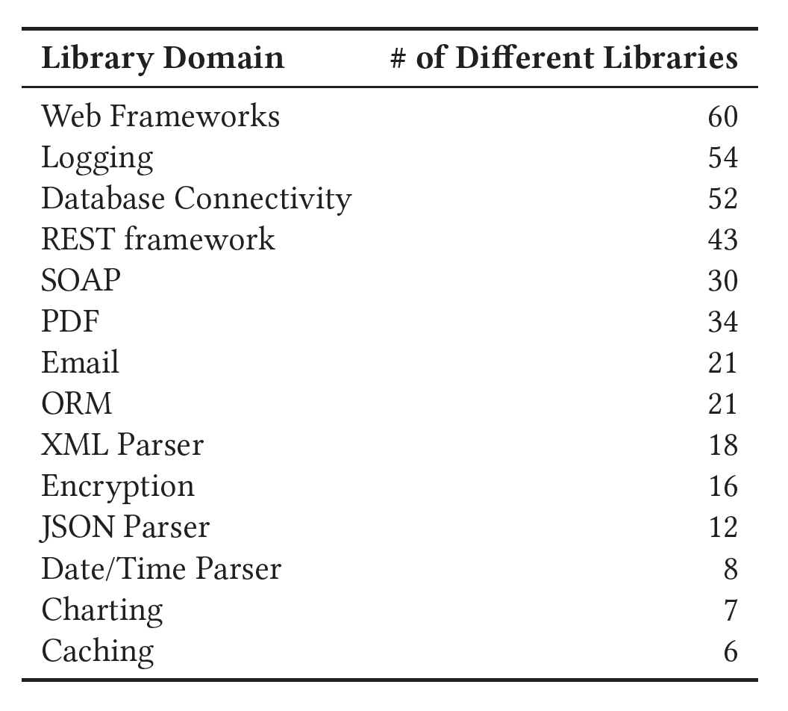
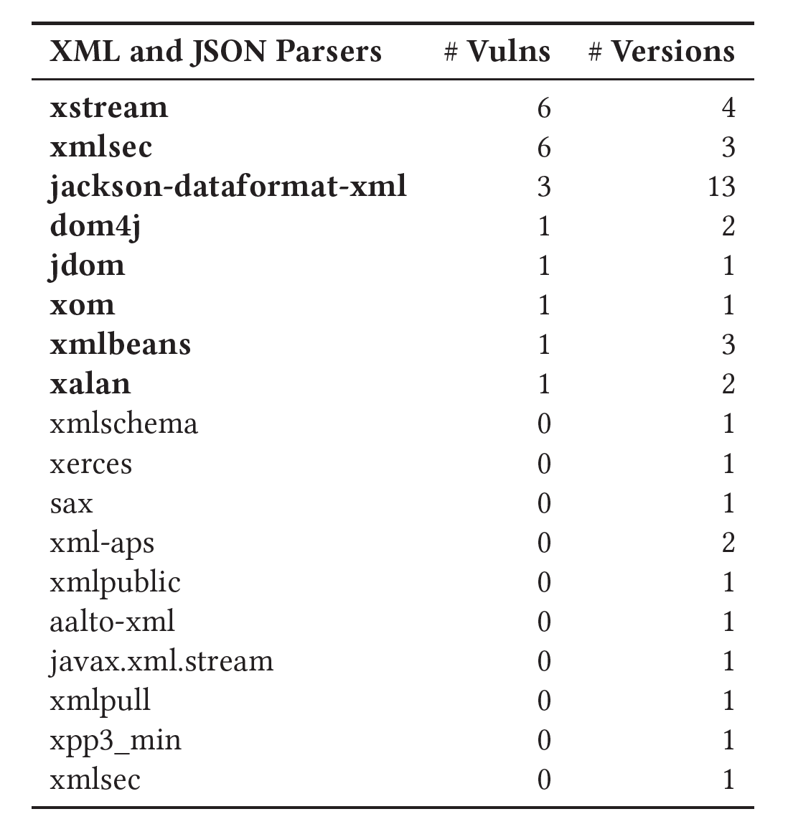
Preliminary results – how bad is it?

Slide 13
Outline
The tools
Preliminary results
What next

Slide 14
People – Processes - Tools
Tools:
Part of the answer
Human element + vetting requires people …
But there is room for more automation
Help enforce agreed-upon processes
Processes:
Who is responsible for vetting?
Qualifications but also time management
Should derogations be possible?
People
Inform
Educate
Engage
People
Tools
Processes

Slide 15
Thank you for your attention

