Slide 1
STATISTICAL ANALYSIS OF CREATENINE LEVELS BEFORE AND AFTER TREATMENT FOR PATIENTS WITH KIDNEY IMPAIRMENT
Zajiba Sadia Islam
501279357

Slide 2
BACKGROUND
Clinical trial evaluating new drug efficacy in treating renal problems across varying degrees of kidney impairment.
Study includes 285 patients categorized into mild, moderate, and severe impairment groups.
Monitoring renal function through creatinine level measurements before and after treatment.
Data challenges: incomplete trials, missing data, and corrupted values excluded.
Analysis focuses on drug impact within and between groups, comparing pre- and post-treatment creatinine levels.

Slide 3
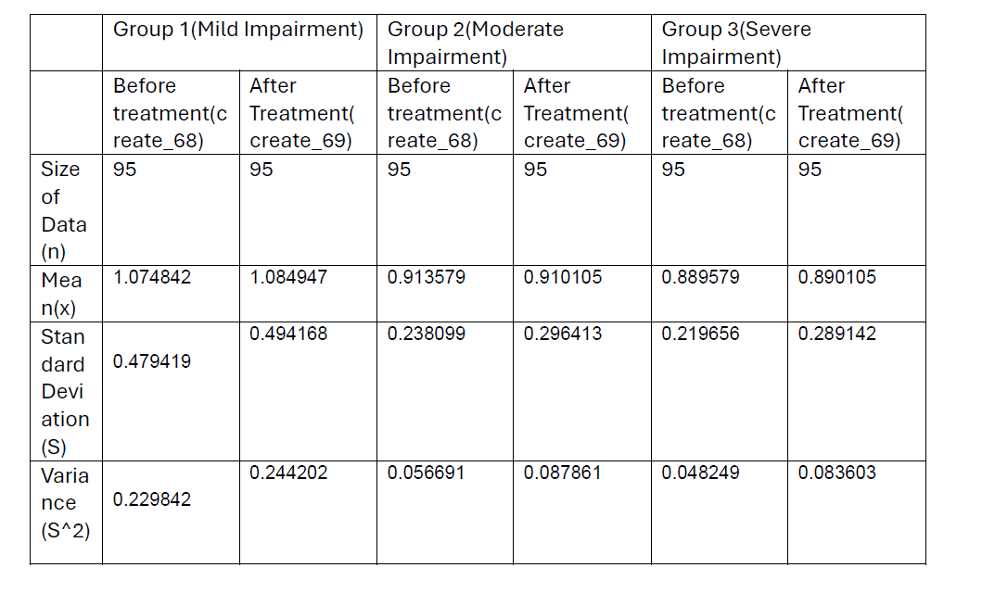
Descriptive Statistics
Image : Descriptive Statistics

Slide 4
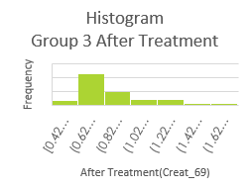
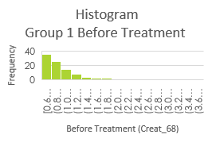
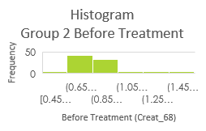
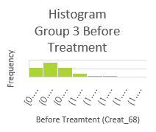
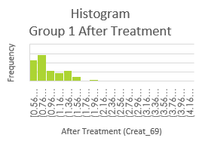
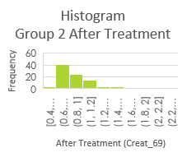
Frequency Histogram
Before Treatment
After Treatment

Slide 5
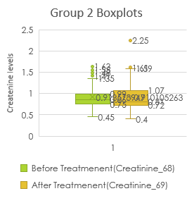
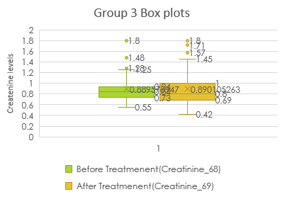
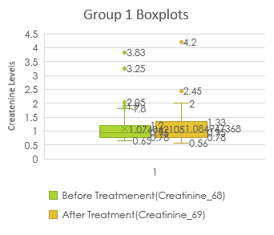
Outlier Analysis

Slide 6
Normality Check

Slide 7

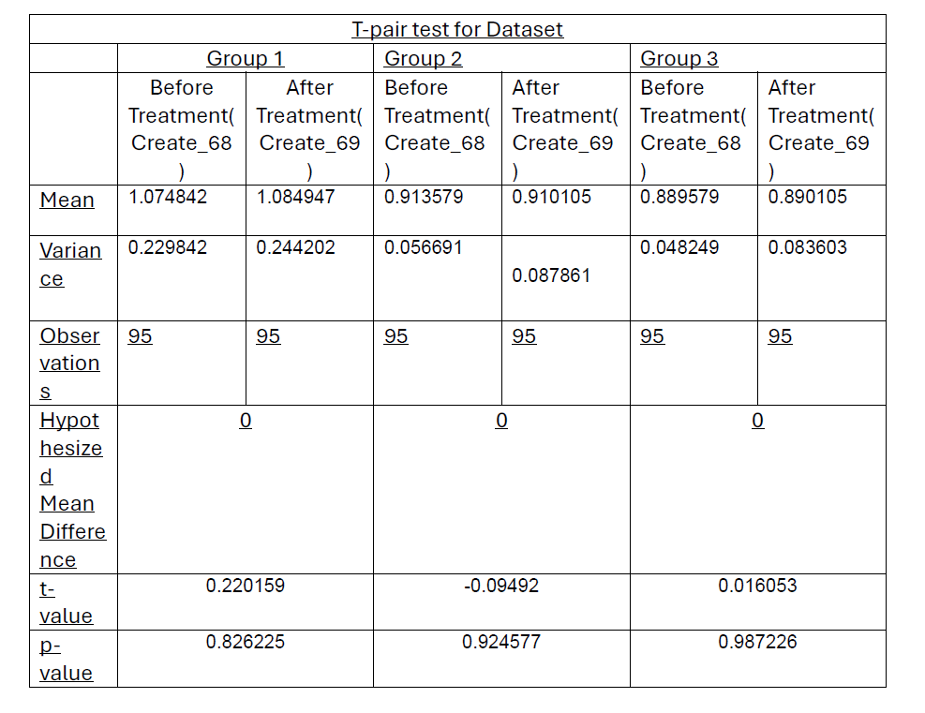
Hypothesis Testing
Image : T-Pair Test For Dataset

Slide 8
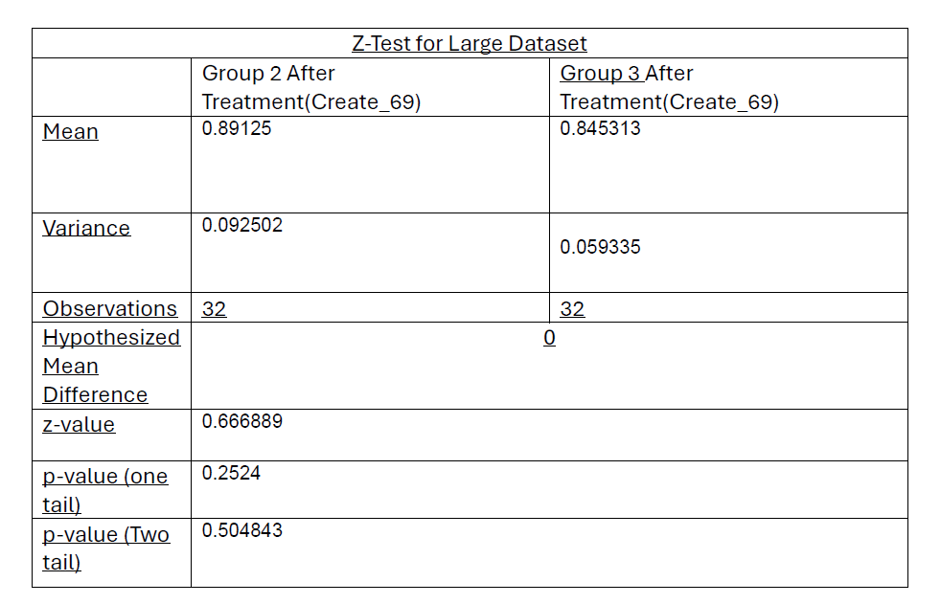
Large Dataset Hypothesis Testing
Image : Z-Test

Slide 9
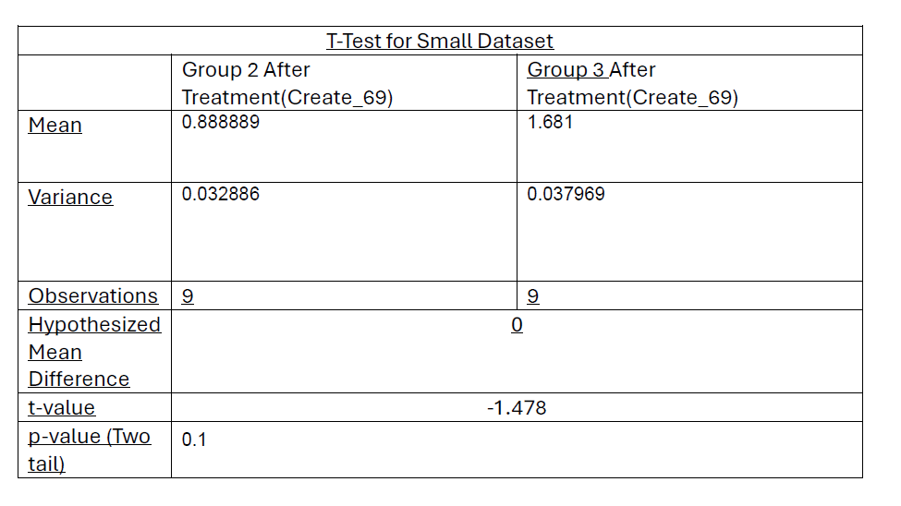
Small Dataset Hypothesis Testing
Image : T-Test

Slide 10
Co-relation Analysis
Group 1
r=0.577
P=1.78
Group 2
r=0.124
P=0.232
Group 3
r=0.296
P=0.0036

Slide 11
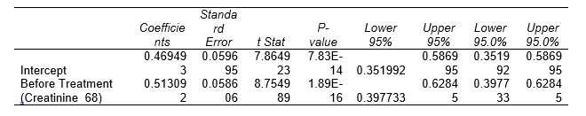
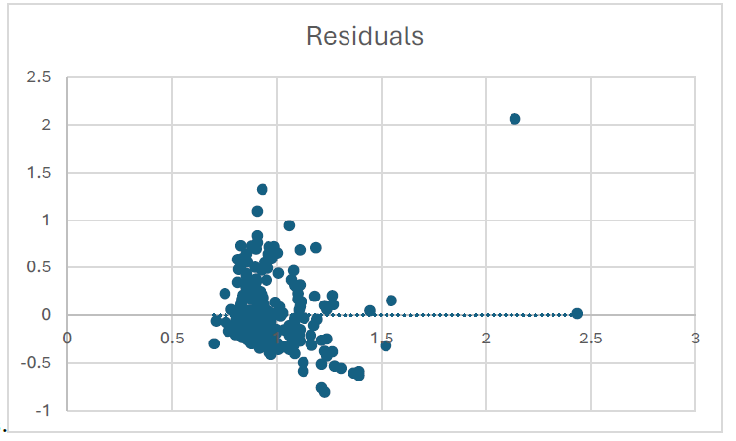
Linear Regression and Goodness of Fit
Y=constant+ B1*X
Or, Y= 0.469493+ 0.513092X

Slide 12
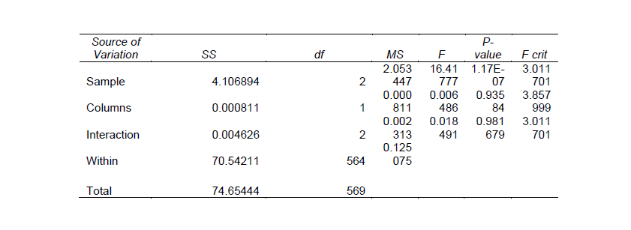
ANOVA Table

Slide 13
Conclusion
Significant difference in mean creatinine levels between the groups (severity of impairment).
No significant difference in mean creatinine levels between the time points (before and after treatment).
No significant interaction between the severity of impairment and the time point.
The Drug has no effect.

Slide 14


