Slide 1
Walmart Demand Forecasting
Dr. Z. Lasmar

Slide 2
Plan
Introduction
What is the M5 dataset?
Daily sales of 30k items and12 levels of aggregation
The .csv files
Metrics: RMSE and WRMSSE
Baseline: LightGBM
Feature engineering
Hyperparameter optimization using optuna and cross-validation
Model training
Challenger: N-BEATSx
Feature engineering
Cross validation using different loss functions
Model training
Results: N-BEATSx wins
Back-of-the-Envelope ROI & Business Impact (Illustrative)

Slide 3
Part I - Introduction

Slide 4
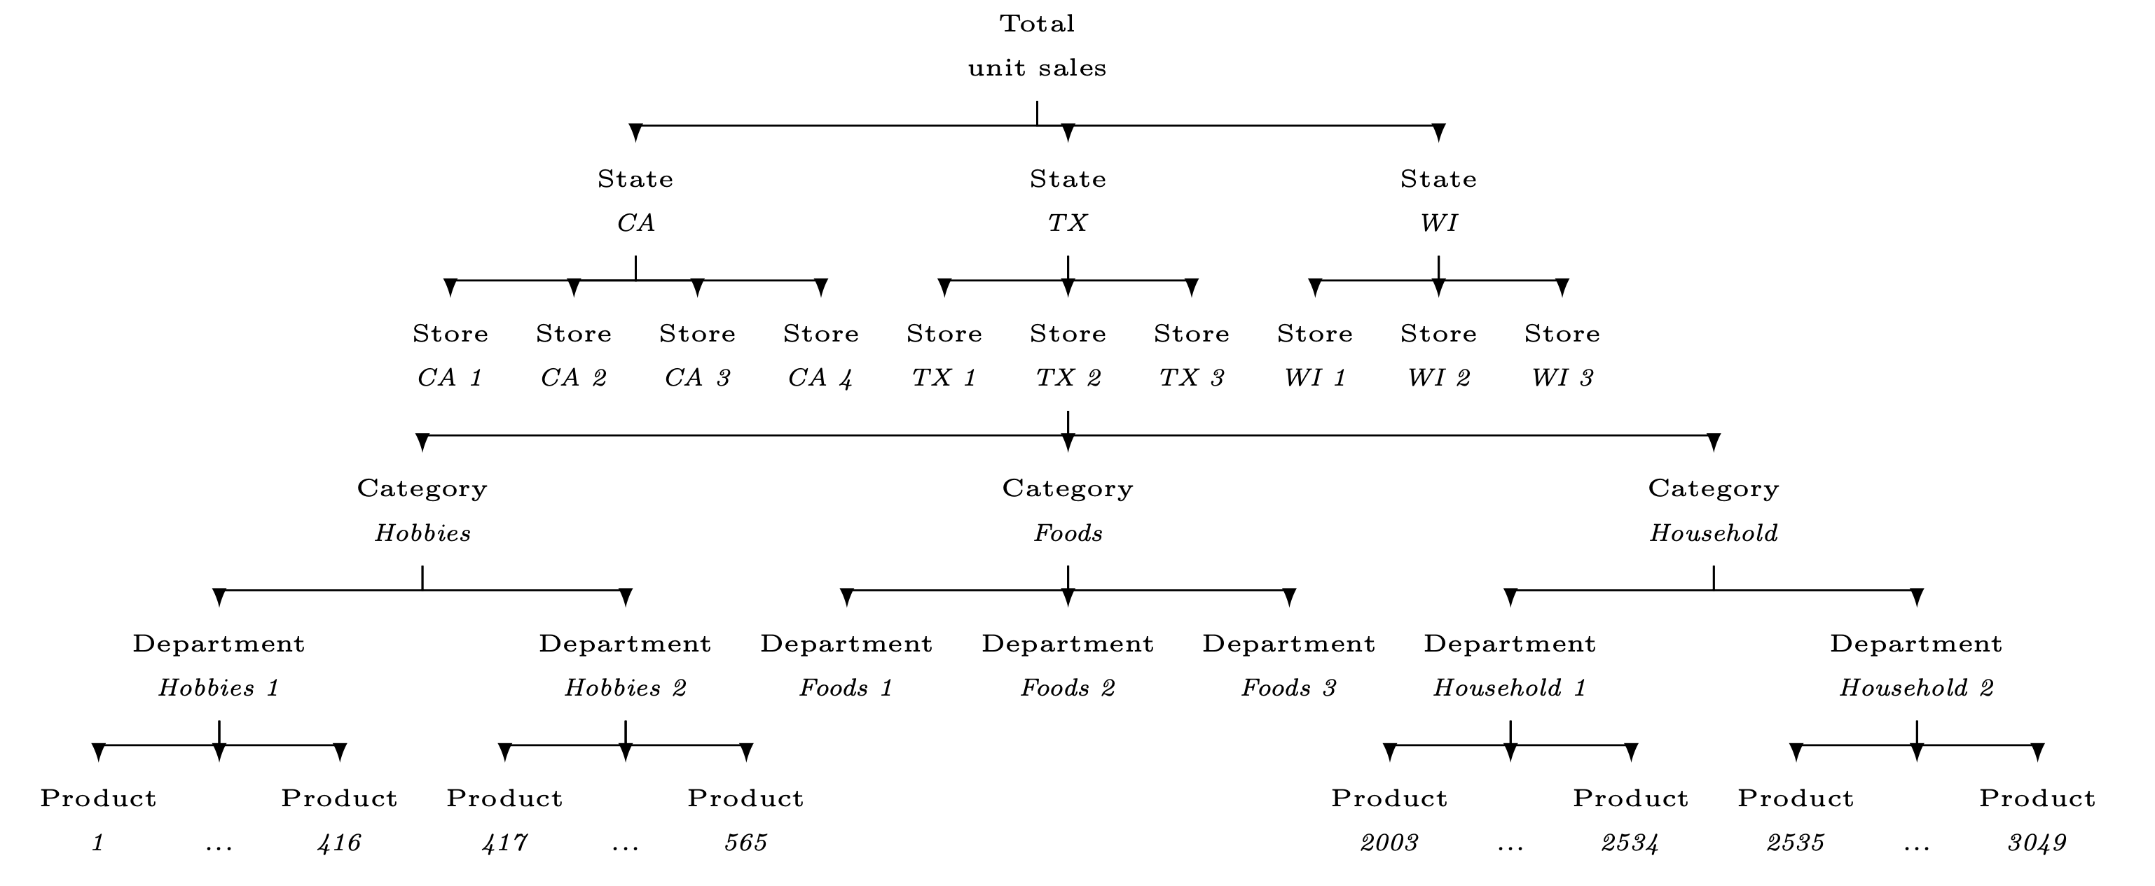
Introduction: What is the M5 dataset?
The M5 dataset, generously made available by Walmart, involves the unit sales of various products sold in the USA, organized in the form of grouped time series.
The dataset involves the unit sales of 3,049 products:
Classified in 3 product categories (Hobbies, Foods, and Household)
7 product departments in which the above-mentioned categories are disaggregated
The products are sold across 10 stores, located in 3 States (CA, TX, and WI)
The most disaggregated data, i.e., product-store unit sales, can be grouped based on either location (store and state) or product-related information (department and category)

Slide 5
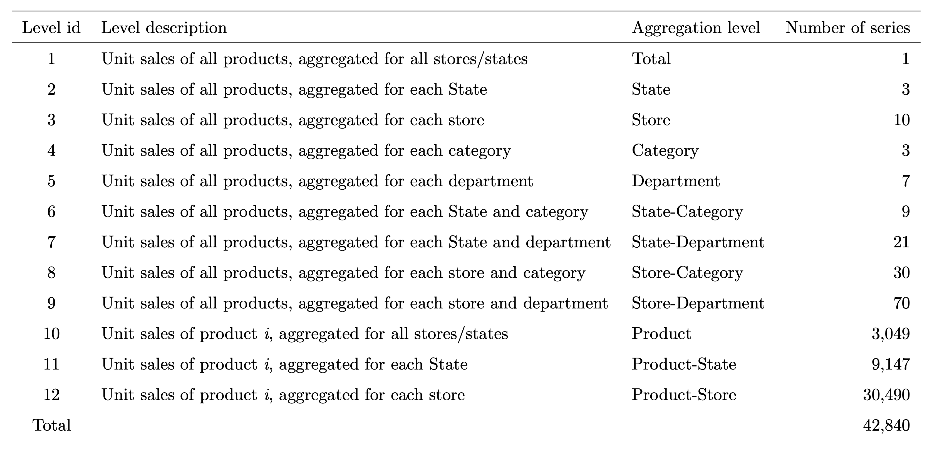
Introduction: What is the M5 dataset?
The M5 dataset, generously made available by Walmart, involves the unit sales of various products sold in the USA, organized in the form of grouped time series.
The dataset involves the unit sales of 3,049 products:
Classified in 3 product categories (Hobbies, Foods, and Household)
7 product departments in which the above-mentioned categories are disaggregated
The products are sold across 10 stores, located in 3 States (CA, TX, and WI)
The most disaggregated data, i.e., product-store unit sales, can be grouped based on either location (store and state) or product-related information (department and category)
In this project, I will build models to predict sales at level 12

Slide 6
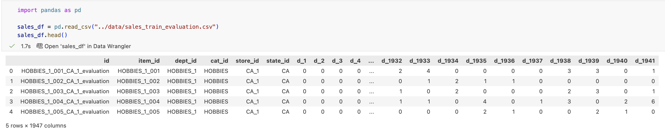
Introduction: The .csv files
The “sales_train_evaluation.csv” file contains the sales of each unique item
The column ‘id’ specifies a “unique id” for each item in this dataset
The columns ‘item_id’ to ‘state_id’ contain information about each item
The same item could be sold at different stores and/or different states
The columns ‘d_1’ to ‘d_1941’ contain information about the unit sales of each item

Slide 7
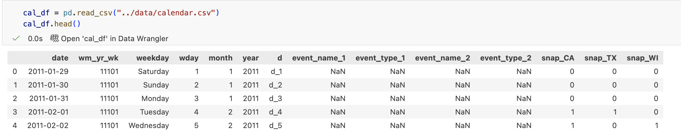
Introduction: The .csv files
The “calendar.csv” file contains:
The corresponding timestamps (e.g., date, weekday, week number, month, and year)
Special events and holidays (e.g. Super Bowl, Valentine’s Day, and Orthodox Easter), organized into four classes, namely Sporting, Cultural, National, and Religious.
SNAP activities that serve as promotions
The United States federal government provides a nutrition assistance benefit called the Supplement Nutrition Assistance Program (SNAP)
This is a binary variable (0 or 1) indicating whether the stores of CA, TX or WI allow SNAP purchases on the date examined
1 indicates that SNAP purchases are allowed

Slide 8
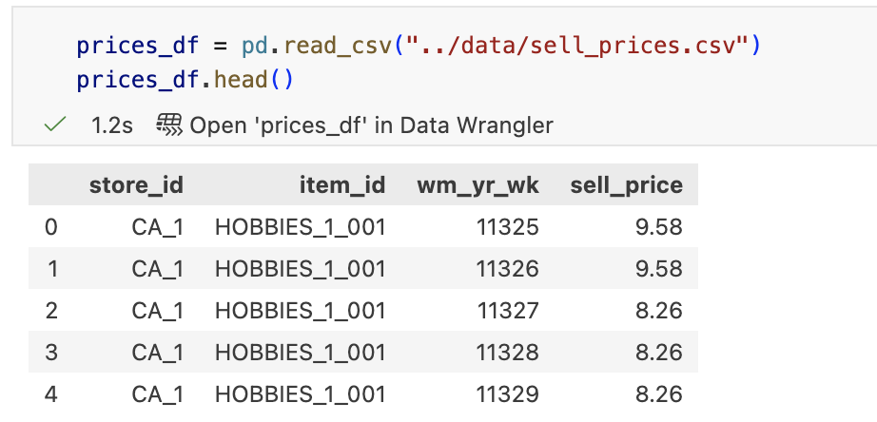
Introduction: The .csv files
The “sell_prices.csv” file contains selling prices, provided on a week-store level (average across seven days).
If not available, this means that the product was not sold during the week examined.
Although prices are constant on a weekly basis, they may change with time

Slide 9
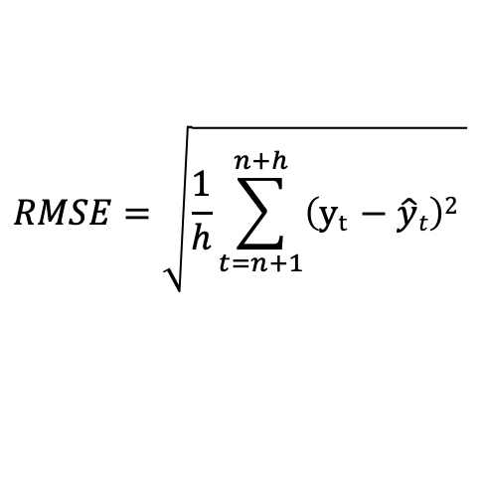
Metrics: RMSE and WRMSSE
Root Mean Square Error (RMSE) is a standard metric used to measure the average difference between predicted values from a model and the actual, observed values.
It represents the standard deviation of the residuals (prediction errors), with lower values indicating better model fit and higher precision.
It is calculated by taking the square root of the average of squared differences between prediction and truth.
See next slide for definitions of each variable
$$RMSE=\sqrt{\frac{1}{h}\sum_{t=n+1}^{n+h}{\left(\text{y}\text{t} −\hat{y}t\right)2 }}$$

Slide 10
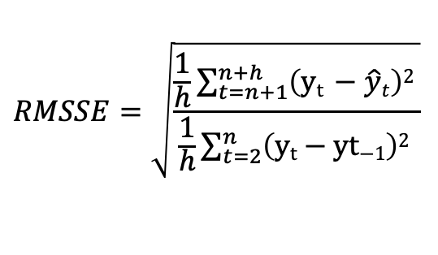
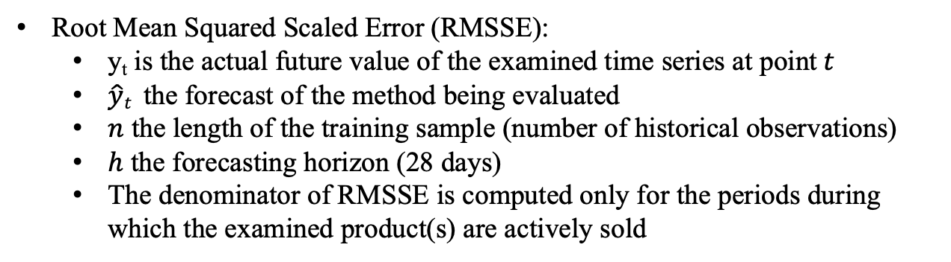
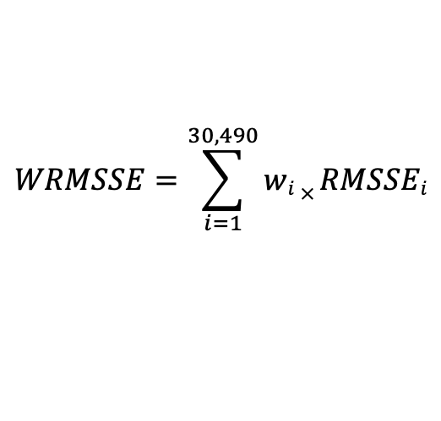
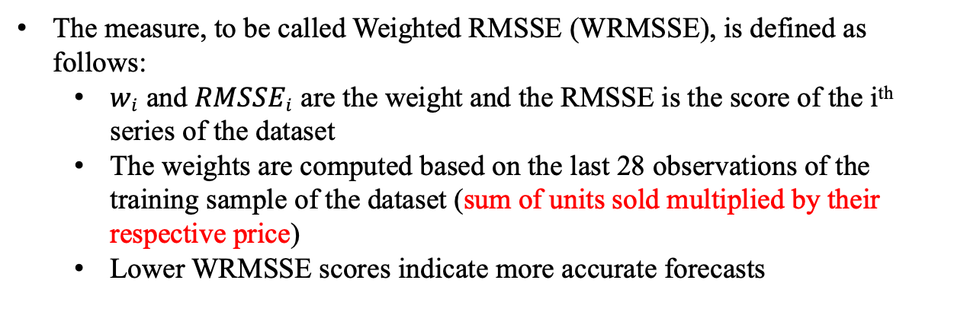
Metrics: RMSE and WRMSSE
Root Mean Squared Scaled Error (RMSSE):
y_{t} is the actual future value of the examined time series at point$t$
$\hat{y}t$ the forecast of the method being evaluated
$n$ the length of the training sample (number of historical observations)
$h$ the forecasting horizon (28 days)
The denominator of RMSSE is computed only for the periods during which the examined product(s) are actively sold
$$RMSSE=\sqrt{\frac{\frac{1}{h}\sum_{t=n+1}^{n+h}{\left(\text{y}\text{t} −\hat{y}t\right)2 }}{\frac{1}{h}\sum_{t=2}^{n}{\left(\text{y}\text{t}\text{ − }\text{yt}\text{−1}\right)2 }}}$$
The measure, to be called Weighted RMSSE (WRMSSE), is defined as follows:
$wi \text{and} RMSSEi$are the weight and the RMSSE is the score of the i^{th} series of the dataset
The weights are computed based on the last 28 observations of the training sample of the dataset (sum of units sold multiplied by their respective price)
Lower WRMSSE scores indicate more accurate forecasts
$$WRMSSE=\sum_{i=1}^{30,490}{wi × RMSSEi}$$

Slide 11
Part II – The baseline Light Gradient Boosting Machine

Slide 12
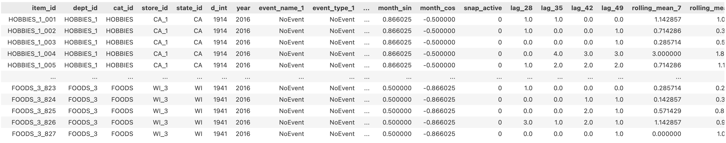
LightGBM - Feature engineering
Added cyclical sin/cos encoding for days of the week and for months and added the year as integers
Added a “snpa_active” column to replace the 3 column in the raw data (each series is linked to a specific state)
Added a “sell_price” column for each item and for each day and filled the NaNs with a “.ffill().bfill()”
Added an “is_available” column but it did not improve the model’s performance, so I dropped it.
Added lags of 28, 35, 42, and 49 days
Added rolling means of 7, 28, and 49 days
Added ‘d_int’ as the integer number of each day in each series
Added [‘event_name_1', 'event_type_1', 'event_name_2', 'event_type_2’ ] and filled the missing values with the string ‘NoEvent’.
Used ['id', 'item_id', 'dept_id', 'cat_id', 'store_id', 'state_id', 'snap_active', 'event_name_1', 'event_type_1', 'event_name_2', 'event_type_2'] as categorical features
Filtered out old data: only used the data between day 1200 and 1941

Slide 13
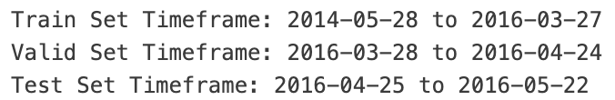
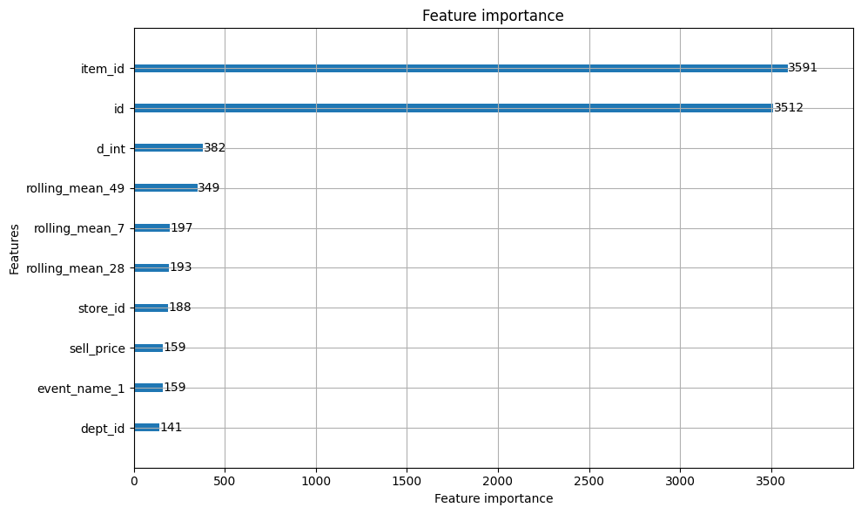
LightGBM - Hyperparameter optimization using optuna and training
The train/val/test split was as follows:
Only kept the data between day 1200 and 1941 (the older data was discarded)
Used the last horizon (28 days) as the test set
Used the penultimate horizon as the validation set
Used all remaining data as the training set
Ran an Optuna study (15 trials) to search for best hyperparameters
Used “tweedie” as objective and “RMSE” as metric
Optimized tweedie_variance_power and learning_rate
The study ran on combined train+val data
Sampled 10% of the combined data to speedup the study
Cross-validation over 3 folds
Trained the global LightGBM model
Used the best parameters identified in the study: {'tweedie_variance_power': 1.1030189277265174, 'learning_rate': 0.09596292009666046}
The resulting model had RMSE: 2.2209 WRMSSE: 0.8669

Slide 14
Part III – The challenger Neural Basis Expansion Analysis with exogenous variables

Slide 15
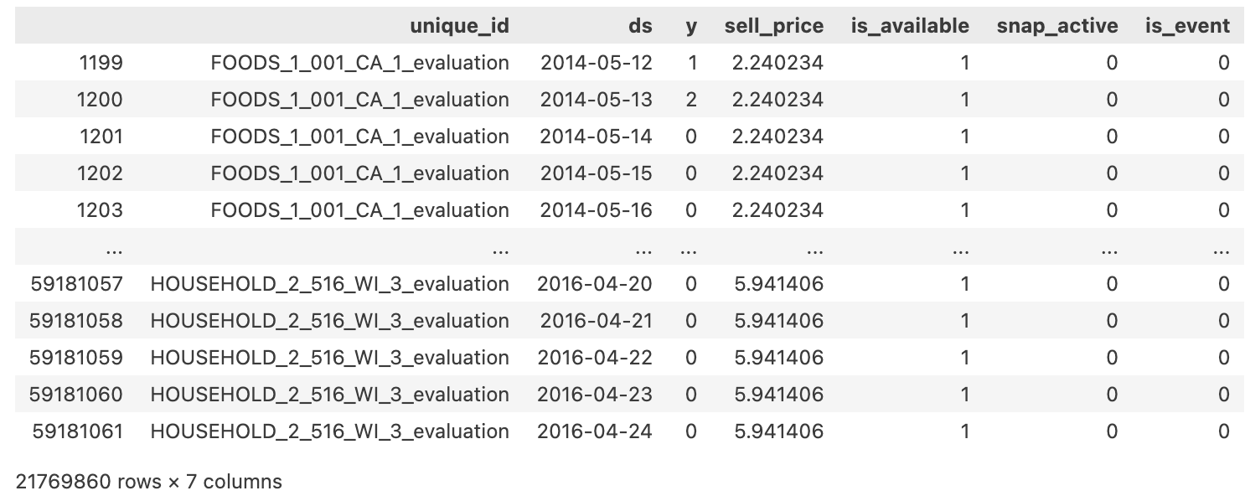
N-BEATSx - Feature engineering
Added a “snpa_active” column to replace the 3 columns in the raw data (each series is linked to a specific state)
Added a “sell_price” column for each item and for each day and replaced the missing values using a “.ffill().bfill()”
Added an “is_available” column where 1 means that the sell_price is real and 0 mean that it is a replacement for a missing value
Added an “is_event” column to where 0 means it is a normal day and 1 means it is a holiday
Filtered out old data: only used the data between day 1200 and 1941

Slide 16
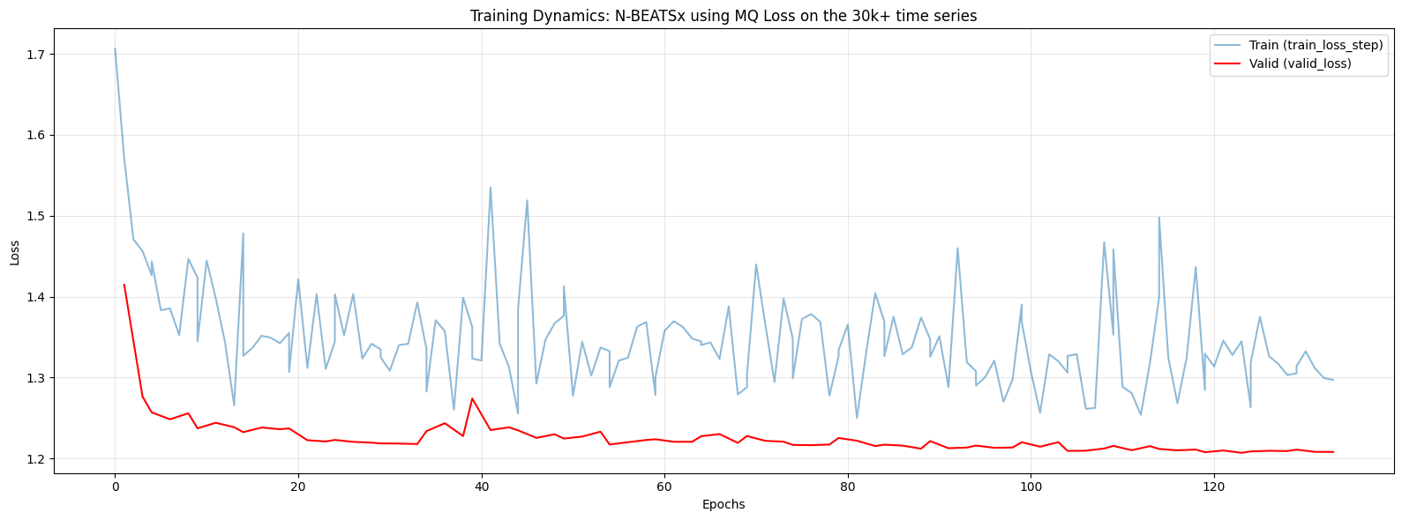
N-BEATSx - Model training
Used the NBEATSx class (from NeuralForecast)
As a loss function I used the MQ Loss with (0.5, 0.8 and 0.9) as the quantiles.
Input size: 370 days, Dropout: 0.2, Bach_size: 512, Accelerator: MPS
Learning rate was controlled using a cosine annealing scheduler (CosineAnnealingWarmRestarts)
{'T_0': 2000, 'T_mult': 4, 'eta_min': 1e-6}
Made a few attempts using “ReduceLROnPlateau”, but “CosineAnnealingWarmRestarts” yielded the best performing model
The train/val/test split was identical to the one used for the baseline (LightGBM)
The trained model achieved the metrics
RMSE: 2.1814
WRMSSE: 0.8568

Slide 17
Part IV – Results

Slide 18
Results: N-BEATSx wins
This study was done in two acts:
Used only the Food items from the Californian stores to train local model (to allow for faster iterations)
Used all 30k+ series to train a global model that make forecasts for the entire M5 dataset
In this presentation, I only cover the case of global models (Act 2)
Both acts are available on a dedicated GitHub repository [link]
A summary of the metrics for both acts is captured below:

Slide 19
Back-of-the-Envelope ROI & Business Impact (Illustrative)
Accuracy result (this evaluation protocol):
item‑level WRMSSE improved by ~1% from 0.8669 → 0.8568, alongside an RMSE improvement of ~1.8% from 2.2209 → 2.1814.
Revenue context (from M5 data):
Total revenue across all 10 stores for fiscal year 2015 is about $42.4M
Illustrative range (not a claim):
If a **1%** improvement in weighted accuracy translated into 0.5%–2.0% improvement in inventory efficiency on comparable operations, that corresponds to roughly $212k–$848k/year on this dataset’s revenue scale.
Extending this to a larger retailer (e.g., hundreds of stores) is directional only. A more defensible estimate would tie quantile forecasts to explicit service-level targets and simulate inventory policies.
Engineering ROI:
LightGBM’s performance depends on ongoing maintenance of lag/rolling features and calendar joins.
The global N‑BEATSx setup reduces that feature-engineering surface area, which can lower operational risk and iteration time in production.

Slide 20
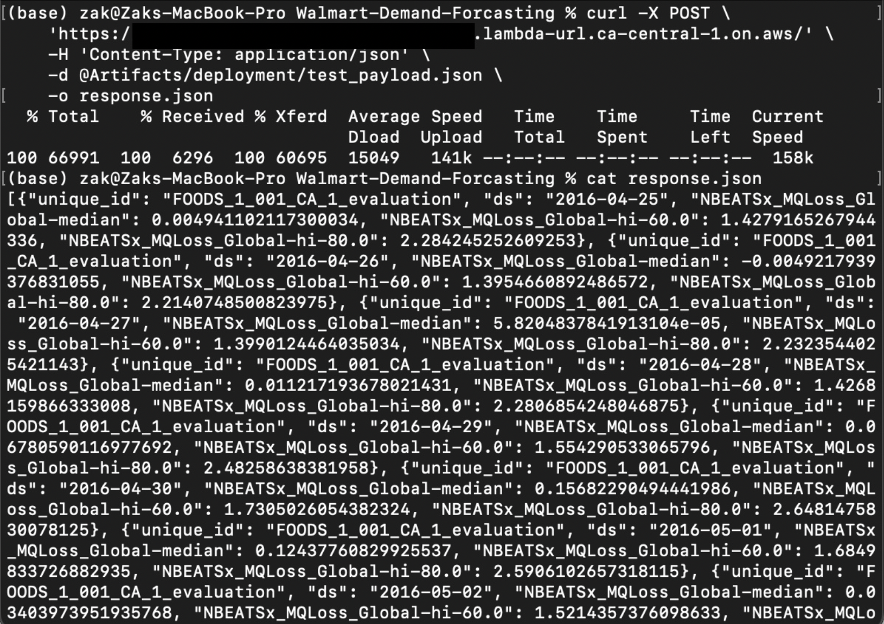
Deployment on AWS Lambda
Global N-BEATSx model deployed
Run Make prepare_deployment to generate deployment artifacts (history slice + future exogenous + sample payload)
Output: probabilistic forecasts of the selected item for the next 28 days
To invoke the deployed model run
curl -X POST \
'<INSERT_LAMBDA_URL>’ \
-H 'Content-Type: application/json’ \
-d @Artifacts/deployment/test_payload.json \
-o response.json
Lambda URL is available upon request

