Slide 1
The Unified Modeling Language CS350/SE310
Fall 2015

Slide 2
The Unified Modeling Language (UML)
A standard language for
specifying, visualizing, constructing, and documenting the artifacts of software systems,
business modeling and other non-software systems.
The UML represents
a collection of best engineering practices
that have proven successful in the modeling of large and complex systems.¹
The UML helps project teams
communicate, explore potential designs,
validate the architectural design of the software.

Slide 3
The UML Diagrams
Use Case Diagram
Class Diagram
Interaction Diagrams
Sequence Diagram
Collaboration Diagram
State Diagram
Activity Diagram
Physical Diagrams
Component Diagram
Deployment Diagram

Slide 4
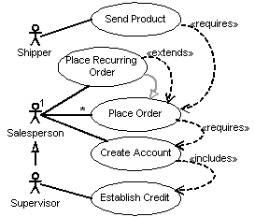
The Use Case Diagram
displays the relationship among actors and use cases.

Slide 5
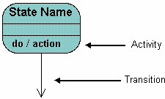
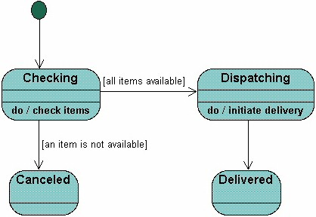
The State Diagram
displays the sequences of states that an object of an interaction goes through during its life in response to received stimuli, together with its responses and actions.

Slide 6
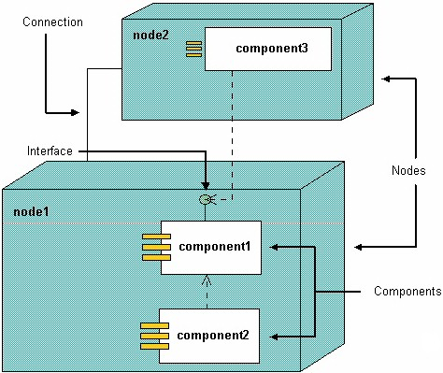
Physical Diagrams --The Component Diagram
displays the high level packaged structure of the code itself. Dependencies among components are shown, including source code components, binary code components, and executable components. Some components exist at compile time, at link time, at run times well as at more than one time.

Slide 7
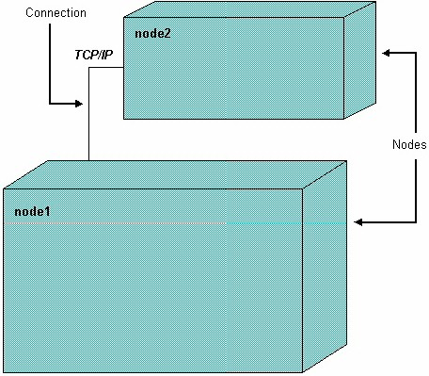
Physical Diagrams -- The Deployment Diagram
displays the configuration of run-time processing elements and the software components, processes, and objects that live on them. Software component instances represent run-time manifestations of code units.

Slide 8
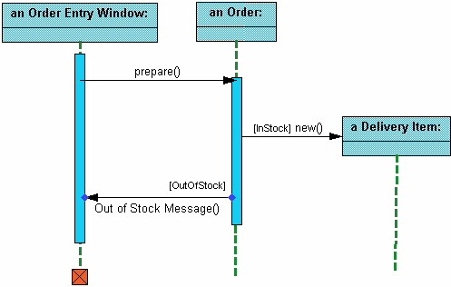
The Interaction Diagrams-Sequence Diagram
displays the time sequence of the objects participating in the interaction. This consists of the vertical dimension (time) and horizontal dimension (different objects).

Slide 9
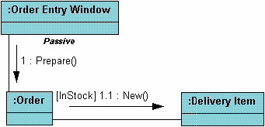
The Interaction Diagrams--The Collaboration Diagram
displays an interaction organized around the objects and their links to one another. Numbers are used to show the sequence of messages.

Slide 10


Class Diagram

Slide 11

The Class Diagram –A Class
models class structure and contents using design elements such as classes, packages and objects. It also displays relationships such as containment, inheritance, associations and others.
Class Name
Attributes
Operations

Slide 12


UML Class Relationships
B is derived from A
A generalizes B
B realizes the interfaces defined in A

Slide 13
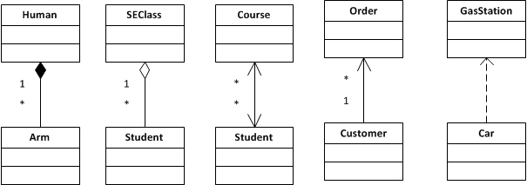
UML Class Relationships
Composition
Aggregation
Bi-Association
Uni-Association
Dependency

Slide 14
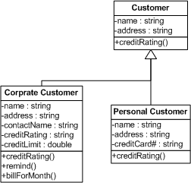
The Class Diagram – Implementation Inheritance (Generalize/Specialize)

Slide 15

The Class Diagram – Interface Inheritance (Specifies/Redefines/Realizes)

Slide 16
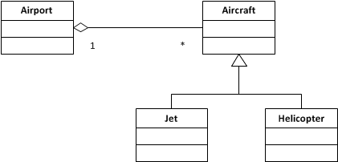
UML Class Diagram

Slide 17
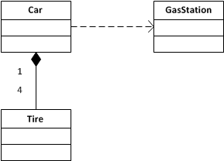
UML Class Diagram

Slide 18
The Maze Game UML

Slide 19
UML Tools
Proprietary
Rational Rose
Visio
OmniGraffle
Open Source
Dia (http://live.gnome.org/Dia)
Eclipse MDT UML2 (http://www.eclipse.org/modeling/mdt/downloads/?project=uml2)
BOUML (http://bouml.free.fr)
ArgoUML (http://argouml.tigris.org)

Slide 20
References
UML Distilled by Martin Fowler
http://www.holub.com/goodies/uml

