Slide 1


Crime and Socioeconomics Indicators
By:
Abdelrahman Walid 196643
Adam Elhefnawy 193183
Mohamed Fawzy 194379

Slide 2
Problem statement
Chicago is one of the most known cities in USA, but also the most city known by the high crime rate in it.
We decided to analyze the crime and socioeconomics of the city, to see what are the reasons to these crimes. Whether it was the population, the holidays and global pandemics, the economics of the city, or even the lights.
We visualized the output to help deliver the information we discovered.

Slide 3
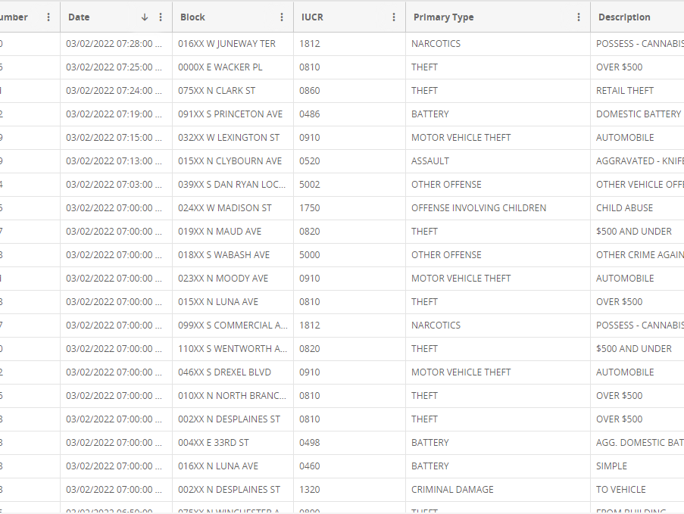
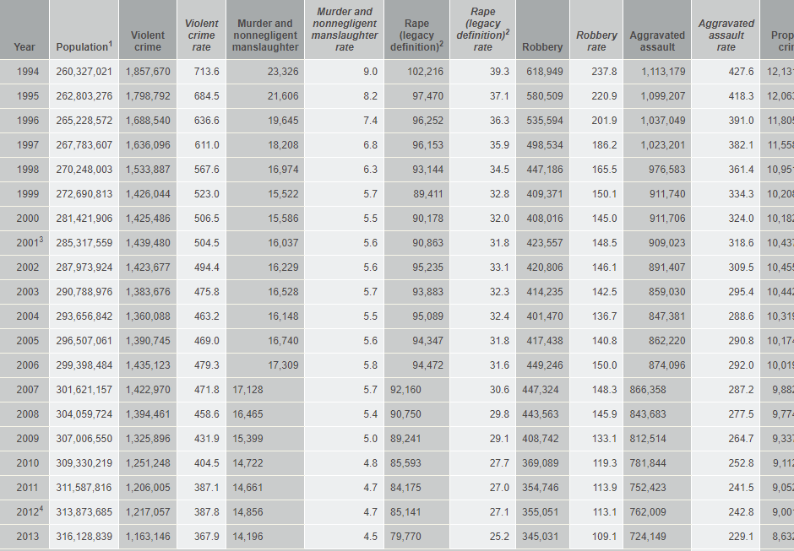
The Data-phase one
The first dataset represents crimes that happened in Chicago from 2001 till now. Our is from the Chicago police department and it consists of about 7.5 million records.
The second dataset includes the crime rates from 1994 to 2013.

Slide 4
Data Cleaning-Phase ONE
The first dataset had a lot of rows 7.5 million to be specific so the first thing we did was dropping the nulls.
We used the LOC function to choose specific columns for each question to answer it.

Slide 5
The Questions-Phase ONE
What is the rate of change of crimes with respect to the population and the year?
What is the crime peak times and dates and does the holidays affect the crime rate?
Do the districts having a high arrest rate affect the rate of crime in the district?
Do the percentage of housing crowded get affected by the percentage of unemployment and does that affect the per capita income as well?

Slide 6
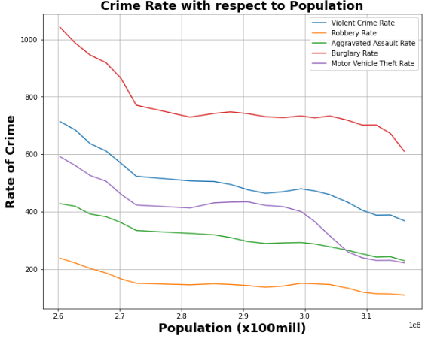
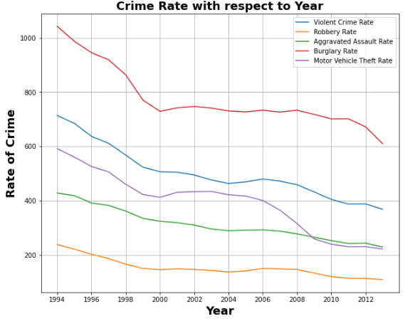
Visualization And analysis q1
Analysis of Q1 states that there is an inverse relationship between the rate of crimes and population from 1994 to 2000 as the crime rate was dropping and the population was rising. From 2000 to 2008 it is probably the same as 1994 to 2000 except for motor vehicle which increased so as years passed population rose and crime rates declined.

Slide 7
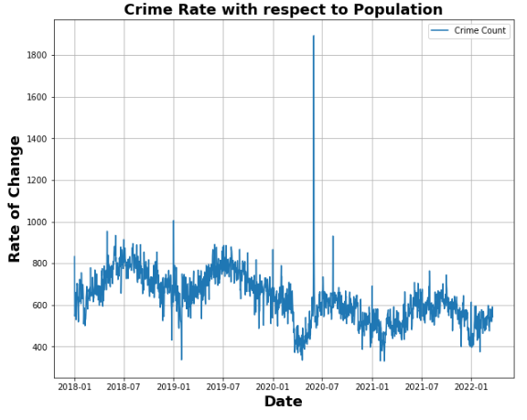
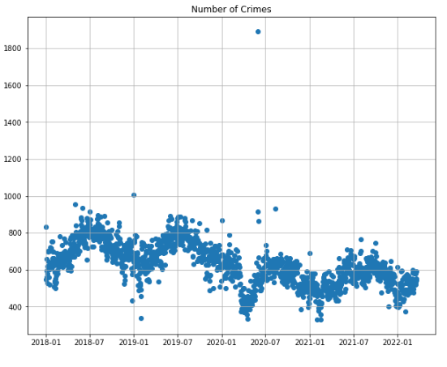
Visualization And analysis q2
In Q2 it was concluded that crime rates are greatly affected by the holidays.
There is an obvious peak on the new year's eve.
The average frequency of arrests is increased in the months of the summer vacation (from May to October).
There is a huge peak of arrests in May 2020, which is when the black lives matter protests happened.
Winter break also has an impact on the arrest rates, as there is a peak trend in February of every year.

Slide 8
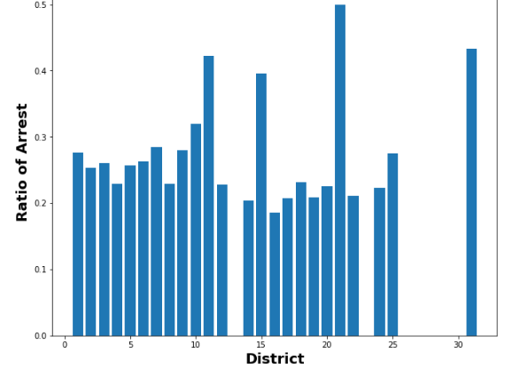
Visualization And analysis q3
It was discovered in Q3 that a low arrest rate does not always mean the ratio of crime to arrest is bigger also the crime rate does not have to impacted by the high arrest rate.
In District 8, which has the highest number of arrests overall, has lower number of crimes than about 5 other districts. While having one of the lowest crimes to arrest ratio (The lower the better), especially in the first 15 district.
On the other hand, district 20 has the lowest number of arrest and the lowest number of crimes, but a low ratio of crimes to arrest which indicates a good police department and a safe neighborhood with little to no crimes.
While there are exceptions like district 11 which has all three of high arrest numbers, high crime number and high crime to arrest ratio. Which may indicate that this district has a high arrest number indicating a good police department as well but a dangerous neighborhood.
While there is a trend of having a low arrest rate tend to give a better ratio of crime to arrest, there are some exceptions where a district might have a high arrest rate but a low ratio as in district 8.

Slide 9
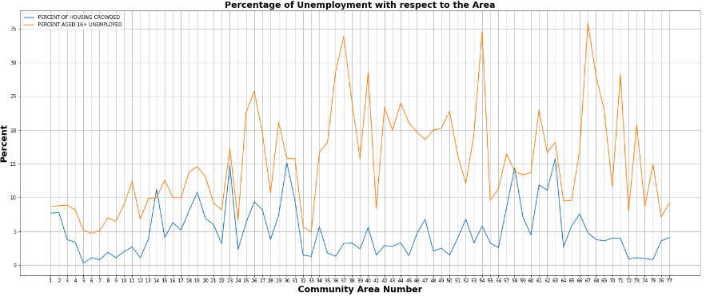
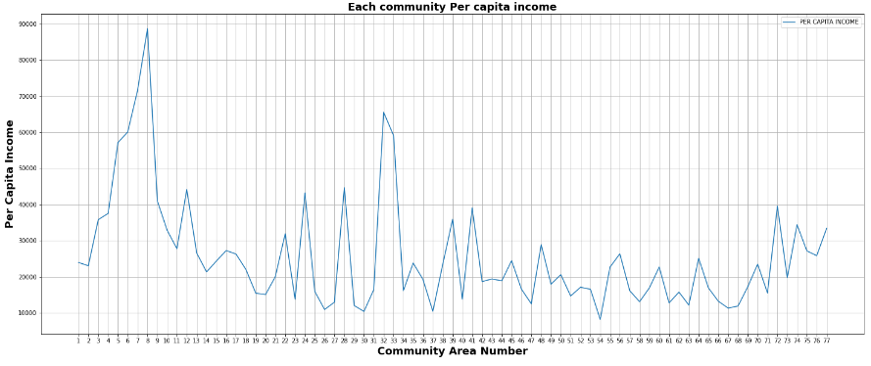
Visualization And analysis q4
Q4 shows that there is a positive relationship between the percentage of housing crowded and unemployment except for three districts while the per capita income has an inverse relationship between it and the housing crowded and unemployment rates.
In the first graph both lines of unemployment and housing crowded are nearly identical, in the peaks and the lowest points, with a strange exception of the districts 50, 51, 52, where they have a high unemployment rate and has a decreasing line, but unlike the remaining 77 district, they have a low housing crowded rate but an escalating line, which means that they have an inverse relation. The second graph indicates that as the unemployment rate is low the per capita income is high, as in district 8, which has the highest per capita income, has a low unemployment and housing crowded rate. While district 54 which has the lowest per capita income has the highest unemployment rate.
Percentage of housing crowded gets affected identically as the unemployment, except for the exception of districts 50, 51, and 52. While the per capita income is nearly the exact inverse of the housing crowded and unemployment rates.

Slide 10

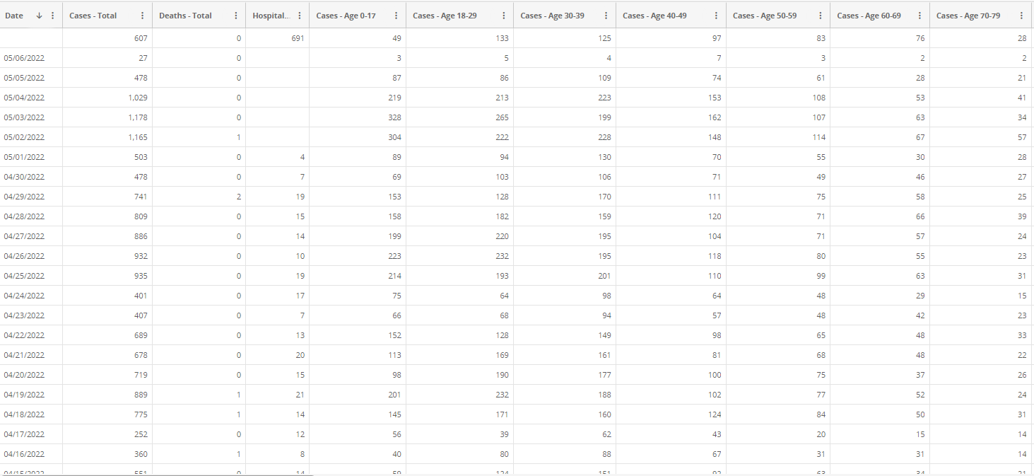
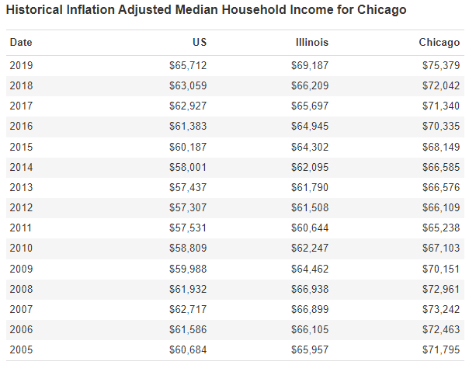
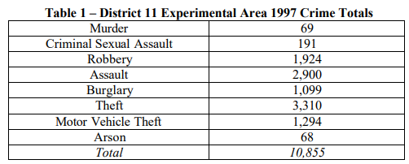
The data-phase two
The first dataset represents the number of daily COVID-19 cases in Chicago and some other details as the age and ethnicity.
The second dataset represents the average income for Chicago by the year.
The third dataset is the number of crimes in both districts that have lights and the other that does not.

Slide 11
Data Scraping-Phase TWO
We scraped the data from three different types of files HTML, JSON, and PDF.
We had to look up google on how to scrap the data using the PDF file and JSON.
We used “read_html” function to retrieve the html page and request the data. Then we searched for the table in the html page, and then saved it in a dataframe.
In the JSON scrapping we had to request the JSON link, then converted it to html, then we saved it in a dataframe.
In the pdf file we had to read the file, convert it to an excel file and then read the excel file to save the data in a dataframe.

Slide 12
The Questions-Phase TWO
Does Crime differ between Districts that have more Light than the ones that do not have Lights?
Does the days with high COVID-19 cases have an impact on the crime rate?
Is there a relation between the average income in Chicago and the crime rate?

Slide 13
Data Cleaning –Phase TWO
We dropped an unnecessary column from the table we got from HTML.
We merged the table we got from JSON and the data frame from question 2 in phase one.
We dropped the rows that contained nulls in the merged data frame then dropped some unneeded columns.
We merged the table we received from HTML and the data frame from question 1 in phase 1.
We dropped the rows that contained nulls in the merged data frame.
We added a new column(Crime Rate) to the data frame that equals the mean of specific columns we chose using loc then we dropped those columns as they have no use for us now.

Slide 14
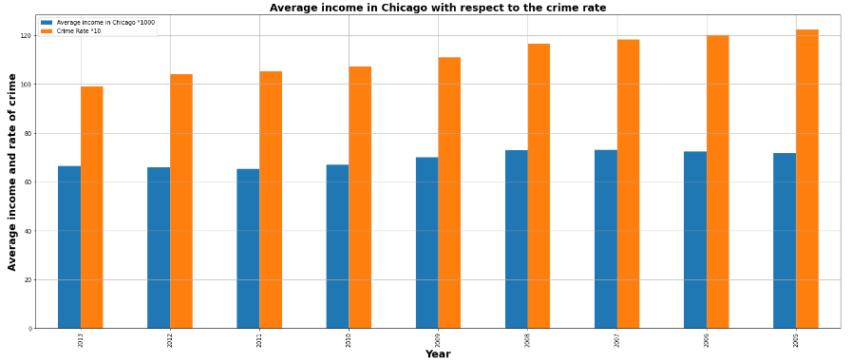
Visualization And analysis q5
From Q5 it seems that there is no link between crime rates and the average income.
We can find that the crime rate is constantly rising, while the average income declined at first and then increased but declined again at the end.

Slide 15
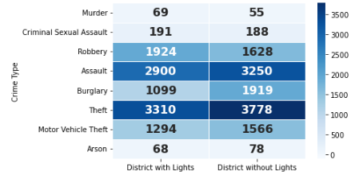
Visualization And analysis q6
It was concluded in Q6 that crimes are bigger in the districts that do not have lights while the crime assault being an exception.
It is observed that in the Murder, the SA, and Assault are slightly more in the District with Light.
While the difference between the two districts in the other crimes is well noticeable as the difference between each of the crimes is pretty large that it sometimes reaches around 900!

Slide 16
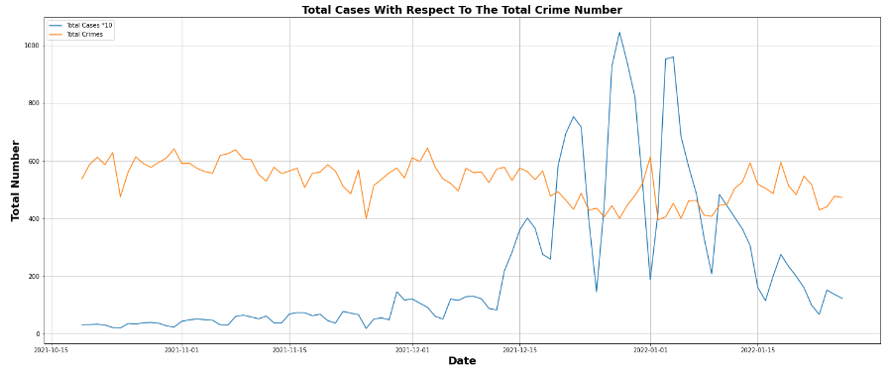
Visualization And analysis q7
It was found out in Q7 that most of the time COVID-19 and crime rate do not have a connection. Except on the COVID-19 peaks.
Most of the time COVID-19 does not have any effect on the crime rate, although on some days where COVID-19 peaks in numbers crime rate gets relatively low, and when COVID-19 gets extra low in number there are some occasions where the crime rate does get larger. But most of the time they have no relation.

Slide 17

Obstacles we faced
We did not find a suitable dataset for a question, so we had to change the question with another one.
While data scraping, we discovered that the URL did not show us the desired table that was shown on the website it turned out that the data we wanted was in a JSON file that is called very late.
We found out later by using google how to scrap the data using JSON files.
One of the problems that we encountered was that one of the tables was in a pdf file, so we had to search on google how to retrieve the table using the pdf file.

Slide 18
Thank you! Any questions?

