Slide 1
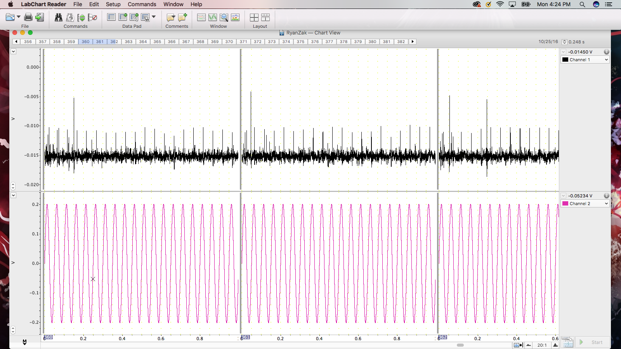
Neural Activity Response Modulated by 20Hz Sinusoidal Wave
Voltage (V)
Time(s)
Figure 1.a – Spike Train Response To 20Hz Stimuli.
This recording shows the elicited response of the cockroach afferent axon to a 20Hz stimulation. The spikes phase lock to the peak of each cycle.

Slide 2
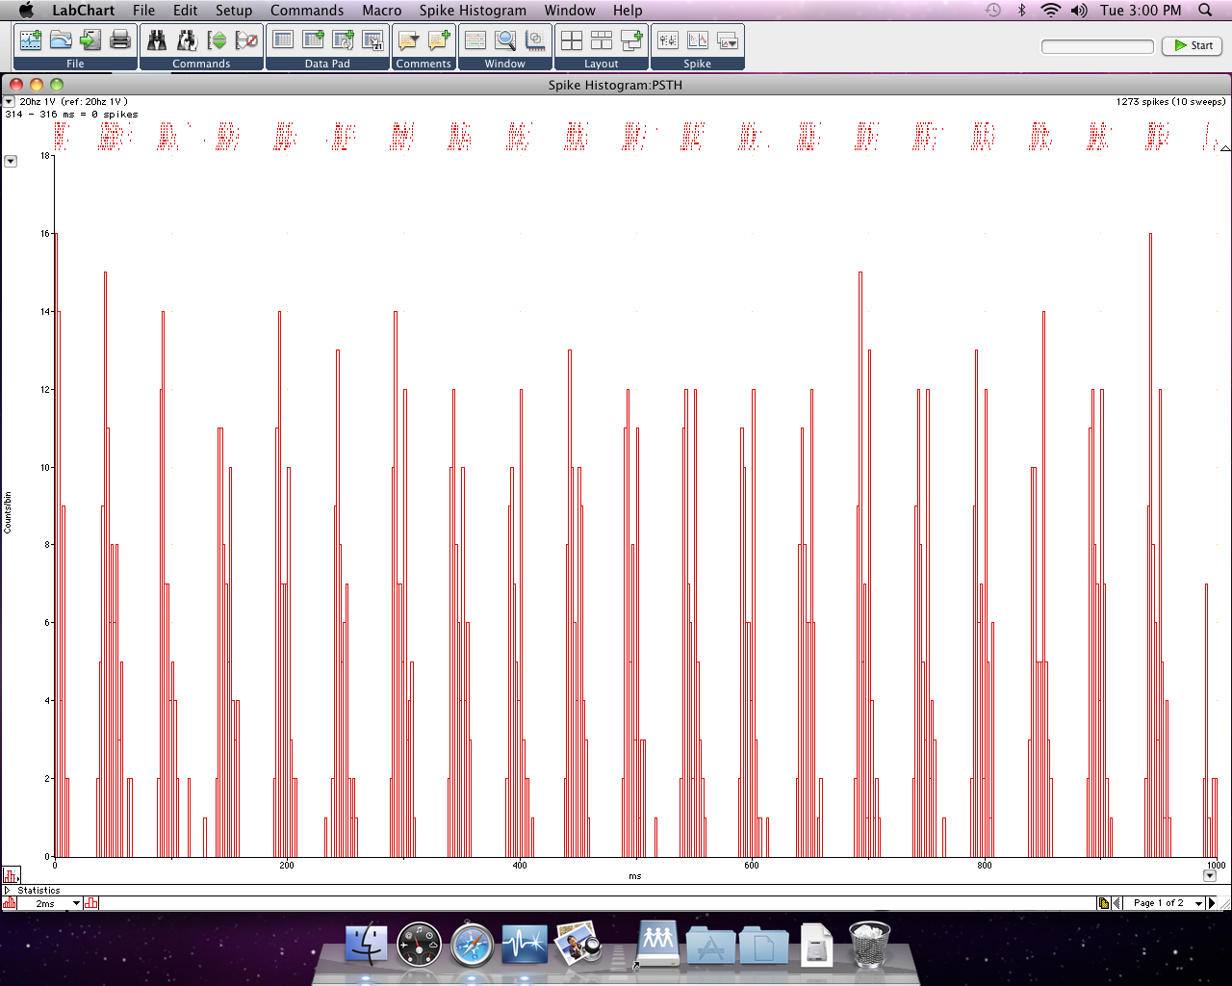
Raster Display and PSTH of Neural Response to Periodic 20 Hz Stimulation
Counts/Bin
Times (ms)
Figure 1.b – Neural Activity During 20Hz Stimulation.
This shows the average spikes divided into each bin, providing an estimate of spike rate as a function of time. The nerve was stimulated by a 20Hz stimulus and we see that about every 1/20th of a second a spike occurs consistently for each trial.

Slide 3
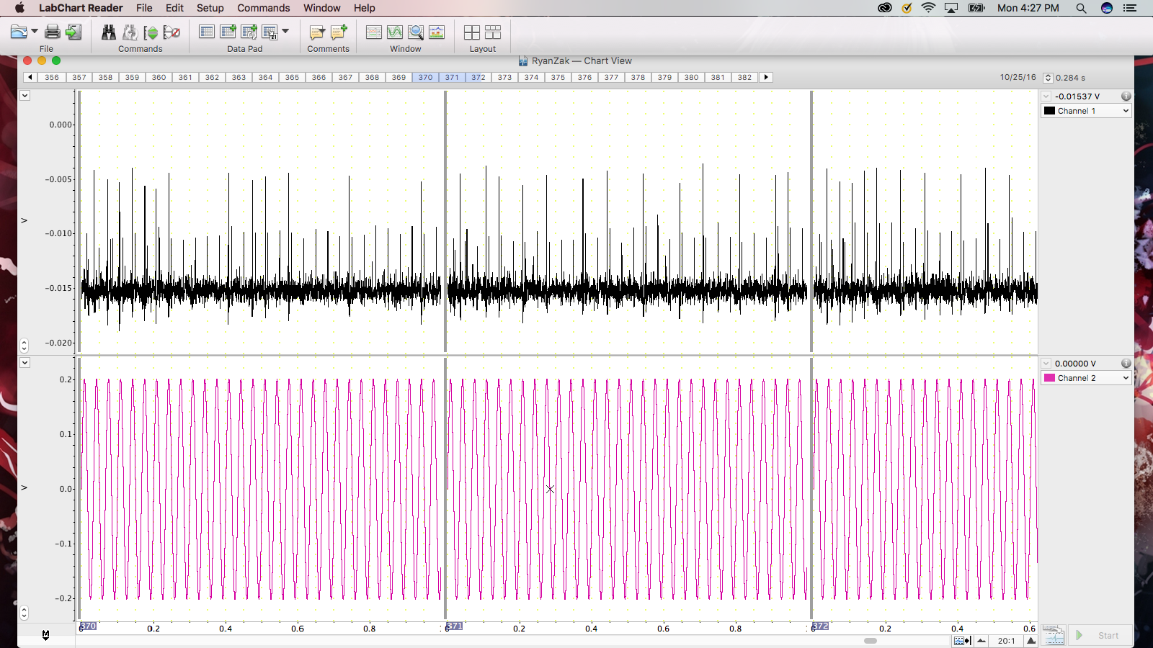
Neural Activity Response Modulated by 30Hz Sinusoidal Wave
Figure 2.a – Spike Train Response To 30Hz Stimuli. This recording shows the elicited response of the cockroach afferent axon to a 30Hz stimulation. There is responses coming from two nerves, one which spikes at an amplitude around the height of the orange line (approx. 0.005V), and another at an amplitude at the height of the the blue line (approx. 0.01V).
Voltage (V)
Time(s)

Slide 4
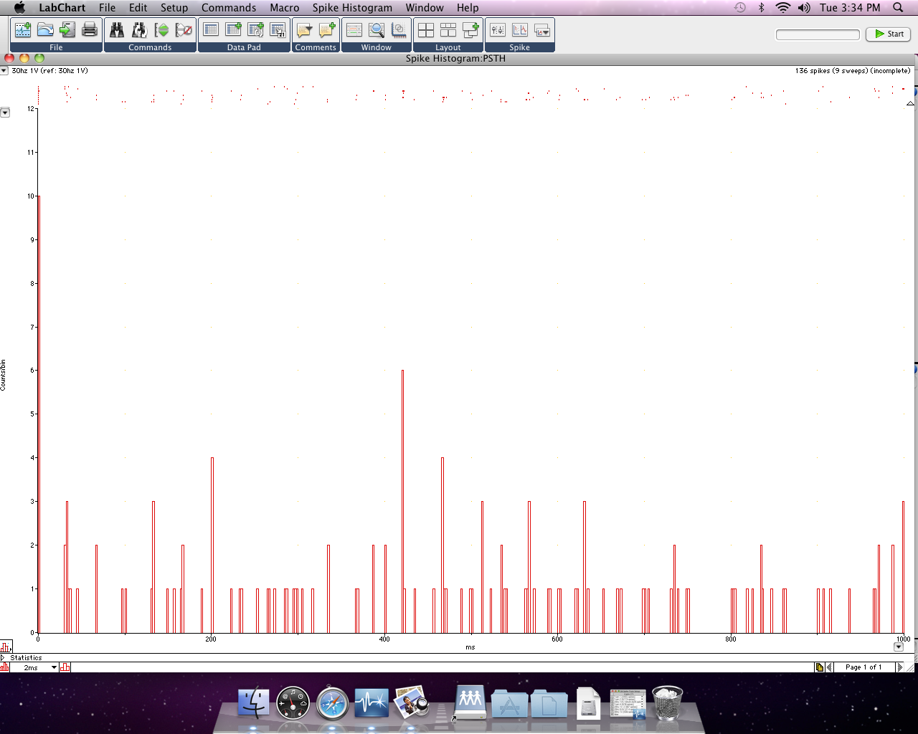
Raster Display and PSTH of Neural Response to Periodic 30 Hz Stimulation
Counts/Bin
Times (ms)
Figure 2.b – Neural Activity During 30Hz Stimulation.
This shows the average spikes divided into each bin, providing an estimate of spike rate as a function of time. The nerve was stimulated by a 30Hz stimulus and we see that the some spiking occurs inconsistently for the combined 10 trials. This means the responses are not consistently phase-locking to the cycles of the sinusoidal stimuli during each trial.

Slide 5
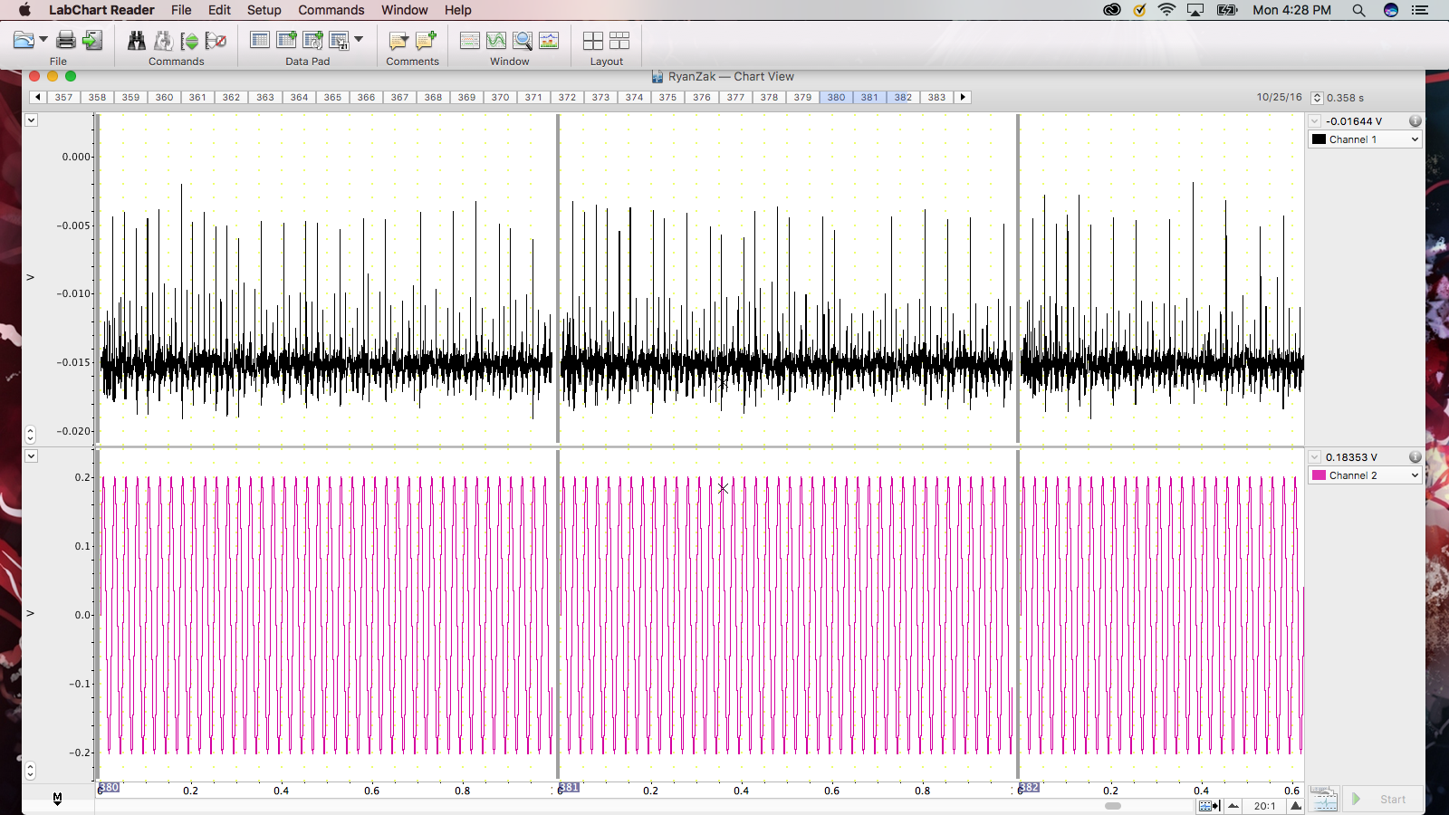
Neural Activity Response Modulated by 40Hz Sinusoidal Wave
Figure 3 – Spike Train Response To 40Hz Stimuli. This recording shows the elicited response of the cockroach afferent axon to a 40Hz stimulation. This shows two nerves spiking. The smaller spike (orange) is around 0.005V and the larger(blue) is around 0.01V.
Voltage (V)
Time(s)

Slide 6
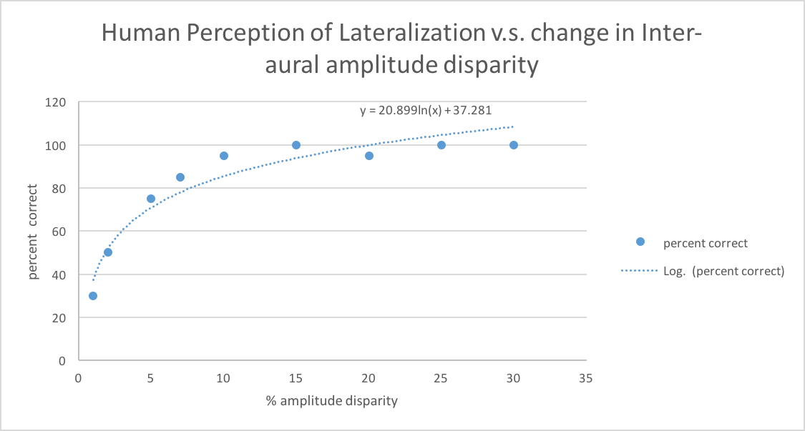
Figure 4 – Inter-Aural Amplitude Disparity Experiment, 600Hz Waveform.
This scatter plot shows how changing the % amplitude disparity effects the ability of a human to perceive sound lateralization.

