Slide 1
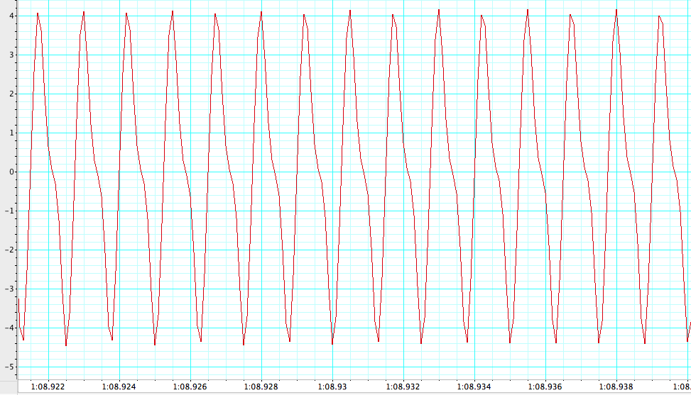
Electric Organ Discharge of Knifefish Resting-state Activity
Figure 1 – Resting State Activity
This recording shows the EOD frequency elicited from the knifefish. The duration of the positive phase (PP) of each wave is about 0.6 ms. The negative phase(NP) of each wave is about 0.7 ms.
PP
Voltage (mV)
NP
Time (s)

Slide 2
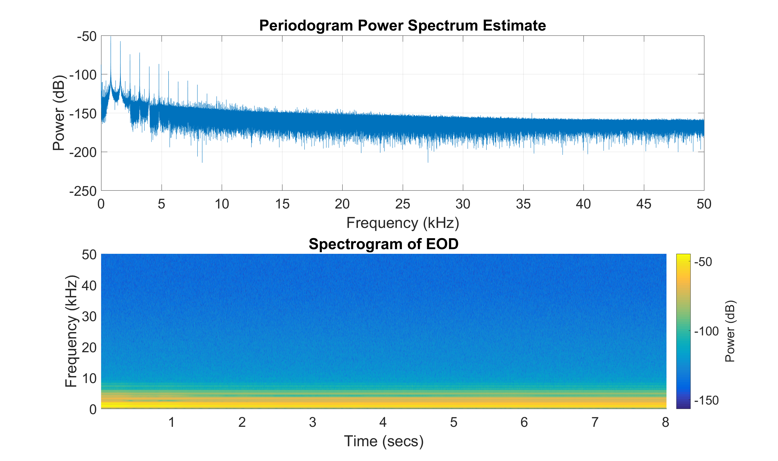
Figure 2 – Spectral View:
The Periodogram shows the power of the fish’s EOD signals based on the frequency of the waves. The first spike represents the fundamental, which is the lowest non-zero component, and is followed by harmonics.

Slide 3
Class Data Showing the Characteristics of Their Weakly Electric Fish
Section AC | (Hz) | (ms) | (ms)2 | (ms)3 | (cm)
 | EOD Freq | PP Dur | NP Dur | PP + ND | TL
Elliott + Graham | 976.5 | 0.625 | 0.4 | 1.025 | 9.5
Sara + Kris | 927.734 | 0.4 | 0.675 | 1.075 | 8
Julian + Justin | 905 | 0.465 | 0.475 | 0.94 | 8.5
Ryan + Zak | 859.375 | 0.608 | 0.568 | 1.176 | 7.5
Dorothy + Andrew | 820.31 | 0.45 | 0.788 | 1.238 | 7.5
Josie + Sarita | 800.78 | 0.6 | 0.7 | 1.3 | 7.5
Sarahi + Fernanda | 781.25 | 0.75 | 0.55 | 1.3 | 6.5
Average: | 867.2784286 | 0.556857143 | 0.593714286 | 1.150571429 | 7.857142857
Figure 3 – Characteristics of Each Fish.
This Data shows the Characteristics of each group’s
Specimen. It contains info about each fish’s EOD freq, the positive and negative portion duration of an individual EOD, and the total length of the fish. It also displays the class average of the cumulative data for each column.

Slide 4

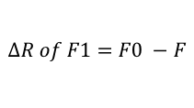
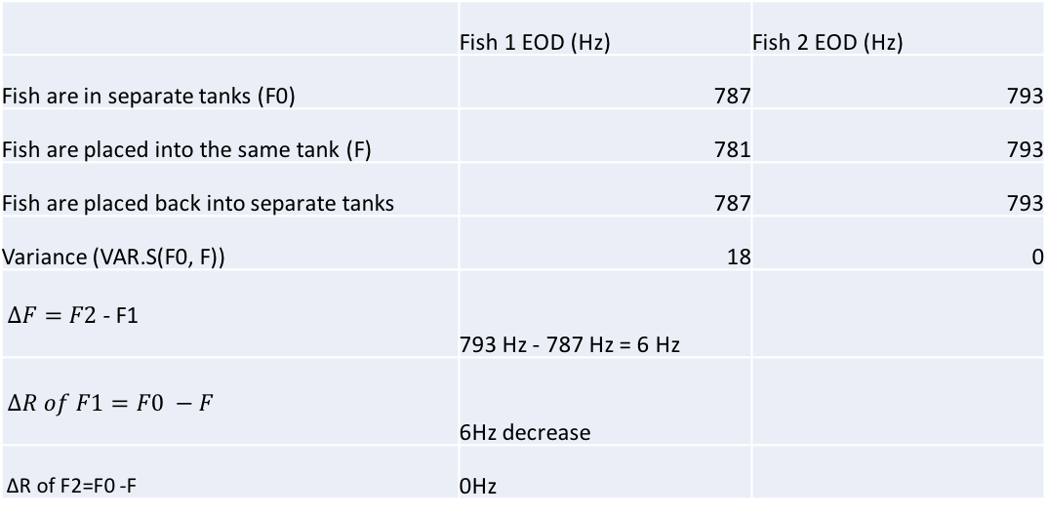
Sequence of Activity During Interaction Between Two Knifefish
 | Fish 1 EOD (Hz) | Fish 2 EOD (Hz)
Fish are in separate tanks (F0) | 787 | 793
Fish are placed into the same tank (F) | 781 | 793
Fish are placed back into separate tanks | 787 | 793
Variance (VAR.S(F0, F)) | 18 | 0
$∆F=F2$ - F1 | 793 Hz - 787 Hz = 6 Hz
$∆R of F1=F0 −F$ | 6Hz decrease
∆R of F2=F0 -F | 0Hz
Figure 4 – JAR Interaction Between Knifefish.
Data extrapolated from two knifefish showing the jamming avoidance response (JAR). Rows one – three show the shift in EOD frequency during interaction between the two fish. Rows four through seven show calculations used to analyze the interaction to determine which fish is dominant.
$∆F=F2$ - F1
$$∆R of F1=F0 −F$$

Slide 5
Figure 5– EOD vs Size Correlation.
This graph shows the correlation between the electric organ discharge frequency in relation to the height of each specimen studied by the class. The line of best fit is represented by the equation y = 69.519x + 321.06. and the r^2 correlation coefficient is 0.83252.

