Slide 1
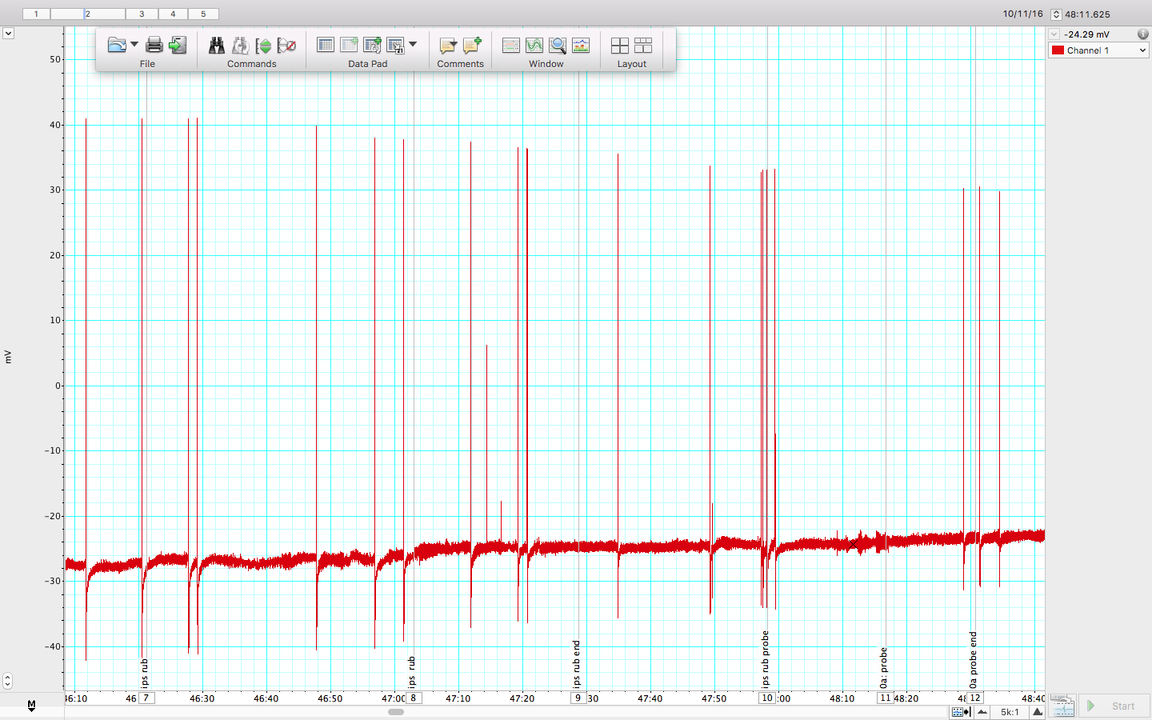
T-Type Neuronal Response From Physically Applied Force Throughout Leech Annuli
Voltage (mV)
4
5
1
2
3
6
Time (ms)
Figure 1 – Response of T-cell located ipsilateral and rostral in ganglia.
This recording shows the elicited response of the neuron at 6 different locations(depicted by arrows). Area 1 and 2 show the response of rubbing along the length of the ipsilateral wall, while applying a medium force; whereas, areas 3 through 6 show the application of a medium force to single points along the annuli.

Slide 2
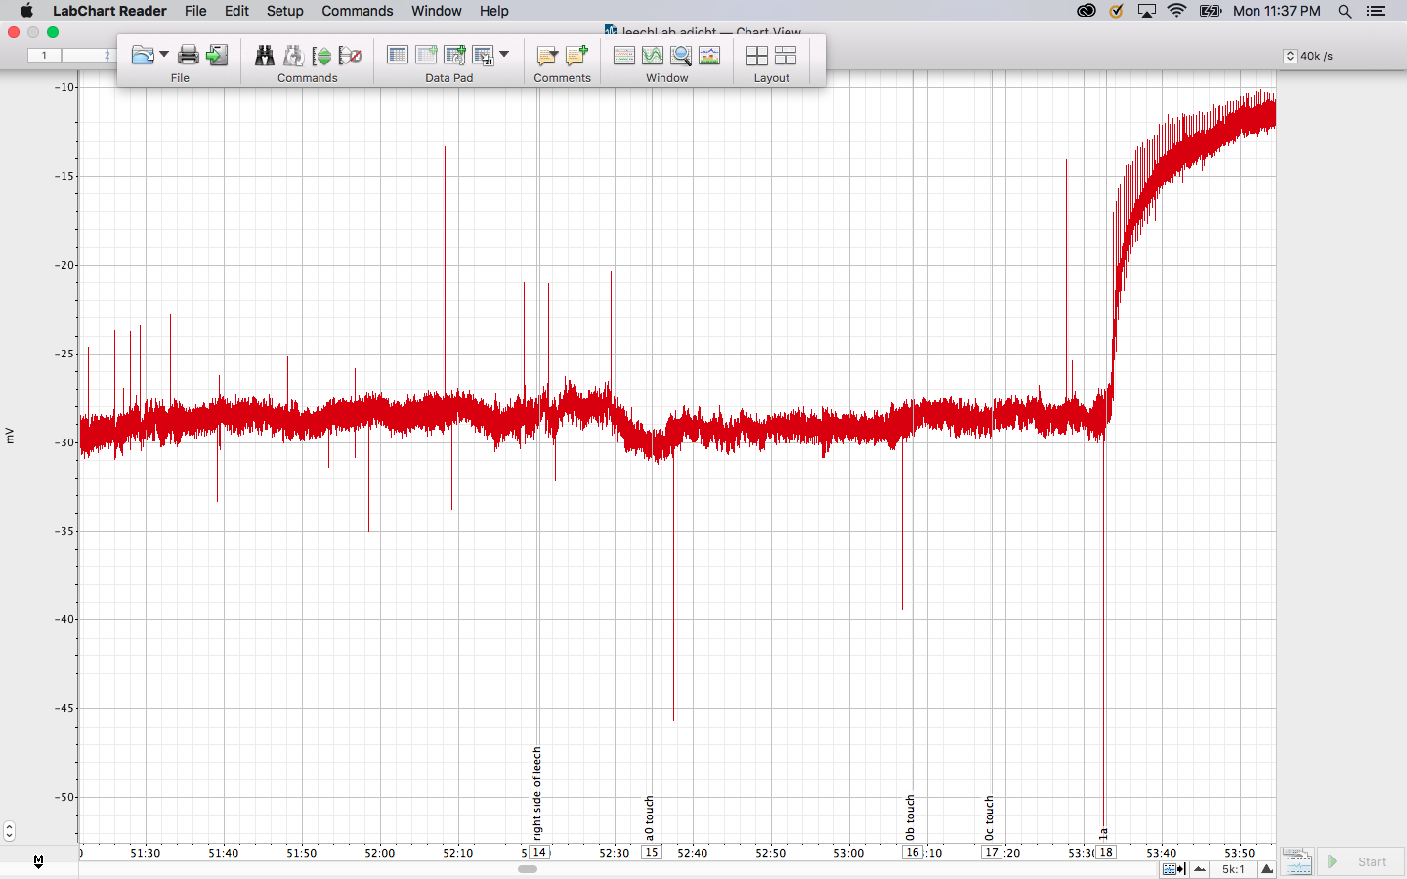
T-Type Neuronal Response From Physically Applied Force Throughout Leech Annuli
3
4
Voltage (mV)
1
2
Time (ms)
Figure 2 – Response of T-cell located contralateral and rostral in ganglia.
This recording shows the elicited response of the neuron at 4 different locations(depicted by arrows). Area 1 shows the response of rubbing along the length of the ipsilateral wall, while applying a medium force; whereas, areas 2 through 4 show the application of a medium force to single points along the annuli.

Slide 3
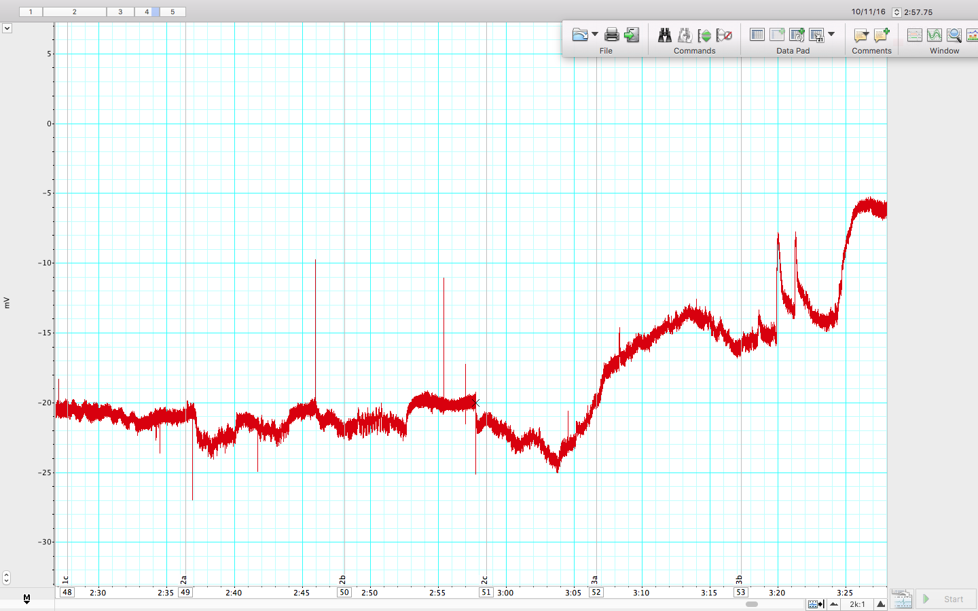
T-Type Neuronal Response From Physically Applied Force Throughout Leech Annuli
3
4
5
2
Voltage (mV)
1
Time (ms)
Figure 3 – Response of T-cell located laterally along the center-contralateral region of the ganglia.
This recording shows the elicited response of the neuron at 5 different locations(depicted by arrows). Area 1 through 5 show the application of a medium force to single points along the annuli.

Slide 4
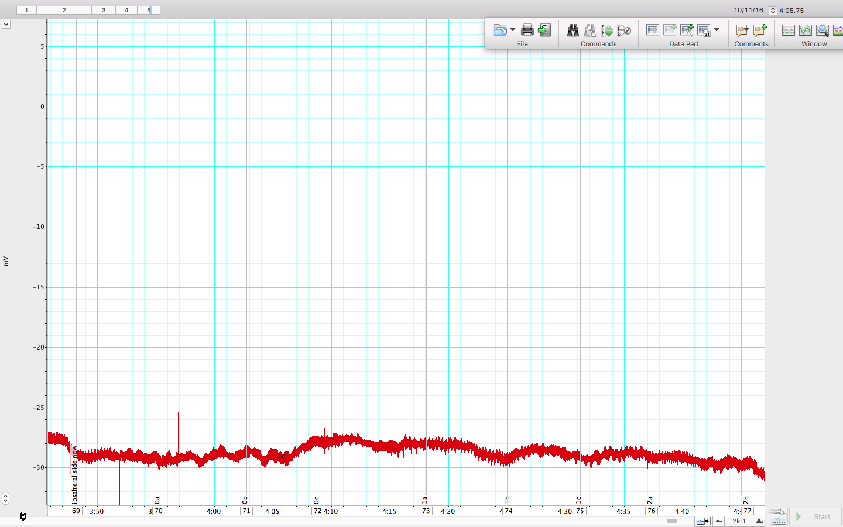
T-Type Neuronal Response From Physically Applied Force Throughout Leech Annuli
Voltage (mV)
1
3
4
5
6
7
8
9
2
Time (ms)
Figure 4a – Response of T-cell located ipsilateral and caudal in ganglia.
This recording shows the elicited response of the neuron at 9 different locations(depicted by arrows). Area 1 shows the response of rubbing along the length of the ipsilateral wall, while applying a medium force; whereas, areas 2 through 9 show the application of a medium force
to single points along the annuli.

Slide 5
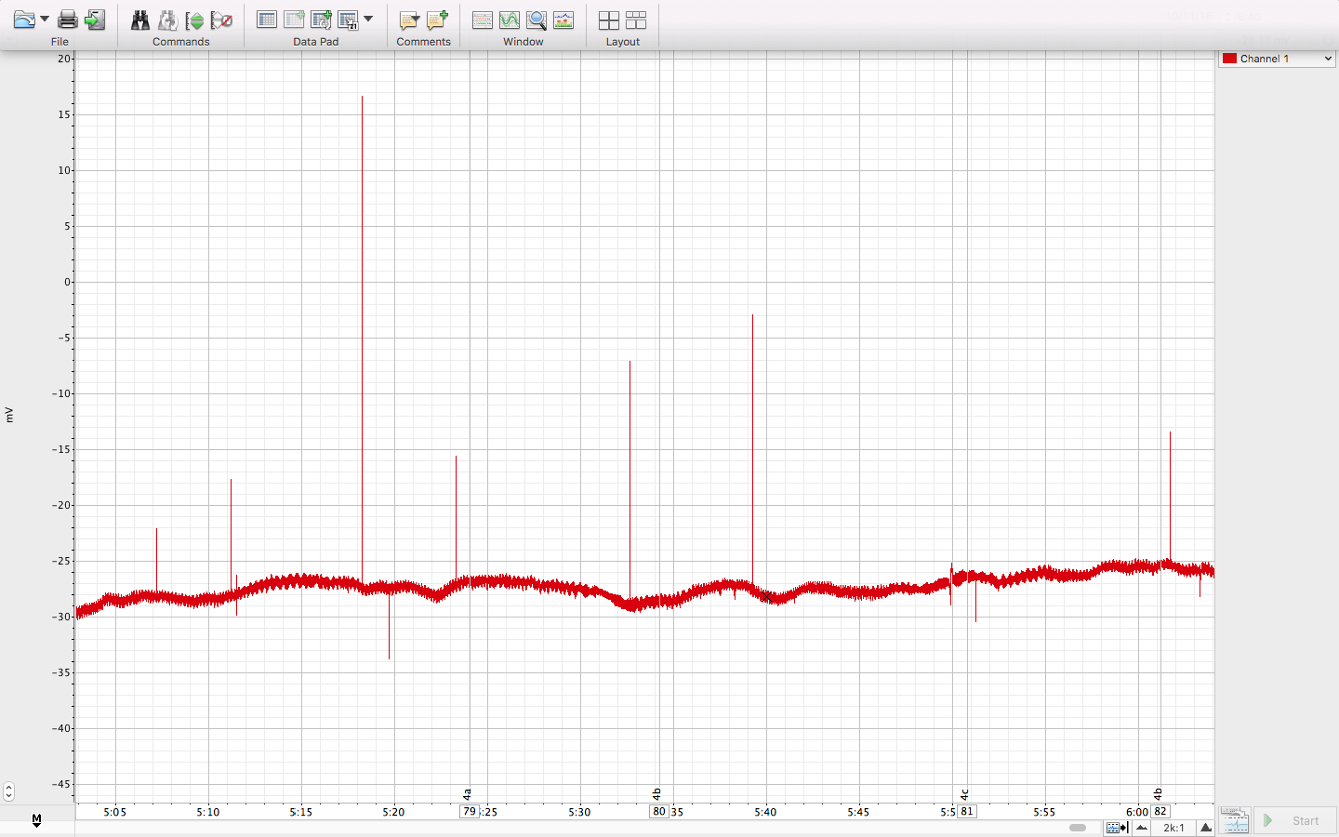
T-Type Neuronal Response From Physically Applied Force Throughout Leech Annuli
1
4
Voltage (mV)
2
3
Time (ms)
Figure 4b – Continued Responses of T-cell located ipsilateral and caudal region in ganglia.
This recording continues to show the elicited responses of the neuron in Figure 4a at 4 more locations(depicted by arrows) from the application of a medium force to single points along the
annuli.

Slide 6
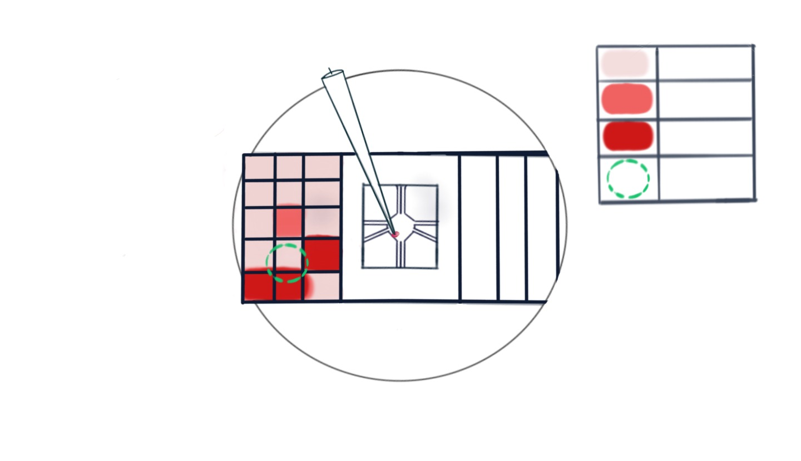
Figure 4C - Leech Mechanoreceptor Stimulation.
KEY:
0 A.P.
Figure 4c
this diagram shows the
Location of the neuron recorded from in Figure 4a and Figure 4b. The total action potentials elicited at the different areas along the grid allow us to calculate a weighted sum to predict the location of the cell’s receptive field.
MicroElectrode
1 A.P.
2 A.P.
a
b
c
0
Receptive field
1
2
3
4
Ganglion
Ipsilateral
Contralateral

