Slide 1
Optical Mark Recognition
CSE 4128 : Image Processing and Computer Vision Laboratory
Presented by: Md. Zakaria Hossain Roll: 1907056 Semester:1st Year: 4th | Teachers: Dr. Sk. Md. Masudul Ahsan Professor Dipannita Biswas Lecturer
Department of Computer Science and Engineering
Khulna University of Engineering & Technology (KUET)
Date: 02/09/2024

Slide 2
Outlines
Objectives
Introduction
Tools used
Methodology
Limitations
Conclusion

Slide 3
Objectives
To develop an automated system to process OMR sheets.
To implement image processing algorithms to detect and extract marked responses from OMR sheets.
To create a user-friendly interface for uploading, processing, and printing OMR sheet results.
Ensure high accuracy in identifying and analyzing marked responses.
To generate detailed reports and analytics based on processed OMR data.

Slide 4
Introduction
Optical Mark Recognition (OMR) is a process of capturing human-marked data from document forms such as surveys and tests.
Leverages image processing techniques to detect and extract marked responses from scanned OMR sheets.
Includes user-friendly interface to facilitate the upload, processing, and review of OMR sheet results.
Generated reports and analytics from processed OMR data will provide valuable insights and assist in decision-making processes.

Slide 5
Tools Used
Python
OpenCV (Open Source Computer Vision Library)
Tkinter
PIL (Python Imaging Library)
openpyxl

Slide 6
Methodology
Upload Image
Grayscale Conversion
Smoothing
Edge Detection
Thresholding
Answer Area
Biggest Contour
Contour Detection
Evaluate Answer
Second Biggest Contour
Grade Area
Save to excel file
Final Grading

Slide 7
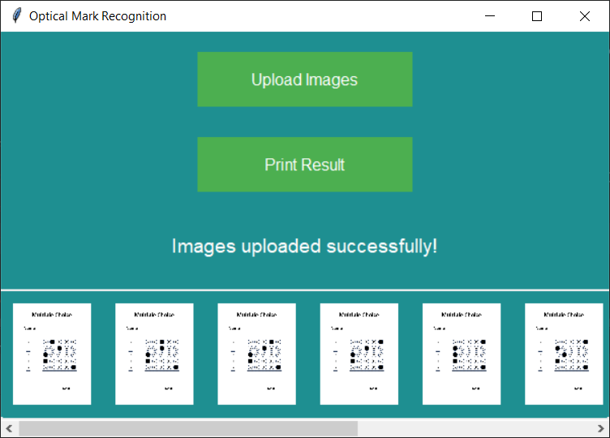
GUI
A basic interface has been built using tkinter.
Fig 1: Interface

Slide 8
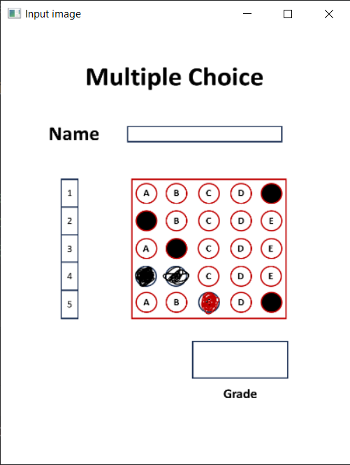
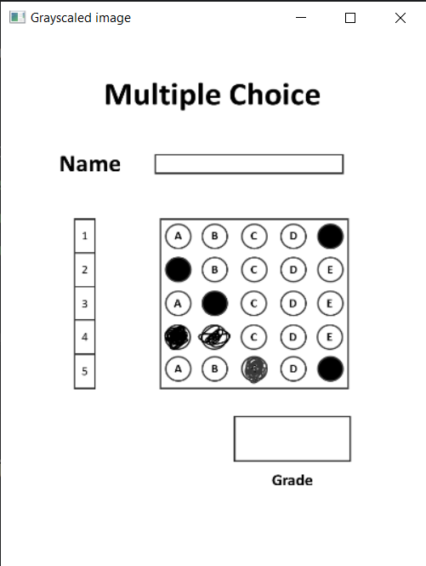
Grayscale Conversion
Input image is converted into grayscaled image for processing.
Fig 2: Input and Grayscaled Image

Slide 9
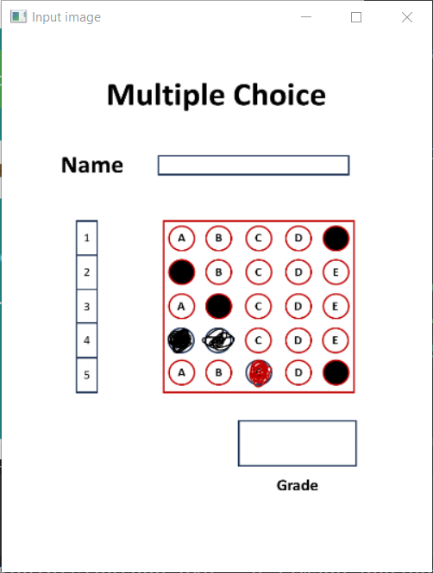
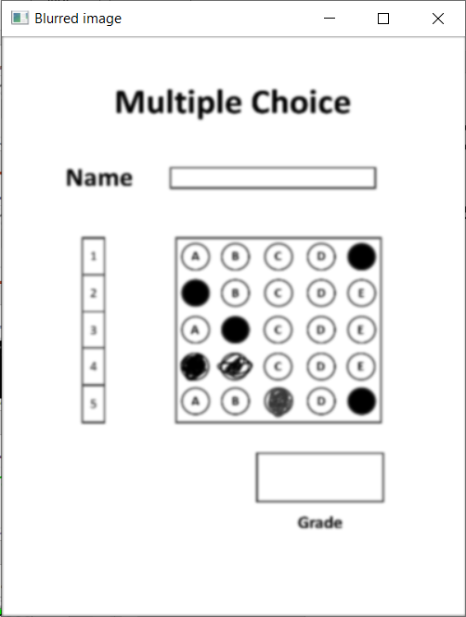
Smoothing
The grayscaled image is blurred using gaussian filter.
Fig 3: Input and Blurred Image

Slide 10
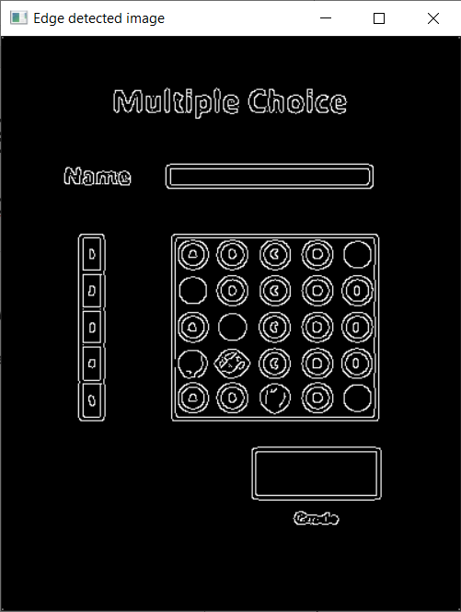
Edge Detection
Edges are detected using canny edge detection technique.
Fig 4: Input and Edge Detected Image

Slide 11
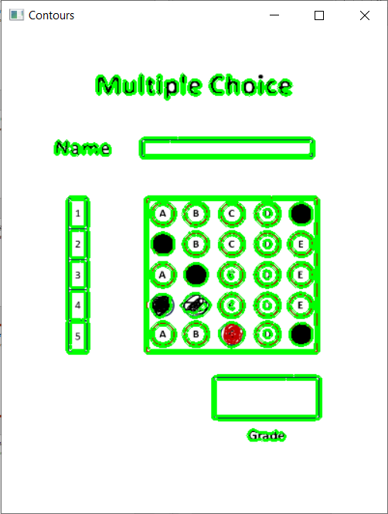
Contour Detection
Contours are detected using breadth first search technique.
Fig 5: Input and Contour Detected Image

Slide 12
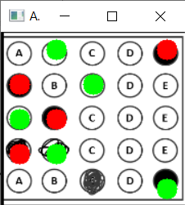
Answer Section
Answer section is extracted from the biggest contour and determined by thresholding.
Fig 6: Input and Answer Section

Slide 13
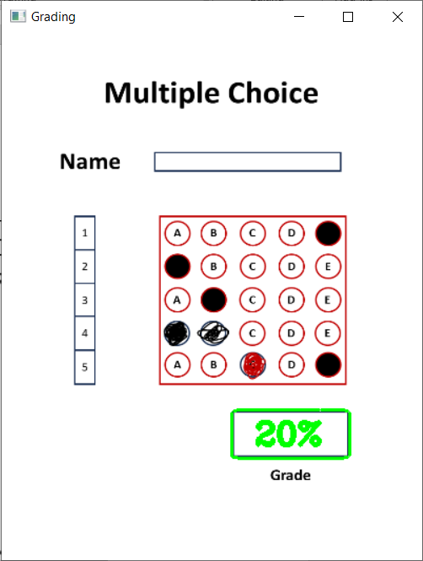
Grading Section
The grading section is extracted from the second biggest contour.
Fig 7: Input and Grading Section

Slide 14
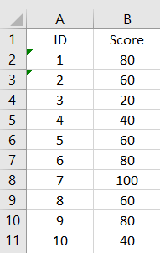
Save Result
The final result is saved in an excel file.
Fig 8: Result sheet

Slide 15
Limitations
Fails to handle large volumes of data efficiently.
Integrating OMR technology with existing information systems or workflows may require significant customization and compatibility checks.
Poor-quality scans or document defects can compromise accuracy and reliability.
OMR systems may struggle with handwritten inputs, leading to potential errors in data capture.

Slide 16
Conclusion
Optical Mark Recognition (OMR) technology offers significant advancements in automating data extraction and processing from physical documents.
By leveraging sophisticated7image processing techniques and machine learning algorithms, OMR systems streamline the capture and interpretation of marked responses, enhancing efficiency and reducing errors in various applications such as education, surveys, and assessments.
Future advancements in image processing capabilities and integration with artificial intelligence promise to further improve the accuracy and flexibility of OMR systems.

Slide 17
Thank You

