Slide 1

Mute Assistant System
CSE 3200: System Development Project
03 December 2023
Supervised By
Dr. Sk. Md. Masudul Ahsan
Professor
Department of Computer Science and Engineering
Khulna University of Engineering & Technology, KUET
Md. Zakaria Hossain
Roll: 1907056
Md. Mahir Abrar Khan
Roll: 1907008

Slide 2
Contents
Introduction
Related work
Objectives
System Architecture
Methodology
Tools used
UI design
Conclusions
Future Study
References

Slide 3

Introduction
Assisting the verbally disabled people in communication

Slide 4
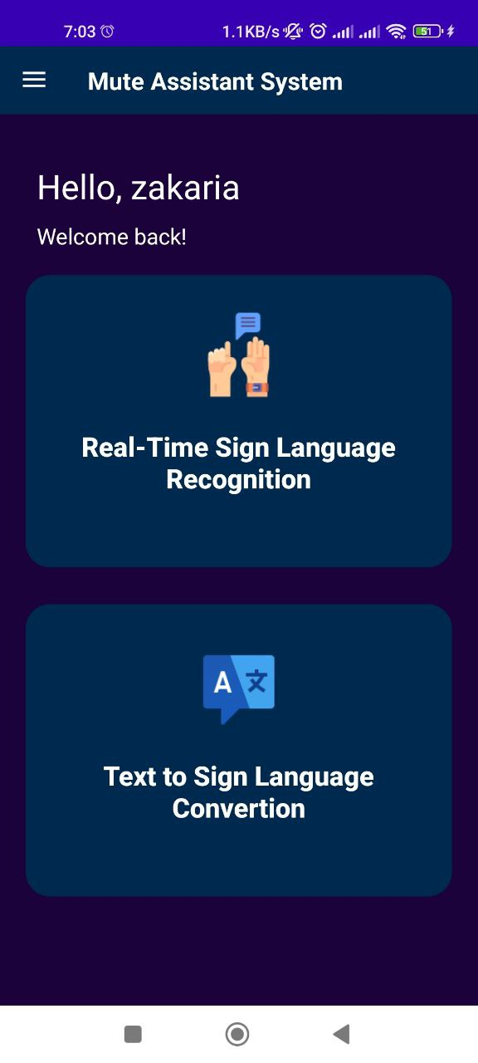
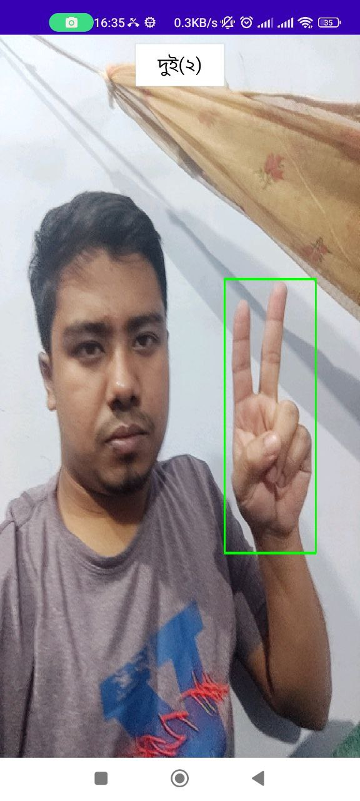
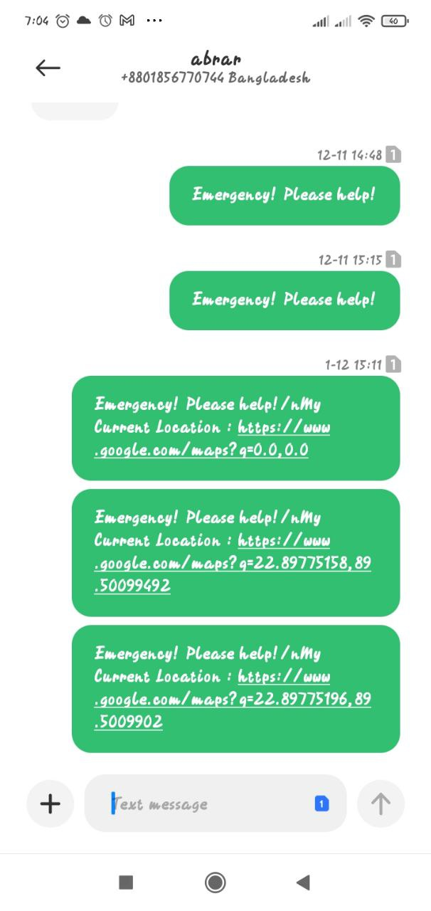
Introduction
Vision based ml application for converting sign language both way and assisting in emergency situation.

Slide 5
Related Works
The existing applications like Sign Language ASL Pocket Sign or Hand Talk Translator only provide features like text to sign language conversion, ASL dictionary, fun questions etc.
Gap in the existing solution:
Lack basic features like real-time sign language recognition, emergency contact, user preferences, AI assistance etc.

Slide 6
Objectives
To develop a robust , vision-based & both single and double handed sign-based system for real-time recognition of sign language and convert it to text.
To develop a system that can convert text to vision based sign language with an auto suggestion of word feature to enhance good user experience.
To develop an emergency system that can send alert message to the preset contacts with the location of the user collected from the GPS system.
To develop admin system to provide user management for ensuring user reliability and their empowerment.

Slide 7
System Architecture
Data Flow Diagram:
Convert to text
Video input
model
user
Process usage data
admin
Collect usage data
Send to google assistant
storage
generate
Video output
Upload/
delete
Text input
Perform task
Location from gps
Send message
contacts
Fig 3.4: DFD diagram for mute assistant system

Slide 8
Methodology
Use case diagram
SL Recognition
Camera View
Process Model
Send to Google Assistant
Home
Profile
Text Output
Voice Output
Text to Sign Language Conversion
About SL
Text Input
Fetch the location online
Auto word suggestion using n-gram based probabilistic algo
Fetch word from local storage or firebase
emergency
Premium
Get amount
Execute payment
User
history
Night mode
Send alert message with current to contacts
Show the video
Settings
Terms and Conditions
Contact
Security and Privacy

Slide 9
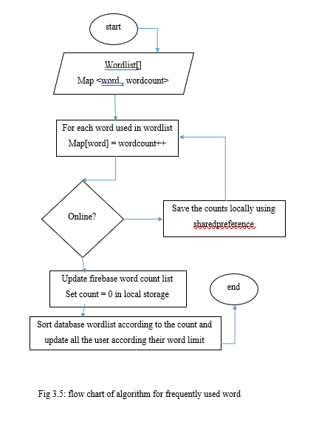
Contd…
Auto suggestion algo:

Slide 10
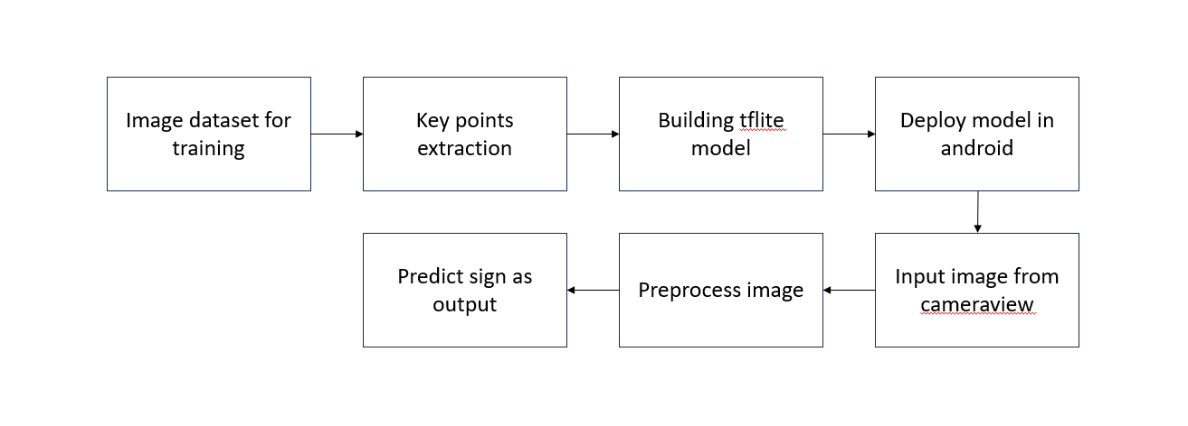
Contd…
Model Implementation:

Slide 11
Tools Used
Android Studio
Java
Python
PHP
Javascript
Laravel
Vscode

Slide 12
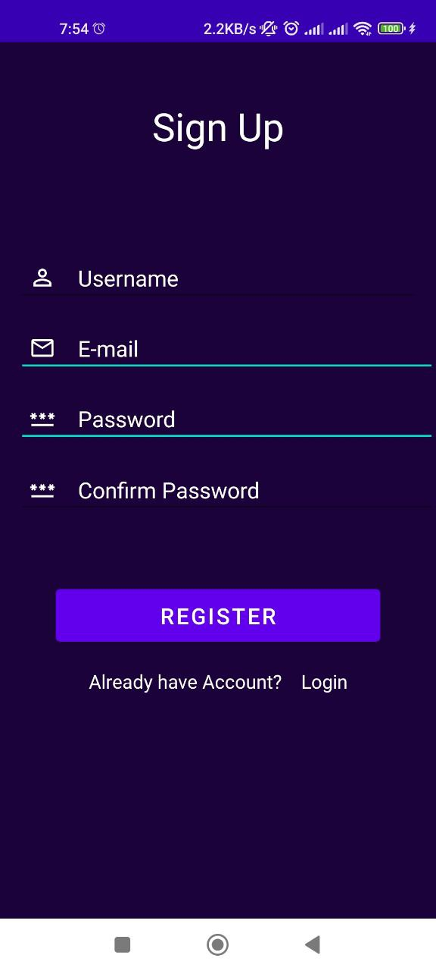
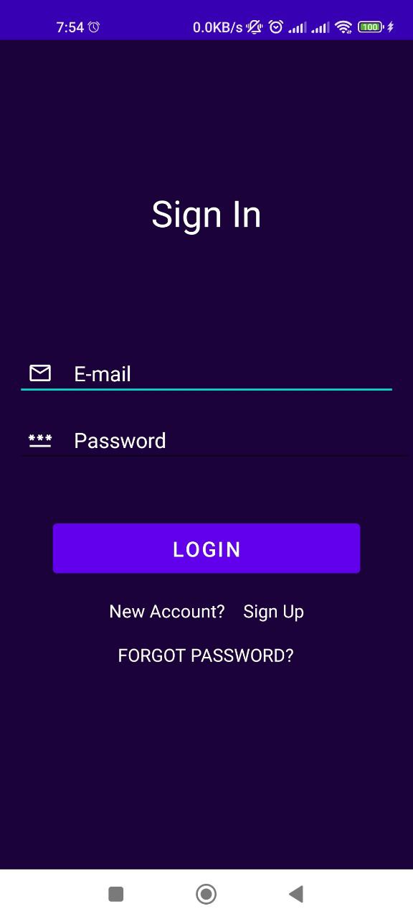
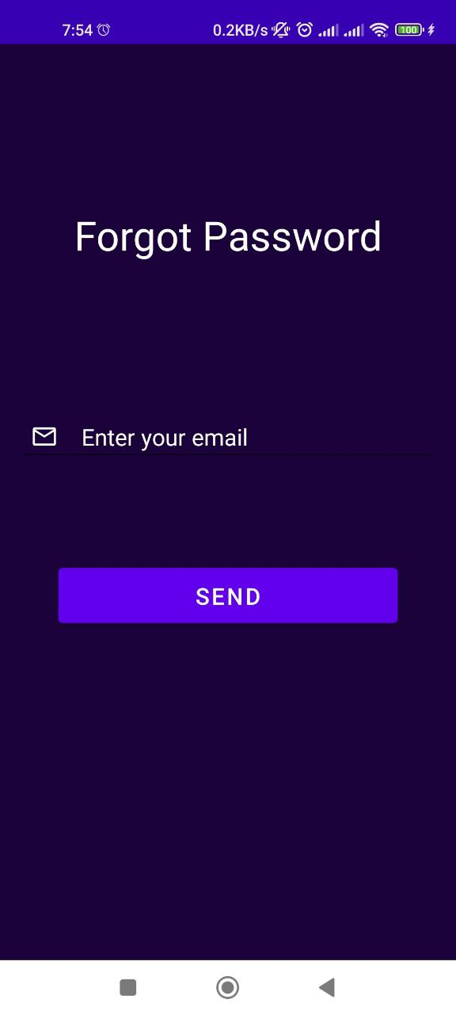
UI Design(User)
Signup
Signin
Forgot password

Slide 13
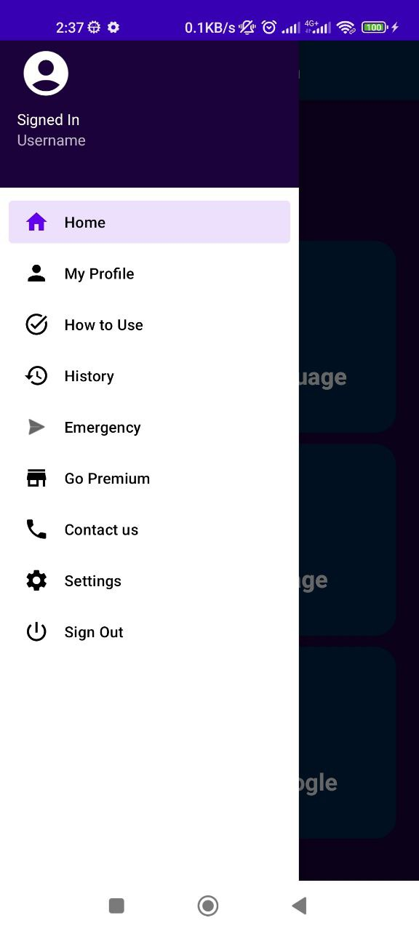
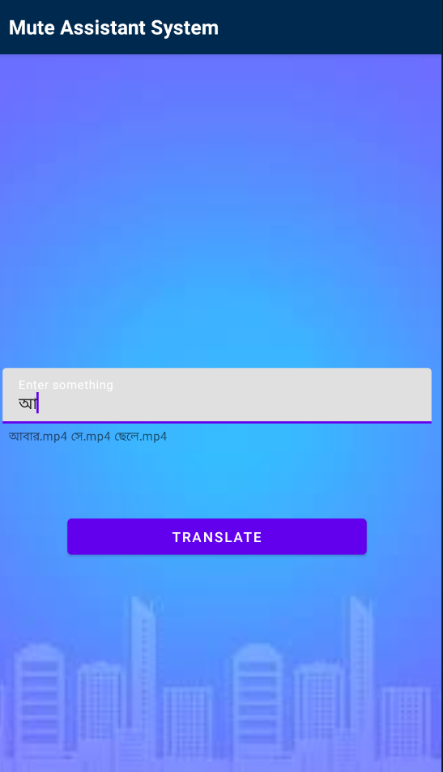
Contd…
Navigation Bar
Homepage
Video to text
Text to video

Slide 14
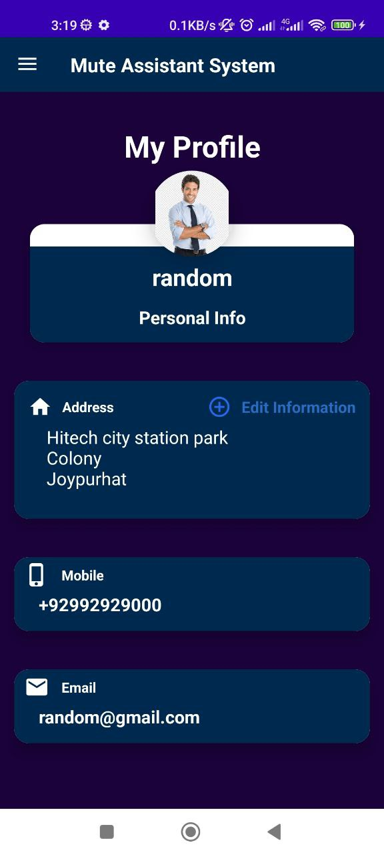
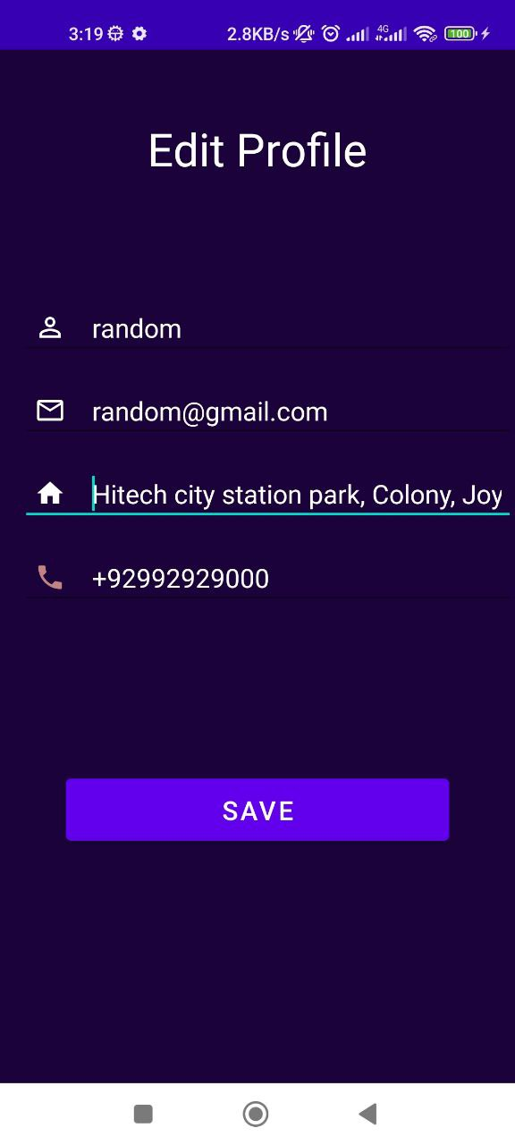
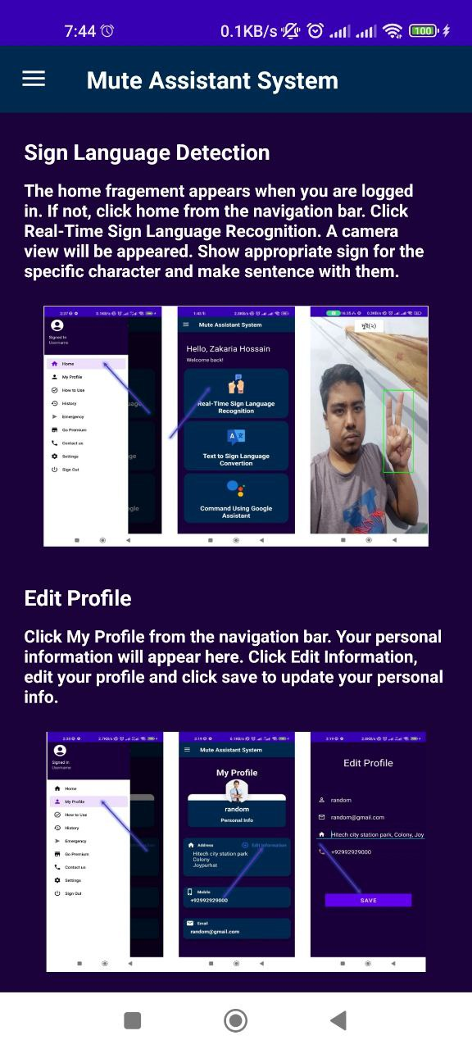
Contd…
Profile
Edit Profile
How to use

Slide 15
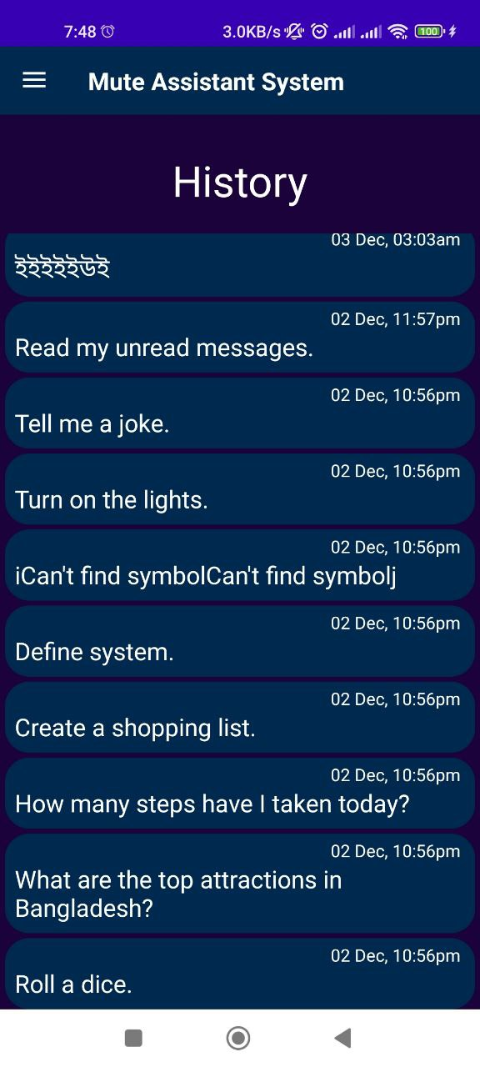
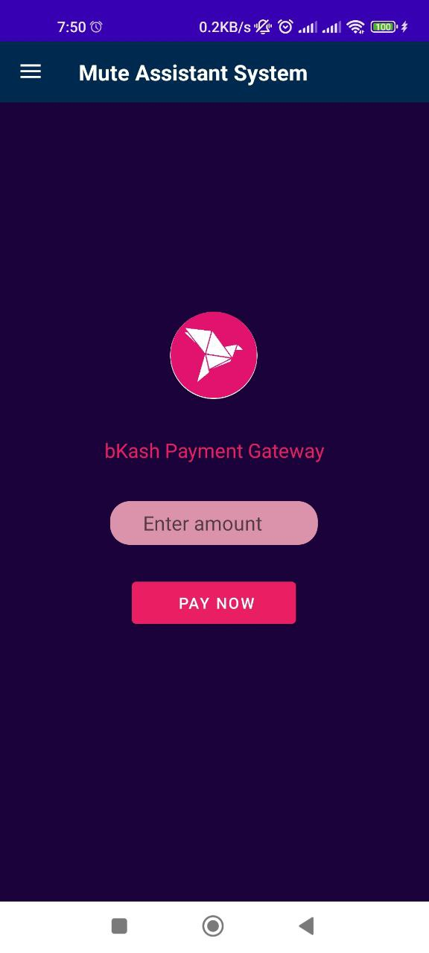
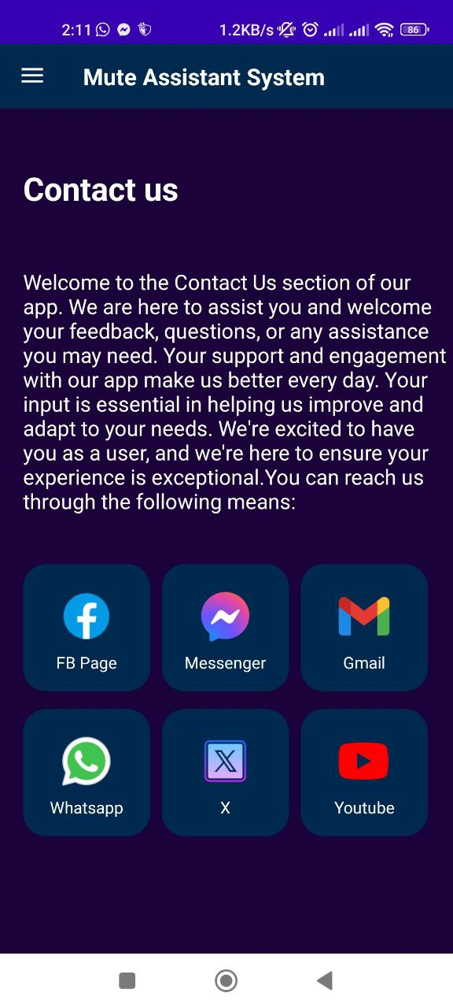
Contd…
History
Payment
Contact us

Slide 16
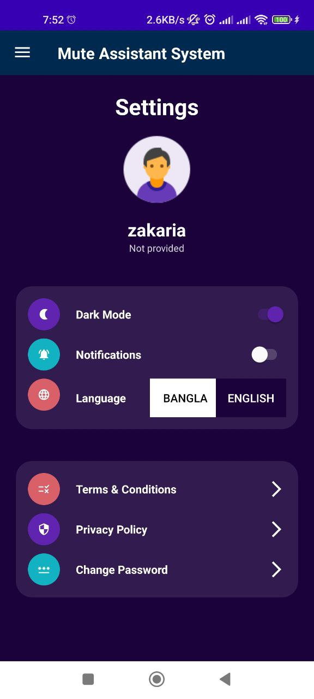
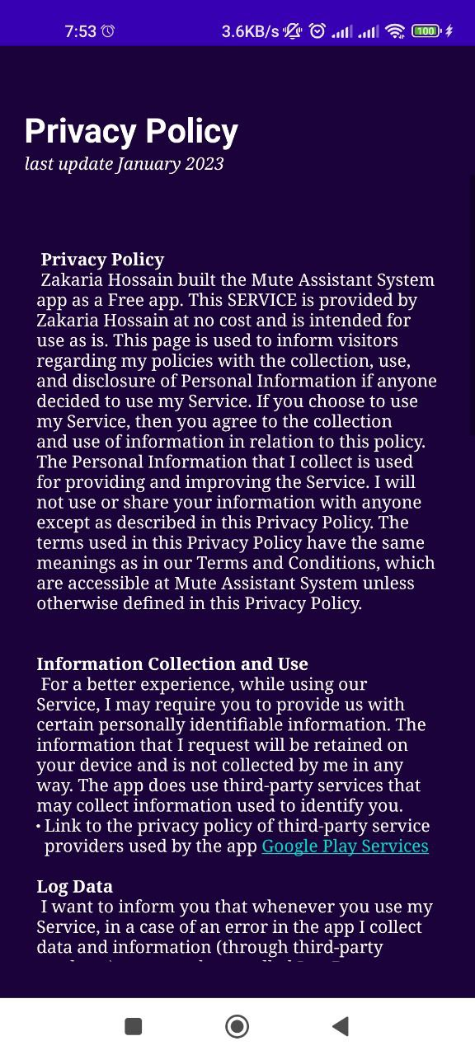
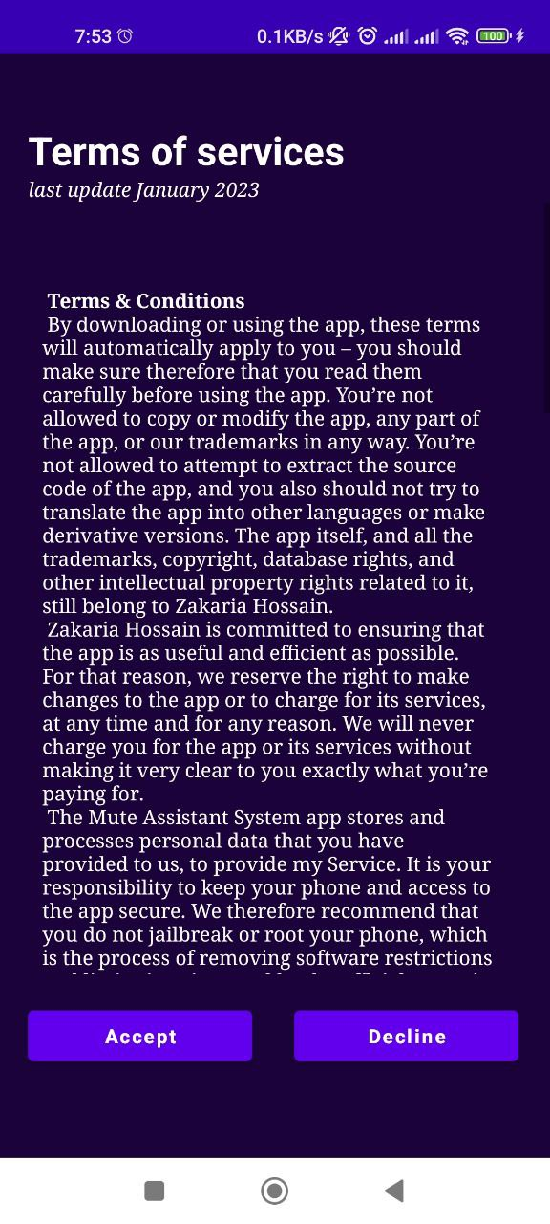
Contd…
Settings
Privacy Policy
Terms and Conditions

Slide 17
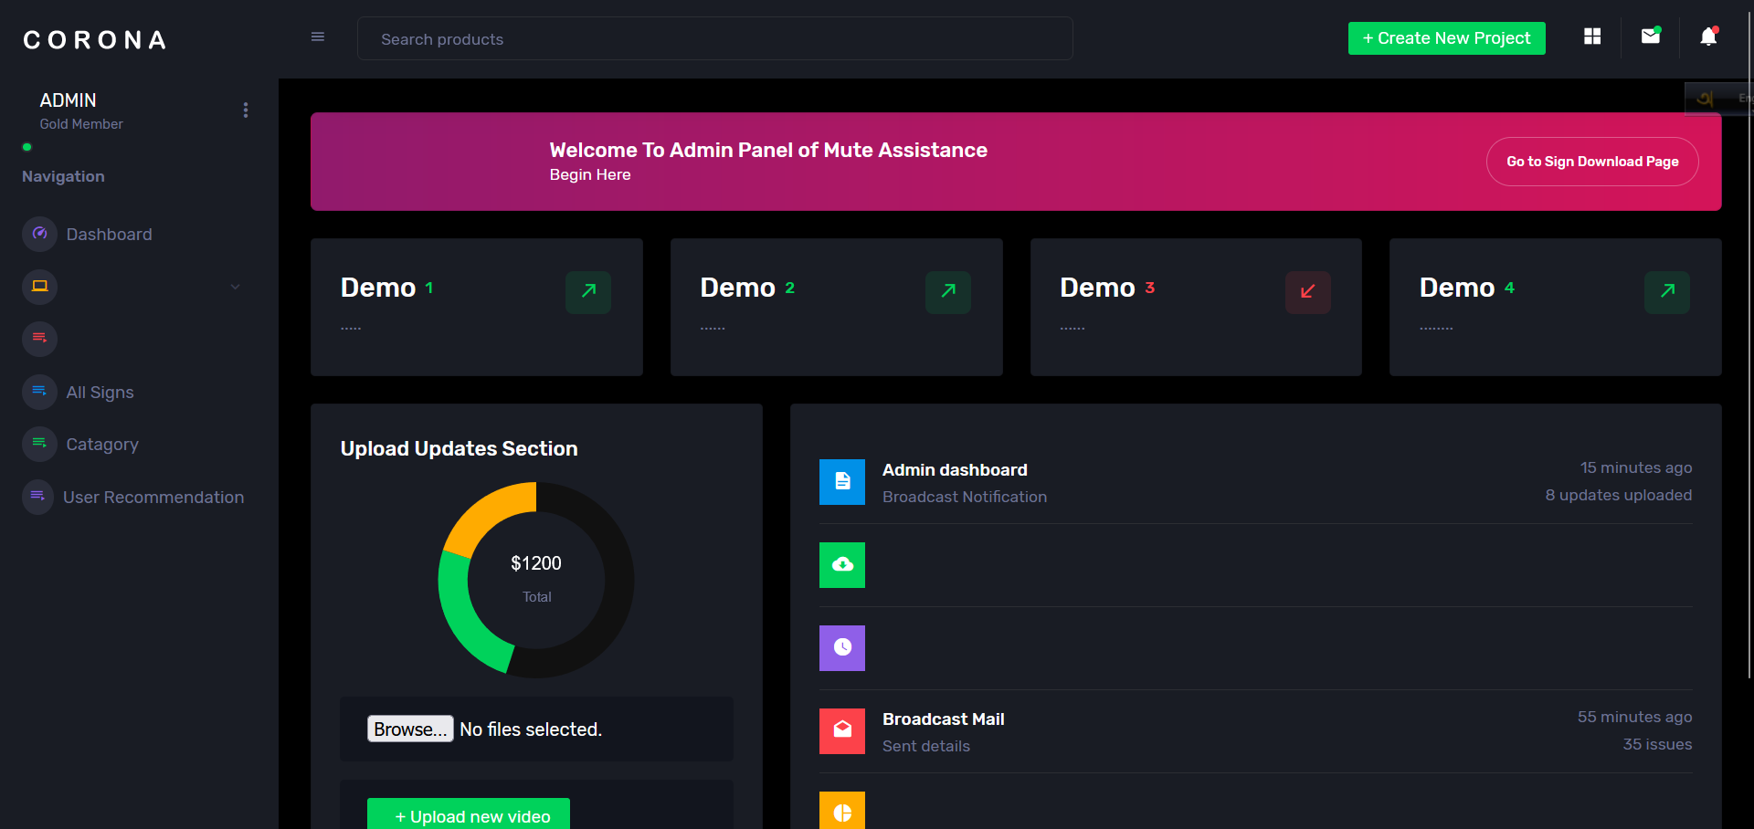
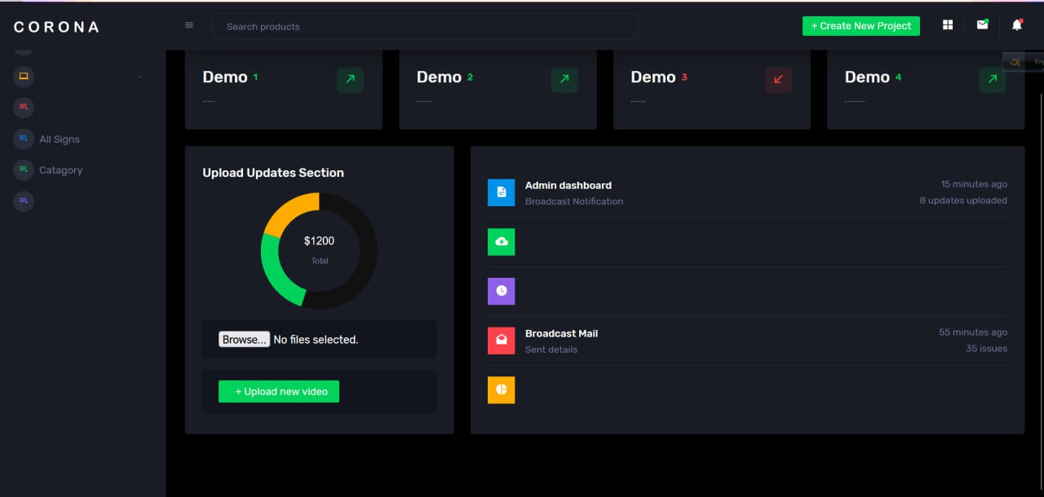
UI Design(Admin)
Dashboard

Slide 18
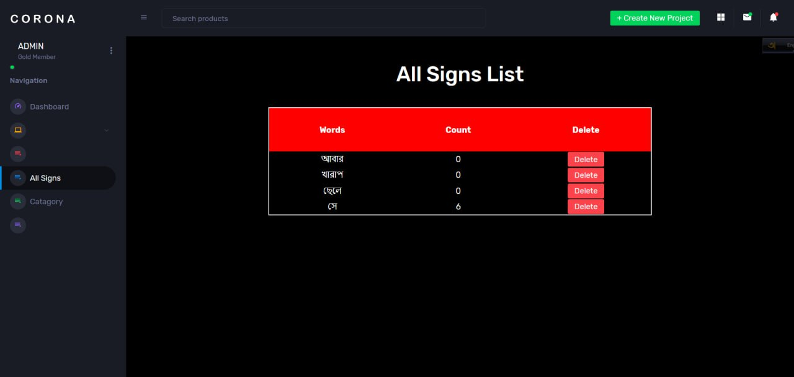
Contd…
Signs

Slide 19
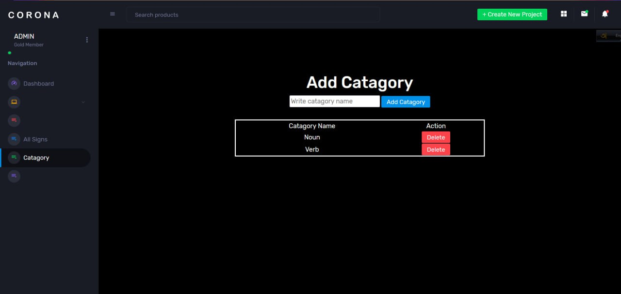
Contd…
Categories

Slide 20
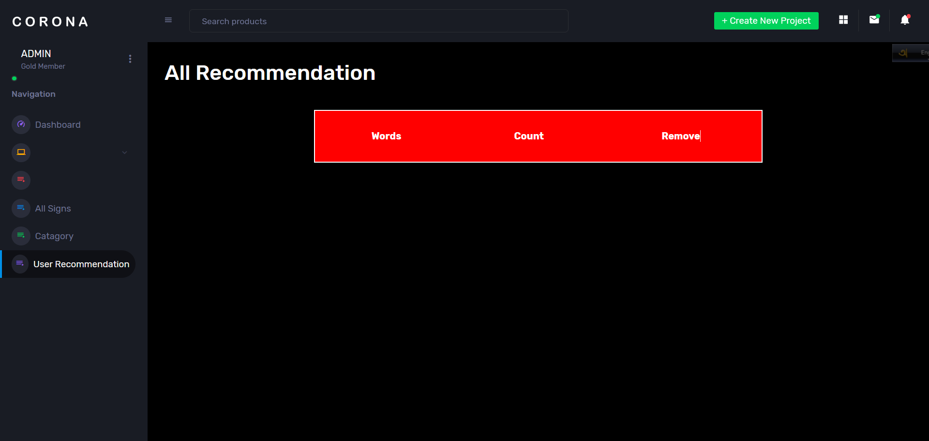
Contd…
User recommendation

Slide 21
Conclusion
Aimes to bridge communication gaps by leveraging technology to recognize and interpret sign language
Characterized by notable achievements and contributions indicating successful implementation, user empowerment, educational impact, community engagement etc. to the field of assistive technology.
Exhibit a high degree of complexity, with variations in gestures, facial expressions, and regional differences

Slide 22
Future Study
Continuous refinement to enhance accuracy and expand its vocabulary.
Exploration of multilingual support.
Integration with education platforms.
Emergency sos calling system

Slide 23
References
[1] Pramada, Sawant, et al. "Intelligent sign language recognition using image processing." IOSR Journal of Engineering (IOSRJEN) 3.2 (2013): 45-51.
[2] Word Prediction and Word Probability Exemplified in Searches Over a Pharmaceutical Database, Book by Marc Bohnes
[3] https://www.digitalocean.com/community/tutorials/android-location-api- tracking-gps[1] https://github.com/tensorflow/models
[4] https://www.kaggle.com/datasets/pramod722445/sign-language-training
[5] https://firebase.google.com/docs/ml-kit
[6] https://www.kaggle.com/datasets/jahid85/shongket-bangla-sign- language-letter-dataset
[7] https://developer.android.com/reference/android/speech/tts/TextToSpeech

Slide 24
Thank You

