Slide 1
AI Powered Career Advisor
Presented by:
Ali Alaaeddine
Hadi Elham
Zakaria Labban
Mahmoud Ch

Slide 2
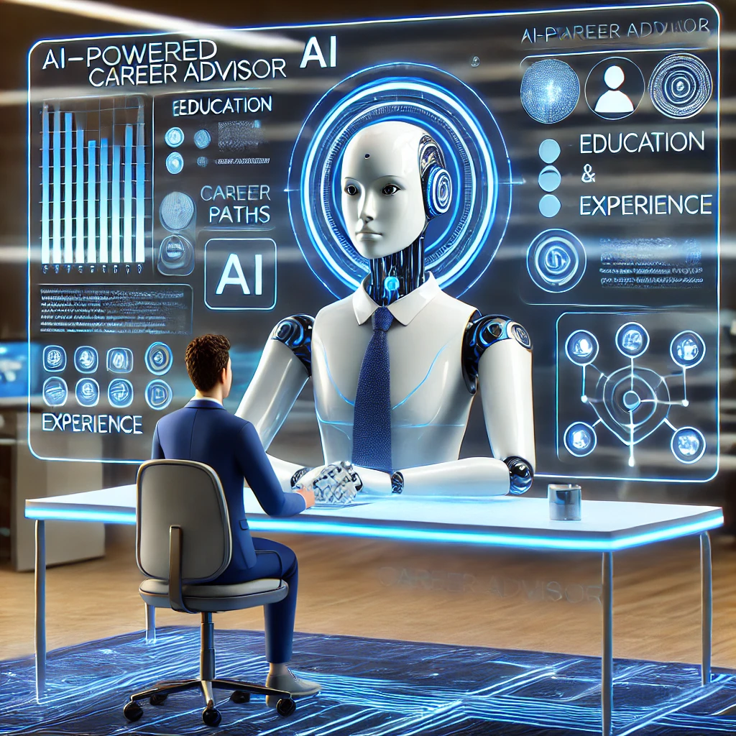
What is AI-Powered Career Advisor
The AI-Powered Career Advisor is a system designed to assist individuals in navigating their career paths by analyzing their skills, education, and experiences to provide personalized recommendations using artificial intelligence.

Slide 3
Adzuna
Coursera
GitHub
APIs Used
Responsible for jobs
Responsible for courses
Responsible for projects

Slide 4
API limitations Implemented caching mechanisms to optimize API usage and reduce latency.
Challenges and Solutions
Resource Constraints Leveraged pre-trained models to avoid resource-intensive training.
Data Volume Managed large datasets using efficient preprocessing pipelines and cloud storage solutions.

Slide 5

Financials
Mainly our product is free because our main audience is students.
However, there will be some ads on the website
To have it free of ads, there is a premium fee which is about 3.99$/month.

Slide 6
Thank You

