Slide 1

Hagital Store Sales Analysis (2014–2017)
Key Findings, Recommendations & Limitations

Slide 2
Key Findings

Slide 3

Sales & Profitability Trends
Key Findings
Revenue grew from $484K (2014) to $733K (2017) – a 51.4% increase.
Profit rose by 88.7%, reflecting improved margins.
Orders increased by ~74%, showing strong market expansion.
Profit margin improved from 10.2% to 12.7%.
Oct–Dec consistently deliver peak sales, especially for Technology products.

Slide 4
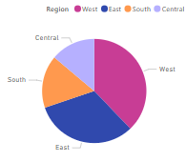
Regional Performance
Key Findings
West region leads in revenue (31.6%) and profit (37.9%).
California alone contributes ~8% of all orders.
South region shows modest revenue with healthy margins.
Central region has weak and sometimes negative profitability.

Slide 5
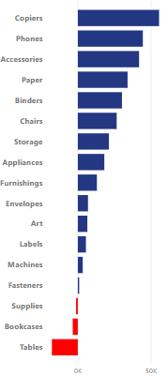
Product-Level Insights
Key Findings
Furniture has a low 2.5% profit margin; Tables incur losses.
Technology & Office Supplies deliver ~17% average margins and lead profitability.

Slide 6
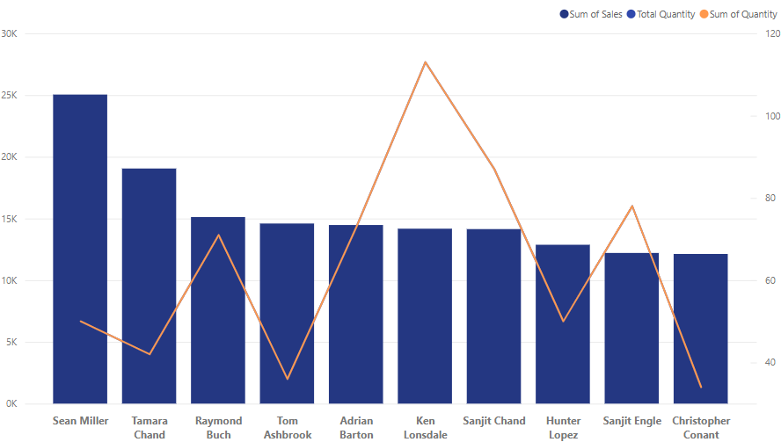
Customer Analysis
Key Findings
Sean Miller: Top revenue but unprofitable (–$1,980)
Tamara Chand: High revenue and 47% margin
Top 20% of customers generate 48.2% of revenue.

Slide 7
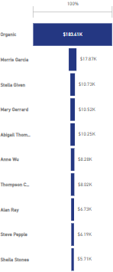
Staff Productivity
Key Findings
Organic team drives 60% of revenue.
Stella Given achieved 387% sales growth from 2014 to 2017
Top reps are based in West and East regions

Slide 8

Seasonality Obvious
Key Findings
Oct–Nov are peak months for orders
Early Fall promos can shift revenue into higher-margin periods.

Slide 9
Shipping Duration Impacts Profit
Key Findings
Orders delivered ≤3 days have 14.2% margin vs. 12.5% for >5 days.
Standard Class averages 5.4 days and has lower margins.
Slower shipments (esp. Furniture) may reduce profitability.

Slide 10

Discount Strategy
Key Findings
Furniture has the highest discounts and lowest margins.
Weak negative correlation (–0.22) between discount and profit.
Discounting often reduces profit without boosting volume.

Slide 11

Concentration of Sales & Products
Key Findings
Top 20% of customers contribute 48% of revenue.
Top 20% of products account for 77% of sales.
Sales are concentrated across a few SKUs and buyers.

Slide 12
Recommendations

Slide 13

Reevaluate Furniture Strategy
Recommendations
Renegotiate vendor COGS; apply freight surcharges.
Reduce focus on loss-leading sub-categories like Tables.

Slide 14

Scale High-ROI Product Lines
Recommendations
Invest in marketing for Phones, Office Supplies, Accessories.
Bundle high-margin items for promotions.

Slide 15

Target High-Value Customers
Recommendations
Offer loyalty perks to top customers like Tamara Chand.
Investigate and correct losses on customers like Sean Miller.

Slide 16

Improve Shipping Efficiency
Recommendations
Promote First Class/Same Day shipping for premium segments.
Streamline Furniture logistics and delivery.

Slide 17
Empower Sales Reps & Teams
Recommendations
Document top performer tactics for training.
Reward reps via ‘Sales Champion’ bonuses and recognition.

Slide 18

Optimize Regional Operations
Recommendations
Focus investment in West and East regions.
Audit Central region for low/negative profitability causes.

Slide 19

Rationalize Discounting
Recommendations
Use data-driven promotions, not blanket discounts.
Avoid high discounts on low-margin products.

Slide 20

Seasonal Promotions
Recommendations
Launch pre-holiday flash sales in September.
Drive sales during July–August with digital campaigns.

Slide 21
Address Concentration Risk
Recommendations
Diversify by nurturing mid-tier customers.
Expand high-margin SKU portfolio to reduce dependency.

Slide 22

Limitations
Data limited to 2014–2017 – no recent trend visibility.
External factors like economy and competitors not considered.
No cost breakdown beyond sales discounts (e.g., marketing, warehousing).
No customer satisfaction or feedback data included.

Slide 23


