Slide 1
Formula One Telemetry App
Zi Yuan Chen

Slide 2
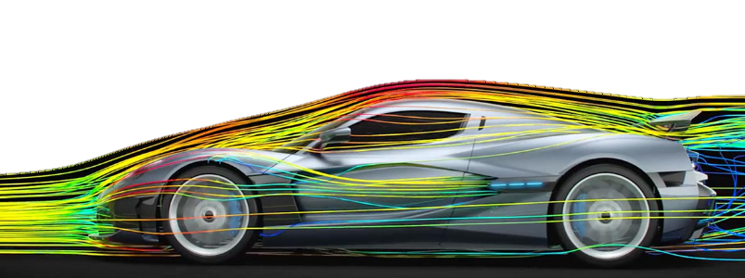
Simulations and Alternatives
Researched about simulations and alternatives such as digital twins.
Digital twins give a real time digital counterpart for a process or physical object.
Simulation imitates the operation of a process by using models which represent key behaviours and characteristics of the models.
The use of simulation is for:
Performance tuning
Training
Testing
As I cannot acquire a digital twin for Formula One, I shall be using a simulation.

Slide 3
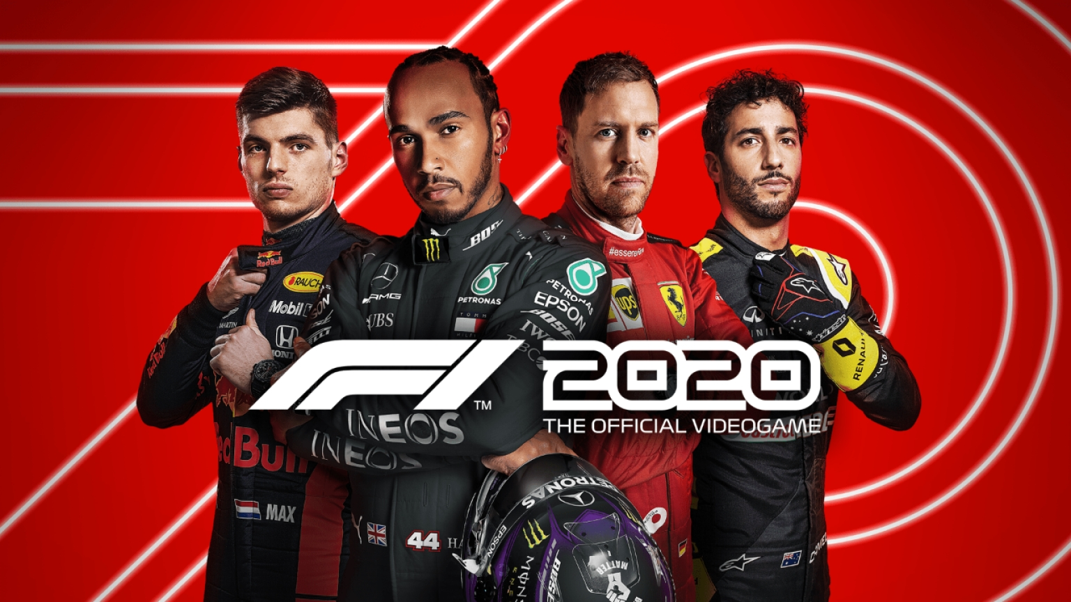
Telemetry
Using the F1 simulation game which provides a high degree of accuracy for Telemetry data.
By focussing my work with the processing of the F1 simulation game so that it is able to gather the abundance of data which the simulation holds of the vehicle
This data is known as Telemetry which consists of data such as:
G-force
Speed
Gear Box data
Tyre Wear
Temperatures
And much more
In theory, by using the simulation of F1 cars, the application can be upscaled to processing of real F1 cars rather than virtual ones.

Slide 4
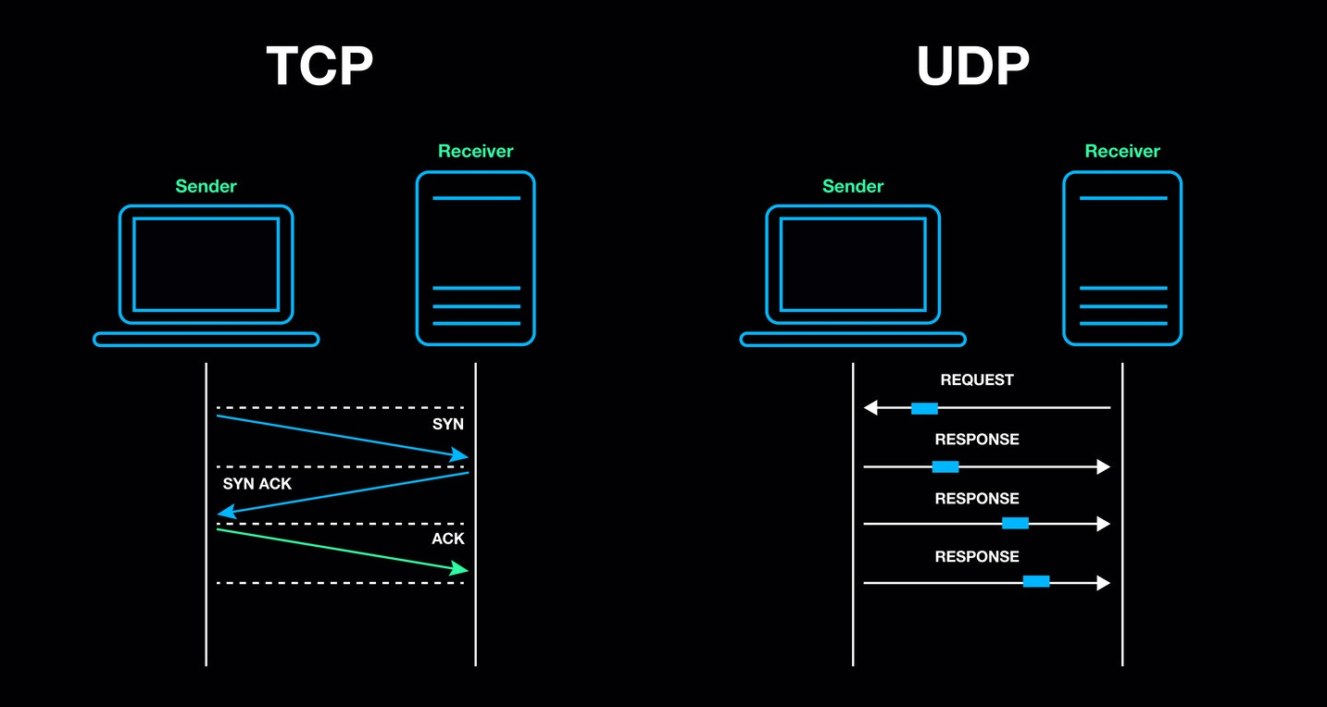
UDP or TCP
Transmission Control Protocol is connection oriented protocol, benefits are:
Reliable delivery
Handshake
Byte Stream
However benefits of User Datagram Protocol are:
Faster transfer
Less resources required
Doesn’t care for packet arrival order
No need for handshake, establishing a proper connection (UDP issues a datagram directly to an address)
UDP is suited more due to the abundance of data and speed required.

Slide 5
Packet unpacking
My program decodes the data by receiving and unpacking the packet down to the individual elements by using a parent Packet class and making children classes for each type.
The types of packets for the vehicle are:
Motion
Session
Lap Data
Event
Participants
Car Setups
Car Telemetry
Car Status
Once broken down, it’s reconstructed and stored in the program so that the application can use it directly.

Slide 6
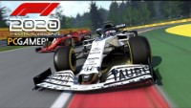
Video of game

Slide 7
Application
In F1 racing, professional engineers interpret the data.
The goal of my java application is to process the telemetry data and visualise it so it can be easily understandable not just by a trained engineer.
It displays key information so that whilst the user/driver is racing, another user/engineer can use the program to monitor the vehicle so that they can report:
Any anomalies
Any changes to strategies
Progress of the race
Key information to the racer
The Telemetry app can also be expanded further in the future to provide more data for the engineer and more options available to them.

