Slide 1

Formula 1 Data processing
Zi Yuan Chen

Slide 2
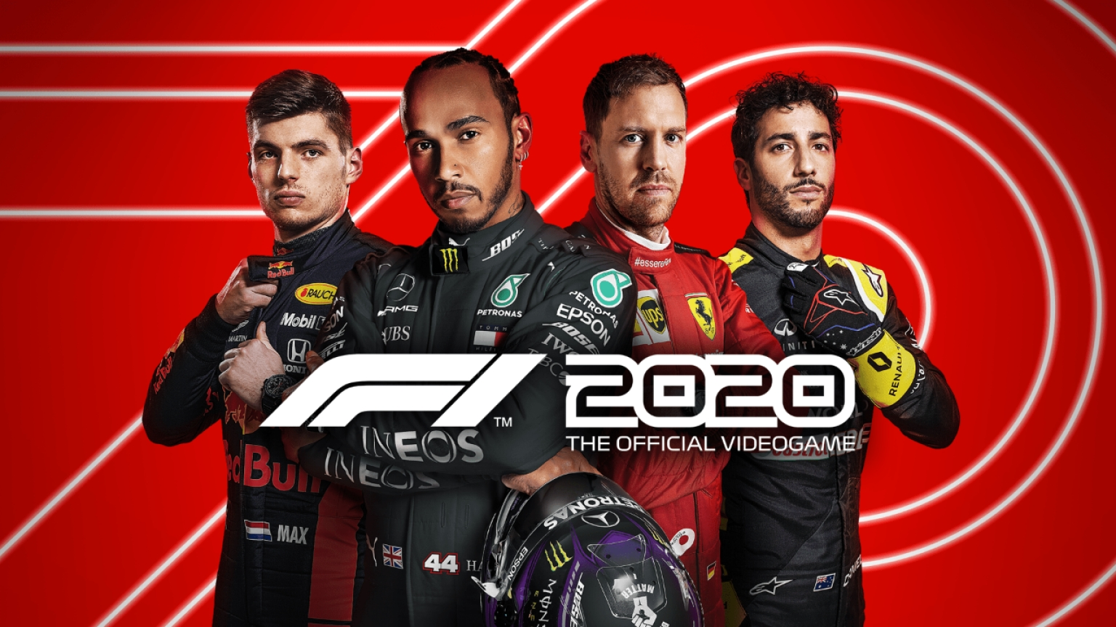
My Project
The goal of my project is to collect and process Telemetry data from F1 vehicles to provide a more user friendly and easy way to access and analyse them to come up with and predict possible strategies for the race.
This will be done by collecting data from the popular Formula 1 2020 Simulation Game as I would not be able to collect data in real time from an actual F1 car.
I will be programming this in Java.
This will provide the possibility for users to view, learn and act on the live data they can see and provide the driver with instructions as if it were a real race.

Slide 3
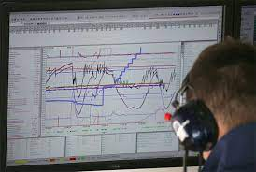
Formula 1 Telemetry
Attached to F1 cars are lots of electronic devices which each have the purpose of transmitting specific data in real time.
Possible data that’s transmitted includes, G-force, gearbox data, suspension, tyre wear and temperatures.
In a F1 race this data is transmitted to professional engineers who analyse the data as the race progresses to look for issues and form possible strategies to ensure their victory.
An example of how they analyse the data.

Slide 4
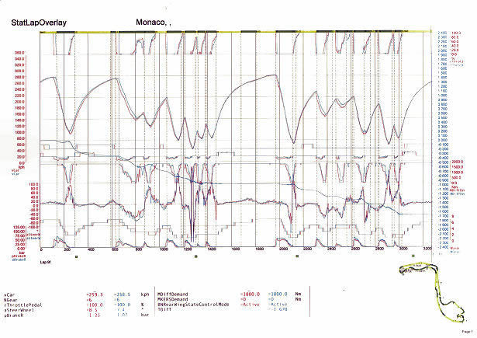
Figure 1: A waveform display of the data

Slide 5
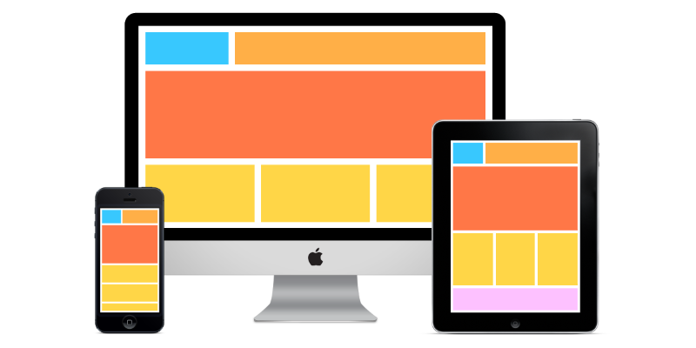
Display
The data can be too complex to understand without being a professional.
This is why I wanted to develop a program to make this much more easily understood.
I have planned out what I am aiming to achieve for the UI of the entire project with hopes to add more in the future.

Slide 6
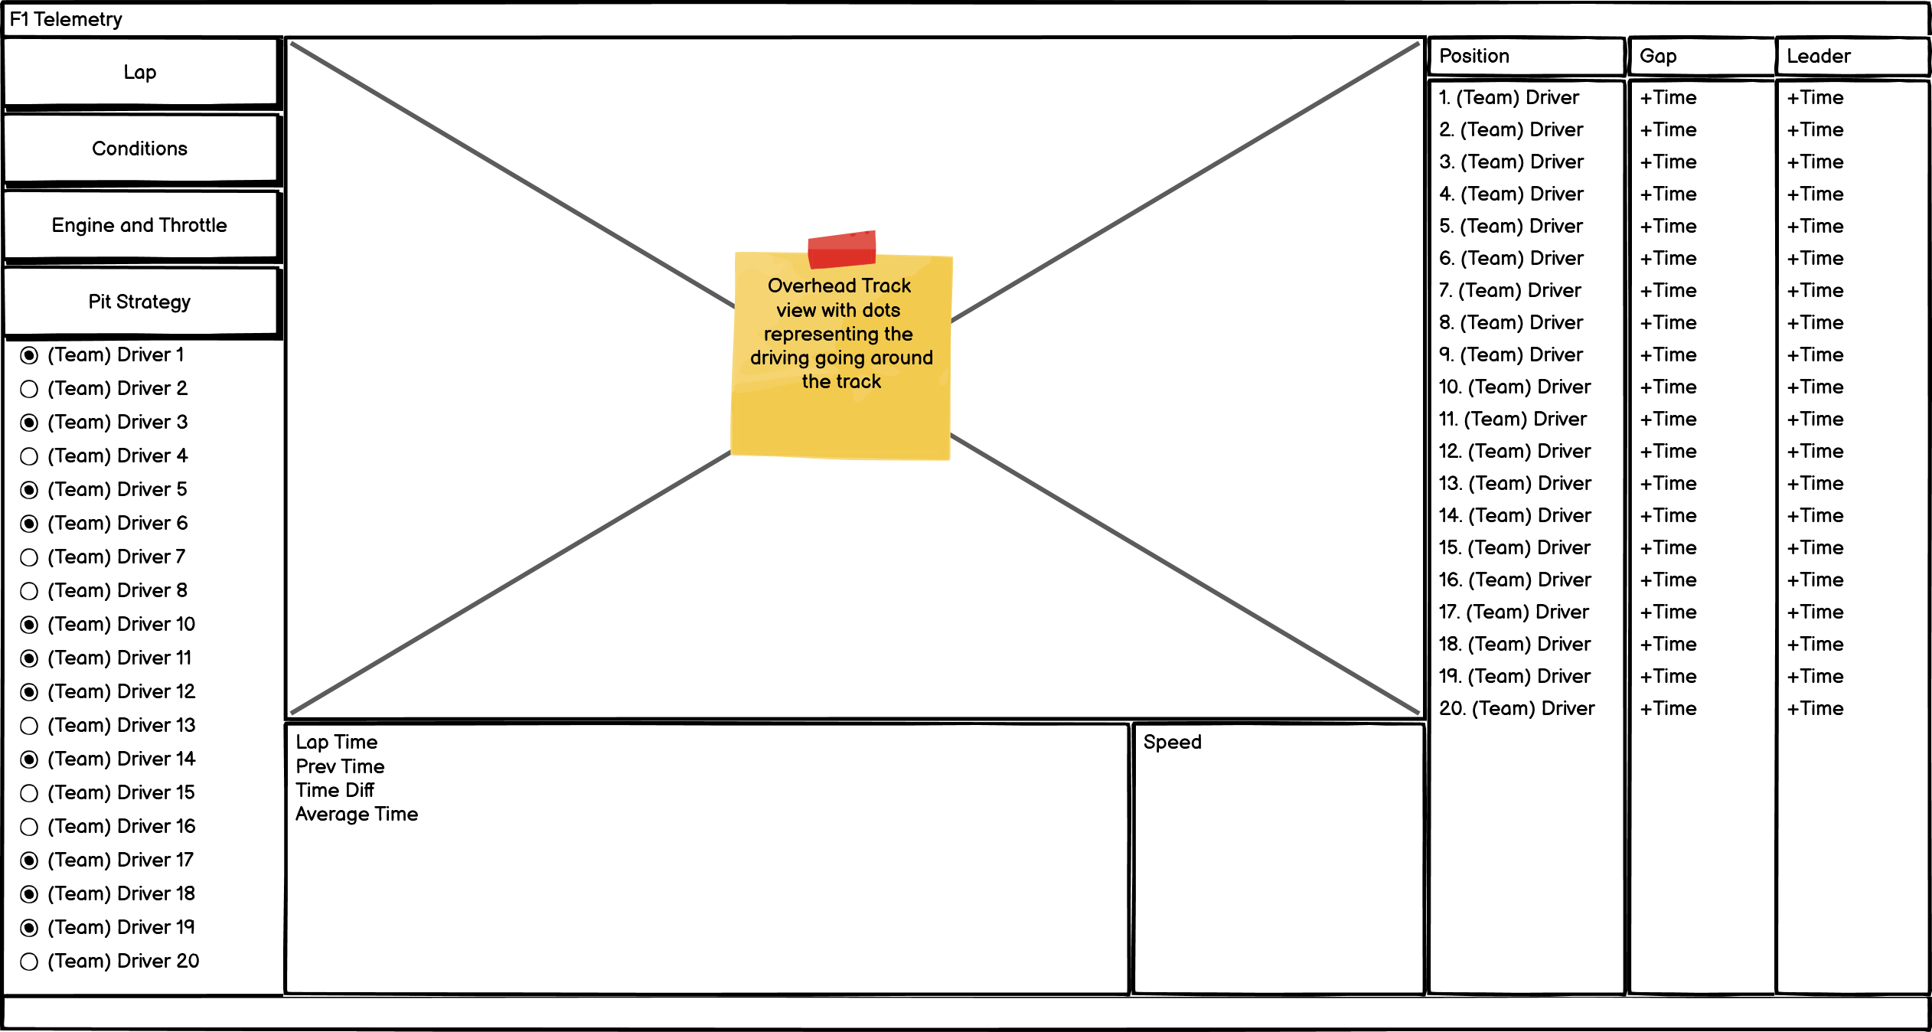
Tabs for different settings
Positions of the drivers, and times
Selected drivers to view
Your driver’s time and speed data

Slide 7
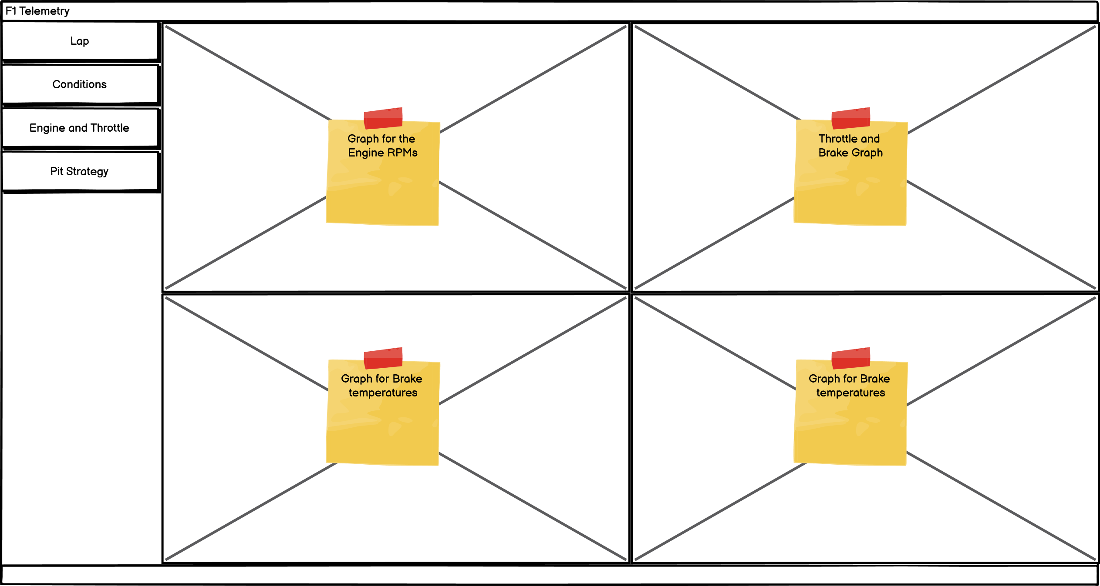
Multiple specific graphs

Slide 8
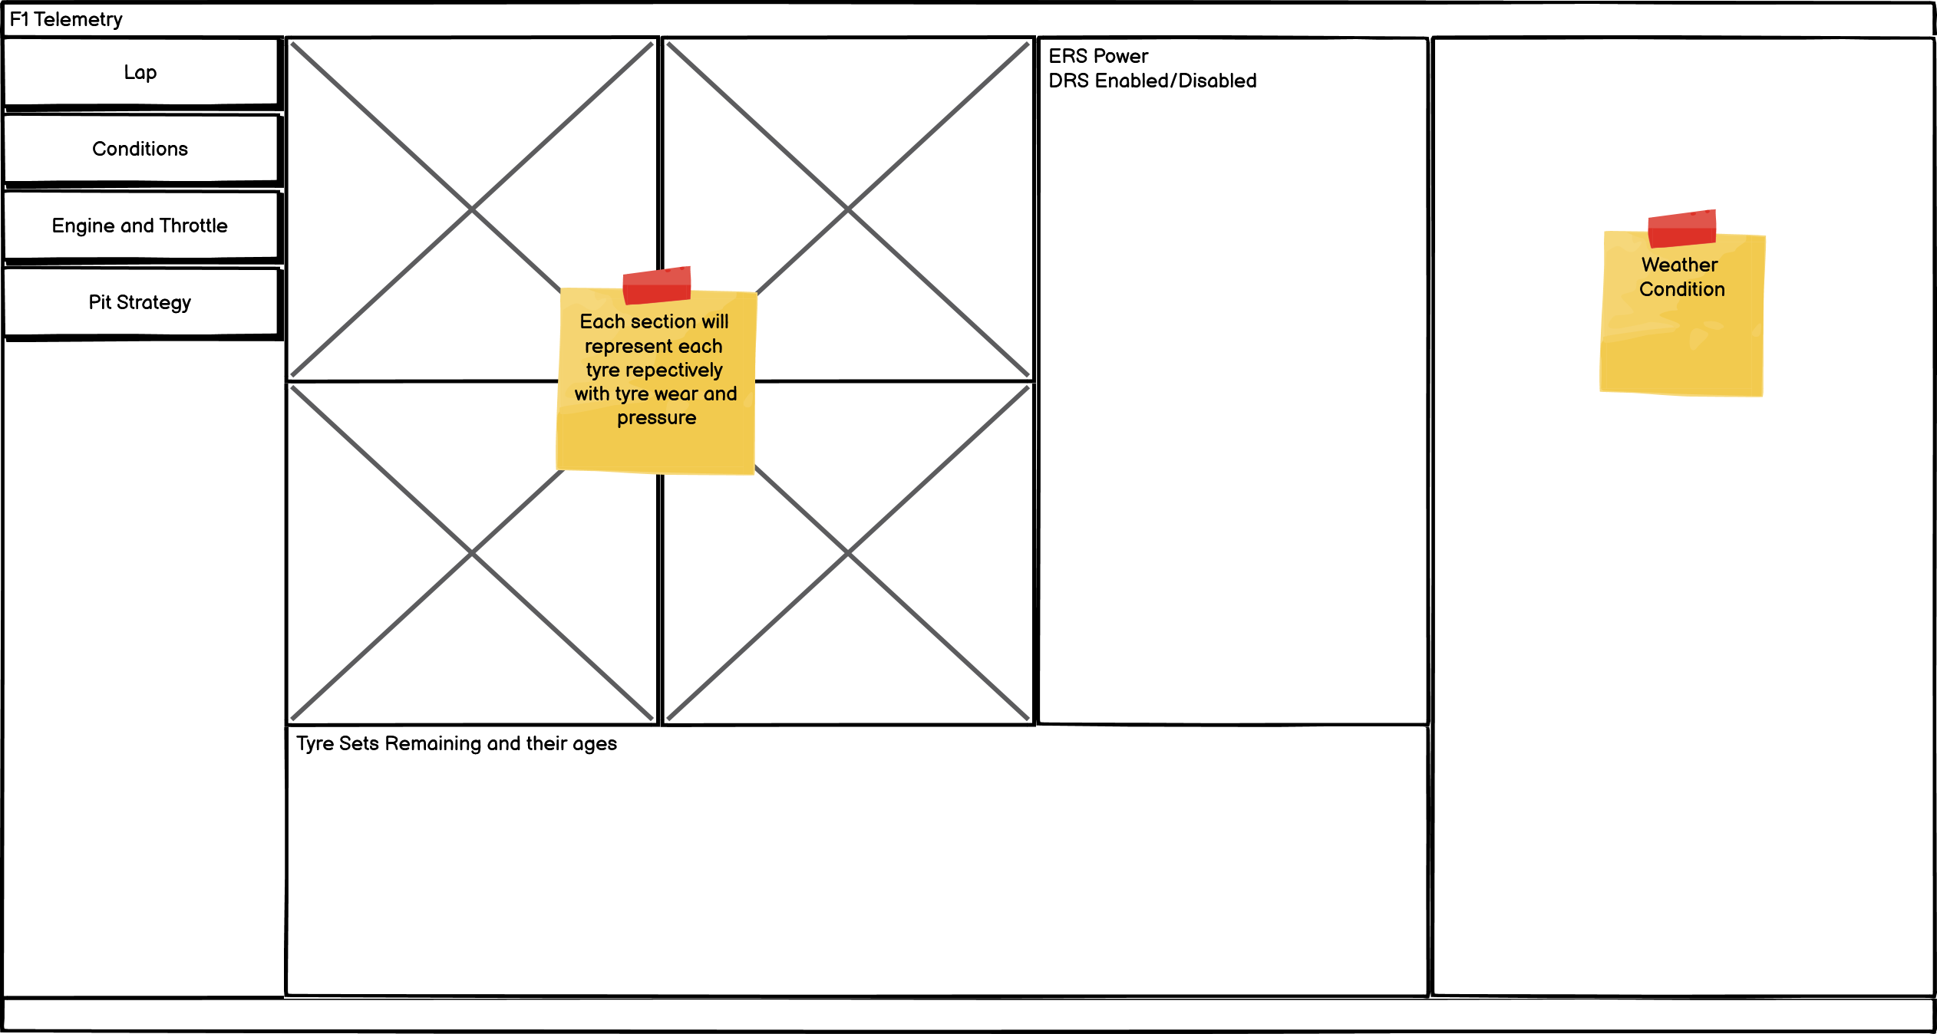
Possibility of weather change
Unused/old Tyres

Slide 9
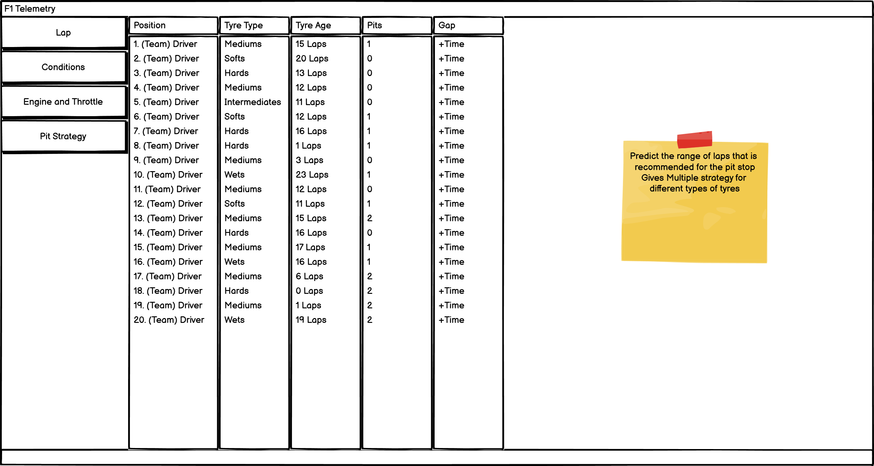
Strategy section to predict best time to pit and provide multiple strategies

Slide 10
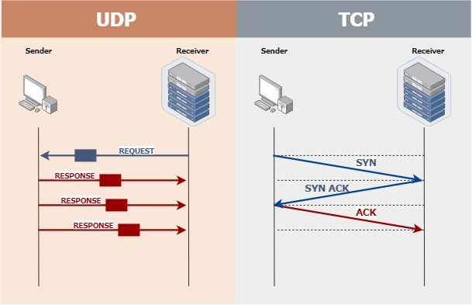
Data Processing
To collect data from the game, there will need to be use of UDP which is User Datagram Protocol.
Similar to TCP but provides a much faster speed on data transmission which is crucial for a fast pace real time race.
Also means that a constant stream of data can be sent.
UDP is a connectionless protocol since it doesn’t need to establish a virtual connection to the sender and all the packets just take the best path to get there.

Slide 11
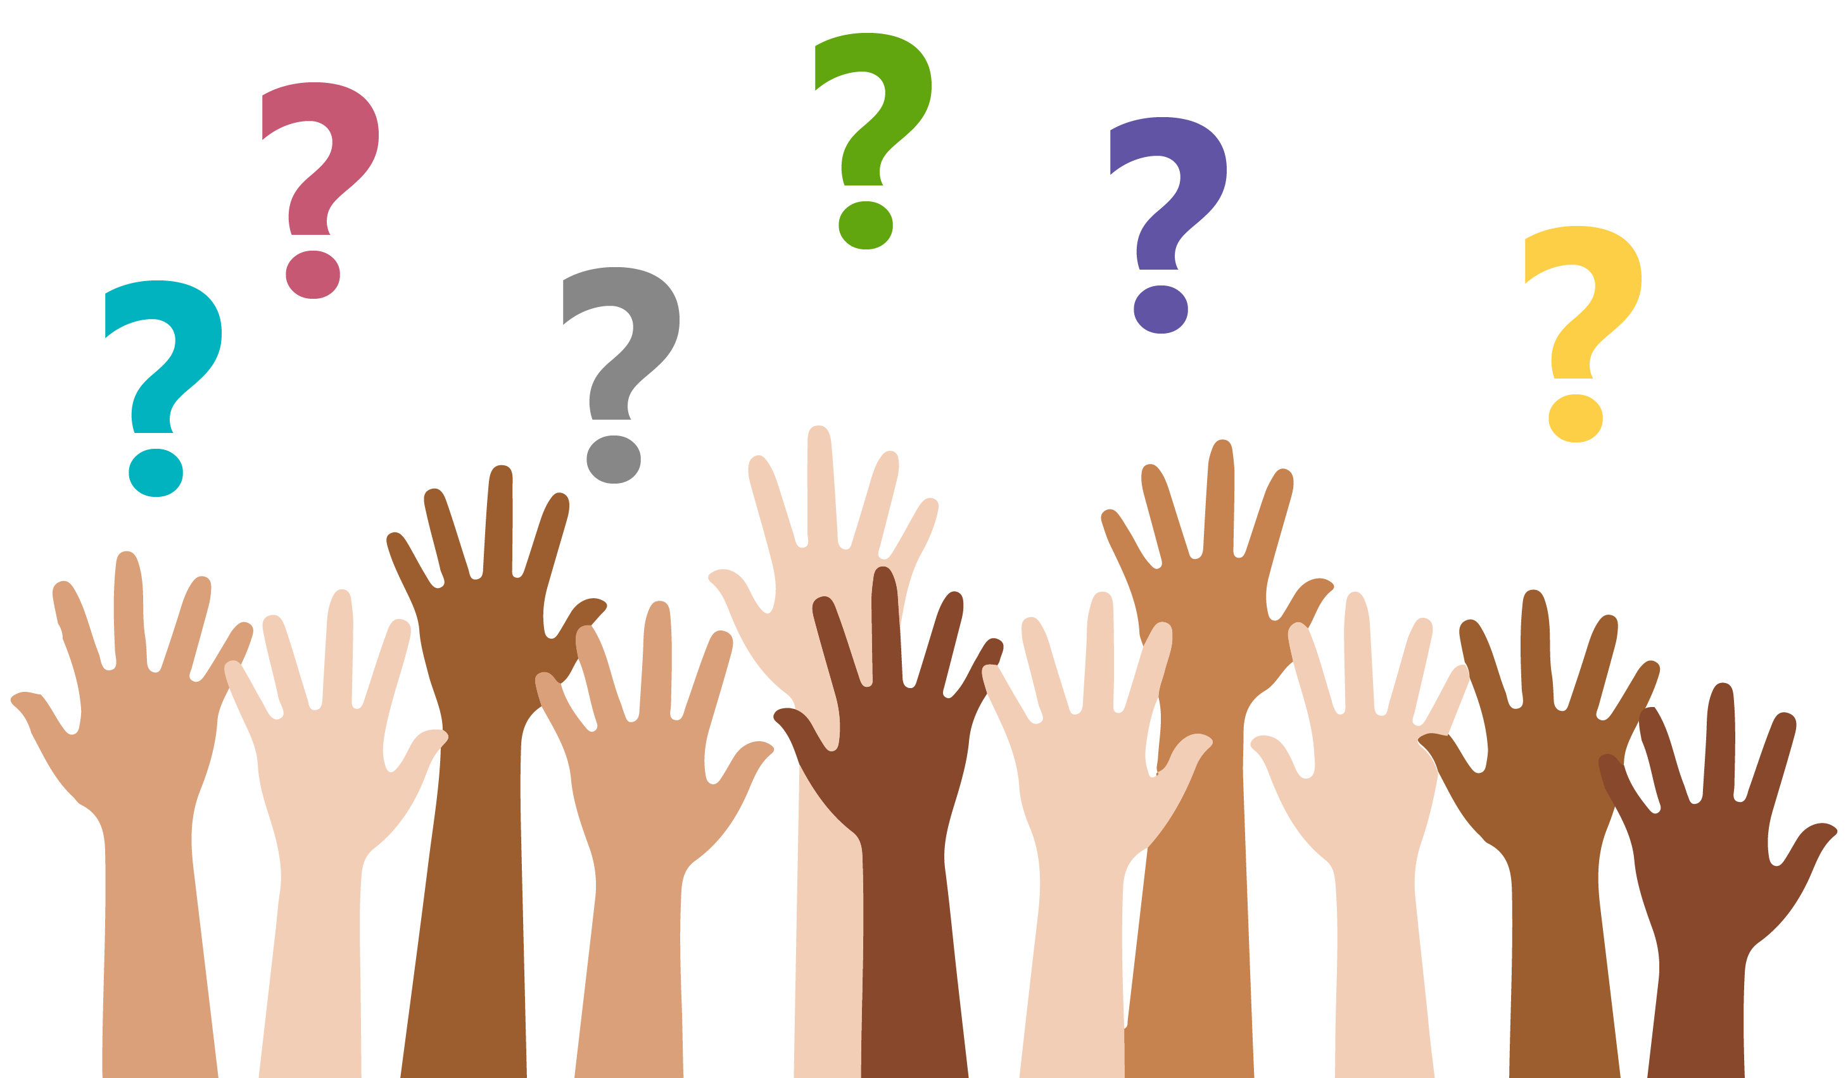
Thank you for Listening Questions?

