Slide 1
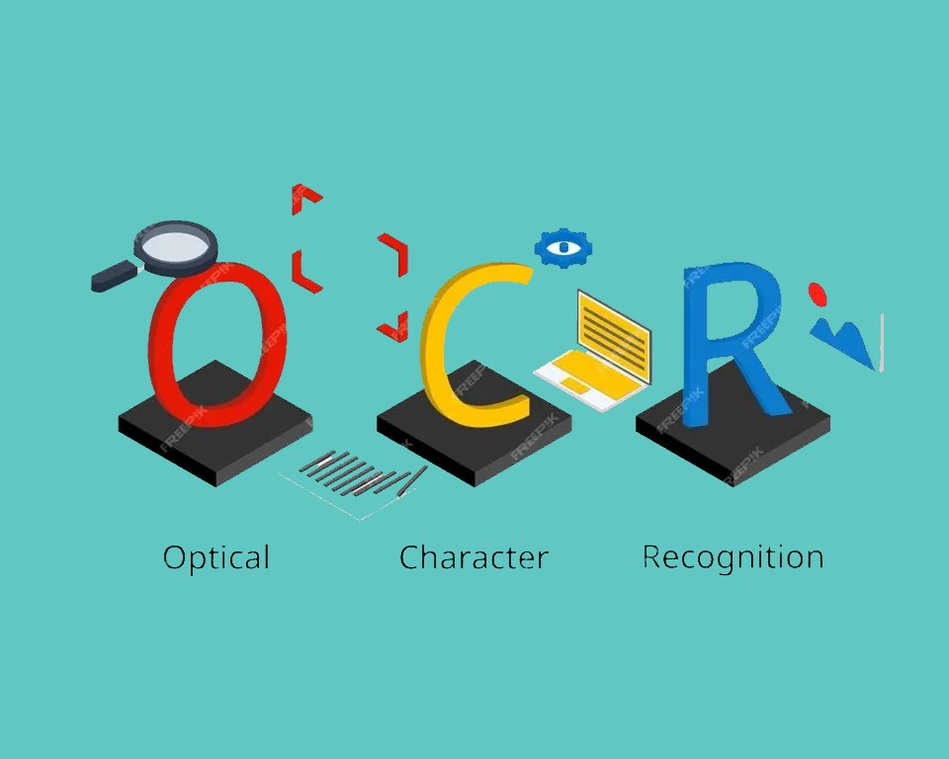
Bangla OCR for Hand-written Texts
Team-5
Abdullah Rahat - 20301134
Jarin Akter Mou - 20301070
Hasim Reza - 21301343
Zaki Habib - 19201073

Slide 2
Introduction
OCR or Optical Character Recognition is a method that extracts text from images, documents etc.
Our project is to work with recognition model for Bangla handwritten text using Neural Network
Using OCR and Neural Network, it can be easy to translate handwritten images to digital text.

Slide 3
Why Neural Network for OCR
Pattern recognition and Adaptability of Neural Network
Improves performance of OCR by the help of end to end learning
Can Handle Complex Structures

Slide 4
Motivation
In the digital educational system, Bangla OCR for handwritten text can easily have a major impact.
Considering other languages, OCR for Bangla handwritten text is still in work
As new models releases with much more improvement time to time, the reognization system can also be improved using these new models.

Slide 5
Literature Review
The first paper proposes a novel approach, Separable Multi-Dimensional Long Short-Term Memory Recurrent Neural Network or SMDLSTM-RNN, for addressing challenges in handwritten Chinese text recognition. The method combines SMDLSTM-RNN with CNN modules, outperforming a Bidirectional LSTM-based model on diverse datasets. Experimental results on the ICDAR-2013 competition dataset show competitive accuracy, surpassing earlier LSTM-based techniques and rivaling state-of-the-art systems. The paper suggests addressing context overfitting for future improvements.
The 2nd paper introduces a CNN-based approach for recognizing Bangla handwritten characters using the BanglaLekha-Isolated dataset, emphasizing the scarcity of research in this area. The proposed model achieves significant accuracy, especially with data augmentation, showcasing its effectiveness and versatility across various datasets.
The paper introduces an OCR system for single-font Bangla documents, combining template and feature matching for character recognition without preprocessing. With a feature-based tree classifier, it achieves an accuracy of approximately 96%, making it a promising solution for Bangla script OCR applications, potentially aiding in text entry automation and assisting visually impaired individuals.

Slide 6
Dataset
A new benchmark image database of isolated handwritten Bangla characters with detailed usage and baseline. The dataset contains 80,403 hand-written images on 50 Bangla basic characters.
The dataset contains 249,911 hand-written images on 171 Bangla unique pattern shapes compound characters written by more than 2,000 unique writers from various institutes across Bangladesh.
Hasan, Md Mahedi; Ibrahim, Mohammad; Abir, Mahathir Mohammad; Sayem, Muhammad; Abdullah, Sohaib (2019), “AIBangla”, Mendeley Data, V1, doi: 10.17632/hf2tt9kxkn.1

Slide 7
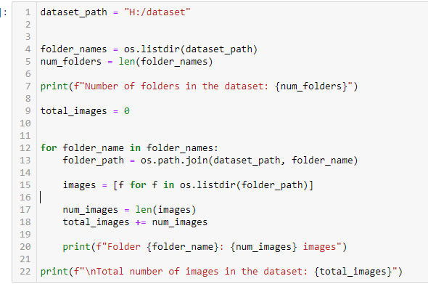
Data Pre-processing
Data Collection and Organization
Collected images from the source path and organized them into a new dataset folder.
Created new folders for each category in the dataset.
Copied a subset of images from each category into the corresponding new folder.

Slide 8
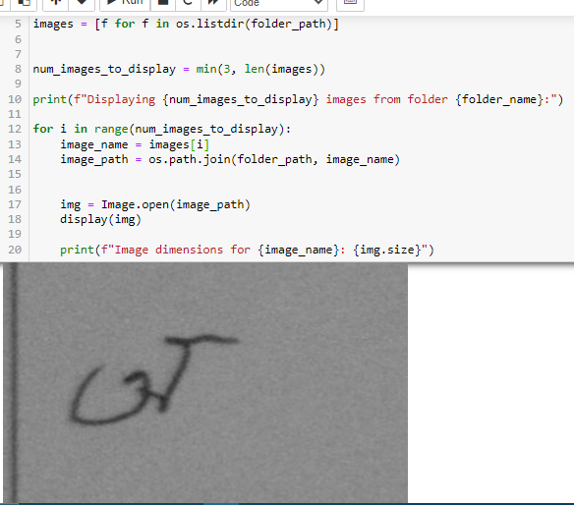
Calculated the total number of categories (folders) and images in the dataset. and displayed a few sample images from the dataset and their dimensions.
Calculated the total number of categories (folders) and images in the dataset. and displayed a few sample images from the dataset and their dimensions.

Slide 9
Image Preprocessing
Converted each image to grayscale and resized it to 64x64 pixels.
Normalized pixel values to the range [0, 1] and flattened the image array.
Dataframe Creation and Storage
Created a dataframe where each row represents an image, and each column represents a pixel.
Encoded the image labels (folder names) into numerical values.
Stored the data frame into a CSV file for future use. This completes the data preprocessing stage.

Slide 10
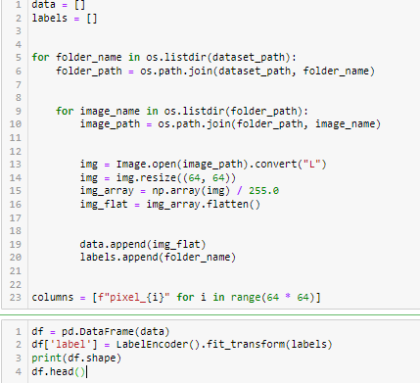
Here is the code snippet of our creating a dataframe

Slide 11
Methodology
The dataset was loaded from a CSV file and the labels were extracted.
The images were reshaped to the appropriate dimensions and the labels were one-hot encoded.
A Convolutional Neural Network (CNN) model was built using Keras, with three Conv2D layers followed by MaxPooling2D layers, a Flatten layer, and two Dense layers.

Slide 12
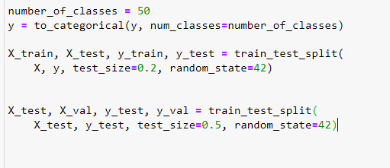
Train, Test and Validation split:
We have splitted the dataset by 80:20 where 805 is the training set. For the rest 20%, we divided it by half to acquire the Train :Test : Validation = 8:1:1

Slide 13
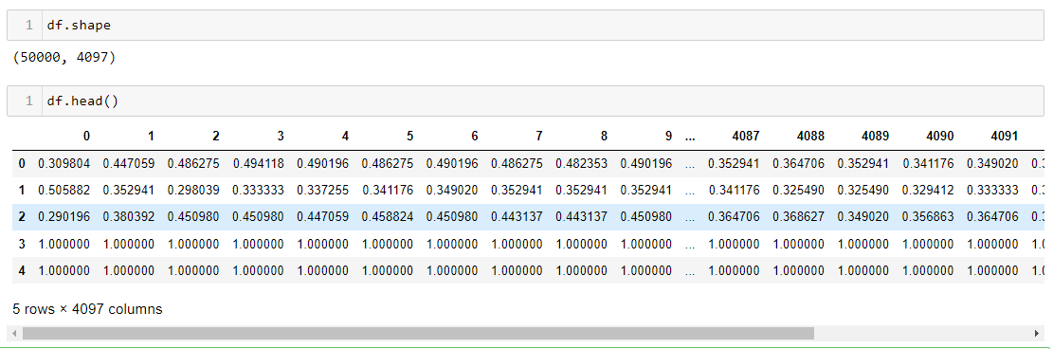
Data Analysis
Dataset Overview:
Data Shape: The dataset has a shape of (5000, 4097), providing insight into the dataset size where 5000 indicates the number of rows i.e number of images and 4097 indicates the number of features is 4096 and last column is the target column
Exploratory Data Analysis (EDA): An initial exploration of the first few rows of the dataset helps understand its structure.

Slide 14
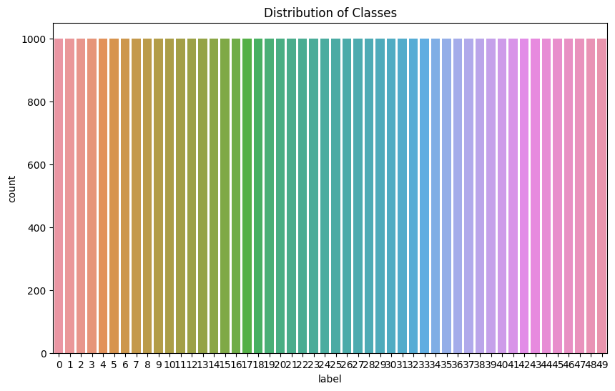
Class Distribution Analysis:
Visualization: Utilized a countplot to visually represent the distribution of different classes in the dataset.
Insights: Analyzed the class distribution to identify potential imbalances or patterns in the dataset.

Slide 15
Prototype Implementation
Convolutional Neural Network (CNN):
Architecture: a CNN with multiple convolutional and max-pooling layers to capture hierarchical features is implemented
Flattening and Dense Layers: Flattening and dense layers for classification are incorporated.
Activation Functions: ReLU activation for convolutional layers and softmax activation for the output layer is utilized.

Slide 16
Training Process:
Optimizer and Loss Function: The Adam optimizer and categorical crossentropy loss for model training are used
Learning Rate Scheduler: Implemented a learning rate scheduler to dynamically adjust the learning rate during training.
Early Stopping: Applied early stopping to prevent overfitting and restore the best weights.

Slide 17
Model Summary and Visualization:
Model Overview: Displayed a summary of the CNN architecture to provide insights into layer configurations and parameter counts.
Visualization of Training: Monitored the training process by observing metrics such as accuracy and loss over epochs.
Callback Usage: Showcased the impact of learning rate scheduling and early stopping on the model's training behavior.

Slide 18
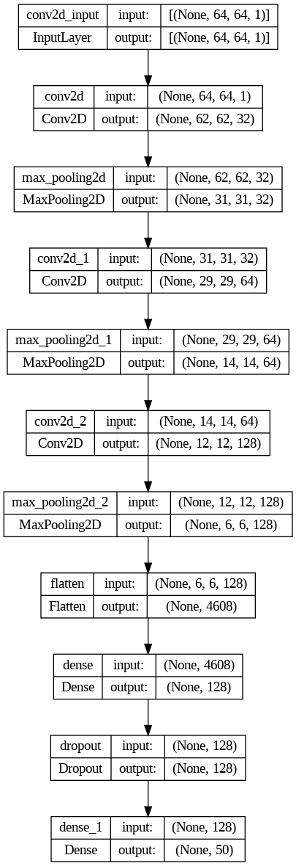
Our Model architecture:

Slide 19
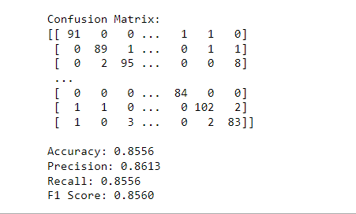
Result
Test Metrics Overview
Test Loss: 0.5496
Test Accuracy: 0.8556
Evaluation: The model achieved an accuracy of 85.56% on the test set.

Slide 20
Classification Report
Precision, Recall, F1-Score:
The classification report provides a detailed breakdown for each class.
Precision ranges from 65% to 97%, indicating the model's ability to correctly identify positive instances.
Recall ranges from 69% to 99%, highlighting the model's sensitivity to true positive instances.
F1-score, the harmonic mean of precision and recall, ranges from 70% to 95%, capturing a balance between precision and recall
For our model:
Accuracy: 0.8556
Precision: 0.8613
Recall: 0.8556
F1 Score: 0.8560
The model demonstrates strong performance across multiple metrics, achieving a balanced trade-off between precision and recall. Further optimization or fine-tuning can be explored based on specific application requirements.

Slide 21
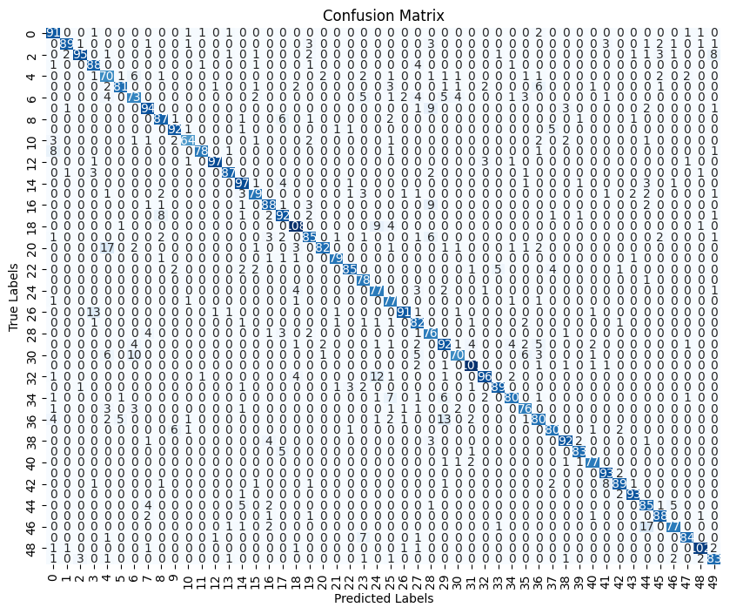
Confusion
Matrix:

Slide 22
Limitations
The AiBangla Dataset has a very large amount of datas. This is where our hardware limitation comes to active. As, running the huge dataset needs a very powerful machine.
The availability of resources for development may be limited for Bangla OCR compared to languages like English due to a possible lack of research efforts and pre-trained models especially designed for the language.
Compound characters, which are only combinations of fundamental characters, are used in Bangla script. For CNNs, reliably identifying and segmenting these intricate characters is a difficulty.

Slide 23
Conclusion & Future Work
For our trained model we have achieved a result of satisfactory mark
With the intrinsic complexity of different writing styles, compound characters, and segmentation problems, the CNN-based method performs remarkably well.
In future, by using improved model, we can increase the result to a more higher number in case of accuracy and time
We can add and increase words or sentences to further enhance the recognition method for our model.

Slide 24
References
Y. -C. Wu, F. Yin, Z. Chen and C. -L. Liu, "Handwritten Chinese Text Recognition Using Separable Multi-Dimensional Recurrent Neural Network," 2017 14th IAPR International Conference on Document Analysis and Recognition (ICDAR), Kyoto, Japan, 2017, pp. 79-84, doi: 10.1109/ICDAR.2017.22.
R. R. Chowdhury, M. S. Hossain, R. ul Islam, K. Andersson and S. Hossain, "Bangla Handwritten Character Recognition using Convolutional Neural Network with Data Augmentation," 2019 Joint 8th International Conference on Informatics, Electronics & Vision (ICIEV) and 2019 3rd International Conference on Imaging, Vision & Pattern Recognition (icIVPR), Spokane, WA, USA, 2019, pp. 318-323, doi: 10.1109/ICIEV.2019.8858545
U. Pal and B. B. Chaudhuri, "OCR in Bangla: an Indo-Bangladeshi language," Proceedings of the 12th IAPR International Conference on Pattern Recognition, Vol. 3 - Conference C: Signal Processing (Cat. No.94CH3440-5), Jerusalem, Israel, 1994, pp. 269-273 vol.2, doi: 10.1109/ICPR.1994.576917.

