Slide 1

Drugs Analysis & Rating Prediction
Predicting user drug ratings using side-effect data
Shaik Zakir Ahammad

Slide 2

Problem Statement
Adverse drug reactions and user experiences are valuable for healthcare decisions. Manually reading thousands of reviews is inefficient.
Goal: Build a system to predict drug ratings and classify them as Low / Medium / High from drug metadata and side-effect text.

Slide 3
Objectives
Clean and prepare drug review data.
Engineer informative features from text and numeric fields.
Train regression and classification models for rating prediction.
Deploy a simple web app for real-time predictions.

Slide 4
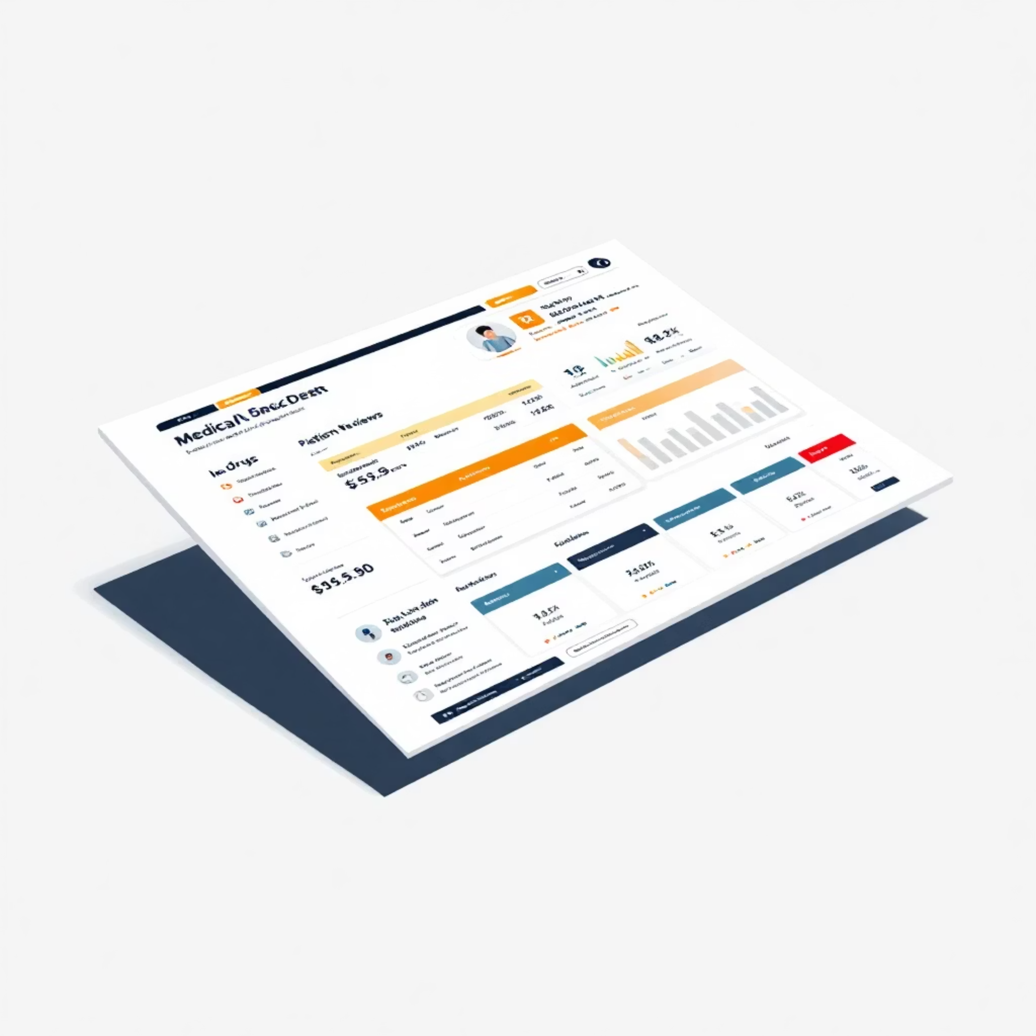
Dataset Description
Covers diverse drugs and conditions, with some missing values handled during preprocessing.
File: drugs_side_effects_drugs_com.csv
Key Fields: drug name, medical condition, drug classes, prescription type, pregnancy category, side-effects text, activity score, alcohol interaction, number of reviews.

Slide 5
Methodology
01
02
Data cleaning and handling of missing values.
Feature engineering: text length, keyword flags (rash, hives, dizziness), label encoding for categorical fields.
03
04
Model training: regression for numeric ratings, classification for Low/Medium/High labels.
Deployment using Flask with saved model artifacts.

Slide 6
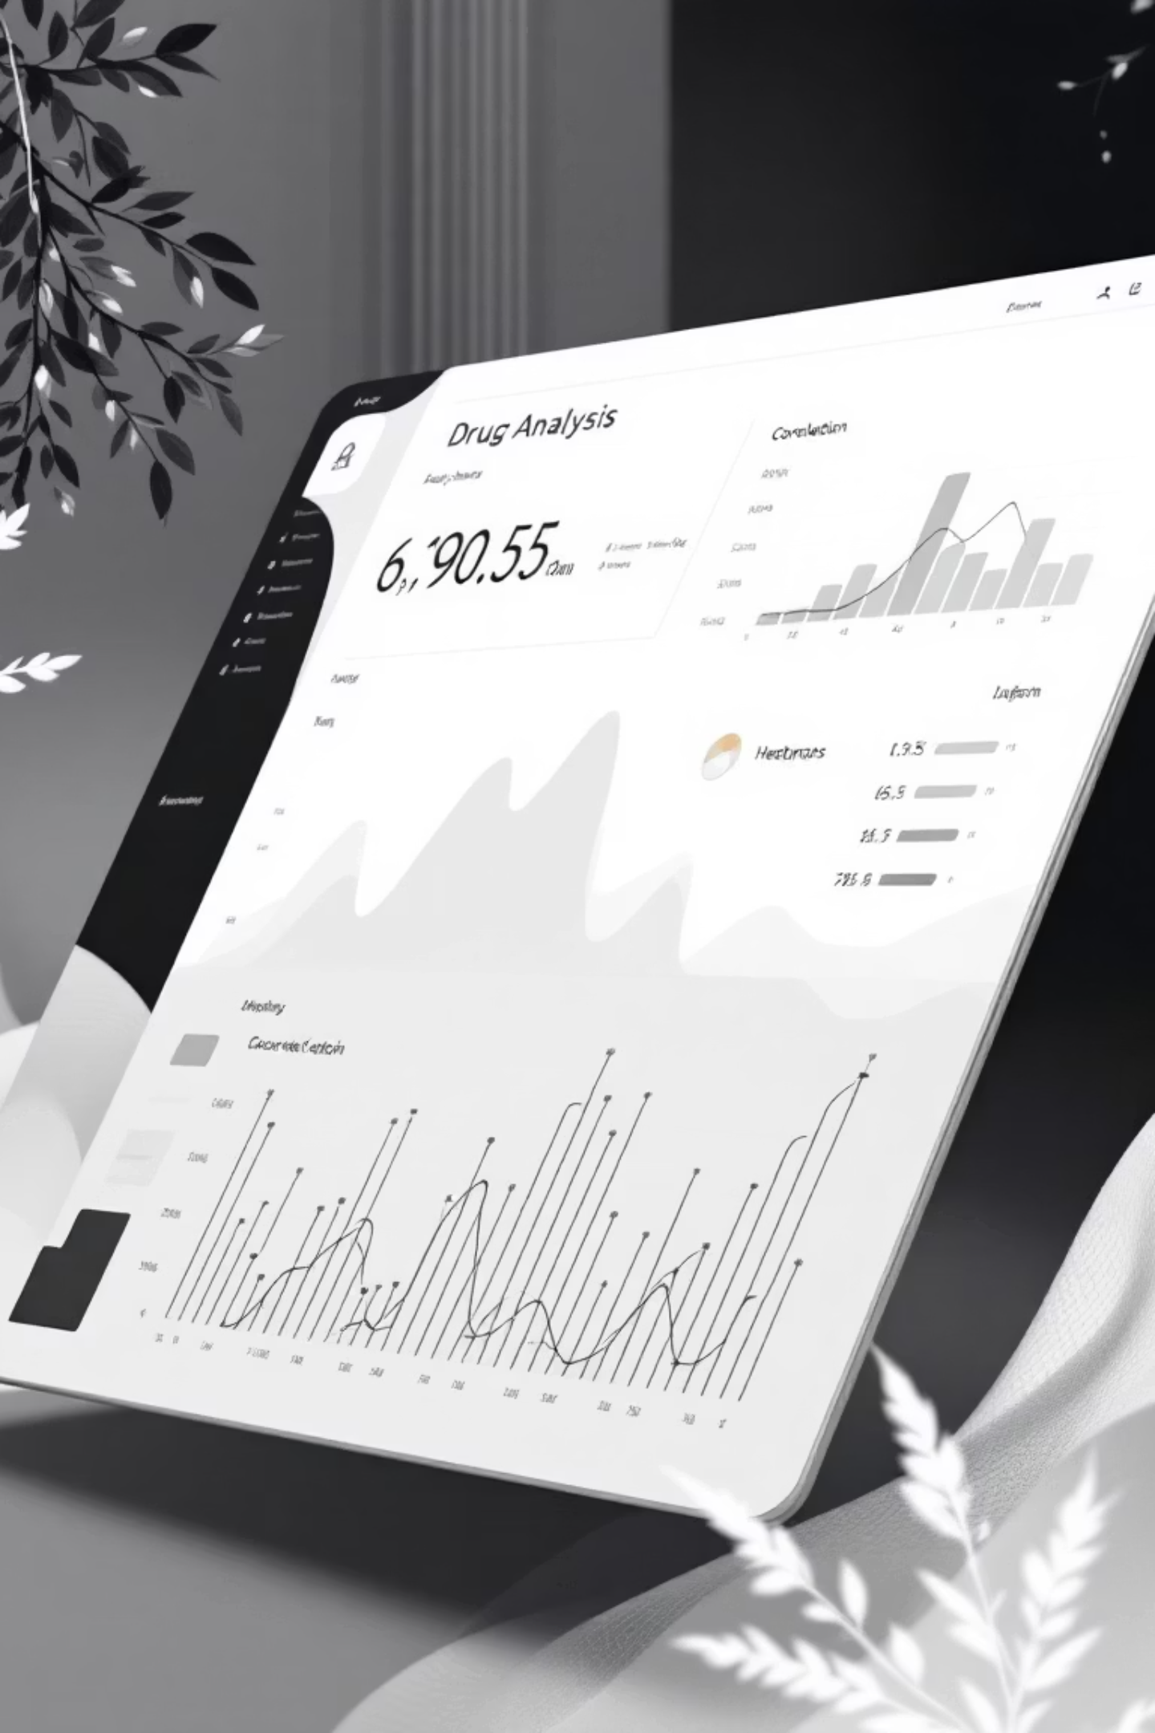
Exploratory Data Analysis
Rating Distribution
Keyword Frequency
Shows majority in medium–high range.
Analysis highlights common side effects.
Correlation Plots
Reveal strong link between review count and rating stability.
Visualizations: histograms, heatmaps, bar charts.

Slide 7
Modeling Approach
Regression:
Evaluation metrics: MAE/RMSE for regression, accuracy/F1 for classification.
scikit-learn model to predict ratings (0–10).
Feature importance shows number of reviews and symptom keywords as top predictors.
Classification:
thresholded regression output (High ≥ 7, Medium 4–6.9, Low < 4).

Slide 8
Results & Insights
Model Performance
Key Findings
Regression achieves low error and high correlation with actual ratings.
High ratings often linked to low-severity side effects and high activity scores.
Classification accuracy strong across all classes.
Flask web app delivers instant predictions with a simple interface.

Slide 9

Conclusion
Machine-learning models can effectively predict drug ratings from side-effect data.
The system aids patients, pharmacists, and researchers in understanding drug performance.
Demonstrates how text plus structured features provide actionable healthcare insights.

Slide 10



Future Work & References
Integrate advanced NLP (transformers) for richer text understanding.
Expand dataset with more recent reviews and clinical data.
Deploy on cloud (AWS/Heroku) with authentication and database logging.
References:
scikit-learn documentation
Flask documentation
Public drug review datasets

