Slide 1

Stock Market Analysis: Data-Driven Investment Intelligence
Transforming raw market data into actionable insights through advanced analytics, interactive visualizations, and web-based tools for investors, traders, and financial analysts.

Slide 2

Bridging Data Science and Financial Markets
This comprehensive project harnesses the power of data science to decode stock market complexities. By combining Python analytics, advanced visualization techniques, and machine learning approaches, we create a robust foundation for informed investment strategies.
Our methodology transforms chaotic market data into clear, actionable intelligence that empowers both seasoned professionals and emerging investors to make data-backed decisions in volatile market conditions.

Slide 3
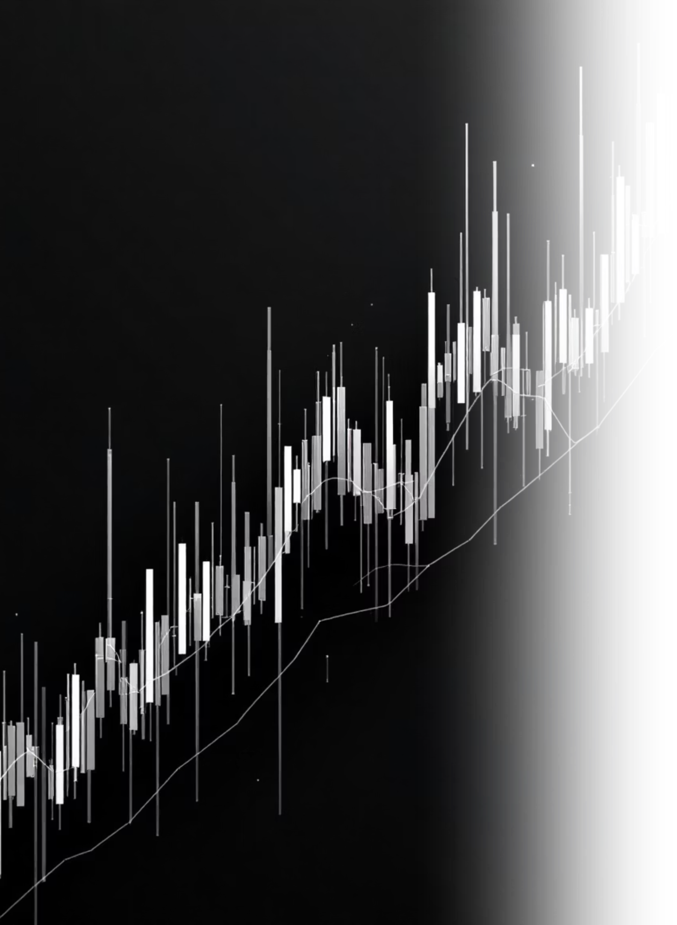
The Challenge: Navigating Market Volatility
Market Unpredictability
Data Overload
Financial markets generate massive amounts of data daily, overwhelming investors who lack sophisticated analytical tools.
Stock prices fluctuate rapidly due to countless variables, making pattern recognition extremely challenging for human analysis alone.
Decision Paralysis
Without clear insights, investors often make emotional rather than data-driven decisions, leading to suboptimal portfolio performance.

Slide 4
Strategic Objectives
01
02
Data Processing Excellence
Interactive Visualization
Clean and standardize historical stock data to ensure accuracy and reliability for all downstream analytics and modeling processes.
Build comprehensive dashboards and charts that reveal market trends, performance patterns, and comparative analysis across multiple securities.
03
04
Web Application Integration
Decision Automation
Deploy insights through a Flask-based platform that provides real-time access to analytics for investors and financial professionals.
Create intelligent systems that enhance decision-making speed and accuracy through automated analysis and user-friendly interfaces.

Slide 5


Dataset Foundation
Our comprehensive stocks.csv dataset serves as the analytical backbone, containing rich historical price data and market attributes that enable deep insights into market behavior.
Historical price movements and volume data
Multi-timeframe analysis capabilities
Cross-stock comparison metrics
Growth opportunity identification tools
This robust dataset enables tracking of price fluctuations, identification of emerging opportunities, and comprehensive performance comparisons across different securities and market sectors.
The dataset provides the essential foundation for all analytical processes, ensuring comprehensive market coverage and reliable insights.

Slide 6





Analytical Methodology
Data Preprocessing
Comprehensive cleaning, validation, and standardization of raw market data to ensure analytical accuracy and consistency.
Exploratory Analysis
Statistical investigation to uncover hidden patterns, correlations, and market behaviors using advanced Python libraries.
Visualization Development
Creation of interactive charts, graphs, and dashboards that transform complex data into intuitive visual insights.
Web Application Deployment
Flask-based platform development for dynamic accessibility and real-time user interaction with analytical results.

Slide 7
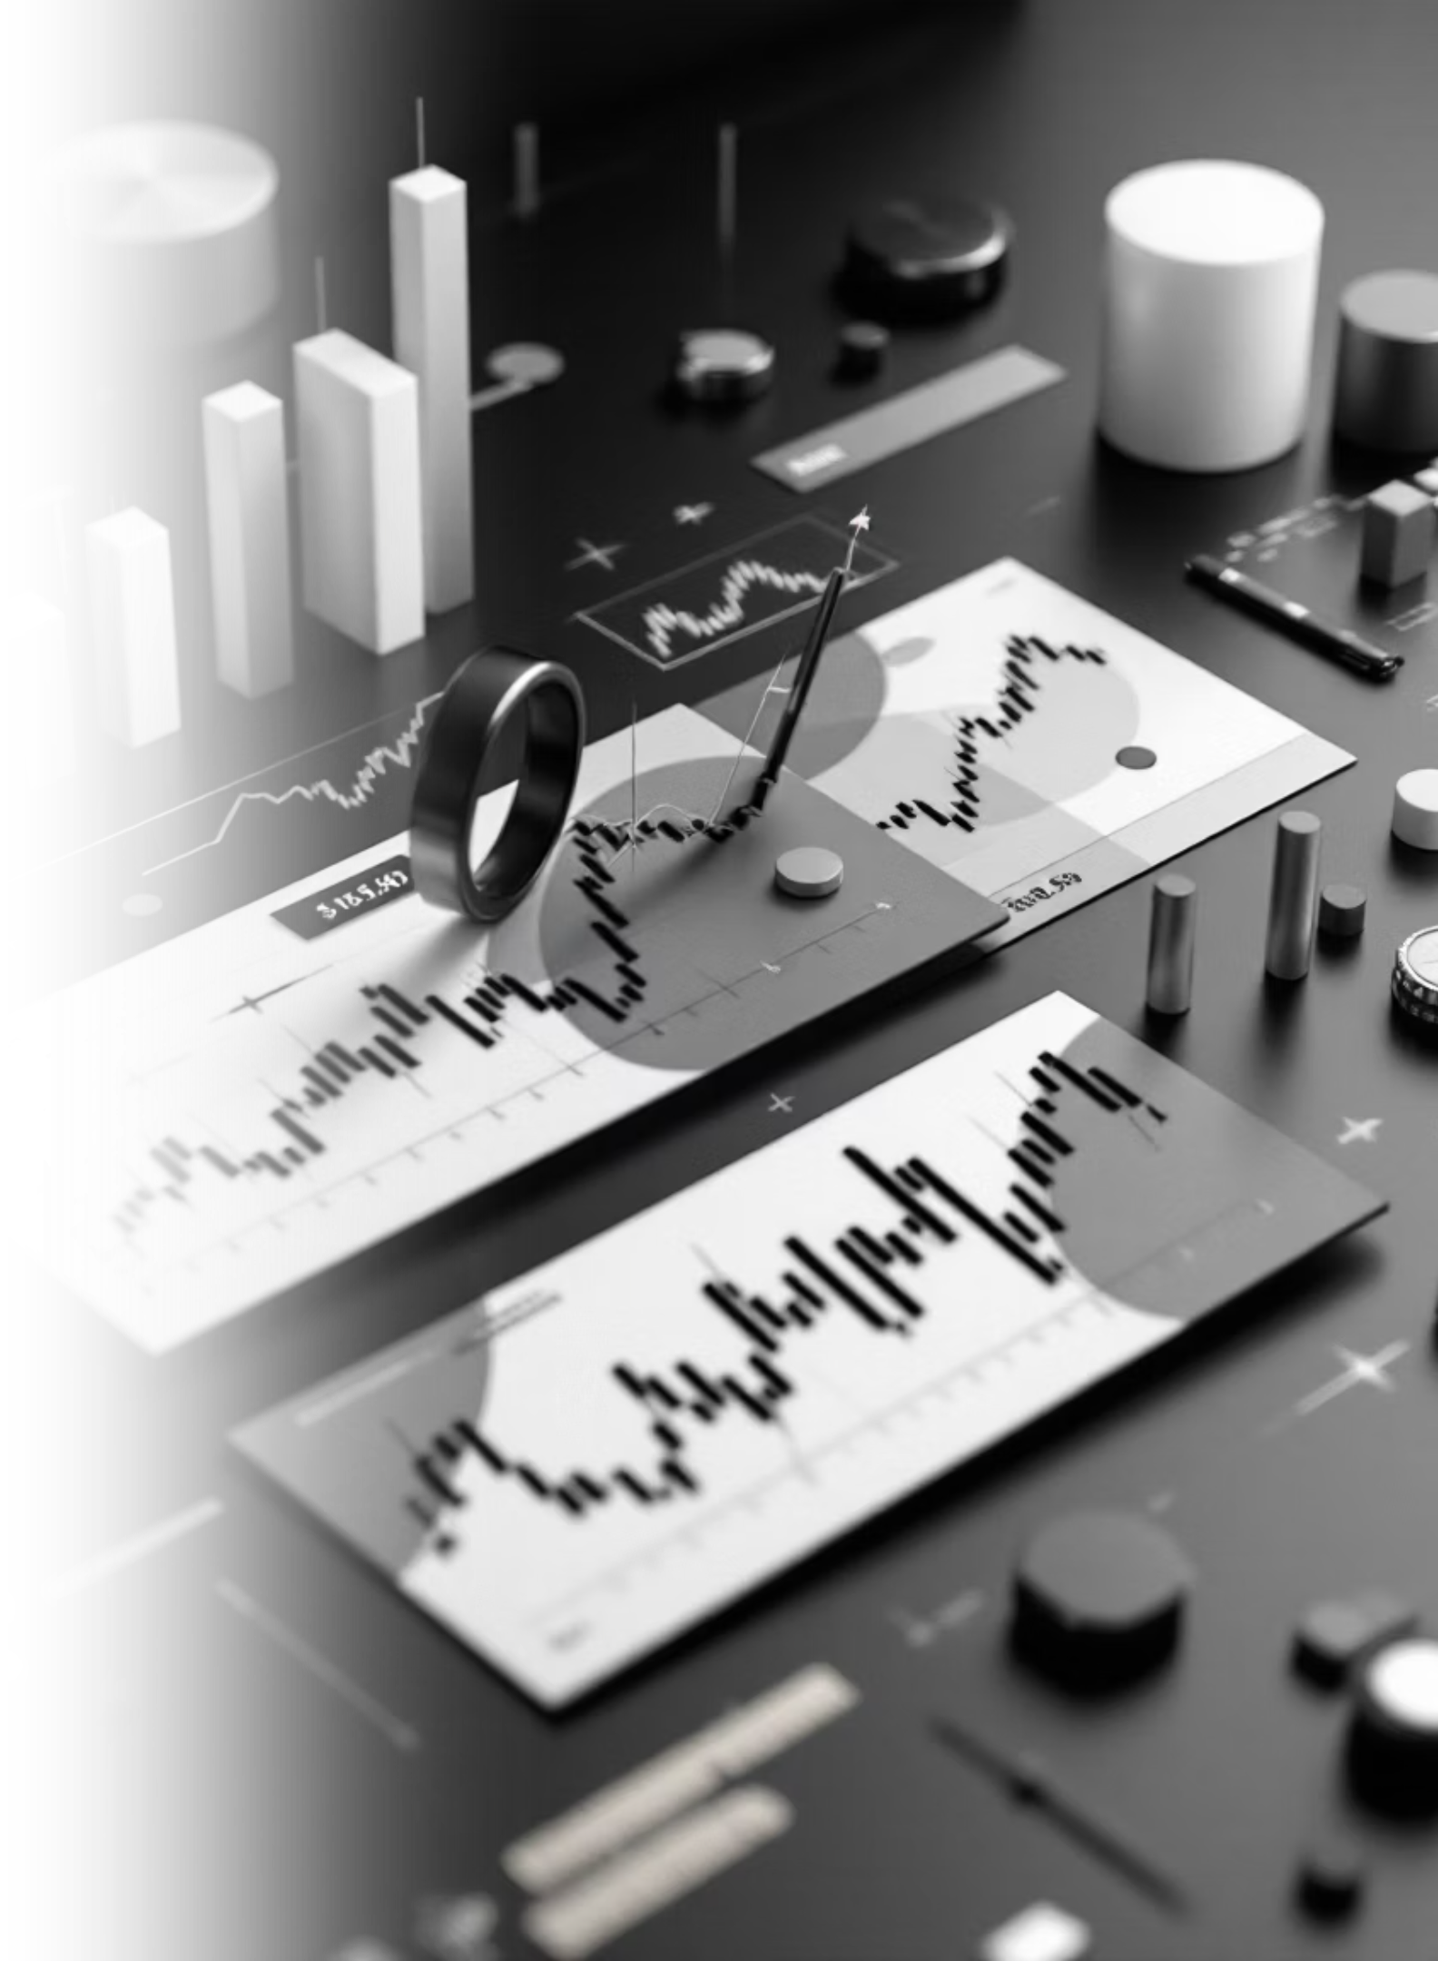



Key Market Insights Discovered
Seasonal Patterns
Analysis revealed consistent seasonal variations in stock performance, with specific sectors showing predictable cyclical behavior that investors can leverage for timing strategies.
Volatility Indicators
Interactive visualizations highlight market volatility patterns, enabling users to identify high-risk periods and adjust portfolio strategies accordingly.
Growth Trajectories
Long-term growth indicators emerged from the data, revealing which securities demonstrate sustainable upward momentum versus short-term fluctuations.

Slide 8
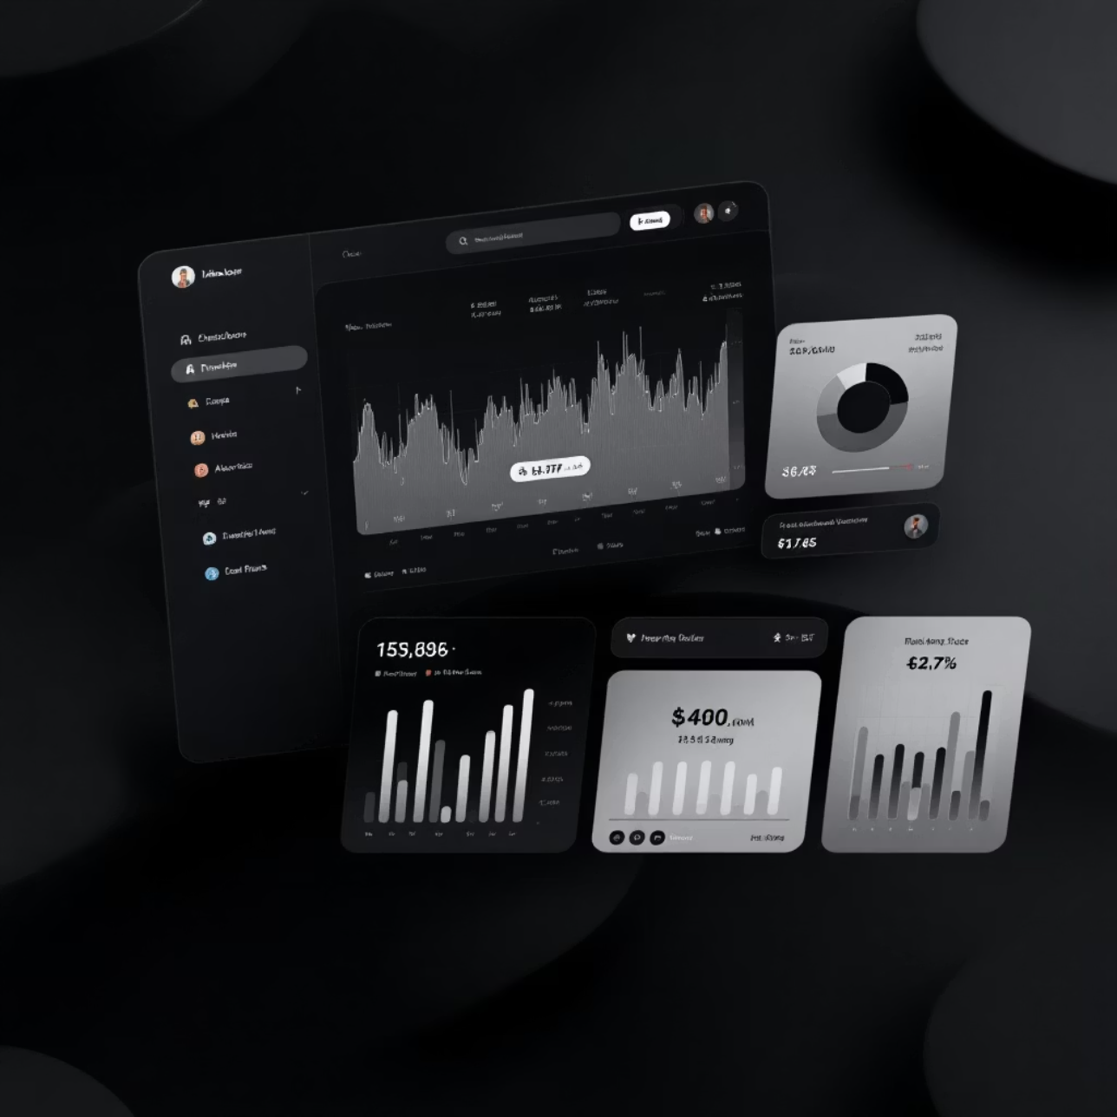
Flask Web Application: Real-Time Market Intelligence
Interactive Platform Features
Real-time stock data exploration and analysis
Dynamic visualization generation and customization
User-friendly interface designed for all experience levels
Comprehensive reporting and export capabilities
The Flask application bridges the gap between complex data science and practical investment tools, providing immediate access to sophisticated analytics through an intuitive web interface.
Empowering investors with professional-grade analytics in an accessible format that transforms how financial decisions are made.

Slide 9

Project Impact and Results
100%
Real-time
Multi-user
Data Processing Success
Interactive Access
Accessibility
Platform designed to serve both novice investors and experienced financial analysts effectively.
Complete transformation of raw stock data into meaningful, actionable insights for investment decision-making.
Deployed web application provides instant access to market analytics and visualization tools.
The project successfully demonstrates how combining data analytics with modern web technology can dramatically simplify complex financial decision-making processes while maintaining analytical rigor and accuracy.

Slide 10
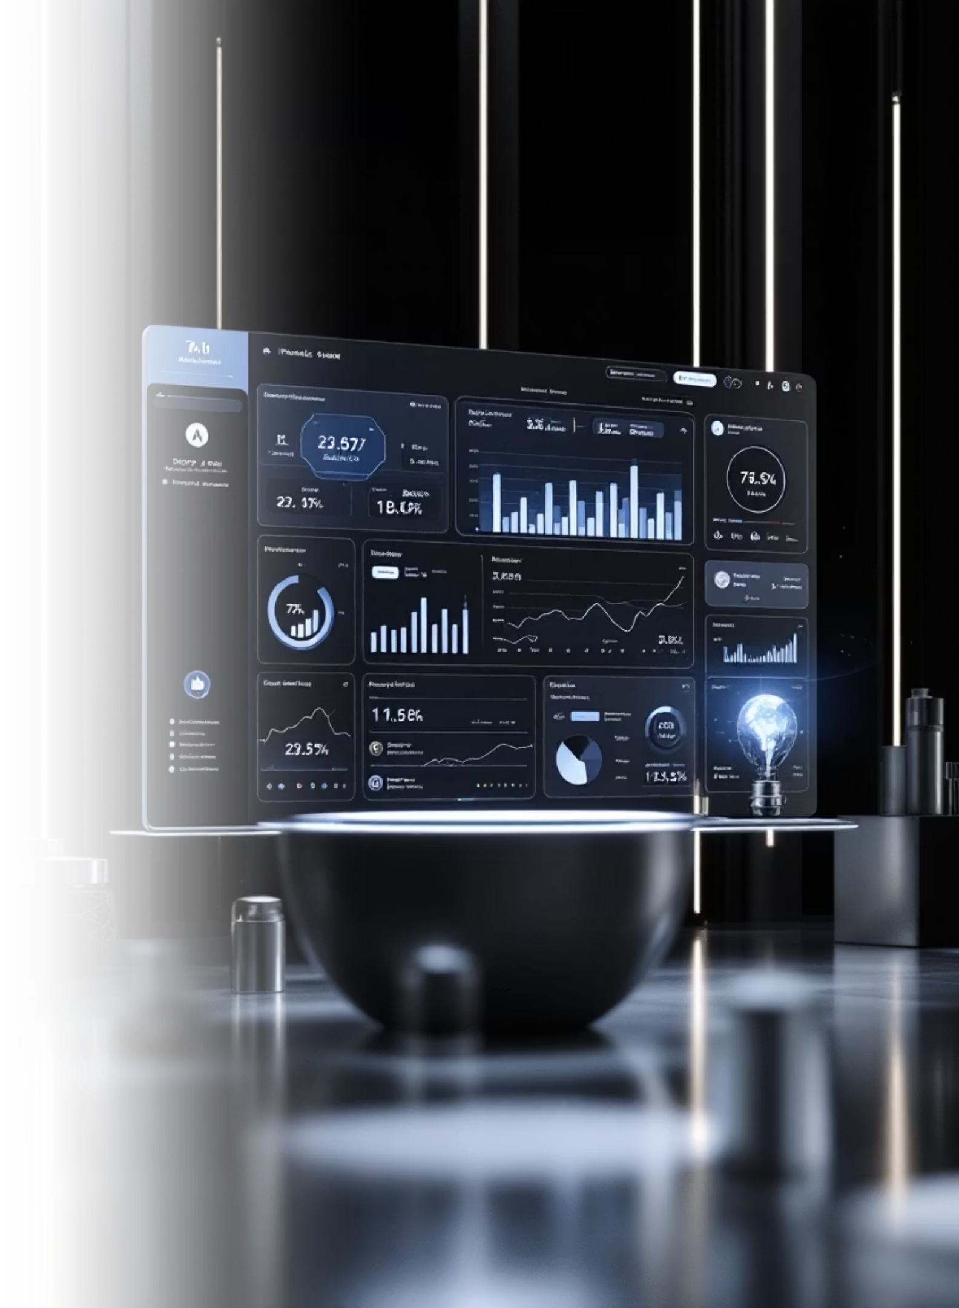
Future Expansion Opportunities
1
Machine Learning Integration
Implement predictive models for price forecasting and automated trading signal generation using advanced ML algorithms.
2
Global Market Expansion
Extend analysis to international markets, cryptocurrency, and alternative investment vehicles for comprehensive coverage.
3
Advanced Dashboard Deployment
Develop sophisticated real-time trading dashboards with live market feeds and advanced analytical capabilities.
This foundation establishes endless possibilities for enhancing financial market analysis through technology, positioning us at the forefront of data-driven investment intelligence.

