Slide 1
Super Store Sales Dashboard
A Power BI Interactive Visualization Project

Slide 2
Project Objective
To design an interactive dashboard that provides key insights into Super Store sales, focusing on metrics like sales, profit, and growth trends across time, region, and categories.

Slide 3
Dataset Overview
- Source: Super Store Sales Data
- Records: 5,900+
- Key Columns: Order Date, Sales, Profit, Category, Segment, Region, State, Payment Mode

Slide 4
KPIs Tracked
- Total Sales
- Total Profit
- Quantity Sold
- Average Delivery Time
- Sales and Profit Trends

Slide 5
Dashboard Features
- Interactive filters for Region (Central, East, South, West)
- Time-series line charts for Sales and Profit
- Donut charts for Segment, Category, Region, Payment Mode
- Bar charts for State-wise and Sub-Category-wise Sales
- Summary cards with totals

Slide 6
Visualizations Included
- Sales and Profit by Month (2019 & 2020)
- Sales by Region, Segment, Category, Payment Mode
- Top-performing States and Sub-Categories
- KPI Cards for Summary
- Slicers for Region-based filtering

Slide 7
Insights & Observations
- Highest Sales: California
- Most Profitable Segment: Corporate
- Preferred Payment Mode: Online
- Tech category leads in revenue
- Year-end months show spikes in Sales and Profit

Slide 8
Conclusion
The dashboard successfully consolidates key metrics and trends, allowing stakeholders to make data-driven decisions regarding regional performance, customer segments, and product categories.

Slide 9
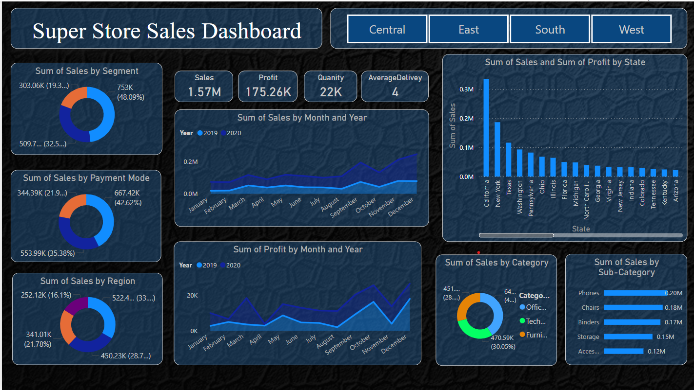
Dashboard Overview

Slide 10
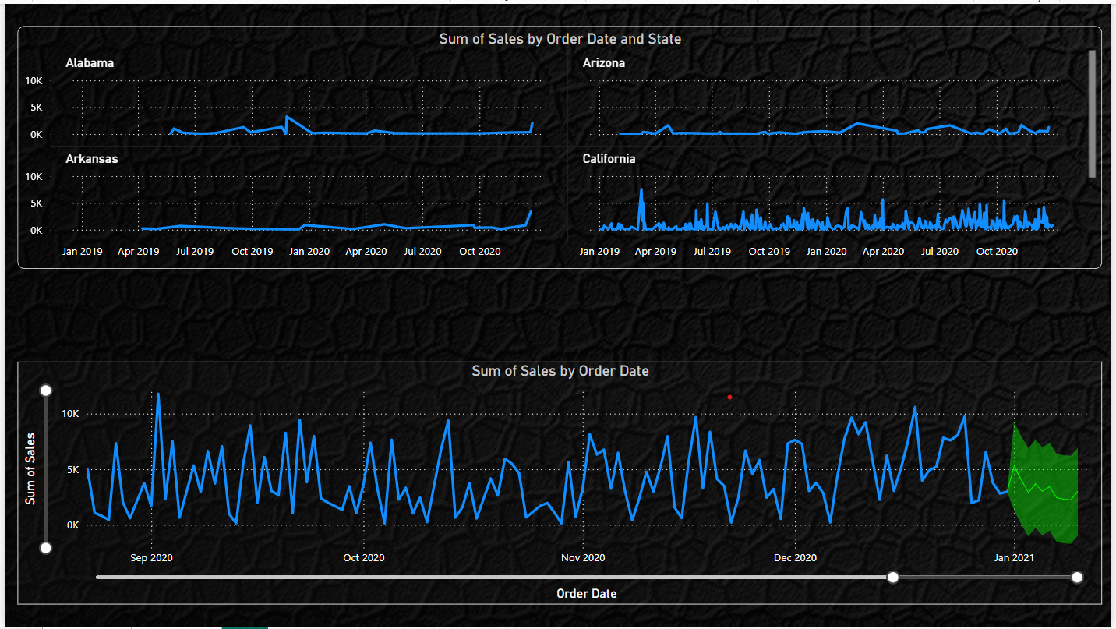
State-wise Sales and Forecast Trend

Slide 11
Thank You!

