Slide 1
Array Data transfer from 1 html page to another

Slide 2
CNIC
CNIC First Name Last Name
12345 Muhammad Ali
45366 Hashim Alvi
42574 Muhammad Babar
First Name
Last Name
Save
Print Data

Slide 3
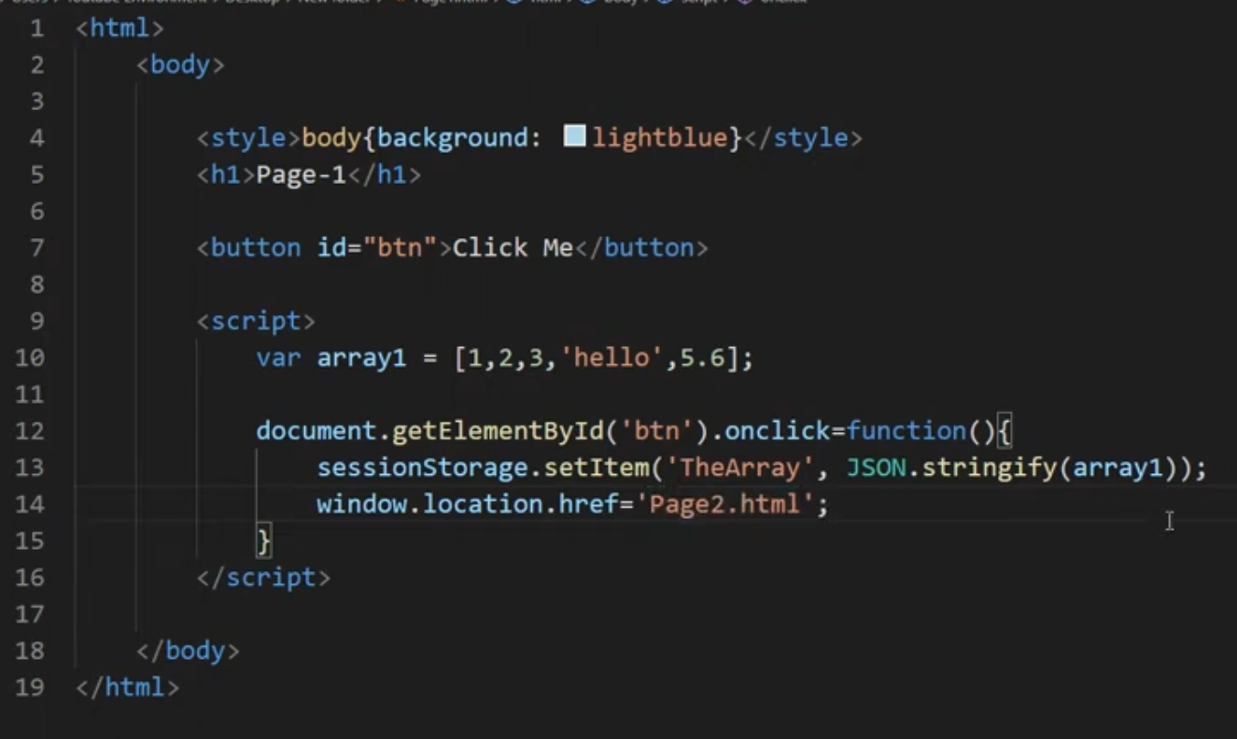
Page1.html

Slide 4
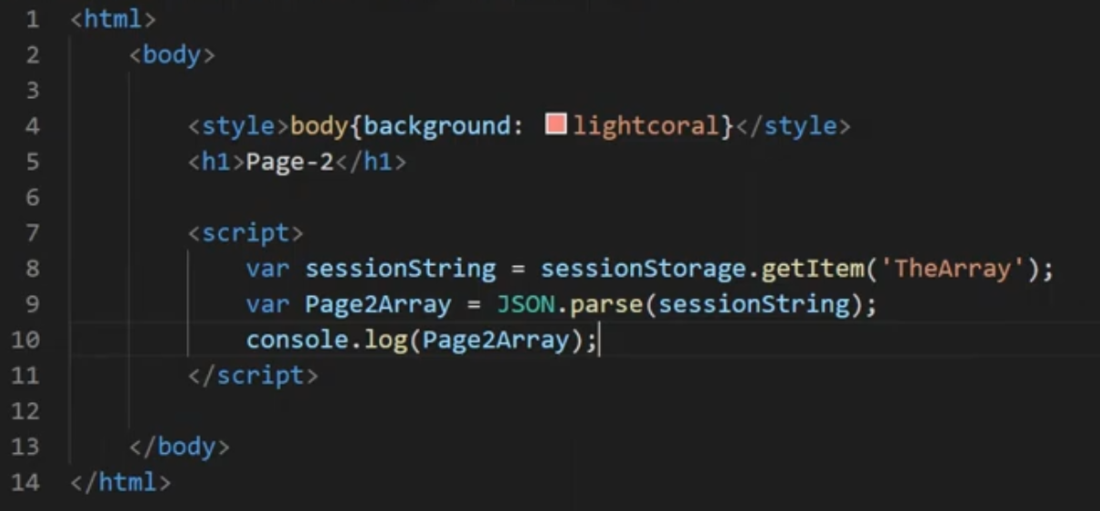
Page2.html

