Slide 1
QIYAS HACK · DATA CLEANING, INTEGRATION & FORECASTING
Forecasting hourly ride demand across Addis Ababa
12 zones · every hour · 1–14 November 2025 · tuned LightGBM, about 6 trips off per zone-hour
OUR TEAM
Niyat Debesay
Henok Solomon
Zakira Abdurahman
Amina Aman
ND
HS
ZA
AA
Notes:
(~10 s) Good morning. We are Niyat Debesay, Henok Solomon, Zakira Abdurahman and Amina Aman. Our project forecasts how many rides each of 12 Addis Ababa zones will need, hour by hour, for 1–14 November 2025.

Slide 2



How many rides will each Addis zone need, every hour?
1 · THE PROBLEM AND THE THREE TABLES
Drivers have to be in place before riders open the app. We forecast trips per zone per hour for 12 zones over the 14 days after our history ends: 1–14 Nov 2025, a test file of 4,032 zone-hours with no target.
The 10-month history (Jan–Oct 2025) is split across three tables that disagree on names, formats and even the clock.
ride_demand_train 85,460 rows
One row per zone-hour: trips (our target), fare, wait time, active drivers.
Catch: 55 spellings of 12 zones, 3 date formats, counts inflated ×8
weather_hourly 7,538 rows
One city-wide station: hourly temperature, rain, humidity, wind.
Catch: Stored in UTC, some °F values, −9999 codes, missing hours
12
4,032
+41%
events_calendar 165 rows
Football matches, concerts, conferences, holidays, road closures.
Catch: Re-issued duplicates, “Citywide” zones, cancelled events
zones
zone-hours to forecast
growth Jan → Oct
Notes:
(~40 s) A ride-hailing platform has to position drivers before demand appears. We forecast trips for each of 12 zones for every hour of 1–14 November — 4,032 zone-hours. We have three tables: ride demand per zone-hour, one city-wide weather station, and an events calendar. Each has its own problems: 55 zone spellings, three date formats, inflated counts, a UTC clock, duplicate events.

Slide 3
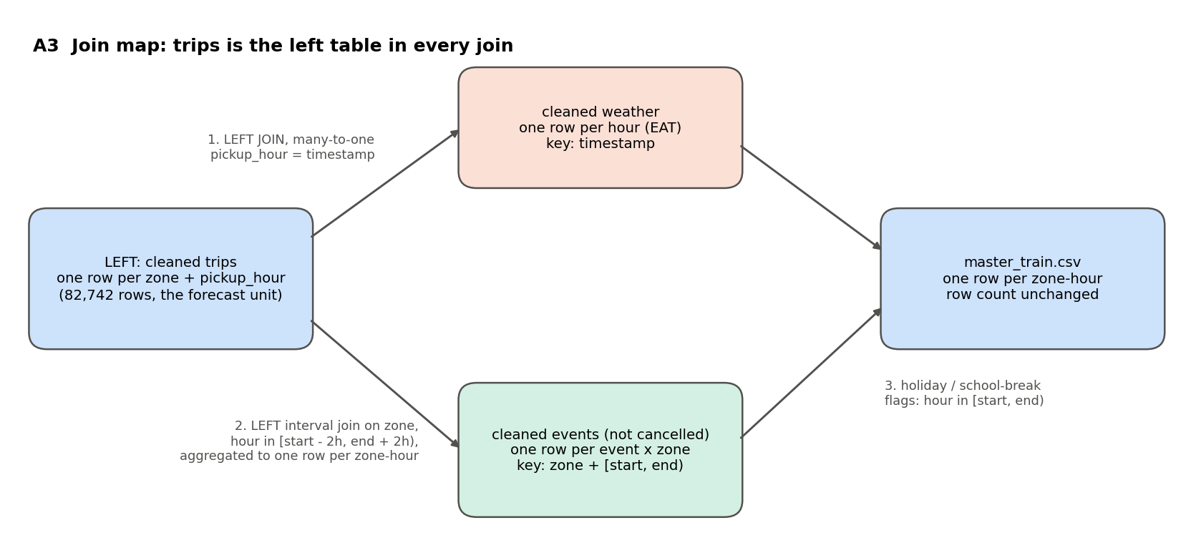
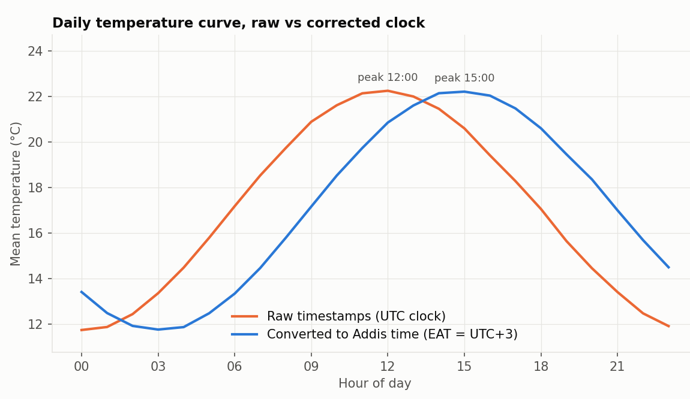
Trips stay the left table, so every join keeps all 82,742 zone-hours
2 · CLEANING & INTEGRATION
85,460 → 82,742
trip rows after cleaning (97% kept); 55 zone labels → 12
100%
weather match; 186 station hours filled and flagged
1,829
zone-hours (2.2%) in an event window: start − 2 h to end + 2 h
146 / 159
events matched; 6 cancelled, 7 fall in the test period
The clock problem. Weather is stored in UTC; trips mix local times with “+03:00” stamps (12,810 rows). We put every table on Addis time (UTC+3). The slash weather rows fit the UTC series at 0 h (0.55 °C apart), not −3 h (2.7 °C). Proof: temperature peaks at 15:00 after +3 h, not 12:00.
Notes:
(~55 s) Cleaning: 55 zone spellings mapped to 12, every date parsed with an explicit format (day-first proven: 351 matches vs 27), 124 counts inflated ×8 divided back, 353 Fahrenheit temperatures converted, −1 and −9999 codes treated as missing. We keep 97% of trip rows.
Join map: trips are the left table in every join because the zone-hour is what we forecast — no join may add or drop a row, and the count stays 82,742. Weather joins many-to-one on the hour; events join on zone and the interval from 2 h before start to 2 h after end; holidays become flags.
A4: weather matches 100% of zone-hours (186 station hours filled and flagged); 1,829 zone-hours are inside an event window; 146 of 159 events matched — 6 were cancelled, 7 fall in the test period.
The clock problem: weather is in UTC. Without the +3 h shift, rain would land three hours early. The temperature curve proves it — peak at noon on the raw clock, 3 pm after conversion.

Slide 4
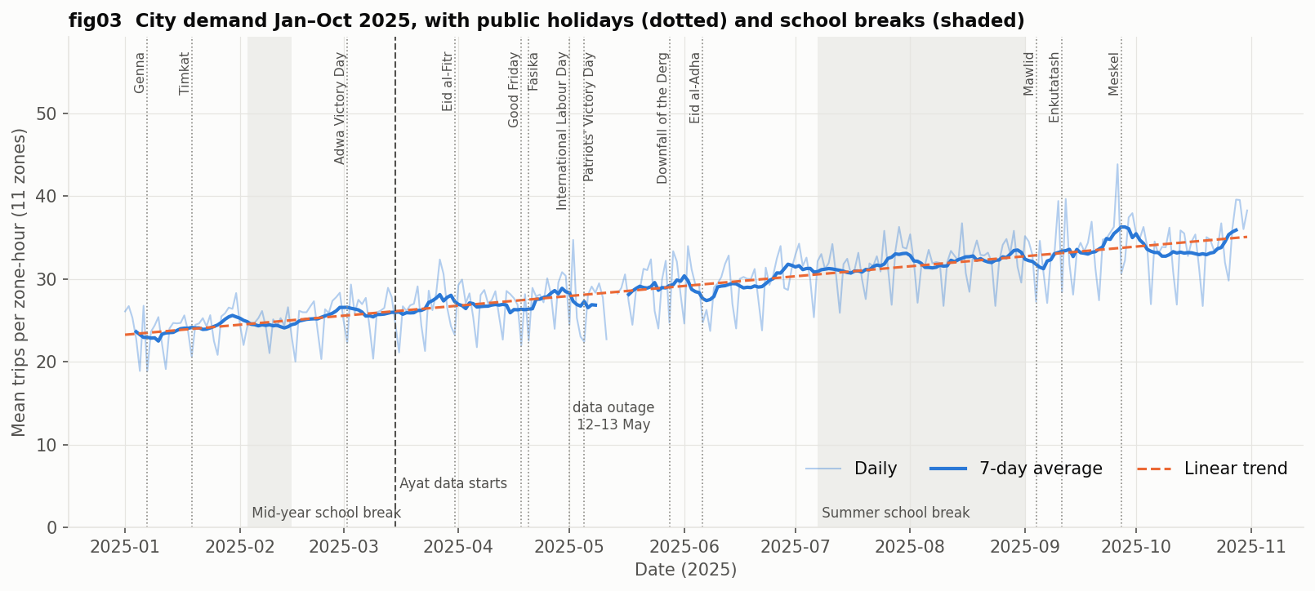
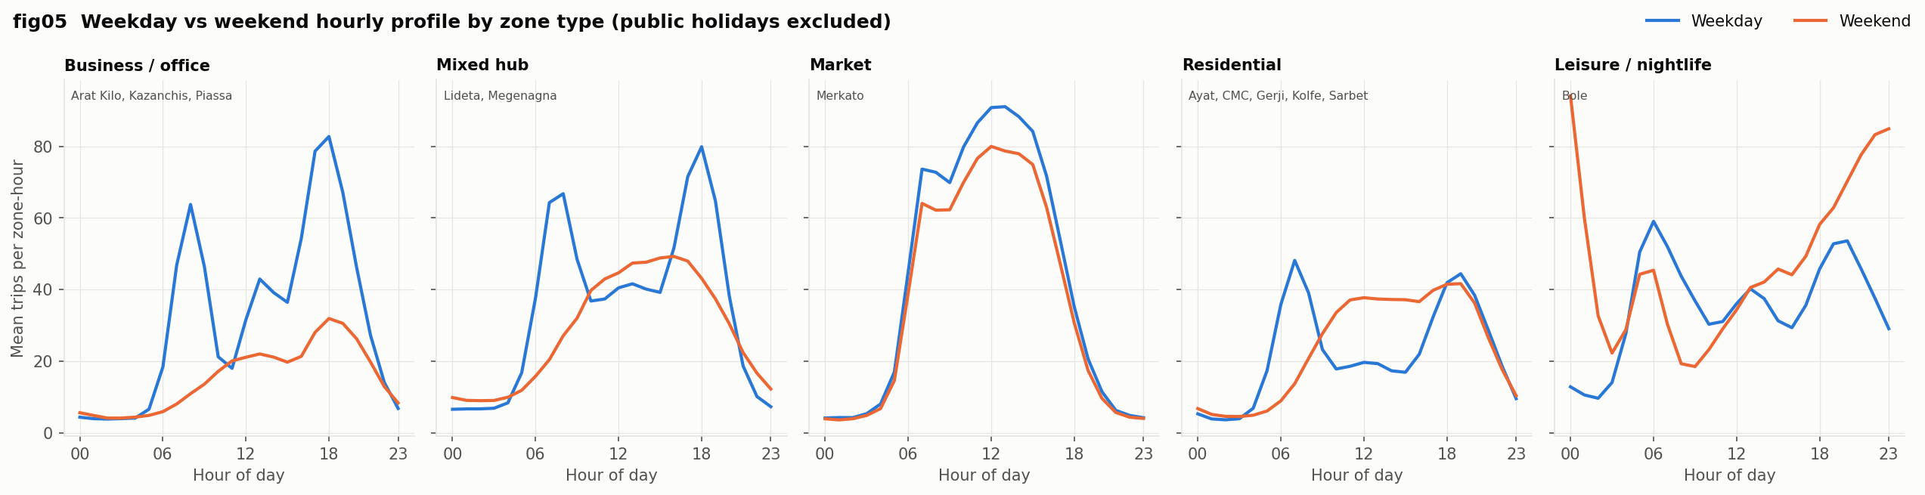
Demand grew 41%, and each zone type has its own rhythm
3 · WHAT THE DATA SAYS · THE PATTERNS
Steady growth, +41% Jan → Oct
About +3.9% a month, with no slowdown — so the model needs a trend term and recent lags.
Weekday holidays fall to about 73–85% of a normal day; Good Friday is lowest.
The 12–13 May dip is a 42-hour data outage, not real demand; Ayat only starts on 15 March.
5 zone types
Clustering hourly shapes: business zones empty at weekends, Merkato peaks at midday, Bole peaks late on weekend nights. One city-wide curve fits no zone.
Notes:
(~35 s) Before the two key findings, the shape of demand. City-wide demand grew about 41% from January to October, steadily — so our model uses a trend term and lags. Weekday holidays dip to around 80% of a normal day. The May dip is a data outage, not a demand drop.
Clustering the hourly profiles gives five zone types: business zones like Piassa collapse at weekends, Merkato has one midday plateau, residential zones swap the morning peak for a flat weekend midday, and Bole peaks late on weekend nights. So zone type is a key feature.

Slide 5
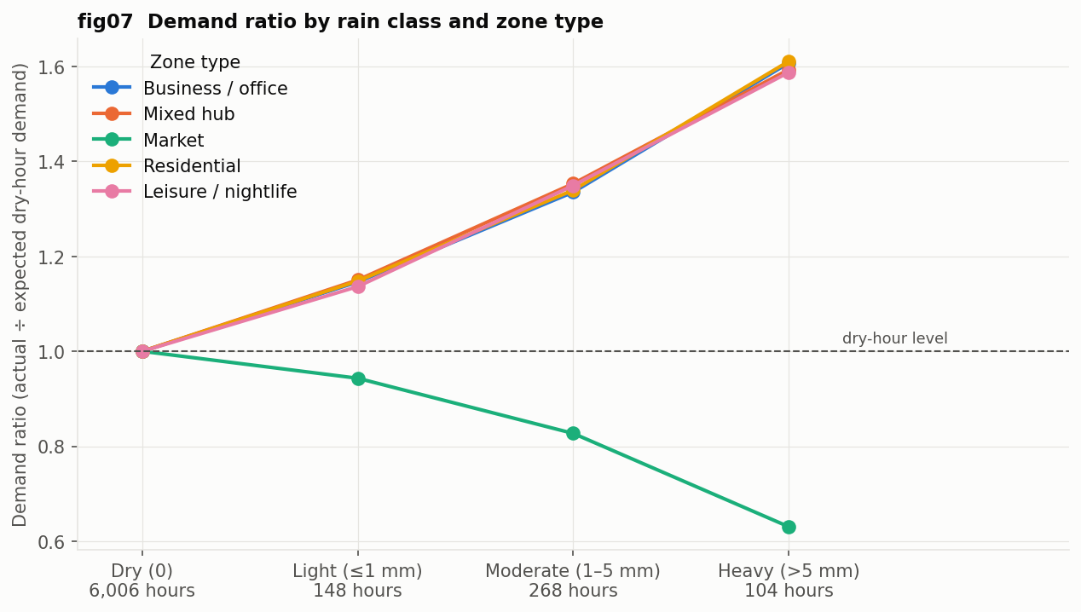
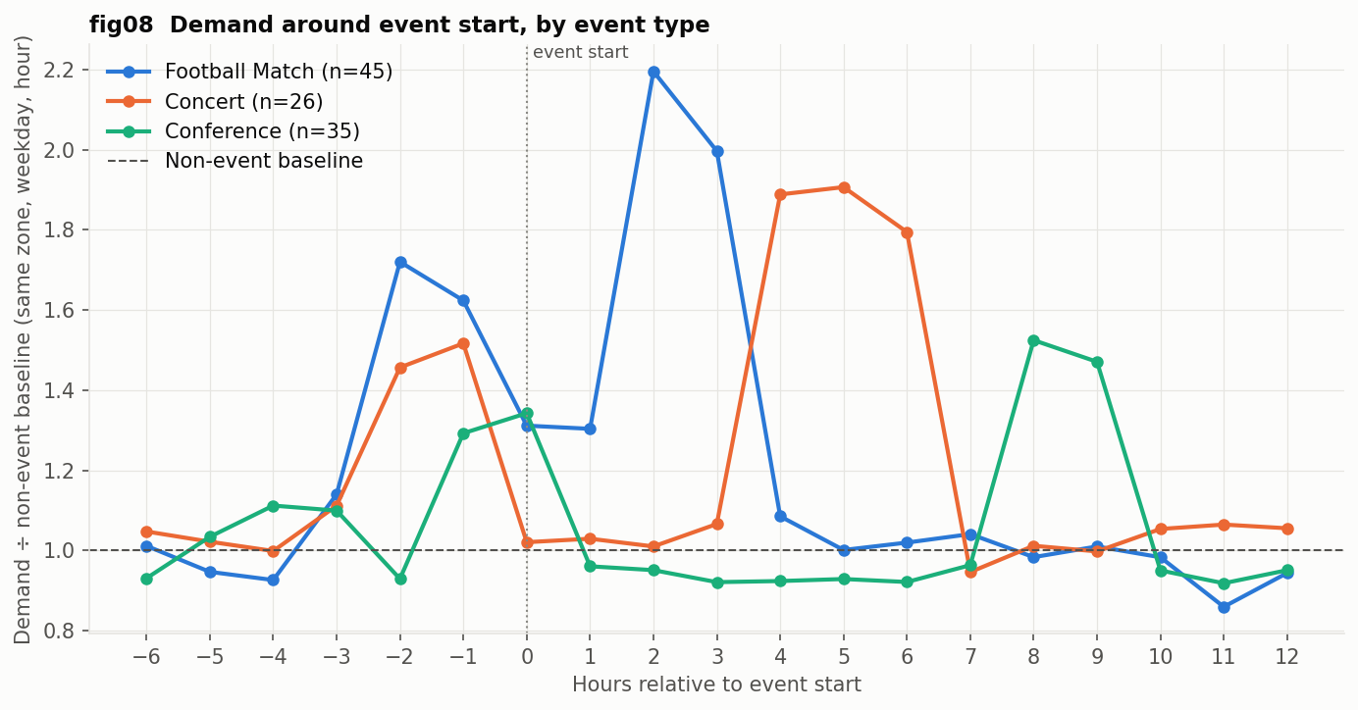
Rain and big events push demand up — except at the market
3 · WHAT THE DATA SAYS · TWO KEY FINDINGS
Heavy rain: about +60% rides — but Merkato falls to 0.63×
Football: 2.2× demand right after the final whistle
Light rain already adds ~15%. Most zones switch from walking to rides; Merkato drops, likely because outdoor market activity stops.
1.7× two hours before kick-off; concerts peak at 1.9× when they end. So our event window runs from 2 h before start to 2 h after end.
Notes:
(~45 s) Our two most interesting findings. Rain: compared with expected dry-hour demand for the same zone, weekday and hour, light rain adds about 15% and heavy rain about 60% — everywhere except Merkato, which drops to 0.63×, likely because the outdoor market stops. Events: football builds to 1.7× two hours before kick-off and jumps to 2.2× just after the final whistle; concerts peak at 1.9× as they end. That sets our event window. Also worth knowing: holidays on weekdays run at about 0.8× a normal weekday (fig09).

Slide 6
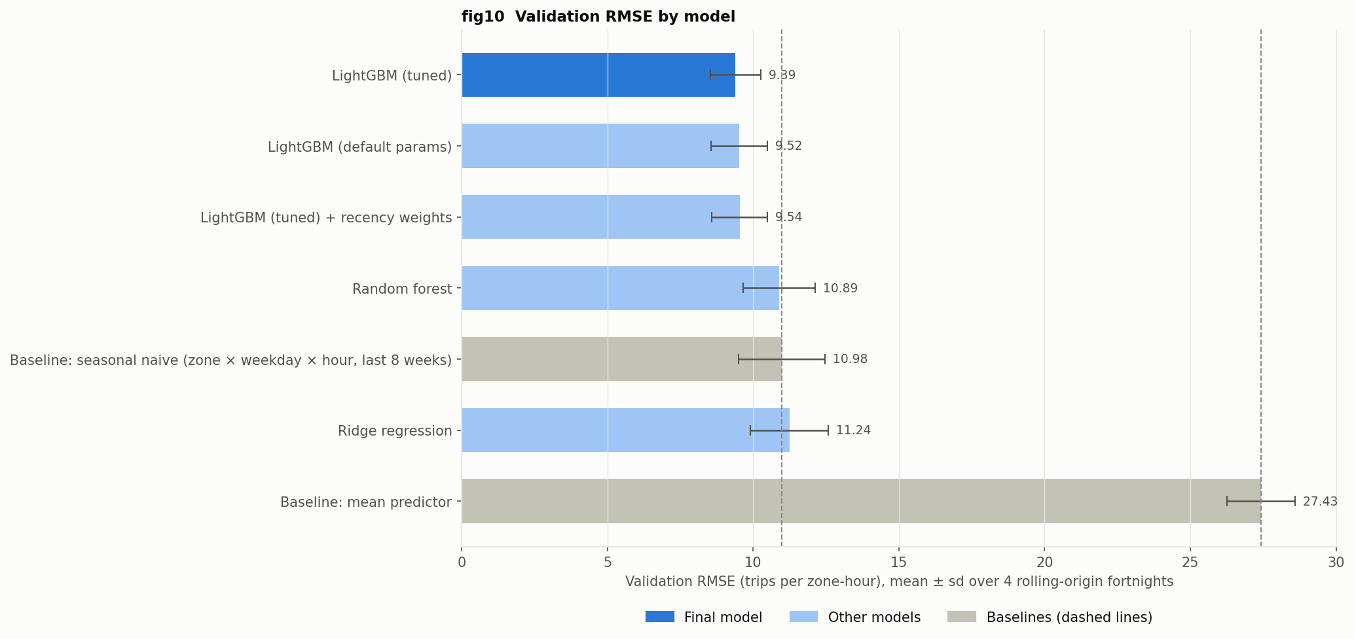
Tuned LightGBM beats the seasonal-naive baseline in every fold
4 · MODELING & EVALUATION
9.39 ± 0.86 mean RMSE
vs 10.98 seasonal naive (−14%). Tweedie loss, 15 leaves, 1,000 trees. Tuning: 9.52 → 9.39 and 3× faster; recency weights did not help.
Notes:
(~55 s) Baselines first. The mean predictor scores 27; the seasonal-naive baseline — same zone, weekday and hour over the last 8 weeks — scores 11. Ridge and random forest don't beat it reliably; LightGBM does, because it learns zone × hour × weekday × rain × event interactions on its own and its count losses suit trips.
Ablation on identical folds: weather alone cuts RMSE 8.6%, events 3.1%, both together 11.5%.
Rolling origin: each fold trains from scratch on everything before its cut and predicts the next 14 days; tuning used an earlier split (23 Aug–5 Sep), so the four evaluation fortnights stay unseen. The model wins in all four; the worst fold, 20 Sep, was simply the busiest.

Slide 7
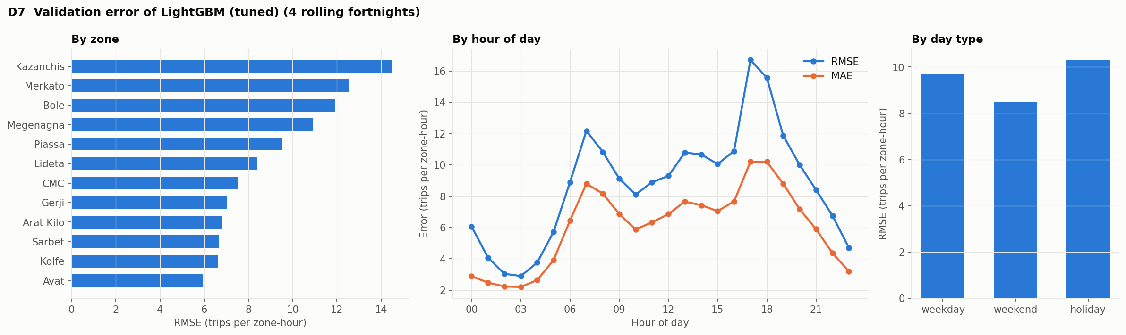
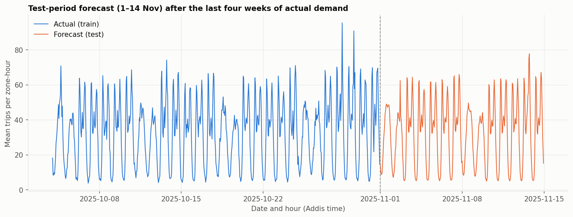
Errors cluster at evening peaks, rainy hours and unlisted spikes
5 · ERROR ANALYSIS, SCORE, DEMO & NEXT STEPS
Top 10 misses: 4 rainy rush hours (Kazanchis 26 Sep 17:00: 311 vs 131), 3 events bigger than expected, 3 spikes with no listed event.
Test forecast: keeps the daily rhythm; mean 32.8 trips vs 33.4 in late October.
FINAL SCORE
MAE 6.1 · RMSE 9.39
Validation, 4 rolling fortnights. About 5 drivers off in a typical zone-hour of 33 trips. submission.csv: 4,032 rows.
LIVE DEMO
Choose any zone and date in 1–14 Nov → the hourly forecast for that day.
Notes:
(~55 s) Error analysis on the out-of-fold predictions: errors are largest in Kazanchis, Merkato and Bole, at 17–18 h, and on holidays. Of the ten biggest misses, four are rainy rush hours — Kazanchis on 26 September at 5 pm had 311 trips against 131 predicted — three are events with bigger crowds than expected, and three are multi-hour spikes on 10 September with nothing in the calendar. The model also under-predicts about 1 trip on average because demand keeps growing; weighting recent weeks did not fix it, so we kept the simpler model.
Final score: MAE 6.1 trips, RMSE 9.39 — about 5 drivers off in a typical zone-hour. Retrained on all of Jan–Oct, the test forecast (right) keeps the daily rhythm, mean 32.8 vs 33.4 in late October.
Demo: [open the link — ask the judges for a zone and a date, e.g. Bole on Saturday 8 Nov or Merkato on a weekday].
Next: rain-by-zone-type interactions, detecting events missing from the calendar, and prediction intervals so operations can plan a range of drivers.

