Slide 1

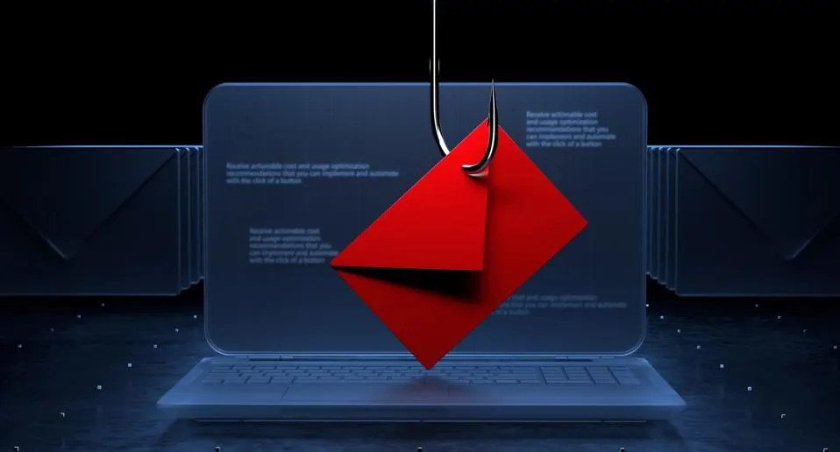
Understanding Phishing
Types, Prevention, Detection, and Response

Slide 2

Phishing Attack
Phishing is a cyber-attack where attackers disguise as trustworthy entities to steal sensitive information like passwords, credit card numbers, and personal details.
Types of Phishing Attacks
Email Phishing
Spear Phishing
Whaling
Smishing
Vishing
Clone Phishing
Pharming

Slide 3
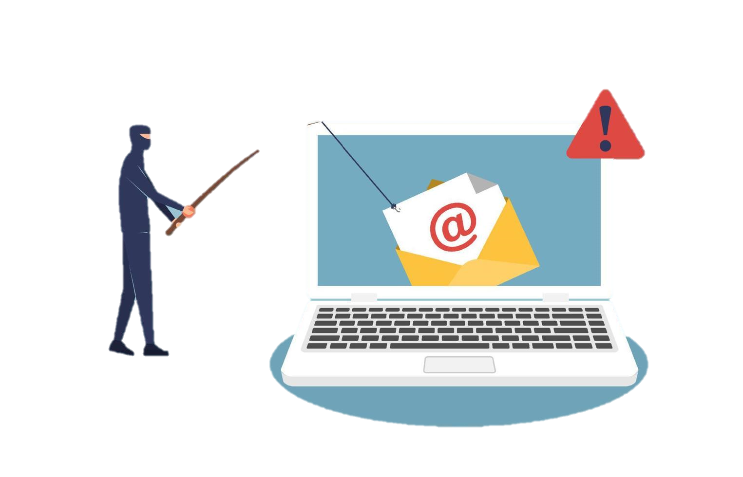
1. Email Phishing: Attackers send fraudulent emails that appear to be from legitimate sources to trick recipients into revealing personal information.
Prevention
Do not click on links or download attachments from unknown sources.
Use email filters to block suspicious emails.
Verify the sender's email address.
Detection
Look for poor grammar and spelling mistakes.
Check for inconsistencies in email addresses and URLs.
Be wary of urgent or threatening language.

Slide 4
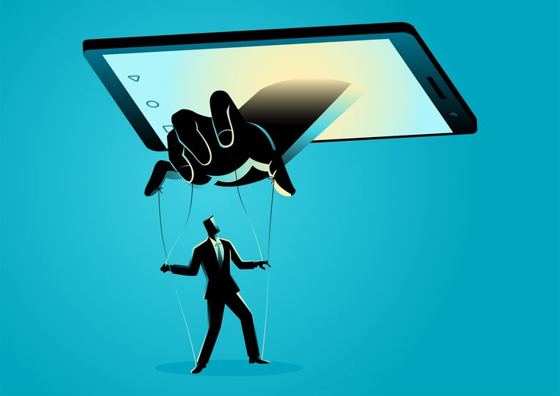
Spear Phishing Targeted attacks on specific individuals or organizations, often personalized to make the deception more convincing.
Prevention
Be cautious of unexpected emails asking for sensitive information.
Verify the identity of the sender through another communication channel.
Use multi-factor authentication.
Detection
Watch for unusual requests for personal information.
Use anti-phishing software to detect targeted attacks.
Monitor for personalized but suspicious emails.

Slide 5

Whaling
Similar to spear phishing but targets high-profile individuals like executives or celebrities.
Prevention
Train executives on recognizing phishing attempts.
Implement stringent verification procedures for sensitive transactions.
Use email security solutions to filter out phishing attempts.
Detection
Detect unusual activity In executive communications.
Implement advanced email security solutions.
Regularly audit high-profile accounts.

Slide 6
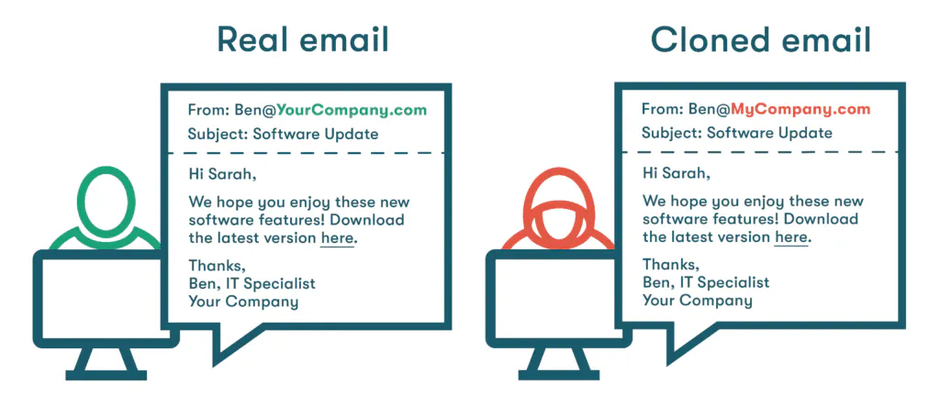
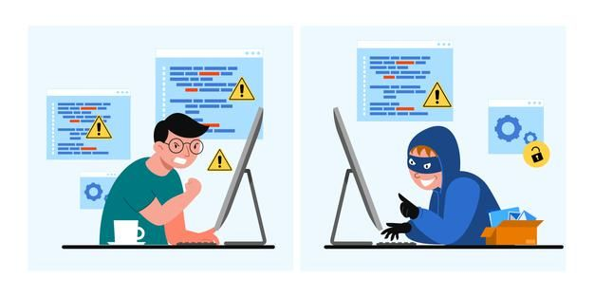
4. Clone Phishing:
Attackers create a copy (clone) of a legitimate email, replacing links or attachments with malicious
ones.
Prevention:
Verify the legitimacy of the email content before interacting with it.
Use security software to detect and block cloned emails.
Regularly update and patch email clients.
Detection:
Spot minor differences in email format or content.
Use advanced threat detection software.
Encourage reporting of suspicious emails.

Slide 7
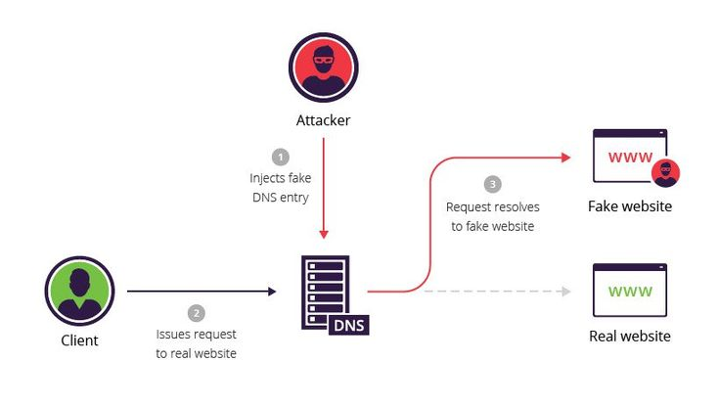
5. Pharming:
Redirecting users from legitimate websites to fraudulent ones without their knowledge, typically through DNS spoofing.
Prevention:
Check for HTTPS in website URLs.
Regularly update your browser and security software.
Be cautious of website redirects and pop-ups.
Detection :
Monitor for unusual website behavior.
Employ DNS security solutions.
Train users to recognize secure website indicators.

Slide 8

What to Do if Attacked ?
Immediate Actions:
Do not provide any information or click on any links.
Disconnect from the internet if malware is suspected.
Report the incident to your IT department or service provider.
Post-Attack Steps:
Change passwords for affected accounts.
Monitor accounts for unusual activity.
Run a full system scan using updated security software.
Notify relevant authorities (e.g., banks, credit bureaus).
Prevent Future Attacks:
Regularly update security software and systems.
Educate yourself and others on recognizing phishing attempts.
Use multi-factor authentication wherever possible.

Slide 9
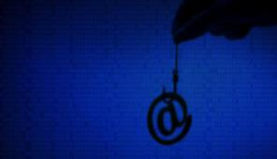
Phishing is a significant cyber threat with various attack methods. Understanding, preventing, and detecting these attacks is crucial for cybersecurity. Stay vigilant and informed to protect your sensitive information.

