Slide 1
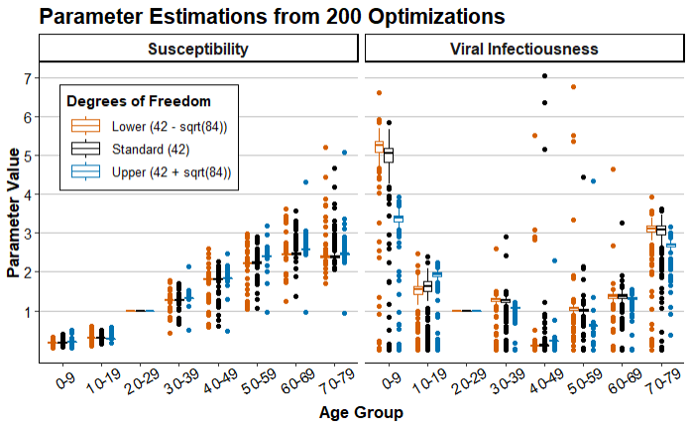
Box and whisker plot of parameter estimates
Lower and Upper estimates are found by adjusting the degrees of freedom by ±√(84) ≈ 9.17
Parameter for age group 20-29 is fixed at 1 to standardize estimations between trials
Lowering DF should increase the spread of point estimates, which is observed in most age groups

Slide 2
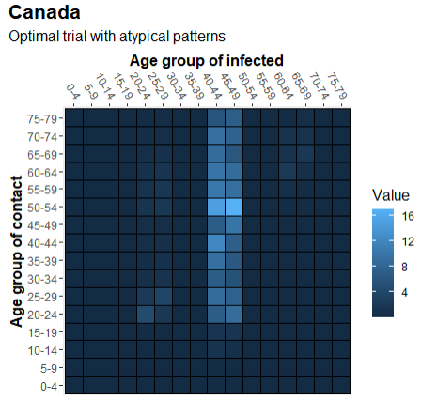
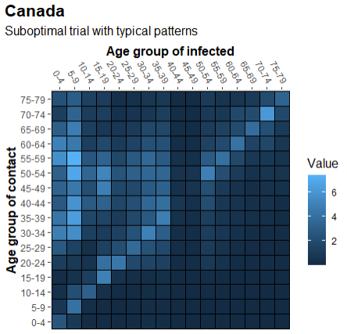
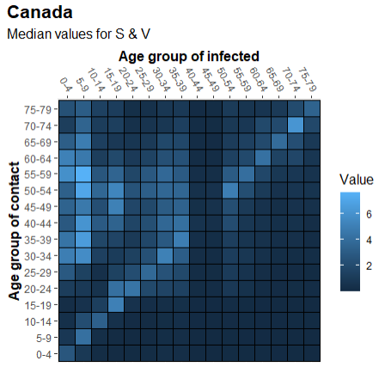
Comparison of optimal trial vs standard trial vs median values
(Canada)

Slide 3
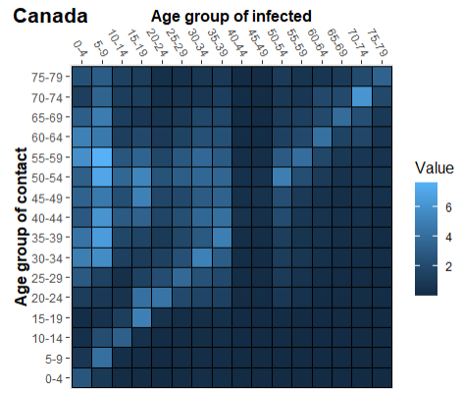
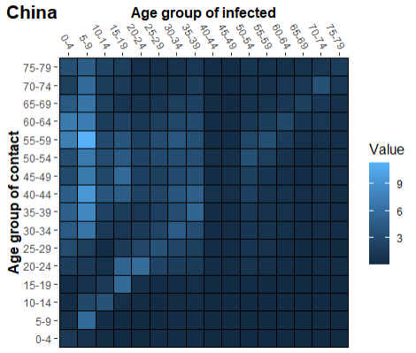
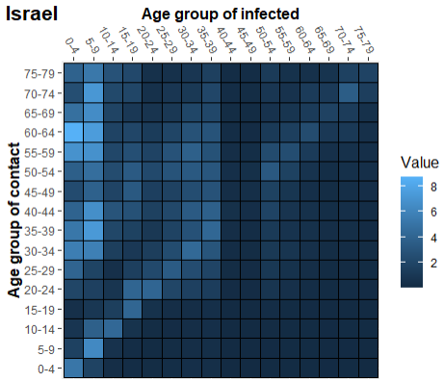
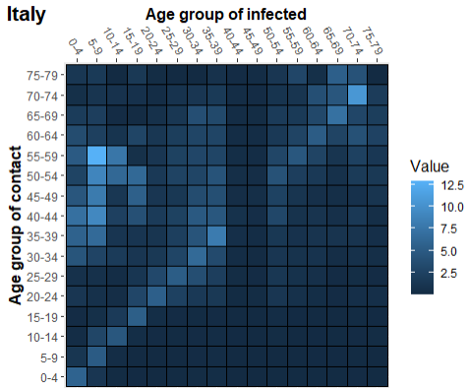
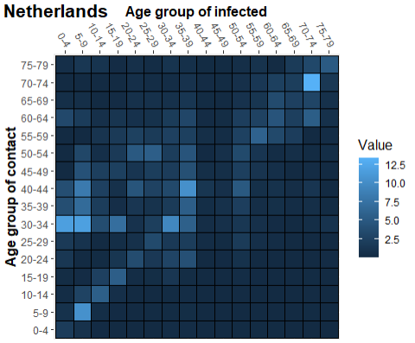
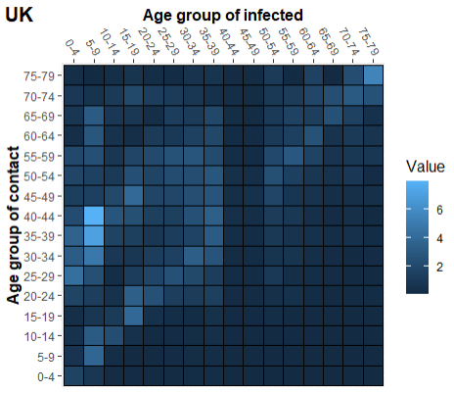
SCV heatmap for all 6 countries (Using median values for S&V)

