Slide 1
Trend detection in news
Text Mining and Semantic Technologies (ICT3)
Zala Herga & Miha Torkar
Notes:
In this project we looked at how different concepts were trending among the published articles.

Slide 2
Data
Articles about Donald Trump
Overall 2.2m articles (~20GB) from 1.1.2014 to 1.1.2017
Only English Articles
Source: Event Registry
Notes:
In this project we will be analysing a large dataset of news articles from various sources. We obtained
our dataset from the Event Registry system
Specifically, we have obtained all of the available articles
about "Donald Trump". Due to large popularity of our topic during the presidential campaign
and after the election results, we had to limit our API queries depending on time of the year.
Hence queries ranged between months (before serious political consideration) to days (election results).
For the simplification of analysis our dataset was limited to articles written in English. This should
not be consider as a larger shortcoming, because English is the source language for most of articles
about our chosen topic

Slide 3
Data pre-processing
Obtained concepts in all articles
Wikification of concepts for easier analysis
Stored in JSON file
Notes:
Each article from Event Registry is obtained and stored as a JSON object. It includes title, the
actual news text, information about language, URL to news, date, etc
Each object also contains concepts which are acquired by text annotation done by
a semantic annotation service. Each concept points to a Wikipedia page. Wikification enabled us
to easily find the topics that we were interested in in the news

Slide 4
Concepts of interest
Abortion
Climate Change
Gay
Illegal Immigration
Mexico
Privacy
Wall Street
Notes:
Searched through articles for these concepts, obtained time series with each day as count of how many articles contained the above concepts
Illegal Immigration as proxy for Trump’s Wall

Slide 5
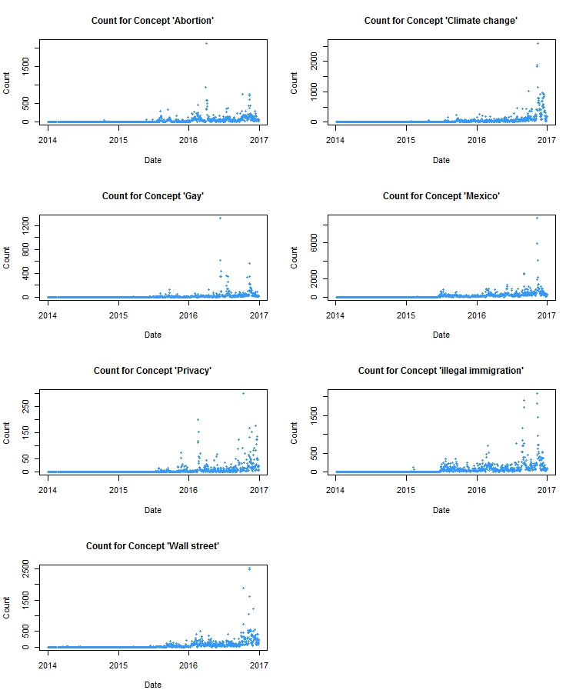
Counts for Concepts
Notes:
We aggregated the number of concept occurrences
on daily basis. Thus, we obtained a times series with 1065 records for each concept (a little less
than 1 record per day, since there were some days when no news were published on Trump

Slide 6
Counts for Concepts
Notes:
Add pictures from pdf

Slide 7
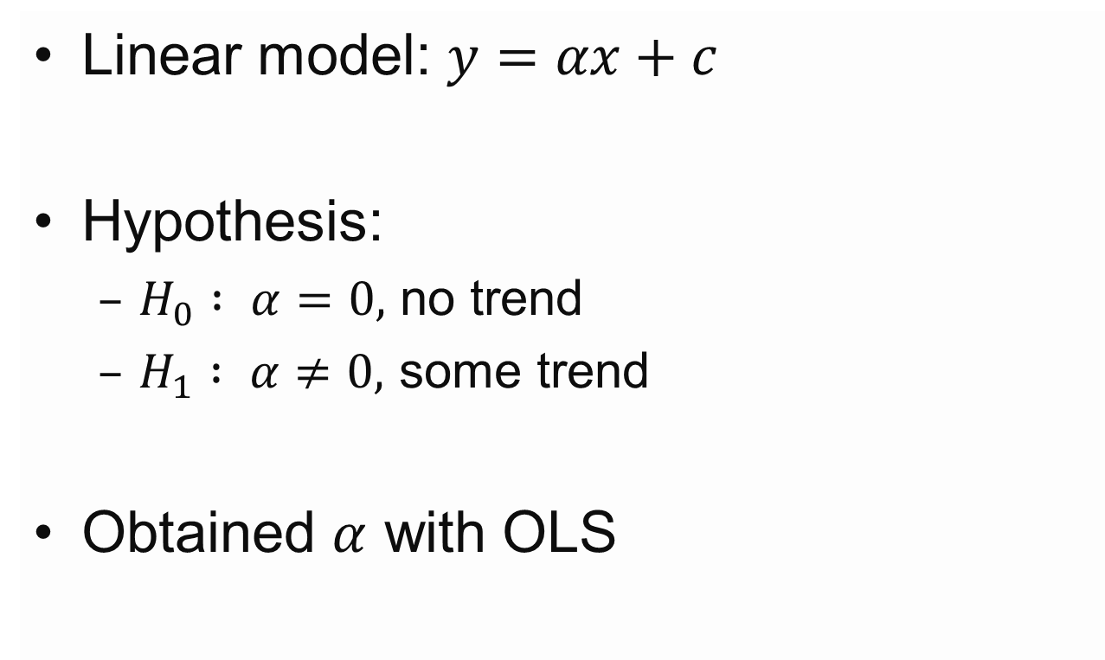
Trend Detection - Model
Linear model: $y=αx+c$
Hypothesis:
$H_{0} : α=0,$ no trend
$H_{1} : α≠0,$ some trend
Obtained $α$ with OLS
Notes:
Once we obtained the number of articles that wrote about specific concept on each day we wanted
to fit a model to this dataset to determine whether a trend was present or not. In order to achieve
this we used linear regression for our model, which in general takes the following form

Slide 8
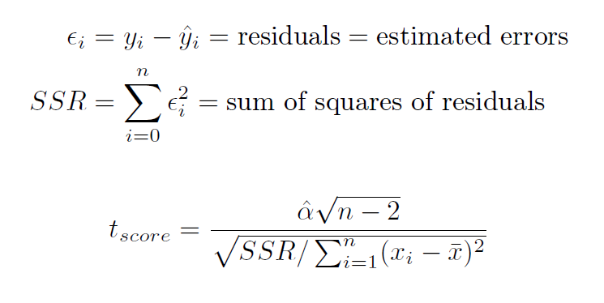
Tests
Notes:
To evaluate whether the coefficient produced by our model is statistically significant, so that we
can reject the null hypothesis, we will use Student’s t-test [3]. The t statistic that is the result
of the test is calculated by the formulas below.
Once we have the t statistic we can easily
determine the p-value, which would determine whether we reject the null hypothesis with predefined
significance level of 5%. We do this by calculating the probability of the t-distribution at the value
of the t statistics at given number of degrees of freedom. In our case the degrees of freedom
represent the difference between the number of samples and number of variables that are not fixed
(2), so overall we have n􀀀2 degrees of freedom.

Slide 9
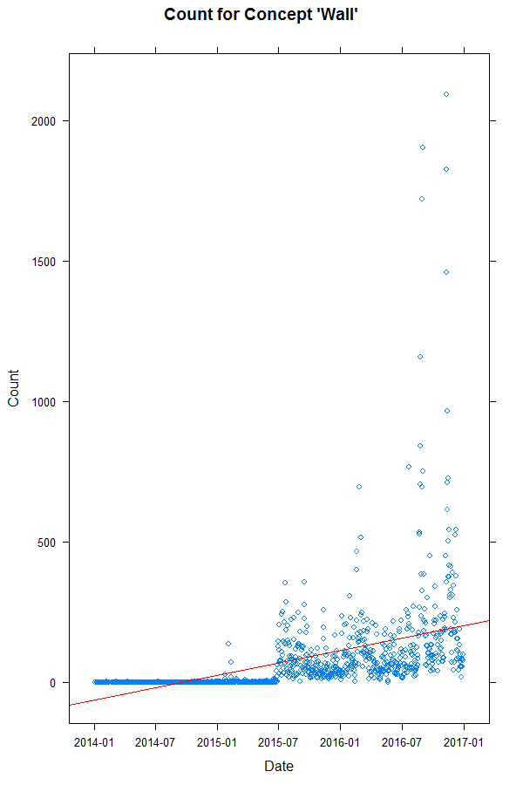
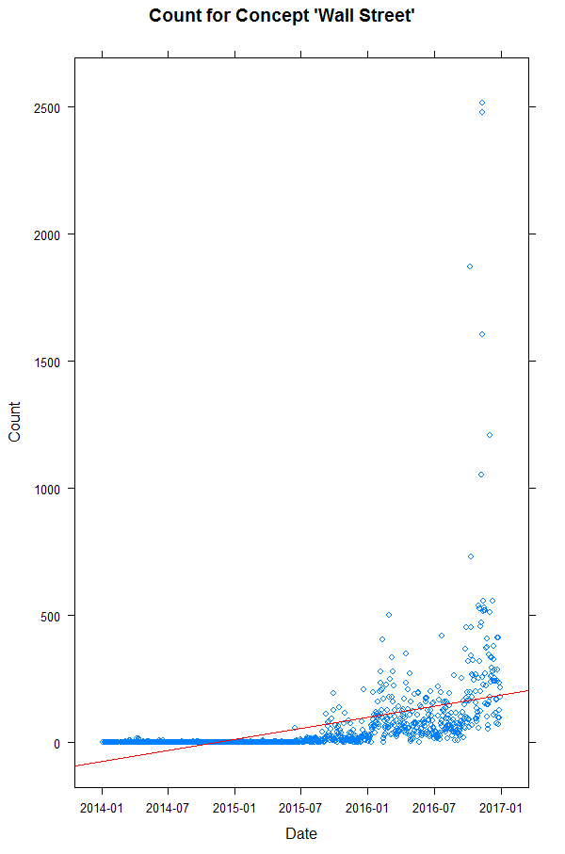
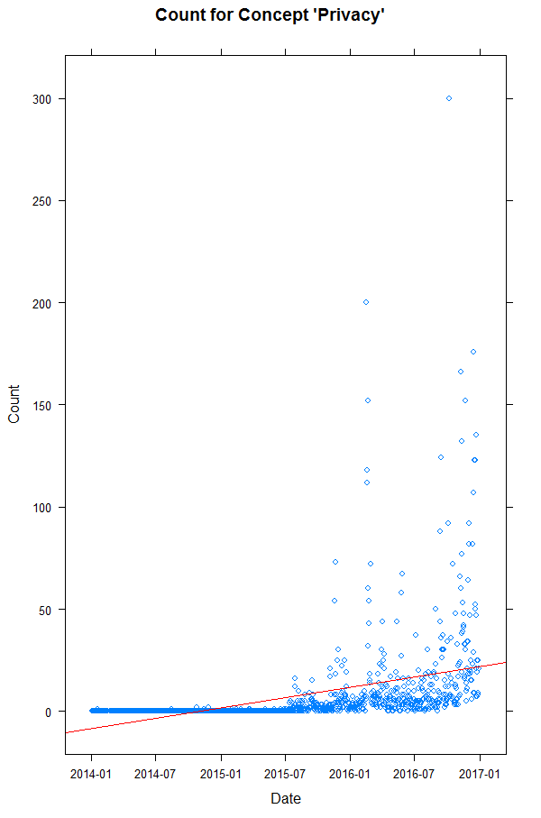
Results

Slide 10
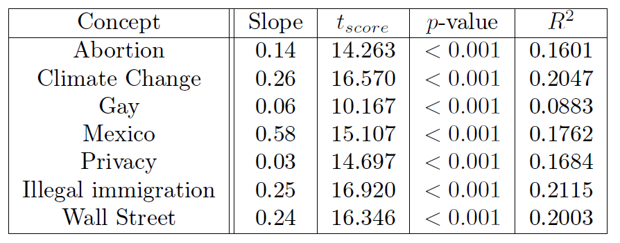
Evaluation of Results

Slide 11
Conclusion and Future Work
Small but statistically significant trend for all concepts
Change time span
Normalization of concept counts
Find concepts with negative trend

