Slide 1
Trend detection in news
Text Mining and Semantic Technologies (ICT3)
Zala Herga & Miha Torkar
Notes:
We focused on articles that are related to Donald Trump and check if some preselected topics are trending in those news

Slide 2
Data
Articles about Donald Trump
Overall 2.2m articles (~20GB) from 1.1.2014 to 1.1.2017
Only English Articles
Source: Event Registry
Stored in JSON file

Slide 3
Concepts of interest
Abortion
Climate Change
Gay
Illegal Immigration (wall)
Mexico
Privacy
Wall Street
Notes:
Searched through articles for these concepts, obtained time series with each day as count of how many articles contained the above concepts
Illegal Immigration as proxy for Trump’s Wall

Slide 4
Data pre-processing
For each article:
Check whether a concept appears (Using wikification)
Aggregate concept counts on daily basis
Store the data
Notes:
- For each articles we checkted whether a concept appears
We used Wikified objects which were easy to match with our concepts of interest
Aggregated the count on daily basis
Stored the data
Thus we obtained time series for each concept

Slide 5
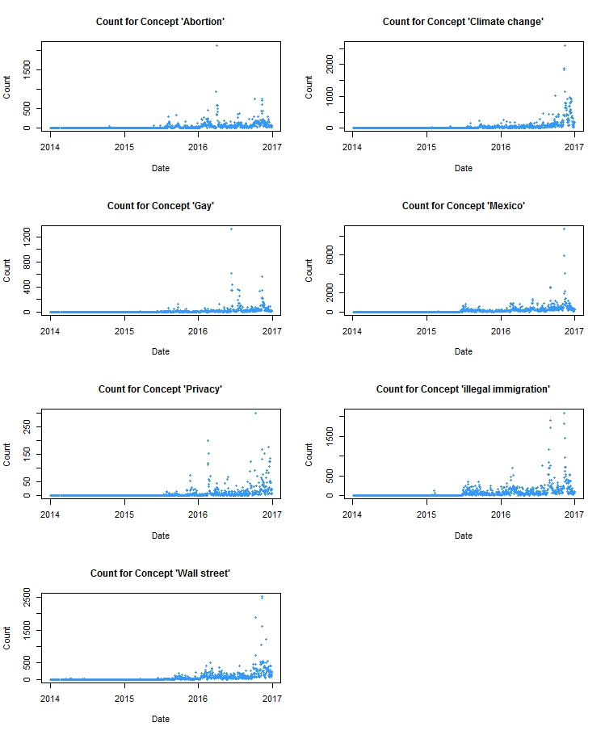
Counts for Concepts
Notes:
Add pictures from pdf

Slide 6
Counts for Concepts
Notes:
Add pictures from pdf

Slide 7
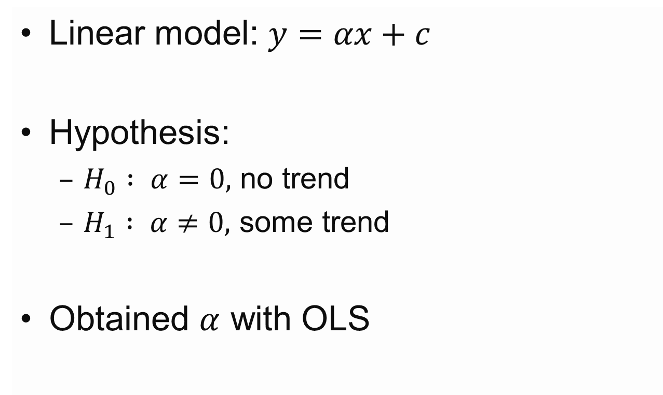
Trend Detection - Model
Linear model: $y=αx+c$
Hypothesis:
$H_{0} : α=0,$ no trend
$H_{1} : α≠0,$ some trend
Obtained $α$ with OLS

Slide 8
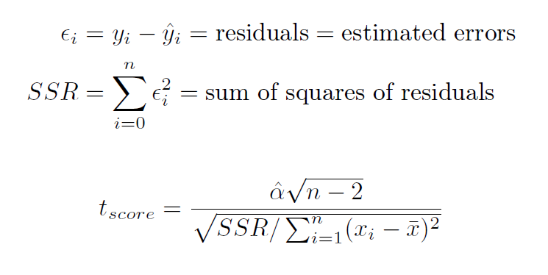
Tests

Slide 9
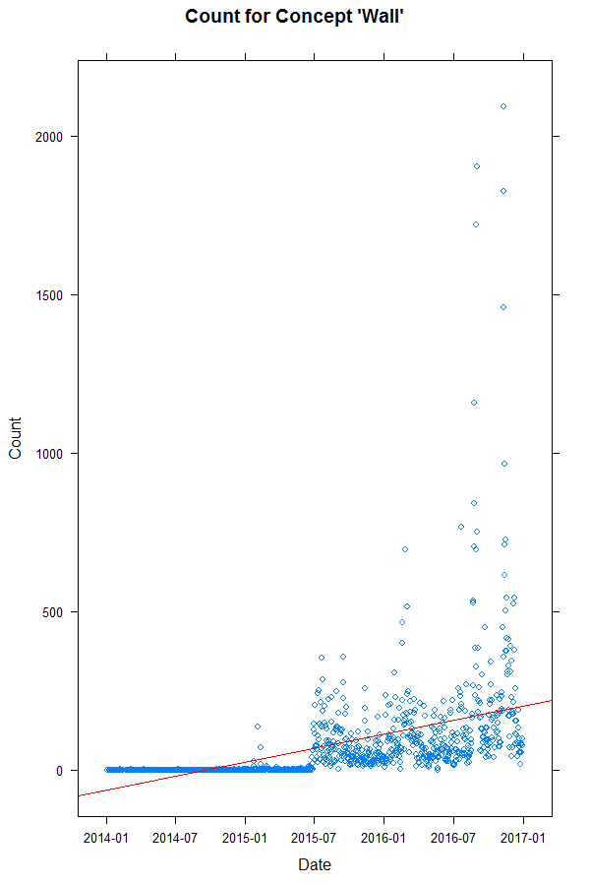
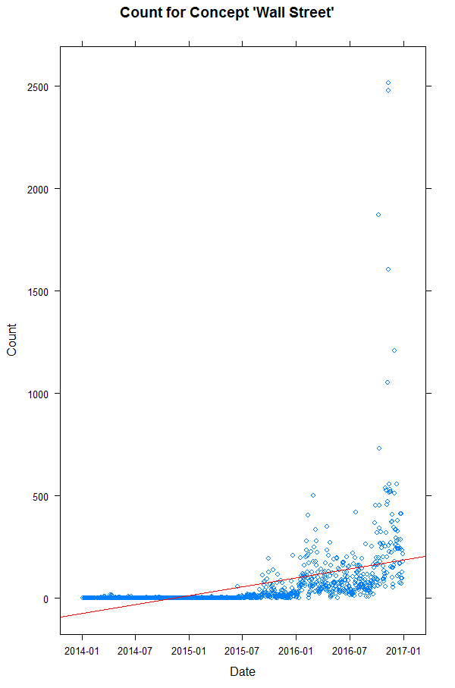
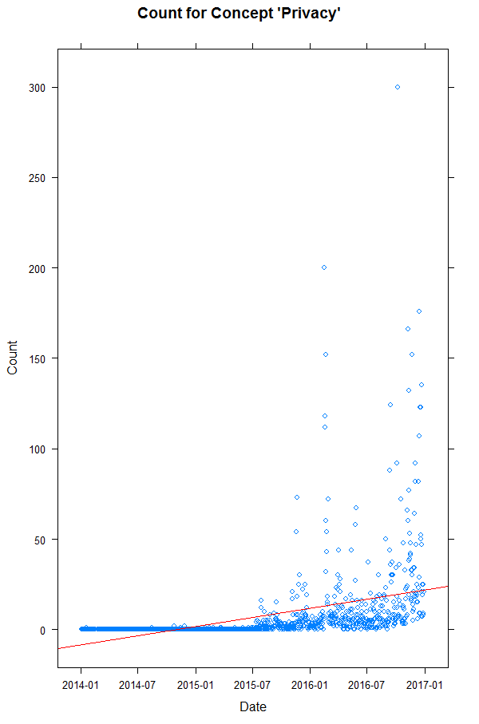
Results

Slide 10
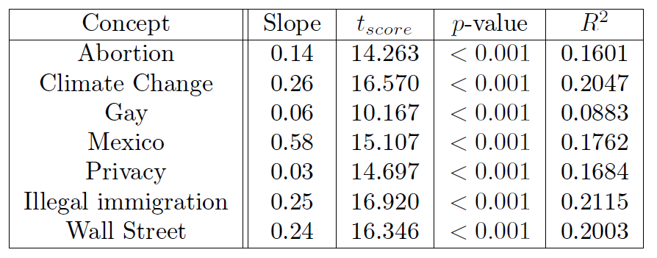
Evaluation of Results

Slide 11
Conclusion and Future Work
Small but statistically significant trend for all concepts
Change time span
Normalization of concept counts
Find concepts with negative trend

