Slide 1
Trend detection in news
Text Mining and Semantic Technologies (ICT3)
Zala Herga & Miha Torkar

Slide 2
Data
Articles about Donald Trump
Overall 2.2m articles (~20GB) from 1.1.2014 to 1.1.2017
Only English Articles
Source: Event Registry

Slide 3
Data pre-processing
Obtained concepts in all articles
Wikification of concepts for easier analysis
Stored in JSON file

Slide 4
Concepts of interest
Abortion
Climate Change
Gay
Illegal Immigration
Mexico
Privacy
Wall Street
Notes:
Searched through articles for these concepts, obtained time series with each day as count of how many articles contained the above concepts
Illegal Immigration as proxy for Trump’s Wall

Slide 5
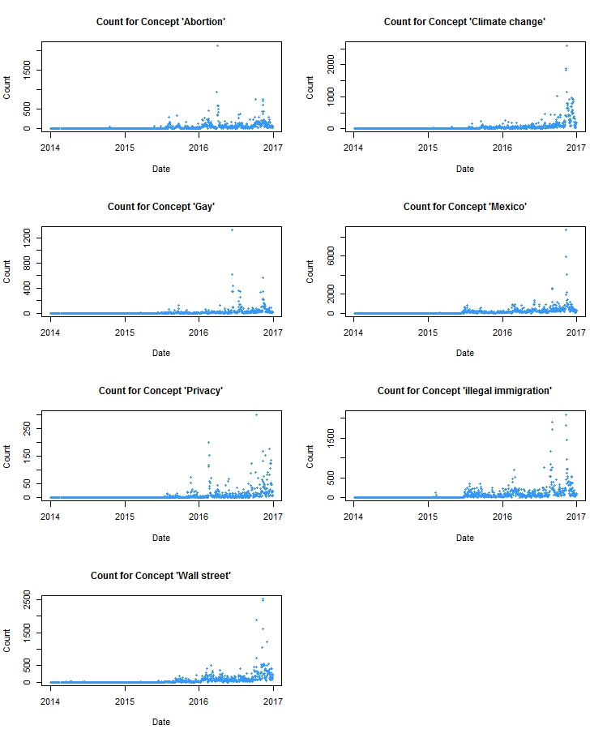
Counts for Concepts
Notes:
Add pictures from pdf

Slide 6
Counts for Concepts
Notes:
Add pictures from pdf

Slide 7
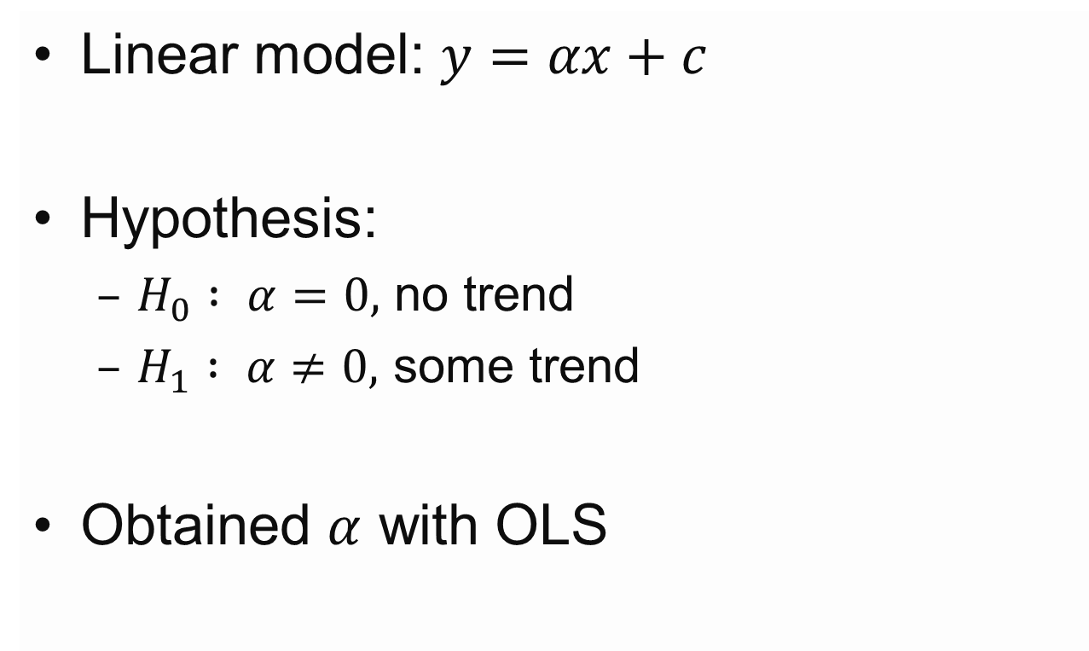
Trend Detection - Model
Linear model: $y=αx+c$
Hypothesis:
$H_{0} : α=0,$ no trend
$H_{1} : α≠0,$ some trend
Obtained $α$ with OLS

Slide 8
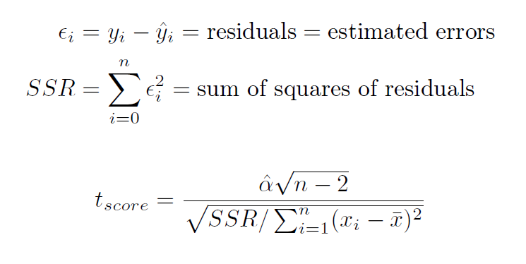
Tests

Slide 9
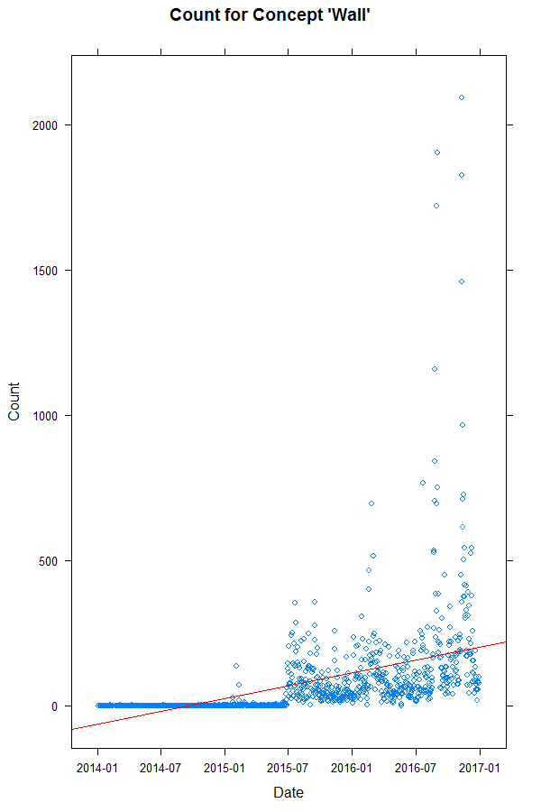
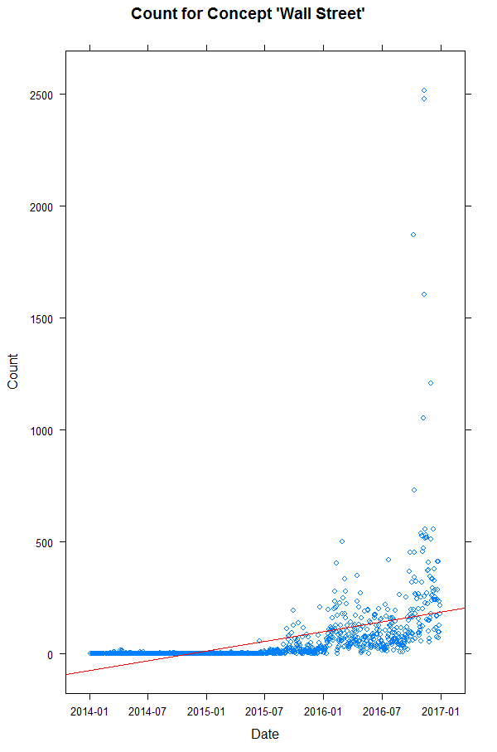
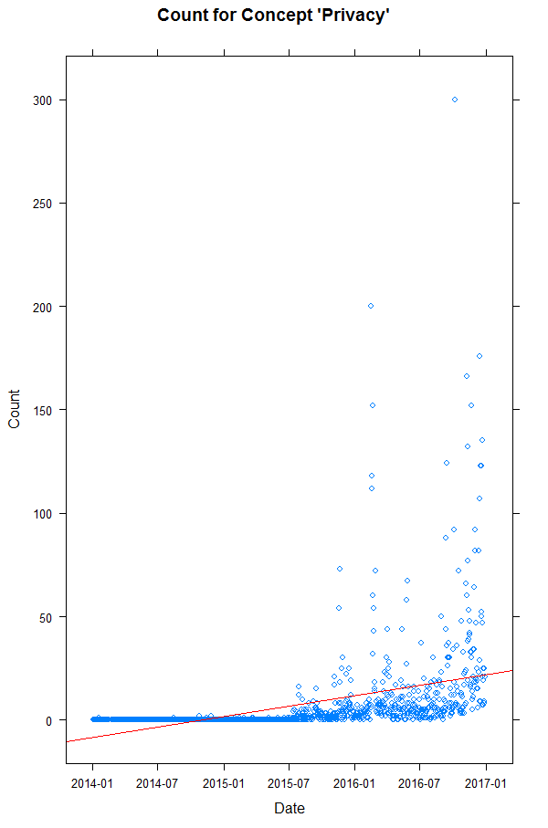
Results

Slide 10
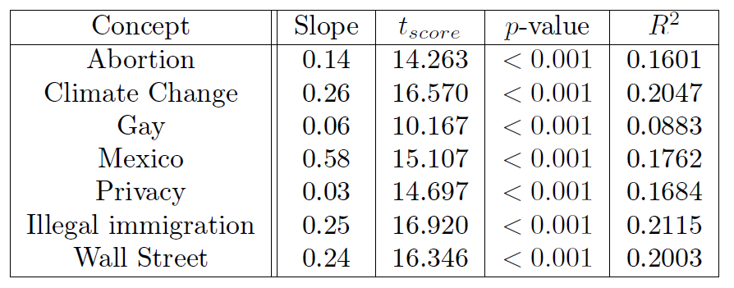
Evaluation of Results

Slide 11
Conclusion and Future Work
Small but statistically significant trend for all concepts
Change time span
Normalization of concept counts
Find concepts with negative trend

