Slide 1
Trend detection in news
Text Mining and Semantic Technologies (ICT3)
Zala Herga & Miha Torkar

Slide 2
Data
Articles about Donald Trump
Overall 2.2m articles (~20GB) from 1.1.2014 to 1.1.2017
Only English Articles
Source: Event Registry

Slide 3
Data pre-processing
Obtained concepts in all articles
Wikification of concepts for easier analysis
Stored in JSON file

Slide 4
Concepts of interest
Abortion
Climate Change
Gay
Illegal Immigration
Mexico
Privacy
Wall Street
Notes:
Searched through articles for these concepts, obtained time series with each day as count of how many articles contained the above concepts
Illegal Immigration as proxy for Trump’s Wall

Slide 5
Counts for Concepts
Notes:
Add pictures from pdf

Slide 6
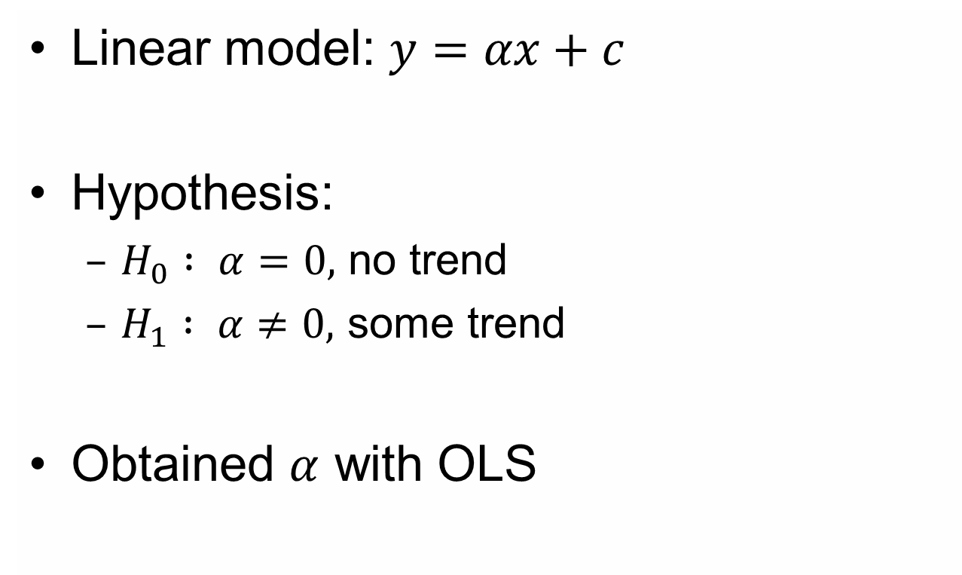
Trend Detection - Model
Linear model: $y=αx+c$
Hypothesis:
$H_{0} : α=0,$ no trend
$H_{1} : α≠0,$ some trend
Obtained $α$ with OLS

Slide 7
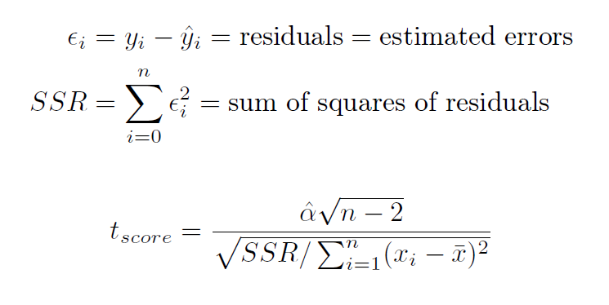
Tests

Slide 8
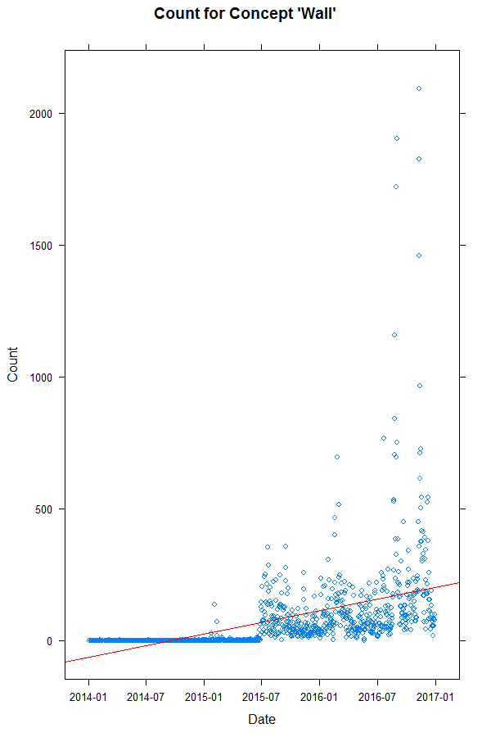
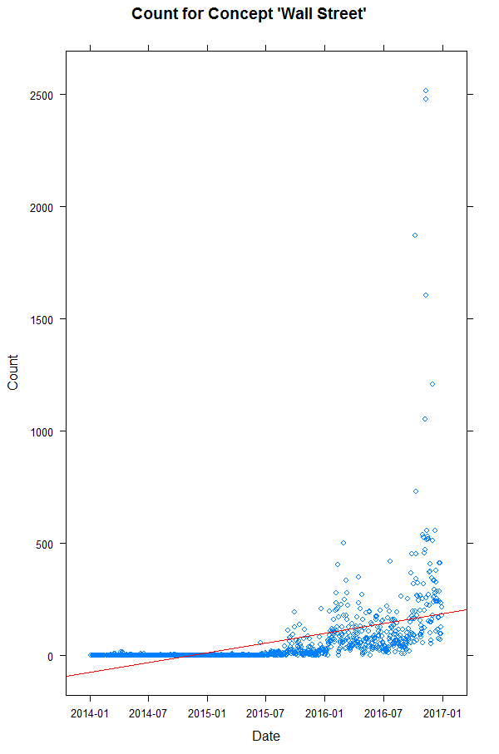
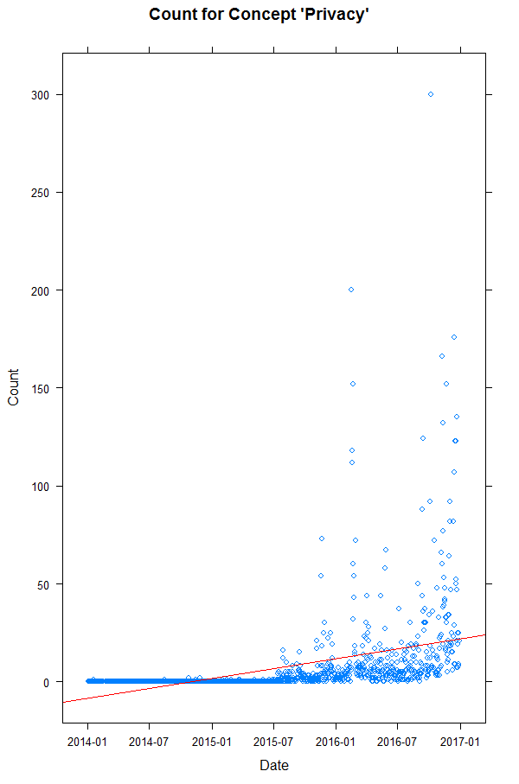
Results

Slide 9
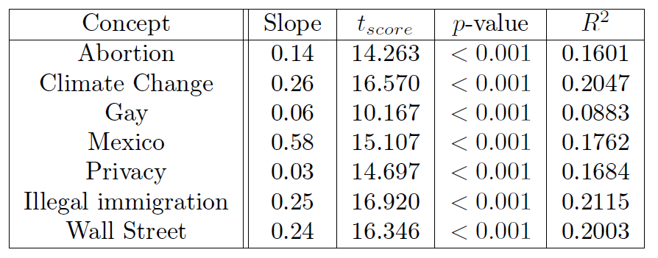
Evaluation of Results

Slide 10
Conclusion and Future Work
Small but statistically significant trend for all concepts
Change time span
Normalization of concept counts
Find concepts with negative trend

