Slide 1
Trend detection in news
Text Mining and Semantic Technologies (ICT3)
Zala Herga & Miha Torkar
Notes:
We focused on articles that are related to Donald Trump and check if some preselected topics are trending in those news

Slide 2
Data
Articles about Donald Trump
Overall 2.2m articles (~20GB) from 1.1.2014 to 1.1.2017
Only English Articles
Source: Event Registry
Stored in JSON file

Slide 3
Concepts of interest
Abortion
Climate Change
Gay
Illegal Immigration (wall)
Mexico
Privacy
Wall Street
Notes:
Searched through articles for these concepts, obtained time series with each day as count of how many articles contained the above concepts
Illegal Immigration as proxy for Trump’s Wall

Slide 4
Data pre-processing
For each article:
Check whether a concept appears (Using wikification)
Aggregate concept counts on daily basis
Store the data
Notes:
- For each articles we checkted whether a concept appears
We used Wikified objects which were easy to match with our concepts of interest
Aggregated the count on daily basis
Stored the data
Thus we obtained time series for each concept

Slide 5
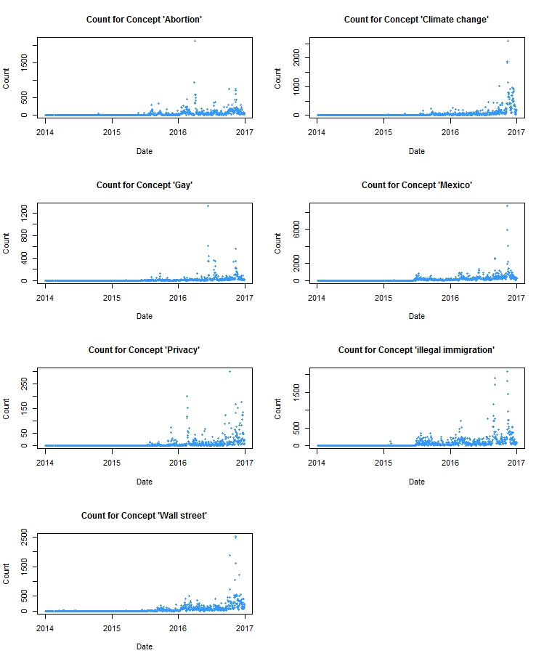
Counts for Concepts
Notes:
Add pictures from pdf

Slide 6
Counts for Concepts
Notes:
Add pictures from pdf

Slide 7
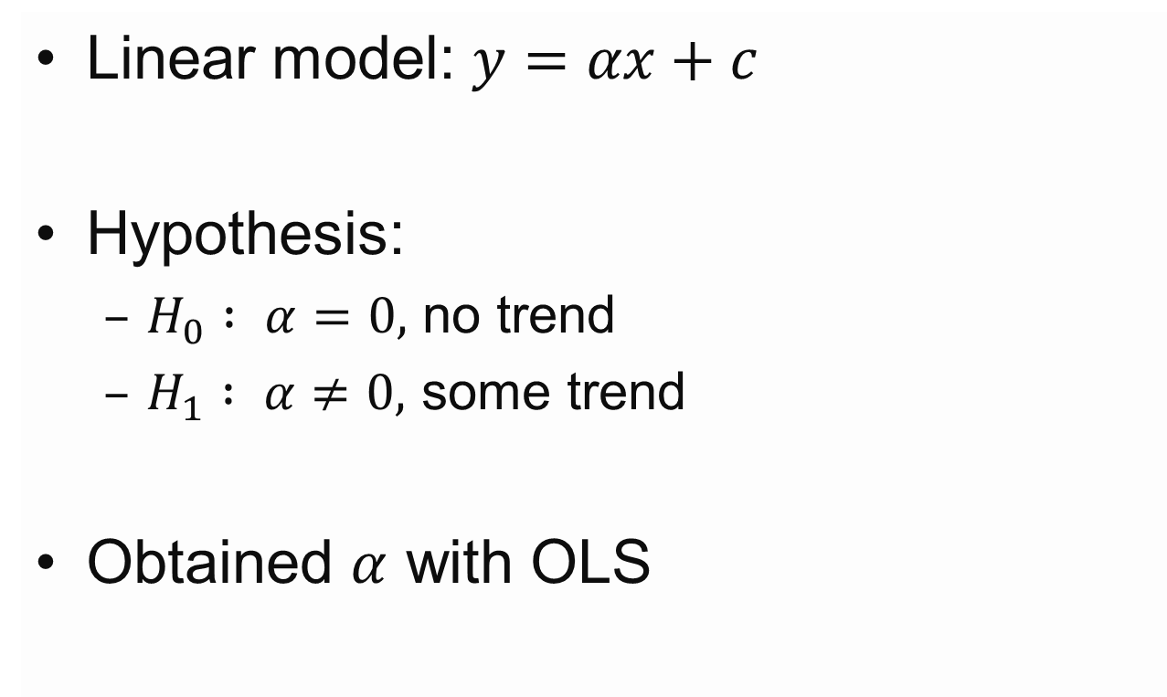
Trend Detection - Model
Linear model: $y=αx+c$
Hypothesis:
$H_{0} : α=0,$ no trend
$H_{1} : α≠0,$ some trend
Obtained $α$ with OLS
Notes:
Once we obtained the number of articles that wrote about specific concept on each day we wanted
to fit a model to this dataset to determine whether a trend was present or not. In order to achieve
this we used linear regression for our model, which in general takes the following form

Slide 8
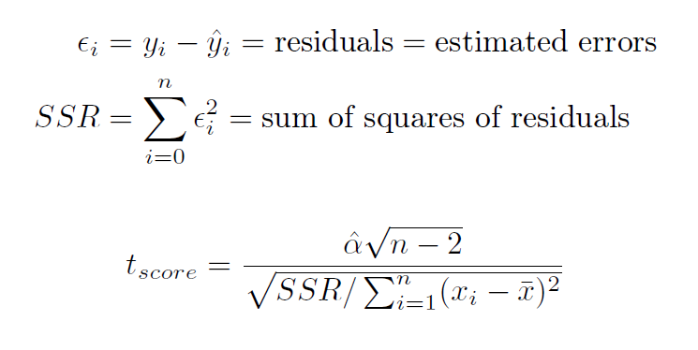
Tests
Notes:
To evaluate whether the coefficient produced by our model is statistically significant, so that we
can reject the null hypothesis, we will use Student’s t-test [3]. The t statistic that is the result
of the test is calculated by the formulas below.
Once we have the t statistic we can easily
determine the p-value, which would determine whether we reject the null hypothesis with predefined
significance level of 5%. We do this by calculating the probability of the t-distribution at the value
of the t statistics at given number of degrees of freedom. In our case the degrees of freedom
represent the difference between the number of samples and number of variables that are not fixed
(2), so overall we have n􀀀2 degrees of freedom.

Slide 9
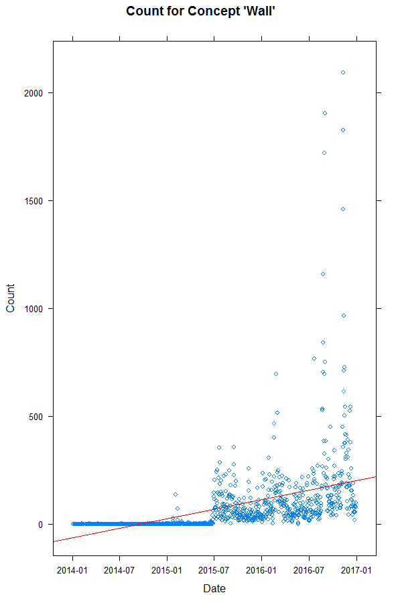
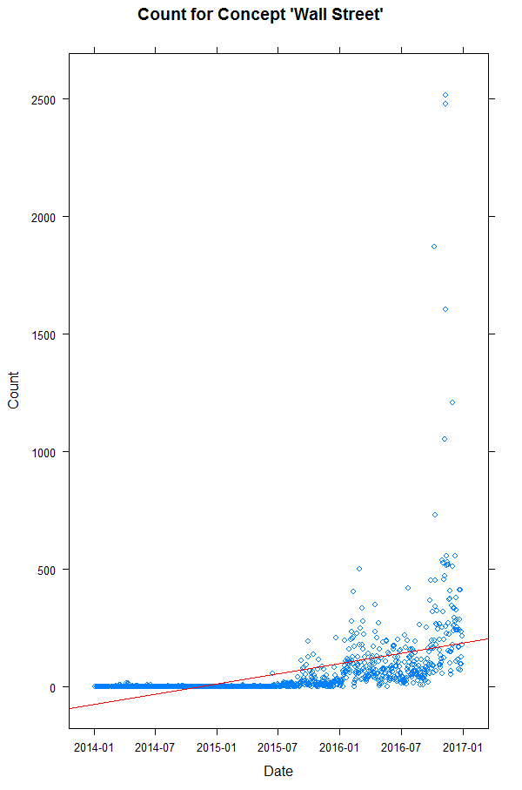
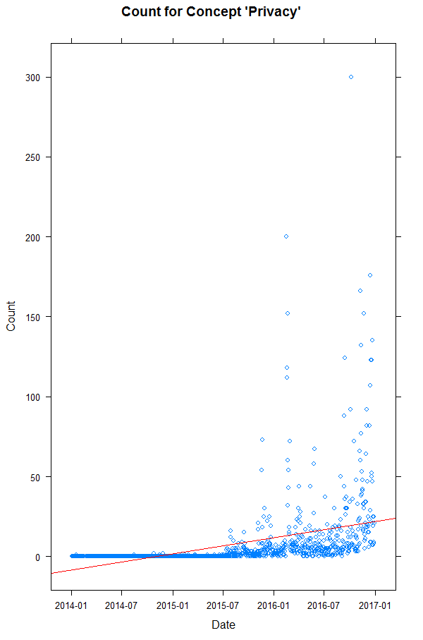
Results

Slide 10
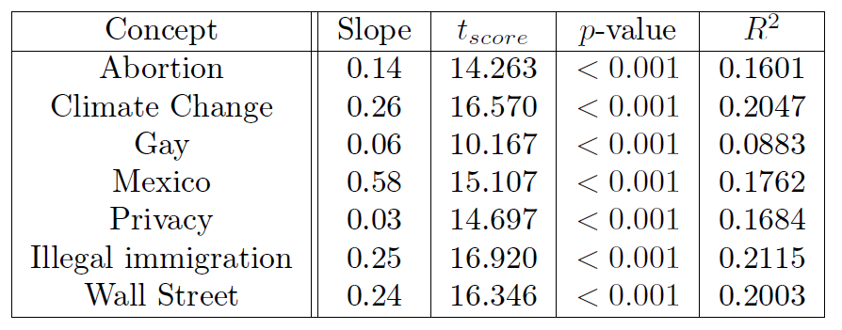
Evaluation of Results

Slide 11
Conclusion and Future Work
Small but statistically significant trend for all concepts
Change time span
Normalization of concept counts
Find concepts with negative trend
Notes:
There are several possible improvements and continuations of our work. One possible direction for
future research would be the variation of time-series time span. In Figure 1 we can see that most
time series’ activities started in the middle of 2015, which corresponds to Trump’s presidential
candidacy announcement on June 16th, 2015. For that reason it might make sense to use this date
as the starting date of our time series. We could then further divide time series into two subgroups:
one that spans over candidacy to election day and another that spans from election day to present.
This way we could see if there were some topics that were excessively used for campaign purposes
only.
We also noticed that none of the concepts had negative or no trend. One reason for that could
be that none of the concepts that we picked is random in conjunction with Trump news. Another
reason for that could be that the number of articles in which Trump’s name occurs in so big (it’s
huge, it’s amazing :)) that in some of them co-appears with all sorts of "unrelated" concepts. E.g.
if "Abortion" concept occurs in 2 out of 10 articles in one day this carries a lot more weight than
5 occurrences out of 1000 articles. We could try to limit that effect by some kind of concept count
normalisation.

