Slide 1


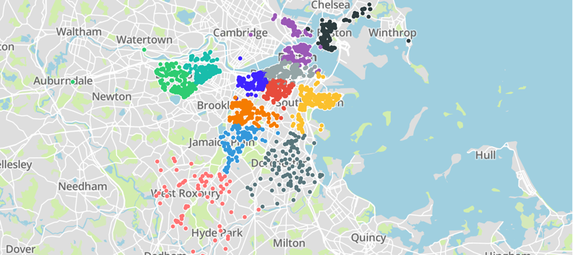
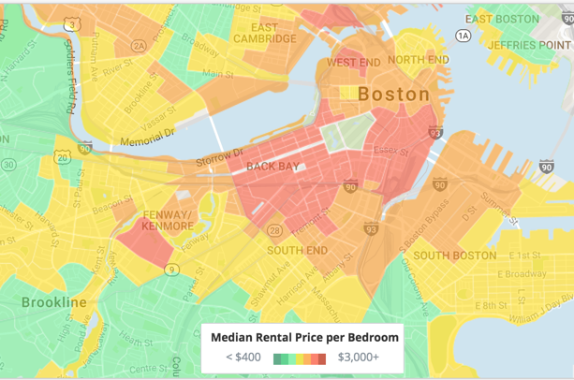
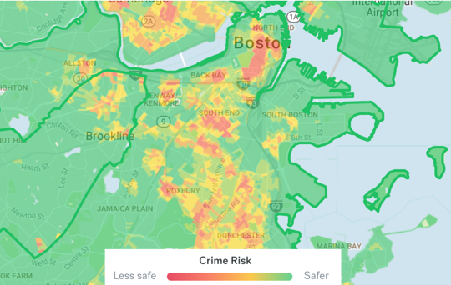
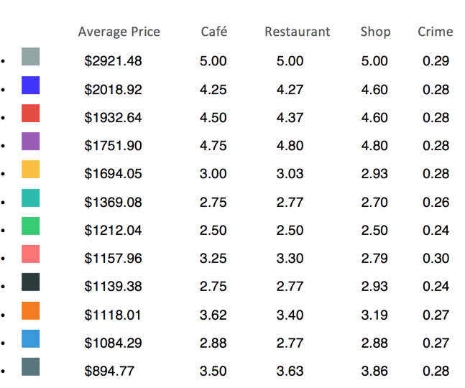
Exploring House Renting Districts in Boston
Based on Multifarious Features
Desheng Zhang / Baoxiang Yang
Department of Computer Science/Boston University
College of Art & Science
Overview
Boston is famous for its high housing and renting price, especially for some areas. But behind price, people might just have an implicit impression based on experience
We believe that there are lots of features behind the renting price and for a new comer, it might be much better to know these hidden reasons by directly looking at a nice district cluster with these information
Techniques
Preprocessing: Most data we scraped have different scales and some of them are descriptive. Thus we need change them into numerical values and preprocess them to reasonable scale.
Linear Regression: Before we doing clustering, we want to find out which features are the most important factor to the price of houses or apartments. Thus we use this method to figure out the influence of each feature.
Clustering: We use the features after filtered to do some clustering and try to find the implicit boundaries. K-means++, Hierarchy and GMM are used in this part, and we choose the one performs best.
KNN: Finally, we used the label from clustering to train a KNN model. we separated the data into training set and test set. The predict label for test set should match their actual one, which is helpful to decide the price of houses in test set.
Analysis
For all the features, we use linear regression to find the linear relation between features and price and some of them plays an important roles here. Then we use each feature to do the clustering and filter some useless features such as crime rate (which has similar score in figure 2). Compare to the actually heatmap of crime situation in Boston, we can confirm that most area of Boston have similar crime rate.
In figure 2, when we look at the areas of the top 3, we could find that they are the districts that near Back Bay, Fenway and Kenmore. It is expected to see that these areas have a highest price among Boston but also combine with a high score on cafe or shopping.
Another example on the other hand would be the two green clusters, which located in Allston and Brighton. These areas enjoy a much lower price but at the same time get a relatively lower scores on other features
Motivation
Find the implicit boundaries and classification of Boston house renting based on various of features
Recommend house renting to different types of people base on the clustering results.
Clustering
Scrape Data
Data Sources: Trulia.com, Zillow.com
Three Steps to scrape the data:
Use BeautifulSoup to get basic information such as address, zip code, house url and price.
Use the addresses, zip codes and zillow API to get further information such as number of bedrooms and bathrooms, longitudes, latitudes, home type and zillow id.
Use Selenium package to scrape more features of houses such as number of schools, restaurants, shops, groceries, cafes and crimes.
After we scrape the raw data, we filter some useless data(such as houses without bedroom and bathroom information), then we divided the total price of the house by the number of bedrooms and get the average price for each room.
Beautiful
Soup
Zillow
API
Selenium
Figure 3 house price
Figure 4 crime rate
Conclusion (s)
The results show us that for a higher price, you could get a generally better environment (high score on cafe restaurant, etc). But you may also notice that the price cannot determine everything. Some area with slightly lower price could also get a good performance on other features.
Thus, for different people, since they have their own concern when renting houses or apartments, our clusters based on various of features could actually tell them what determines an area. Not only by price, but also by lots of other features.
Therefore, It might be good to see that people can easily find the renting areas based on their own interests combined with the price they could afford. And by doing this future works, we could expect to see that people would have a more wise choice on renting market
Figure 1. Clusters with K-means(12 clusters)
After filtering some features, We decide to use longitude, latitude, number of restaurants, shops, cafes and price to cluster the houses.
After analyze the error and Silhouette Coefficient score, we find that the best number of cluster should be 12.
We use three methods to cluster the houses ( K-means++, Hierarchy and GMM), finally we found that K-means++ gives the best clustering result.
Instead of using matplot package in python, we use an another powerful plot package called plotly. By using this, we successfully plot each renting point onto a real map.
Figure 2. Labeling
Future Work
Some people may have special demand on house renting. In our recommendation system, they should be able to select their favorite features to cluster the house and choose the most suitable house or apartment for them.

