Slide 1
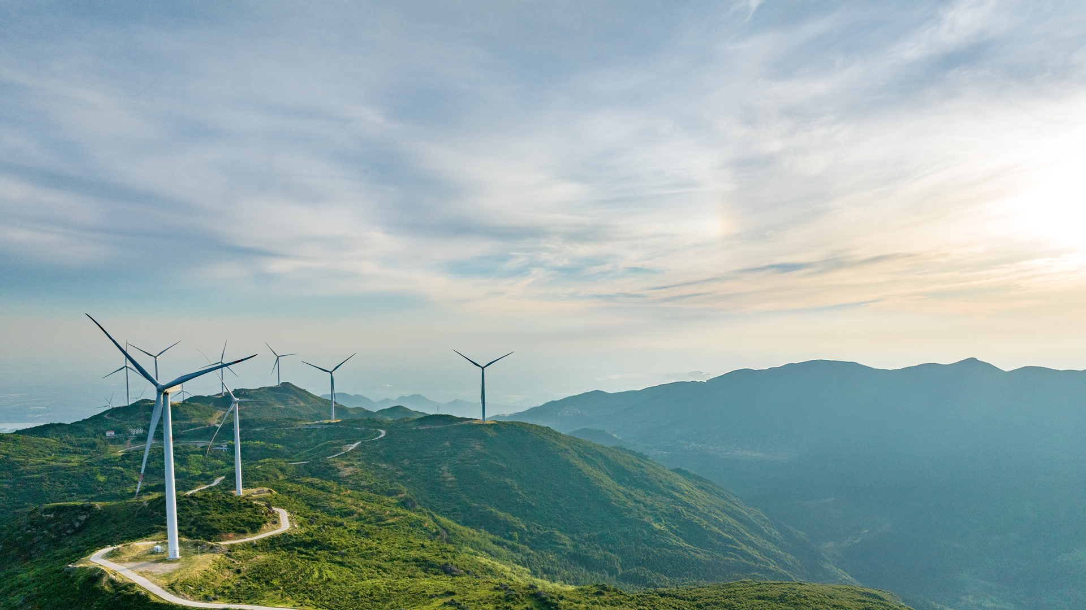


Project Bana
Three cases: base, zero bid and 20 %+ IRR
18 October 2026

Slide 2
Case 3 lifts the hold IRR to 22.0% with Chinese turbines (16.1% European), from 11.4% (7.6%) in the base
Summary
Assumptions
Returns
What it takes
Case 2 drops every bid commitment and assumes 2,850 h and a 100 €/MWh PPA; case 3 adds cheaper, longer debt and lower BoP capex. Both rest on a yield the data room does not yet support.
European / Chinese | Unit | Case 1: base | Case 2: zero bid | Case 3: 20 %+ IRR
Tender points | points | 59.5 / 47.5 | 12 / 0 | 12 / 0
FEP equity to COD | € m | 54.4 / 41.7 | 43.6 / 33.2 | 34.0 / 26.0
FEP IRR, sale at COD | % | 26.3% / 41.0% | 31.9% / 46.1% | 39.0% / 53.2%
FEP IRR, hold | % | 7.6% / 11.4% | 12.4% / 17.3% | 16.1% / 22.0%
FEP NPV, hold | € m | (2.4) / 15.7 | 22.5 / 38.8 | 33.9 / 49.1
Minimum DSCR | x | 1.63x / 2.15x | 2.01x / 2.71x | 2.21x / 3.01x
Reading
Case 2: the upside from yield and price, with the cost saved by bidding nothing.
Case 3: the mildest combination we found that takes the Chinese route above 20 %.
Tender: both score 12 / 0 points against 59.5 / 47.5: the award is the main risk.
Post-tax, FEP 100 %. Cases 2-3 are stored key-assumption sets of the model; everything not listed on the next slide is as in the base.
Source: Bana_Model_20261018.xlsm, 18 Oct 2026.

Slide 3
Cases 2 and 3 change the yield, the bid, the PPA and the debt; case 3 also cuts BoP capex to 300 k€/MW
Summary
Assumptions
Returns
What it takes
Everything else stays as in the base, including the turbine route, the sale price per MW and the tax.
 | Unit | Case 1: base | Case 2: zero bid | Case 3: 20 %+ IRR
What changes
Net P50 hours | h | 2,600 | 2,850 | 2,850
Overbuild / BESS committed | % of MVA | 20% / 20% | none | none
Municipal one-off / community | k€/MW, €/MWh | 50 / 3.0 | none | none
PPA price, whole life | €/MWh | 90 | 100 | 105
Gearing (debt / construction cost) | % | 55% | 60% | 70%
Debt tenor | years | 15 | 15 | 18
All-in interest rate | % | 5.0% | 5.0% | 4.5%
BoP and other wind capex | k€/MW | 355 | 355 | 300
Same in all three
Turbines, European / Chinese | k€/MW | 950 / 500 | 950 / 500 | 950 / 500
Sale price at COD, European / Chinese | k€/MW | 2,450 / 2,100 | 2,450 / 2,100 | 2,450 / 2,100
Corporate income tax | % | 15% | 15% | 15%
Why
Yield: 2,850 h instead of 2,600; to be confirmed by the EYA, which is not in the data room.
Zero bid: no overbuild, BESS, municipal or community payment saves capex and opex.
PPA: COD is 2030 at the earliest, leaving two years to sign a bankable long-term PPA; Aurora is conservative and today's high prices may last longer.
Debt: a signed long-term PPA should support more and longer debt than the banks' first view (48–58 % LTC over 12–15 years).
BoP: a tighter BoP and installation budget; to be tested with contractors.
Bid levers shown for the European route (the Chinese bid is the same, without the EU-turbine points). Bank terms as reported in the October 2026 meetings.
Source: Bana_Model_20261018.xlsm, 18 Oct 2026.

Slide 4
Lower capex and more debt cut the equity to COD to €34.0m in case 3 (€26.0m Chinese), from €54.4m
Summary
Assumptions
Returns
What it takes
The sale at COD gains only from lower capex and more debt, because the sale price is fixed per MW; the hold gains from yield and price as well.
FEP, post-tax | Unit | Case 1 EU | Case 1 CN | Case 2 EU | Case 2 CN | Case 3 EU | Case 3 CN
Total uses to COD | € m | 113.4 | 85.1 | 99.7 | 73.7 | 97.1 | 71.0
Senior debt at COD | € m | 59.1 | 43.4 | 56.1 | 40.5 | 63.1 | 44.9
Debt share of construction cost | % | 55% | 55% | 60% | 60% | 70% | 70%
FEP equity to COD | € m | 54.4 | 41.7 | 43.6 | 33.2 | 34.0 | 26.0
Sale at COD
FEP profit | € m | 20.2 | 29.4 | 22.3 | 30.8 | 24.9 | 33.5
FEP IRR | % | 26.3% | 41.0% | 31.9% | 46.1% | 39.0% | 53.2%
FEP MOIC | x | 1.37x | 1.71x | 1.51x | 1.93x | 1.73x | 2.29x
Buyer IRR, unlevered | % | 5.7% | 7.0% | 8.4% | 9.9% | 9.0% | 10.6%
Hold to maturity
FEP IRR | % | 7.6% | 11.4% | 12.4% | 17.3% | 16.1% | 22.0%
FEP MOIC | x | 3.39x | 4.82x | 5.46x | 7.68x | 7.17x | 10.16x
FEP NPV | € m | (2.4) | 15.7 | 22.5 | 38.8 | 33.9 | 49.1
Minimum DSCR | x | 1.63x | 2.15x | 2.01x | 2.71x | 2.21x | 3.01x
EU = European turbines, CN = Chinese turbines. NPV at 8%. Debt is sized on the gearing; the DSCR is a floor of 1.20x and does not bind.
Source: Bana_Model_20261018.xlsm, 18 Oct 2026.

Slide 5
Case 3 needs a 105 €/MWh PPA, 70% gearing over 18 years and cheaper BoP, and still leaves the European route at 16.1%
Summary
Assumptions
Returns
What it takes
Price and debt move the hold IRR most; the zero bid and the yield need checking before any of this is relied on.
What has to be true
PPA: a bankable long-term PPA at 105 €/MWh (base 90) signed before financing.
Debt: 70% gearing over 18 years at 4.5%; the minimum DSCR is 3.01x (Chinese), so the cash flows carry it.
Capex: BoP, installation and other wind costs at 300 k€/MW, from 355.
Yield: 2,850 h confirmed by an EYA.
Risks
Award: the zero bid scores 12 / 0 points against 59.5 / 47.5; it may not win the connection.
Minimum payments: a coming law may make a municipal and community minimum mandatory even for a zero bid (Kiírás footnote 1).
Banks: both banks' first view is less debt over a shorter tenor; neither has financed a project like this.
European route: 16.1% hold IRR in case 3; reaching 20 % would also need much cheaper turbines and a higher PPA.
Sale price: fixed per MW in all cases; a buyer would pay more for a higher PPA, which the sale IRR does not show.
Model checks in all three cases: all pass. Cases are stored by the scenario macro with the tax solver.
Source: Bana_Model_20261018.xlsm, 18 Oct 2026.

