Slide 1
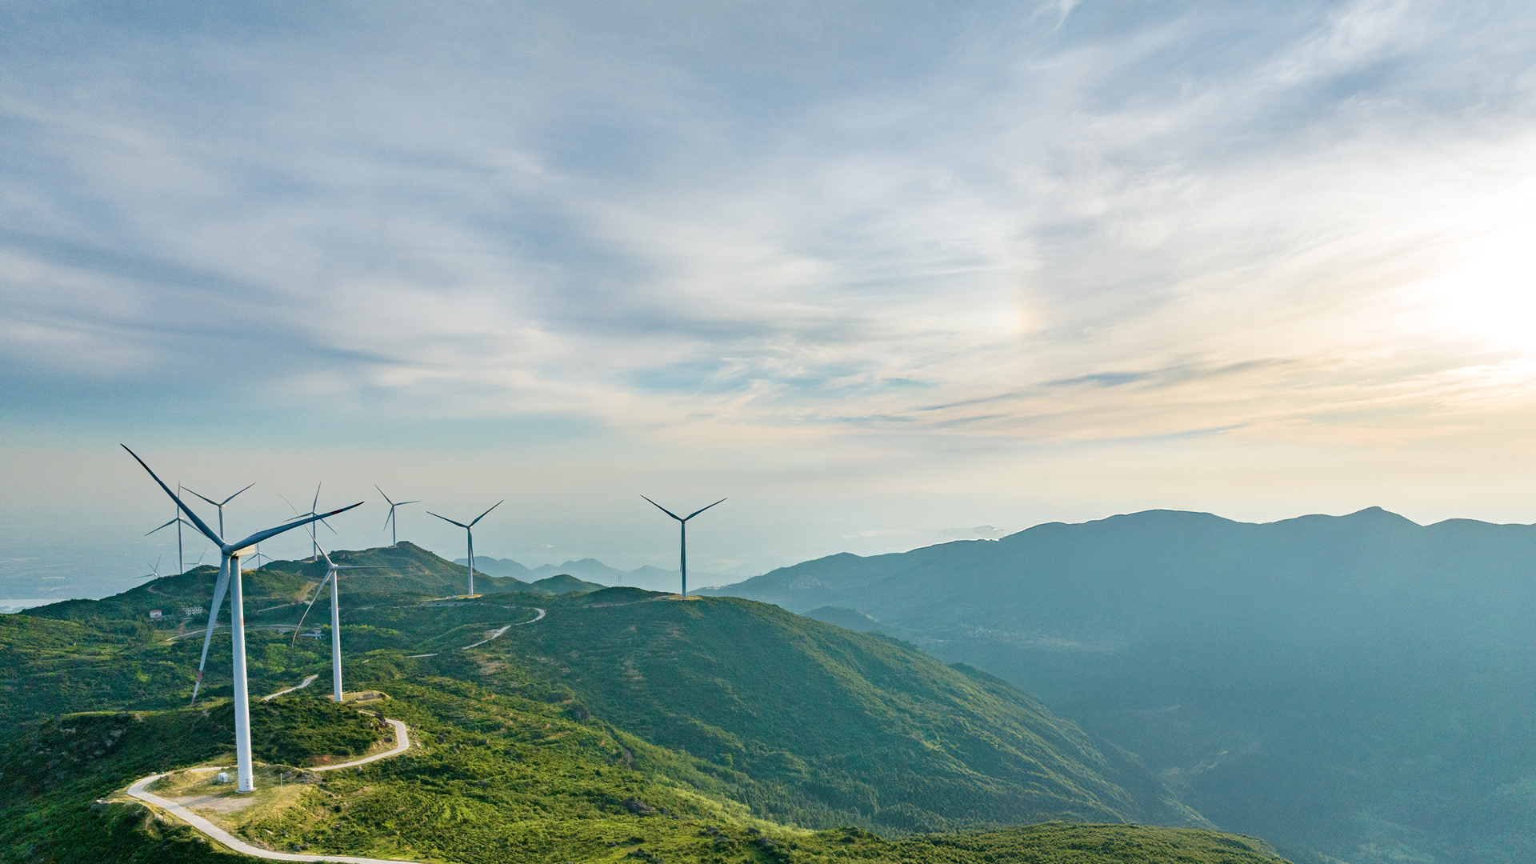


Project Bana
55 MW wind development project opportunity
13 October 2026

Slide 2
At €4.50m, Bana returns 28.4% (European) / 43.2% (Chinese) on a sale at COD and 8.0% / 12.0% if held
Executive summary
Risks and mitigants
Technical overview and tender bid
Funding to COD
Returns: sale at COD vs hold
Sale price and buyer return
Sensitivities
FEP funds €53.6m of equity to COD (€40.9m Chinese) and bids 59.5 points (47.5 Chinese) into the 30 October tender; the European route needs a permit amendment.
GEI has been developing a wind project near the Huayou Cobalt plant in Bana, first as a behind-the-meter supply. It holds a building permit for 6 turbines, is close to RtB and is for sale.
The 2026 MEKH tender offers a grid connection at the Ács Katódgyár node. GEI cannot bid, so a share deal is not feasible: a transfer of rights lets FEP bid in its own name, with closing subject to the award. All land, rights and permits move to FEP. Dentons (sell side) has issued a legal DD report and a draft transfer agreement.
RtB is not yet reached: cable-route permits are missing, the Pér airport flight-path agreement is open and only 6 of 9 turbine positions are permitted. The permits name Goldwind turbines; another manufacturer needs a permit amendment.
The seller asks a near-RtB price, so an RtB exit is not modelled: value comes from building and selling at COD or holding the asset.
FEP asks the IC to approve the purchase price and to give its view on buying and developing the project.
We are assuming a COD sale price of €2.45m/MW with EU turbines and €2.10m/MW with Chinese turbines
Key numbers | Unit | European | Chinese
Tender points | points | 59.5 | 47.5
FEP equity to COD | € m | 53.6 | 40.9
Sale at COD
FEP profit | € m | 21.9 | 31.1
FEP IRR | % | 28.4% | 43.2%
FEP MOIC | x | 1.41x | 1.76x
Buyer IRR, unlevered | % | 5.7% | 7.0%
Hold to maturity
FEP IRR | % | 8.0% | 12.0%
FEP MOIC | x | 3.37x | 4.85x
FEP NPV | € m | (0.1) | 17.7
Minimum DSCR | x | 1.91x | 2.53x
Post-tax, FEP 100 %. Purchase price paid at closing (31‑Dec‑26), after the award. PPA 90 €/MWh for the whole life; NPV at 8%. Chinese = the permitted Goldwind turbines.
Source: Bana_Model.xlsm, 13 Oct 2026.

Slide 3
Legal DD finds no high risks; four of the five medium risks are fixed before signing or closing
Executive summary
Risks and mitigants
Technical overview and tender bid
Funding to COD
Returns: sale at COD vs hold
Sale price and buyer return
Sensitivities
Dentons legal due diligence – no high risks, five medium and seven low
Topic | Issue | Rating | Mitigant (DD recommendation)
Permitting and energy regulatory
Permit transfer | Building and withdrawal permits and the environmental resolution must move to the Project Company; the law is silent, but authorities have allowed it | Medium | Seller to prepare and file the transfer applications before Closing
Building permit validity | Permits lapse 2 years after becoming final (first: 15 Jul 2026); repeat 2-year extensions are unclear, while grid connection may slip to Sep 2032 | Medium | Apply for extensions in time so the permits stay valid until the actual grid connection
Withdrawal permits | Valid 4 years and not extendable; non-agricultural use must start by 2029–2030 or new permits are needed | Low | Track expiry dates and start site use within each validity period
Environmental resolution | Resolution assumes behind-the-meter supply with no grid feed-in; a tender award changes the activity | Low | Notify the environmental authority and confirm whether an amendment is needed
Airport flight procedures | Construction on 4 sites cannot start until Győr-Pér procedures are amended (agreement with ALTEO due Q4 2026, then ~9 months) | Low | Sign the tri-party agreement and complete the amendment ahead of construction
Turbine type | Permits specify Goldwind turbines up to 129 m hub height; a taller turbine may need an EIA, and the EU-manufacturer tender bonus is out of reach | Info | No DD recommendation; any turbine change needs a permit amendment
Real property
Tender land-right test | Land use agreements (ráépítési jog) do not formally meet the tender land-right rule; the bidder declares compliance under criminal liability | Medium | Before or at Signing, sign a preliminary building-right agreement on at least one plot (>1 ha), assigned to the Project Company at Closing; agree the list of plots needed
Land right transfer | Land use rights must be transferred and re-registered plot by plot (landowner consent already given) | Medium | Seller to prepare notices and transfer documents before Closing, effective at Closing
Landowner rescission | RtB milestone expires Mar 2027–Jul 2028 and completion Mar 2029–Jul 2031; RtB needs a grid connection agreement only available after the tender award | Medium | Extend the milestone deadlines in the land use agreements to fit the tender timeline before Closing
Adjacent plots | BN-05 and BN-08 agreements also cover plots 031/4 and 039/8, which the Project does not need | Low | Terminate and deregister those rights before Closing
Plot 07/9 | No right registered yet; plot division expected Dec 2026, final agreement due within 15 days | Low | Sign the final land use agreement and file for registration before Closing
Zoning | Plots 047/12 and 050 are not zoned for wind (amendment takes 4–7 months); county permit runs to 2031 (2032 if extended) | Low | Amend local regulations before the building permit applications; monitor county plan adoption
Municipal cooperation | Agreement expires 18 Oct 2027 unless construction starts; the seller intends to keep it | Low | Extend the term and widen the scope to plots 047/12 and 050
Ratings as assigned by Dentons; Info = for information only, not rated. Recommendations paraphrased from the report.
Source: Dentons, Project Bana Legal Due Diligence Report (draft, 9 October 2026).

Slide 4
55 MW producing 139.4 GWh a year; the bid scores 59.5 points with European turbines and 47.5 with Chinese
Executive summary
Risks and mitigants
Technical overview and tender bid
Funding to COD
Returns: sale at COD vs hold
Sale price and buyer return
Sensitivities
Overbuild 20% (5 points, 55 of 60 MW built, inside the tolerance) and BESS 20% of MVA (7.5 points); European turbines add 12 points but need a permit amendment.
Item | Assumption
Site and grid
Grid node | Ács Katódgyár (BAMO B 132.00)
Connection / wind committed / built | 50 MVA / 60 MW / 55 MW
BESS committed and built | 10 MW / 40 MWh at 240 k€/MW
Energy yield and price
Net P50 equivalent hours | 2,600 h
Curtailment / degradation | 2.0% / 0.30% p.a.
Net generation, first full year | 139.4 GWh
PPA, 100 % of output, whole life | 90 €/MWh at COD, +1.0% p.a.
Timeline
Bid / award / closing | 30‑Oct‑26 / 13‑Dec‑26 / 31‑Dec‑26
NTP / COD | 30‑Sep‑28 / 30‑Sep‑30
Acquisition
Purchase price / DD / devex | €4.50m / €0.15m / €0.50m
Tender bid | Commitment | European | Chinese
ÖSZ-1 municipal one-off | 50 k€/MW (€2.50m) | 20 | 20
ÖSZ-2 community contribution | 3.0 €/MWh | 15 | 15
ÖSZ-3 overbuild | 20% of MVA; 10% built | 5 | 5
ÖSZ-4 BESS power | 20% of MVA, 4 h; built | 7.5 | 7.5
ÖSZ-6 performance security | 1.0x of the minimum | 0 | 0
ÖSZ-9 European turbines ≥ 80 % | European route only | 12 | 0
ÖSZ-5 partial award, ÖSZ-8 shared connection, ÖSZ-9 EU transformers | not offered | 0 / 0 / 0 | 0 / 0 / 0
Total score |  | 59.5 | 47.5
Points are the model's own score on the MEKH 2026 bands (Kiírás Annex 3-4). ÖSZ-4 is scored on net MVA (as Bora); BESS at capex only, no revenue or opex, not in the COD price. Brownfield (ÖSZ-7) is not available. Build shortfall 8.3% against the commitment, inside the 10% tolerance (GYIK 28/30). The municipal one-off is paid at COD.
Source: Bana_Model.xlsm, 13 Oct 2026.

Slide 5
Uses to COD of €111.8m with European turbines (€83.4m Chinese); senior debt funds 52% (51%) and FEP the rest
Executive summary
Risks and mitigants
Technical overview and tender bid
Funding to COD
Returns: sale at COD vs hold
Sale price and buyer return
Sensitivities
A €0.44m bid guarantee at the bid; after the award a €2.22m PB guarantee and €0.62m of TSO cash; the €8.2m connection fees fall due at the HCSSZ, 08‑Jan‑29.
Uses and sources to COD | Unit | European | Chinese
Purchase price, DD and devex | € m | 5.2 | 5.2
Participation fee, TSO security, guarantee fees | € m | 1.1 | 1.1
Construction capex | € m | 90.4 | 63.1
Connection fees, net of TSO security | € m | 8.2 | 8.2
Municipal one-off (ÖSZ-1) | € m | 2.5 | 2.5
Capitalised interest and debt fees | € m | 4.1 | 3.0
Land lease during construction | € m | 0.3 | 0.3
Total uses | € m | 111.8 | 83.4
Senior debt at COD (incl. capitalised interest) | € m | 58.1 | 42.5
FEP equity to COD | € m | 53.6 | 40.9
FEP peak equity if held (incl. DSRA) | € m | 54.9 | 41.9
Tender securities and fees | Form | € m | What happens
Participation fee | cash | 0.01 | not refunded
Bid security | guarantee | 0.44 | released at PB posting
Performance security | guarantee | 2.22 | held to 31‑Mar‑33
TSO connection-request security | cash | 0.62 | credited to the indirect fee
Direct connection fee | cash | 1.26 | paid 08‑Jan‑29
Indirect connection fee, net | cash | 6.89 | paid 08‑Jan‑29
Guarantee fees to COD | cash | 0.49 | 6% p.a. on guarantees
Debt share = senior debt at COD ÷ total uses. Debt draws pro rata with construction costs at up to 55% of cost on both routes; interest capitalised to COD. Securities are the same on both routes; HUF amounts at 365 HUF/EUR.
Source: Bana_Model.xlsm, 13 Oct 2026.

Slide 6
A sale at COD turns €53.6m of equity into €75.5m (1.41x); holding earns 8.0% at a 1.91x DSCR (European)
Executive summary
Risks and mitigants
Technical overview and tender bid
Funding to COD
Returns: sale at COD vs hold
Sale price and buyer return
Sensitivities
With Chinese turbines the sale returns 43.2% and the hold 12.0%; debt is capped at 55% of construction cost on both routes.
FEP, post-tax | Unit | COD – European | COD – Chinese | Hold – European | Hold – Chinese
Sale price (enterprise value) | € m | 134.1 | 115.0 | – | –
Senior debt assumed by the buyer | € m | (58.1) | (42.5) | – | –
Net proceeds to FEP (after sale costs) | € m | 75.5 | 72.0 | – | –
Buyer IRR, unlevered / levered | % | 5.7% / 5.9% | 7.0% / 7.5% | – | –
FEP equity: to COD / peak if held | € m | 53.6 | 40.9 | 54.9 | 41.9
FEP profit | € m | 21.9 | 31.1 | 130.2 | 161.3
FEP IRR | % | 28.4% | 43.2% | 8.0% | 12.0%
FEP MOIC | x | 1.41x | 1.76x | 3.37x | 4.85x
FEP NPV | € m | 12.3 | 19.8 | (0.1) | 17.7
Project IRR, actual tax, before financing | % | – | – | 7.2% | 9.8%
Minimum DSCR (sculpted repayment) | x | – | – | 1.91x | 2.53x
Corporate income tax over the life | € m | – | – | (23.1) | (28.5)
Debt and tax
Debt: 1.20x target DSCR over 18 years, 5.0% fixed; sized at the lower of the DSCR capacity and 55% of cost on both routes; 63% / 47% of the DSCR capacity is used.
Tax: CIT 15% (Pillar Two minimum), no Robin Hood tax in the base; 20-year depreciation; losses capped at 50% of the base and lapse after 5 years. Gain on the COD share sale exempt.
Sale price 2,450 / 2,100 k€ per built MW, less the 0.45% bottleneck loss; the buyer takes the SPV with its debt and funds the DSRA. Hold: PPA 90 €/MWh, 30-year life; DSRA of 6 months funded at COD. HIPA 2% and the innovation contribution on revenue. NPV at 8%.
Source: Bana_Model.xlsm, 13 Oct 2026.

Slide 7
At 2,450 / 2,100 k€/MW a buyer earns 5.7% / 7.0%; at the lower price 6.7% / 8.1%, but FEP's sale IRR falls to 12.1% / 29.7%
Executive summary
Risks and mitigants
Technical overview and tender bid
Funding to COD
Returns: sale at COD vs hold
Sale price and buyer return
Sensitivities
The buyer receives the same cash flows on both routes, so the higher European price lowers its return; the price per MW is an estimate, not a bid.
Case | EU price k€/MW | Buyer unlevered | Buyer levered | FEP sale IRR | CN price k€/MW | Buyer unlevered | Buyer levered | FEP sale IRR
Price −10% | 2,205 | 6.7% | 7.5% | 12.1% | 1,890 | 8.1% | 9.3% | 29.7%
Base | 2,450 | 5.7% | 5.9% | 28.4% | 2,100 | 7.0% | 7.5% | 43.2%
Price +10% | 2,695 | 4.8% | 4.6% | 42.2% | 2,310 | 6.0% | 6.2% | 54.7%
Buyer unlevered: pays the enterprise value at COD and receives EBITDA less tax, guarantee fees and any PB call. Buyer levered: pays the price less the senior debt, funds the DSRA and services the debt. Share deal: SPV tax, debt and depreciation continue.
Source: Bana_Model.xlsm, 13 Oct 2026.

Slide 8
A lower COD price is the largest risk to the sale (12.1%); the hold moves with yield (6.3% if lower) and PPA price (9.8% if higher)
Executive summary
Risks and mitigants
Technical overview and tender bid
Funding to COD
Returns: sale at COD vs hold
Sale price and buyer return
Sensitivities
FEP IRR by key-assumption set, each change on its own (buyer IRR on the previous slide); the sale at COD does not depend on yield or PPA price because its price is fixed per MW.
Key-assumption set | COD – EU | COD – CN | Hold – EU | Hold – CN | DSCR – EU | DSCR – CN
Base | 28.4% | 43.2% | 8.0% | 12.0% | 1.91x | 2.53x
COD price −10% | 12.1% | 29.7% | 8.0% | 12.0% | 1.91x | 2.53x
COD price +10% | 42.2% | 54.7% | 8.0% | 12.0% | 1.91x | 2.53x
Turbine +10% | 21.2% | 39.3% | 7.3% | 11.5% | 1.82x | 2.45x
Yield −10% | 28.4% | 43.2% | 6.3% | 10.1% | 1.70x | 2.26x
PPA +10% | 28.4% | 43.2% | 9.8% | 14.1% | 2.13x | 2.84x
Full PB call | 25.9% | 40.7% | 7.7% | 11.6% | 1.91x | 2.53x
Rate +1 pp | 27.8% | 42.7% | 7.5% | 11.6% | 1.76x | 2.34x
Tenor 10 years | 28.4% | 43.2% | 7.4% | 10.9% | 1.25x | 1.66x
Robin Hood 31% | 28.4% | 43.2% | 6.1% | 9.1% | 1.76x | 2.16x
CIT 9% | 28.4% | 43.2% | 8.3% | 12.5% | 1.94x | 2.60x
What to watch
Turbine choice: the permits name Goldwind; European turbines need a permit amendment and carry the most capex risk.
Overbuild: 55 MW built against 60 MW committed. Pro rata (GYIK 28/30) there is no PB call; if the full-call reading (GYIK 72) applies, the €2.22m PB is lost: COD IRR 25.9%, hold IRR 7.7% (European).
Robin Hood tax: if the 31% levy applies, the hold IRR falls to 6.1% / 9.1%.
PPA: 90 €/MWh for the whole life is an assumption; no offtake is signed.
Debt: a 10-year tenor lowers the European minimum DSCR to 1.25x and the hold IRR to 7.4%.
Each set changes one input, as named; tenor 10 years. Stored by the scenario macro with the tax solver; base = live model. Model checks in every set: all pass.
Source: Bana_Model.xlsm, 13 Oct 2026.

