Slide 1
❤
Insaan
THE HEALTHCARE CONCIERGE
HACK THE EXPERIENCE
Built for patients who just want to talk to a human that understands them.

Slide 2
The Problem
"My parents struggle with English and have a hard time navigating the medical world — bills, appointments, prescriptions. They just want to speak with a human that understands them."
— The inspiration behind Insaan
Insaan means "human" in Pashto — because healthcare should feel human, no matter what language you speak.

Slide 3
What I Built
Multilingual AI Chat
Patients speak in any language. Insaan auto-detects and responds in kind.
Appointment Management
Schedule, reschedule, or cancel visits through natural conversation.
Insurance & Billing Insights
Ask "Why do I pay more?" and get a clear, data-driven breakdown.
Prescription Refills
Request medication refills in any language, validated against records.
Patient Portal
Full dashboard — diagnoses, meds, costs, visits — auto-translated.
Clinical Trial Matching
Patients notified about relevant studies recruiting in their areas.

Slide 4
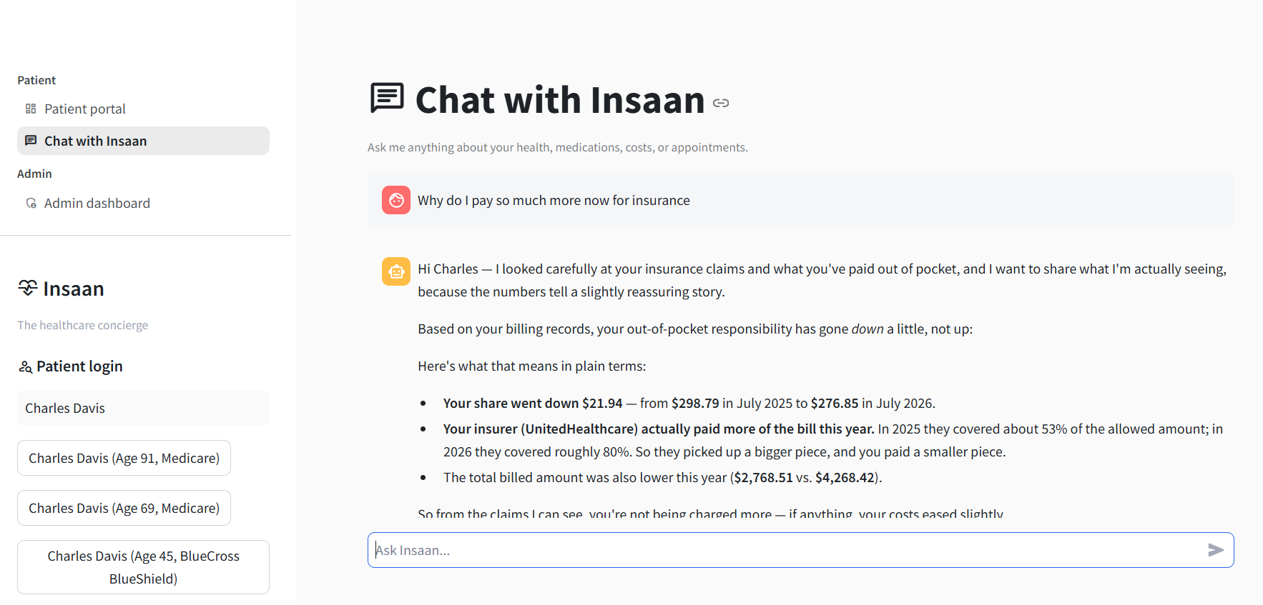
Demo: Insurance Insights
Patient asks: "Why do I pay so much more for insurance?" — Insaan pulls billing data and explains clearly.

Slide 5
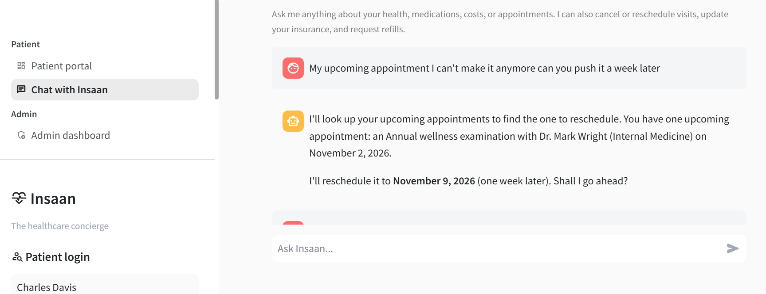
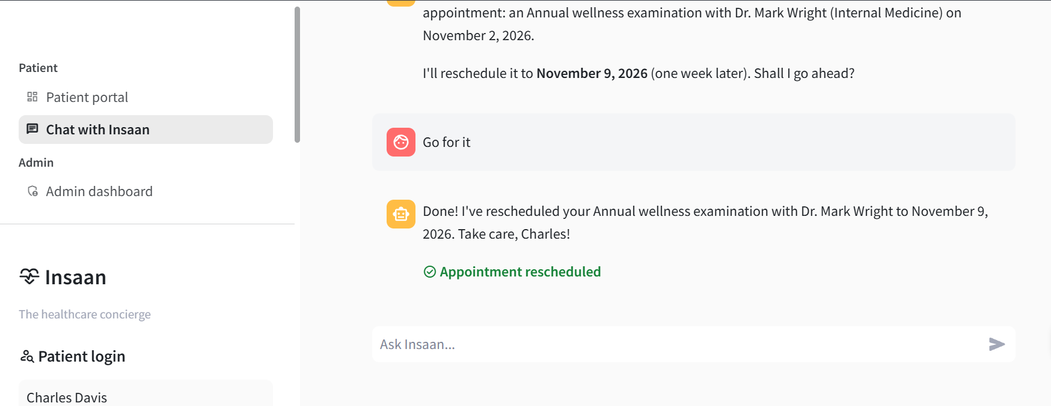
Demo: Appointment Actions
Patient asks to push an appointment. Insaan finds it, proposes a new date, and writes the change.

Slide 6
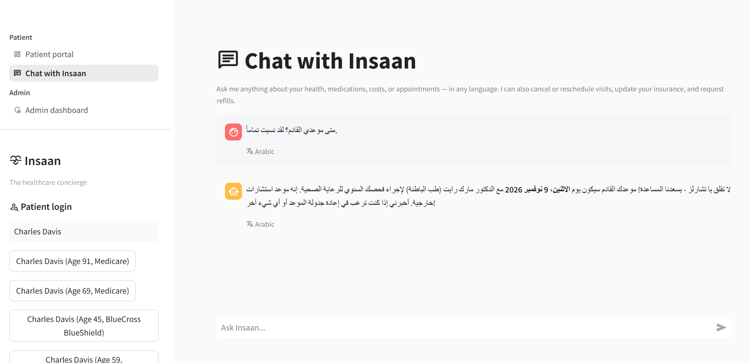
Demo: Speak Any Language
Patient types in Arabic. Insaan detects the language, queries patient data, and responds in Arabic.

Slide 7
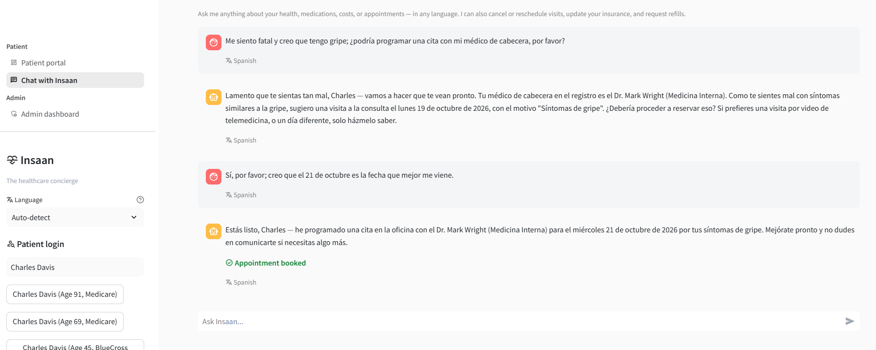
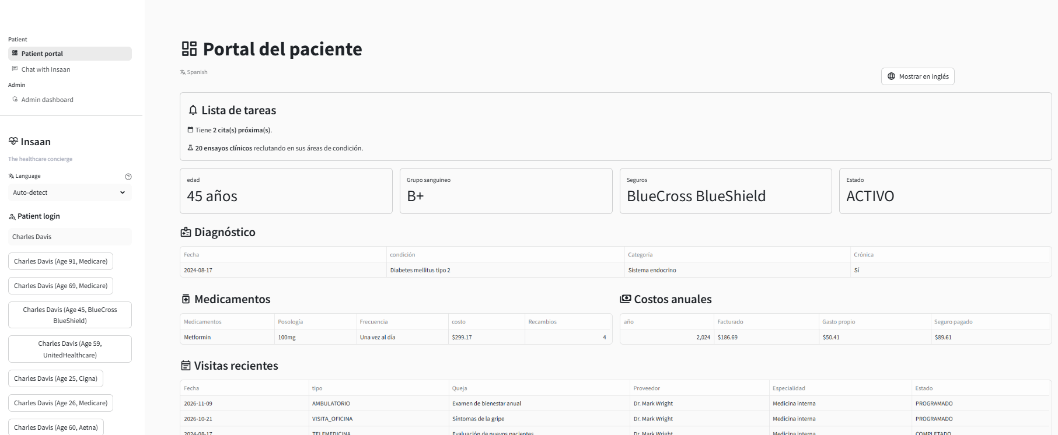
Demo: Spanish Booking & Portal
Full Spanish conversation: patient feels sick, Insaan books with their PCP. The Patient Portal auto-translates too.

Slide 8
Snowflake Features Used
Streamlit in Snowflake
Cortex Agent
AI_TRANSLATE
AI_CLASSIFY
Semantic Views
Cortex Agent — The brain. Routes patient queries to the right data tools and executes write-back actions (book, cancel, reschedule, refill).
AI_TRANSLATE — Translates user input to English for the agent, then translates responses back. Also translates the entire patient portal UI.
AI_CLASSIFY — Detects the language of each message so the system knows which language to respond in — no manual selection needed.
Streamlit — The full front-end: chat interface, patient portal, and admin dashboard — all running natively in Snowflake.

Slide 9
How Baked Is It?
4 / 5
Real: Multilingual chat with auto-detection and translation (AI_TRANSLATE + AI_CLASSIFY)
Real: Cortex Agent answering patient questions with live Snowflake data
Real: Write-back actions — booking, rescheduling, cancelling appointments; requesting refills
Real: Full patient portal with auto-translated UI (diagnoses, meds, costs, visits)
Faked: No login system for patients; just simulated by typing in name from simulated DB

Slide 10
What's Next
VOICE
Speech-to-Text & Text-to-Speech
Let patients speak to Insaan out loud and hear responses — removing the literacy barrier entirely.
SENTIMENT
Conversation Analytics
Track patient sentiment and flag frustration so staff can intervene proactively.
CONTEXT
Deeper Medical Knowledge
Integrate clinical guidelines and drug interaction data for more informed responses.
SCALE
Multi-Provider Support
Extend to support multiple health systems, each with their own data and branding.

Slide 11
❤
Thank You
Insaan — Because Healthcare Should Feel Human
Built with Snowflake Cortex, Streamlit, and a lot of heart.

