Slide 1
Triggers
Exploratory Data Analysis (EDA) Proposal for Triggers on the MTA turnstiles.
Notes:
The restaurant industry is characterized by its competitiveness, and because of that, we have cooperated with our company to solve their problem,

Slide 2



google ads + google Location the restaurant
Marketing for restaurants in the metro station
We are a marketing company that solves the problem of the lack of customers in metro restaurants.
Attracting customers to restaurants through digital ads.
"Data driven marketing"
Foursquare app
Snapchat Location app
Instagram Location app.
Notes:
1. "data-driven marketing"
Employing information to improve marketing decisions in a way that helps increase profits
2. we use Data to Choose the Best Marketing Channels.
3. By tracking them in social media at times of crowding
To truly attract a great flow of leads for your .

Slide 3
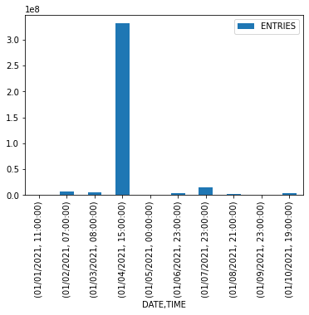
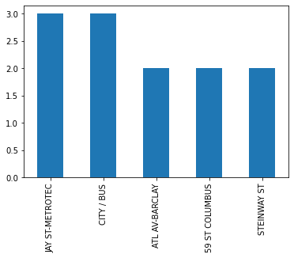
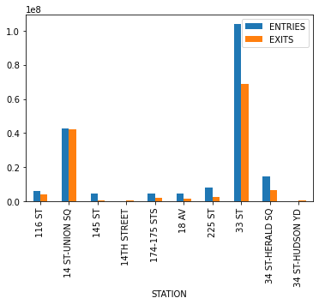
Top 5 STATION
“1”
Top 10 Date with Time
“3”
Top 10 STATION with the Entries and Exits
“2”

Slide 4
Results
increase profit
Solve the problem of lack of customers
reduce cost
Good investment back to restaurants.

Slide 5
Name:
Ghadeer Alsandi.
Zahra Alnasfan.

