Slide 1

Introducing
PONG
** C L A S S I C **

Slide 2
Contributors :
Tasmim Rahman Adib (Roll-19)
Ahmed Zaman Pranta (Roll-43)

Slide 3
Objectives
To get practical knowledge about C/C++ programming language.
To create sense of knowledge about using graphical interfaces.
Getting used to write long codes.

Slide 4
Resources
Sublime text editor
SDL2 graphical interface
Lazyfoo tutorials
TTF texture files
Interactive colorful background images
C/C++ tutorial sources

Slide 5
Gaming Features
Resolution : 1280x720.
A simple 2D based game.
Built over the idea of “User view”.
Single user game.
Opponent is CPU(AI based).
Basically a simple pong game where a player scores a point when opponent misses the ball.

Slide 6
Game-play
This is a simple pong game which is created over the ideas of “Balancing” & “Perfect hitting”.
User has to compete with CPU here which is named “BOT” in the game. A ball is served from the center to a random direction. User has to hit the ball with his hitting techniques and balancing strategy. He’s to hit the ball in order to make the ball out of opponents window. Whenever he’s able to do so,he would score a point.

Slide 7
Previous rules are also applicable for the CPU(BOT).
The velocity of ball gets increased after every 6 hits from both sides(If a game runs to minimum 6 hits,otherwise not applicable).
The player(User or CPU) whoever would be able to score 5 points first,would be declared winner.

Slide 8
Construction
Our game consists of three major structural components :
Interactive menu
Special background texture of playing surface
Paddles
Ping pong ball

Slide 9
Interactive menu
The menu part consists of 4 major functional options :
New Game : Executed by opening a fresh window
for game-play.
High Score : Executed through File in structural programming.
Credits : Mentioned the name of the contributors
and our honorable supervisors.
Quit : Pathway to close the overall window.

Slide 10
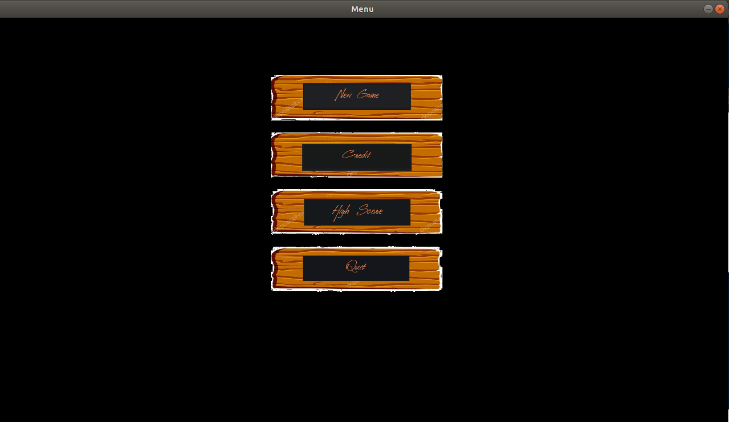
Menu

Slide 11
Background graphics
Built with the help of SDL2 built in rectangle functions.
A combination of Black & White color texture has been added in background in order to differentiate players which seems to be pretty much attractive.

Slide 12
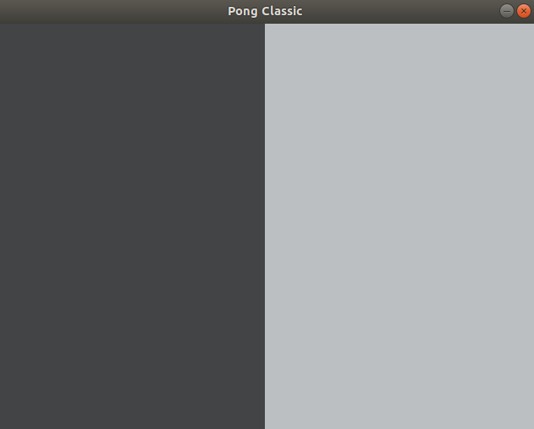
Glimpse of Background

Slide 13
Paddles
Used SDL_Rect function in order to set the dimension of both left paddle(CPU) and right paddle(User).
In order to set the dimension we used 3 basic mathematical factors-
1. Cartesian Co-ordinates
2.Height
3.Weight

Slide 14
Used SDL_SetRenderDrawColor function in order to define the color of paddles.
Used SDL_RenderFillRect function in order to set the color in dimension.

Slide 15
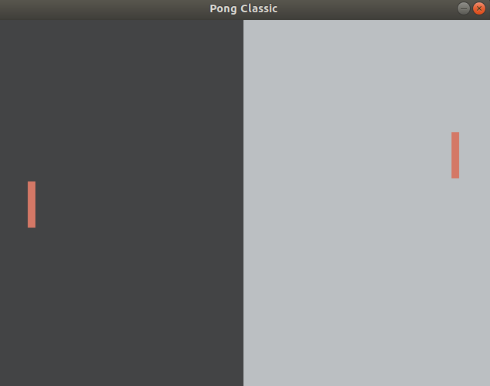
Glimpse of paddles

Slide 16
Ping pong ball
Used SDL_Rect function in order to set the basic dimensional structure of ping pong ball.
Mathematical factors in order to set the dimension of the ball has been used as setting of paddles.
The ball has been set in the center of the window by using Cartesian co-ordinate systems.

Slide 17
Used SDL_SetRenderDrawColor function in order to define the color of ball.
Used SDL_RenderFillRect function in order to set the color in dimension.

Slide 18
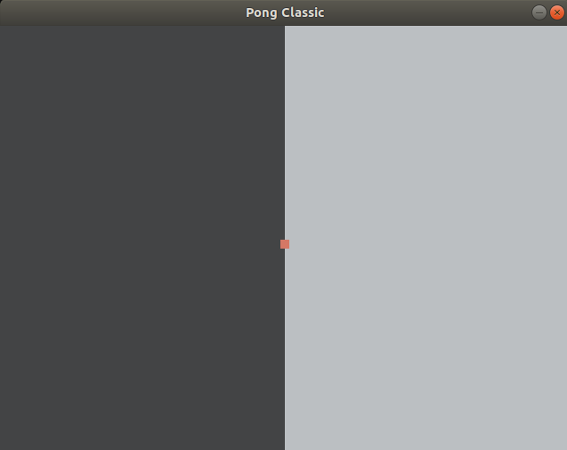
Glimpse of ping pong

Slide 19
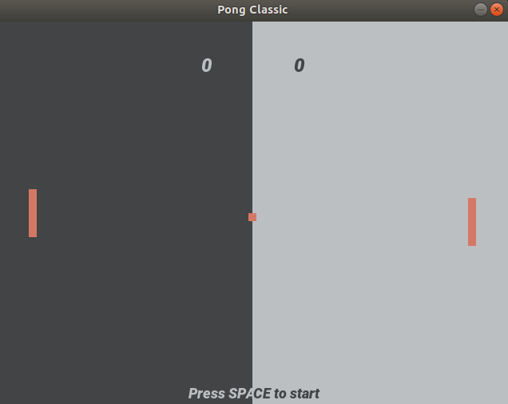
Ready to play!

Slide 20
Logical implementations
Moving of paddles :
We’ve used SDL mouse render function in order to move the user’s paddle.
The opponent paddle is moved through a basic AI function.

Slide 21
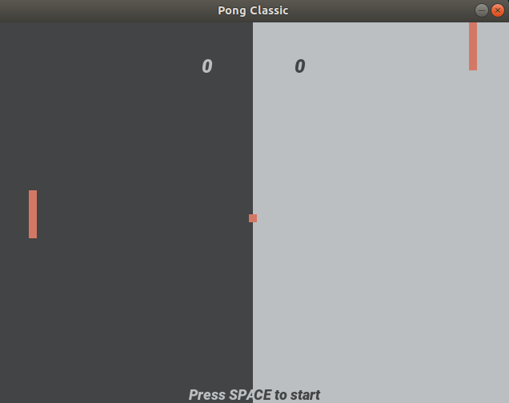
Paddles are moving!

Slide 22
Ball’s movement :
The ball is served from the center of the screen to any random direction.
The service of the ball is executed by pressing “Space” key in keyboard.
Players have to try hitting the ball so that the ball doesn’t go out of its potion of window!
When the ball collide with the CPU’s paddle,determination of angle between ball and the paddle has been executed.

Slide 23
Then multiplied the velocity of the ball and cosine of the determined angle to determine the movement of the ball in X-axis.
Multiplication of ball’s velocity and sine of the angle has been determined to execute the movement of the ball in Y-axis.
The collision function for the other paddle is executed in the same way.
If the ball goes out of the window, the ball is set in the initial center stage with the execution of co-ordinate factors.

Slide 24
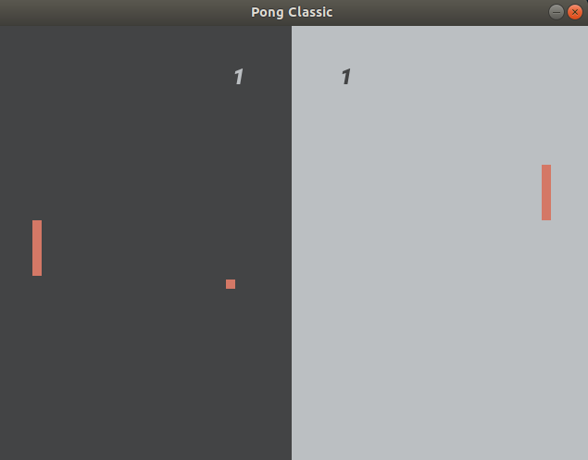
Hit..hit..hit!

Slide 25
Logic for updating score :
Basically,when a player misses the ball and the ball goes out of his own window,opponent gets a point.
The score is updated when the position of ball in X-axis is greater than screen width or less then 0.
* If position of ball in X-axis is greater than the screen width,BOT’s score will be updated.
* If the position ball in X-axis is less than 0,User’s score will be updated.

Slide 26
Once a point is scored by a player,the ball goes back to the center position. It’s again ready to be served!
The player(whether CPU or User) who’ll be able to score 5 points first,will be declared winner!

Slide 27
Flowchart of total gameplay
Menu
Click
New Game
Game Window
Press Space
The Game
starts
Press “esc”
To open menu
again
Score = 5
Game Over
Ball goes outside
Opponent Score
increase
Move the
Paddle
Click
High score
Show
High score
Click
Credit
Show
Credit
window
Click
Quit
Game
Over

Slide 28
User friendliness
Expected to be a game for people of all ages.
Accuracy in calculations can be developed inside them.
Developed High-score options.
Mouse control option has been added.
A perfect game to remove monotony while short span of break,as each game leads to take a short span of time.

Slide 29
Our experience
Working in a project like making a game was really very interesting and we gained much knowledge while building it. Most importantly we developed our structured programming knowledge and as our code was about 700+ lines, this was the first time we wrote such a big code and really was very helpful.
But we faced some problem with SDL2 graphics design library as there is still lack of reliable tutorials to know about the functions.

Slide 30
Thank you!

