Slide 1

Intelligent Support Ticket System
Revolutionizing IT Support with AI-Powered Triage

Slide 2

Introduction: The Triage Bottleneck
Traditional IT help desks face a critical challenge: high volumes of unstructured support tickets. Agents spend valuable time manually reading, classifying, and sorting these tickets before they can even begin problem-solving. This manual triage process creates a significant bottleneck, delaying resolutions and impacting efficiency.
Our project introduces an intelligent solution: a system that integrates the cutting-edge Google Gemini API to automate initial ticket analysis. This transforms raw data into organized, actionable information, empowering support staff to focus on what they do best: solving problems.

Slide 3
Project Objectives
1
2
Gemini API Integration
Priority Assignment
Integrate the Google Gemini API to accurately analyze and categorize incoming ticket text in real-time, leveraging its advanced NLP capabilities.
Utilize Gemini's intelligence to determine and assign appropriate priority levels based on detected urgency within the ticket content.
3
4
Agent Dashboard Development
Reduced Time-to-Response
Develop a user-friendly Agent Dashboard to visualize classified tickets, enabling efficient filtering and rapid pickup by support staff based on their expertise.
Significantly reduce the "time-to-first-response" by eliminating the need for manual pre-sorting by agents, streamlining the entire triage process.

Slide 4
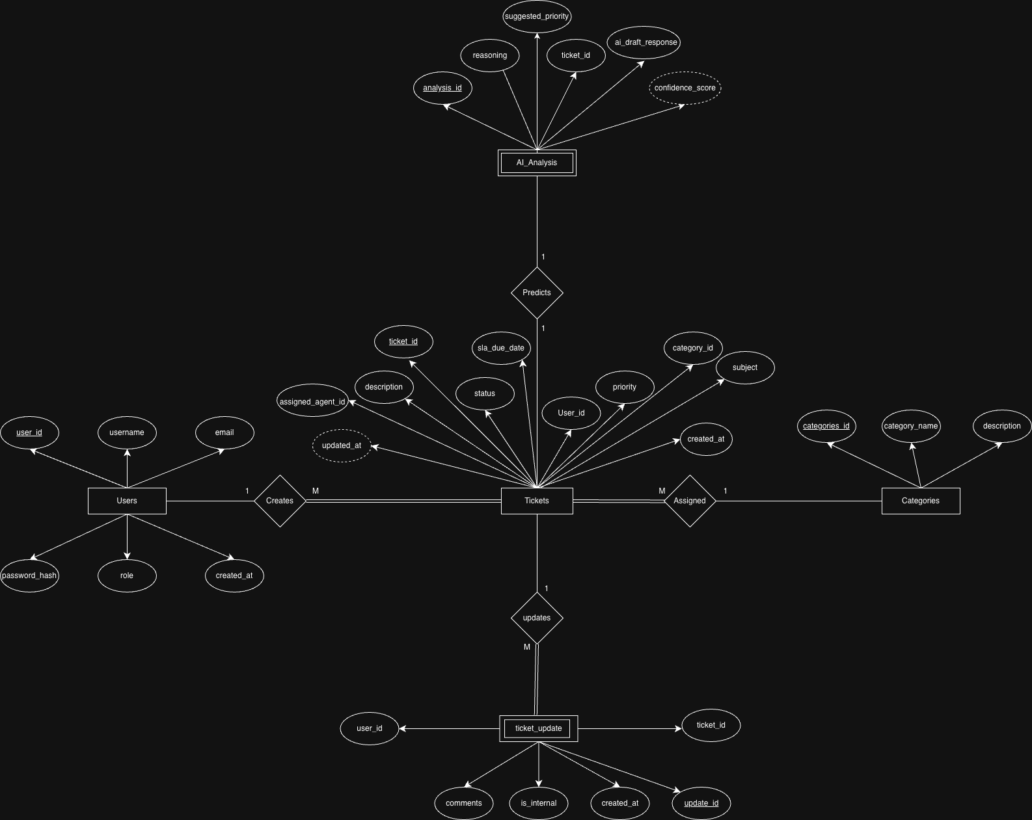

Slide 5
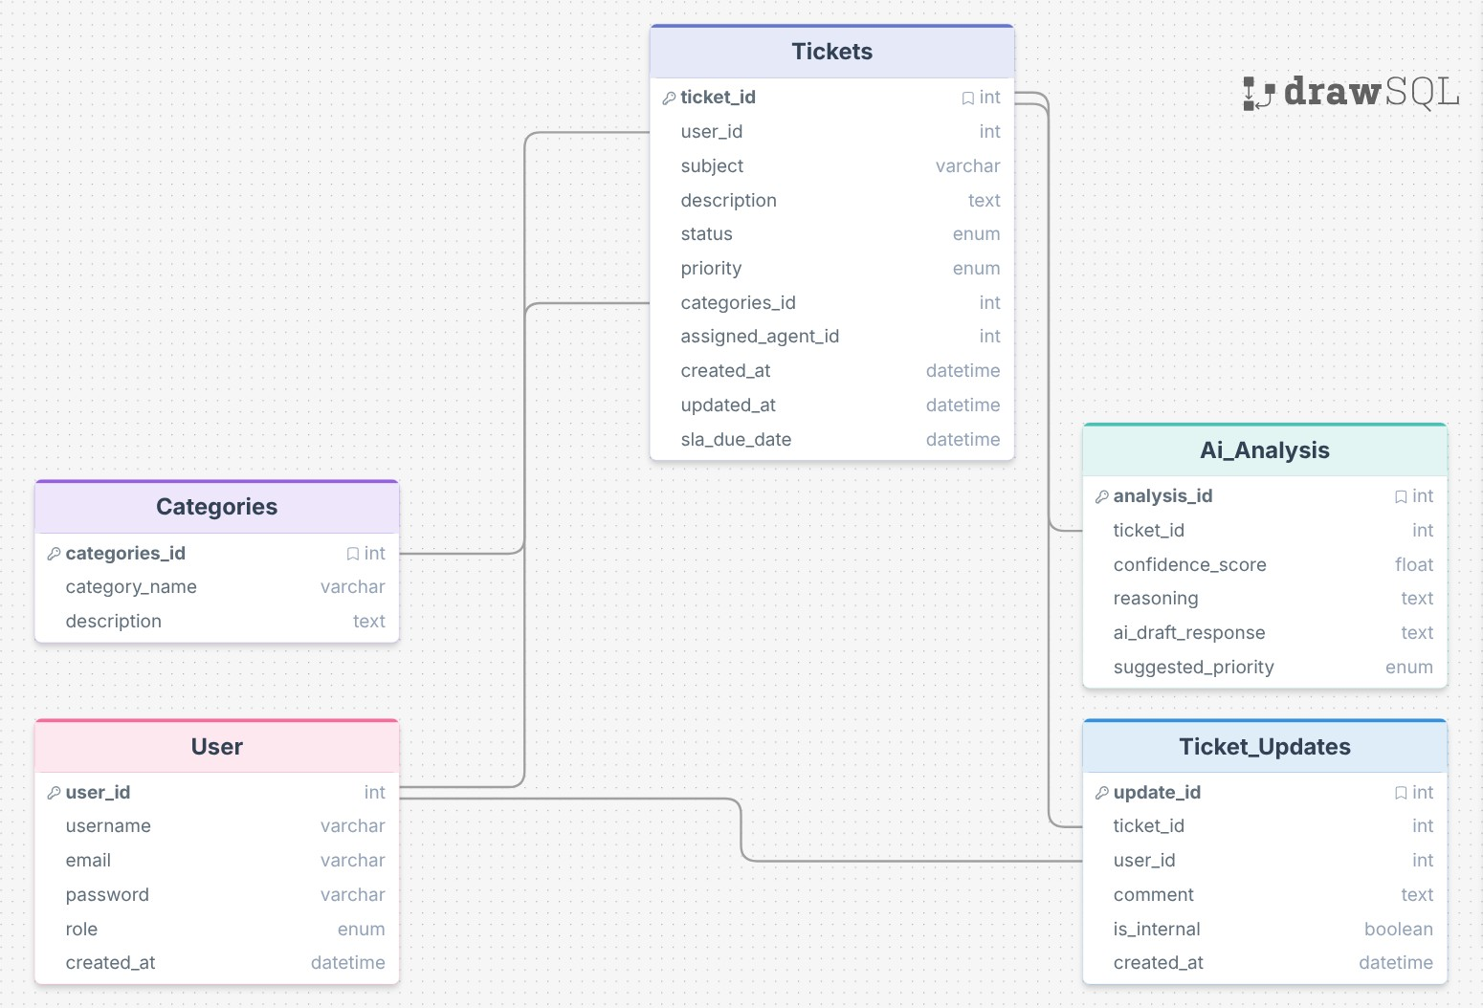

Slide 6
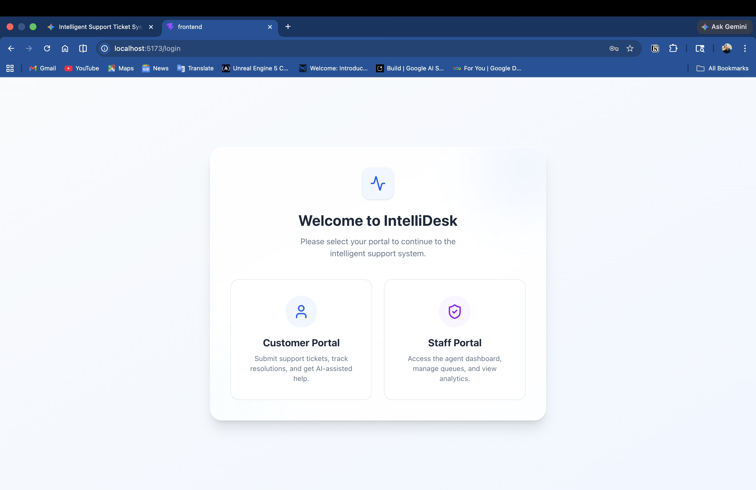
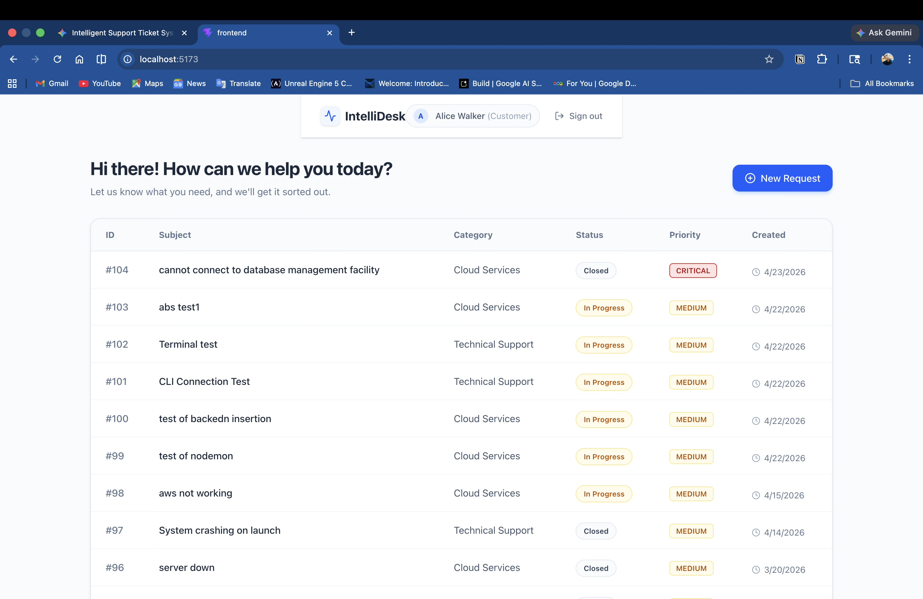
Screenshots Of Front-end
Fig.1 Login page
Fig.2 Customer Dashboard

Slide 7
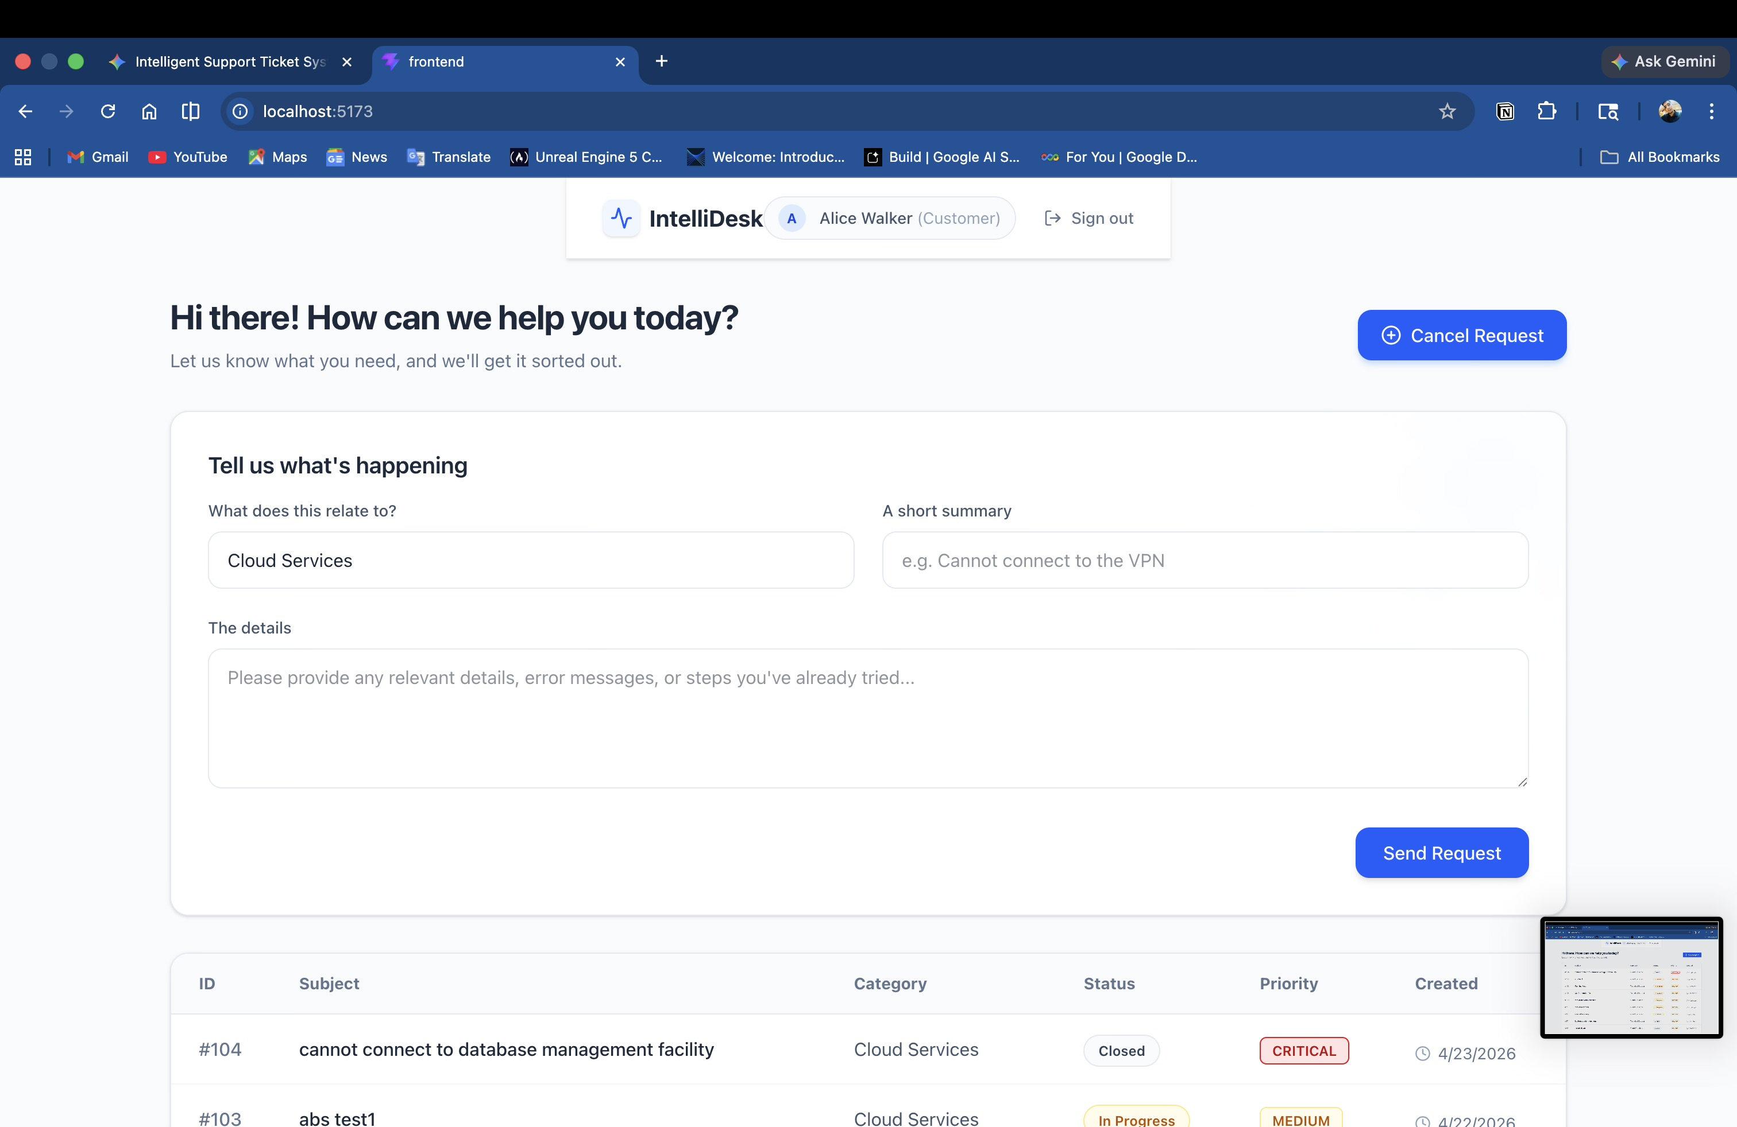
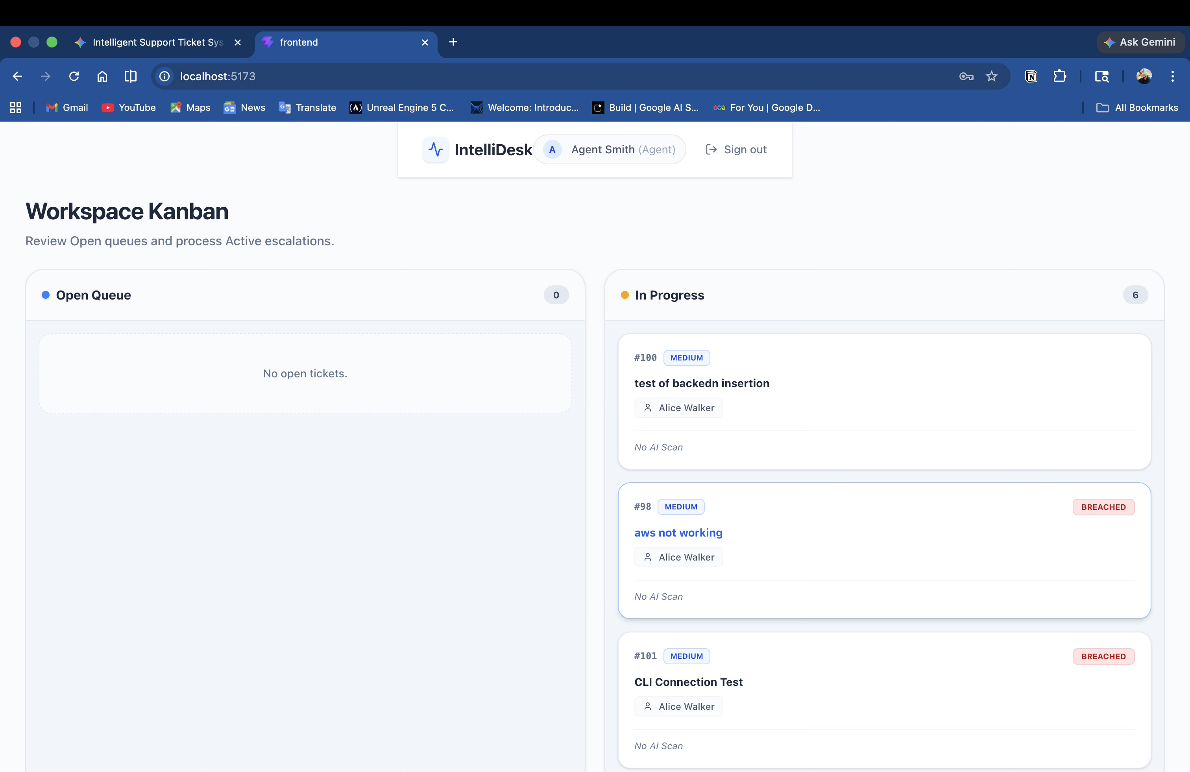
Screenshots Of Front-end
Fig.3 Ticket Creation From
Fig.4 Agent Dashboard

Slide 8
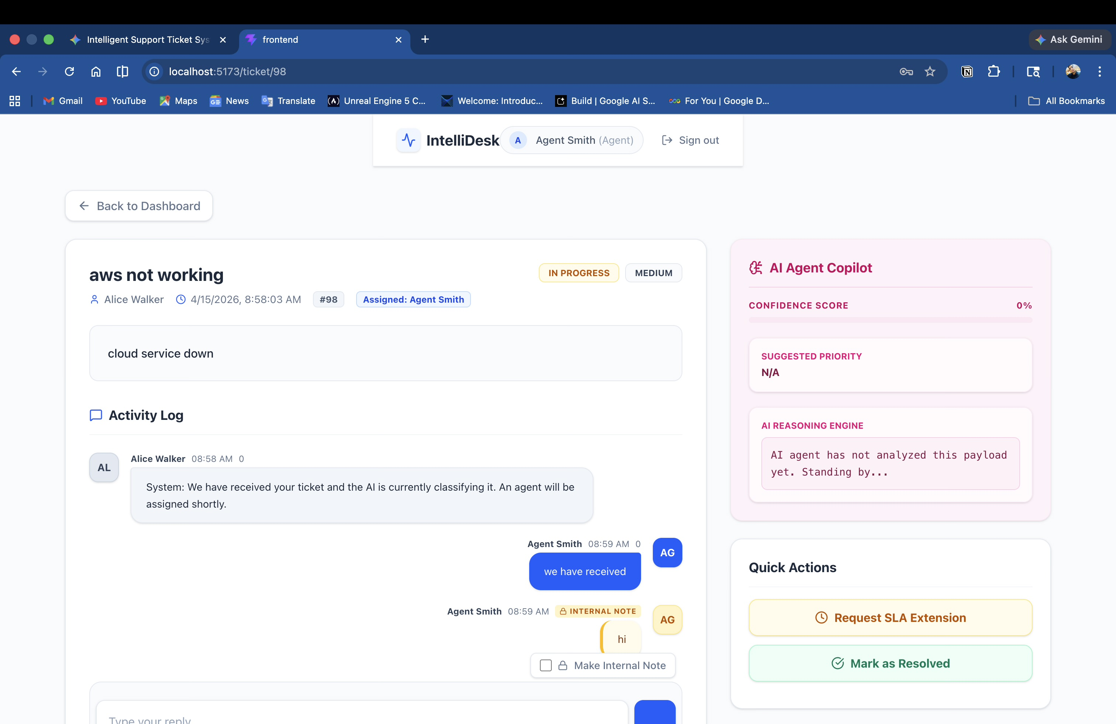
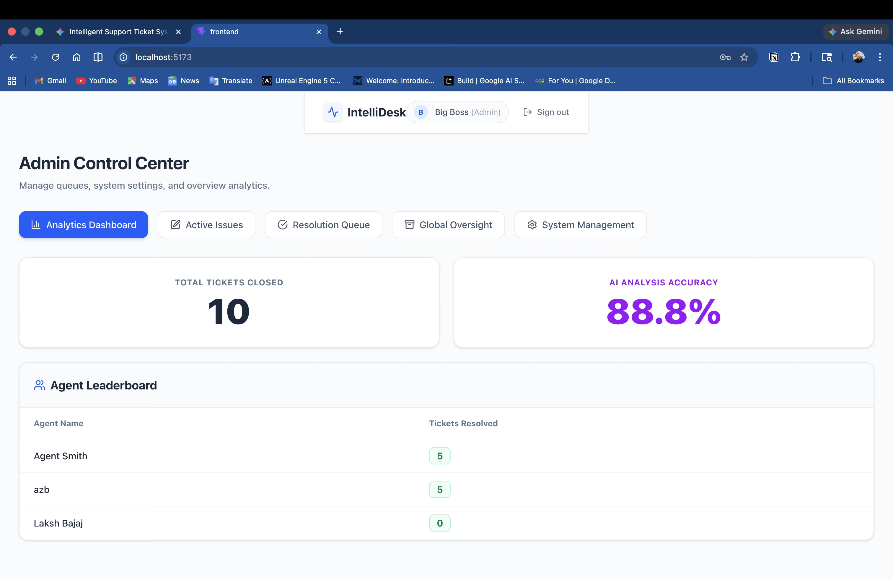
Screenshots Of Front-end
Fig.5 Ticket Overview
Fig.6 Administrator’s Dashboard

Slide 9
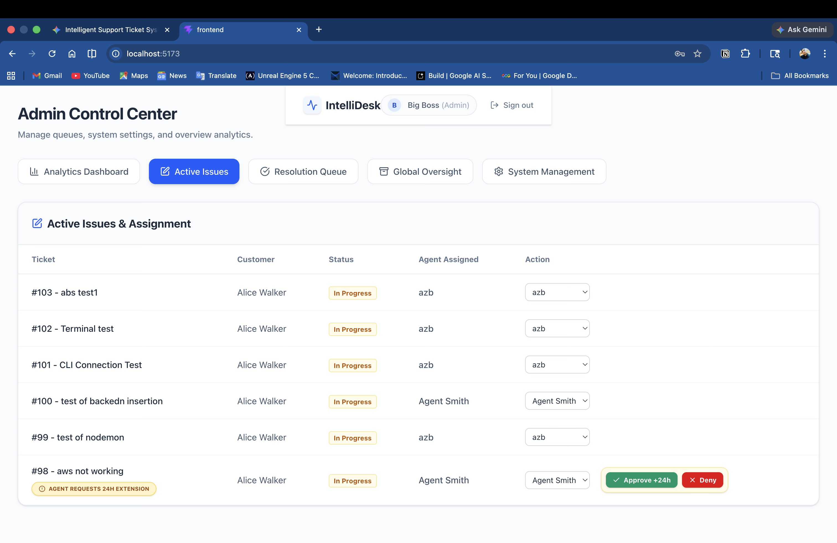
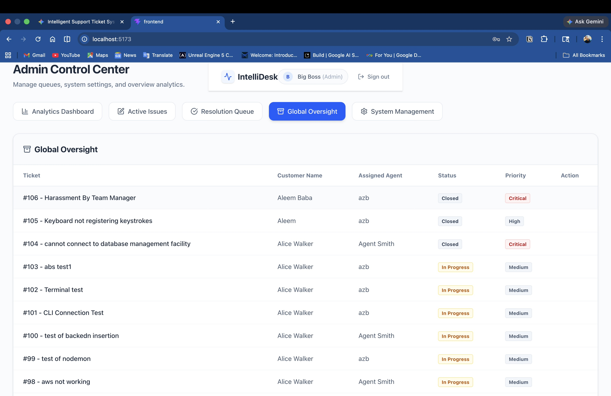
Screenshots Of Front-end
Fig.7 Active Issues
Fig.8 Ticket Archive

Slide 10
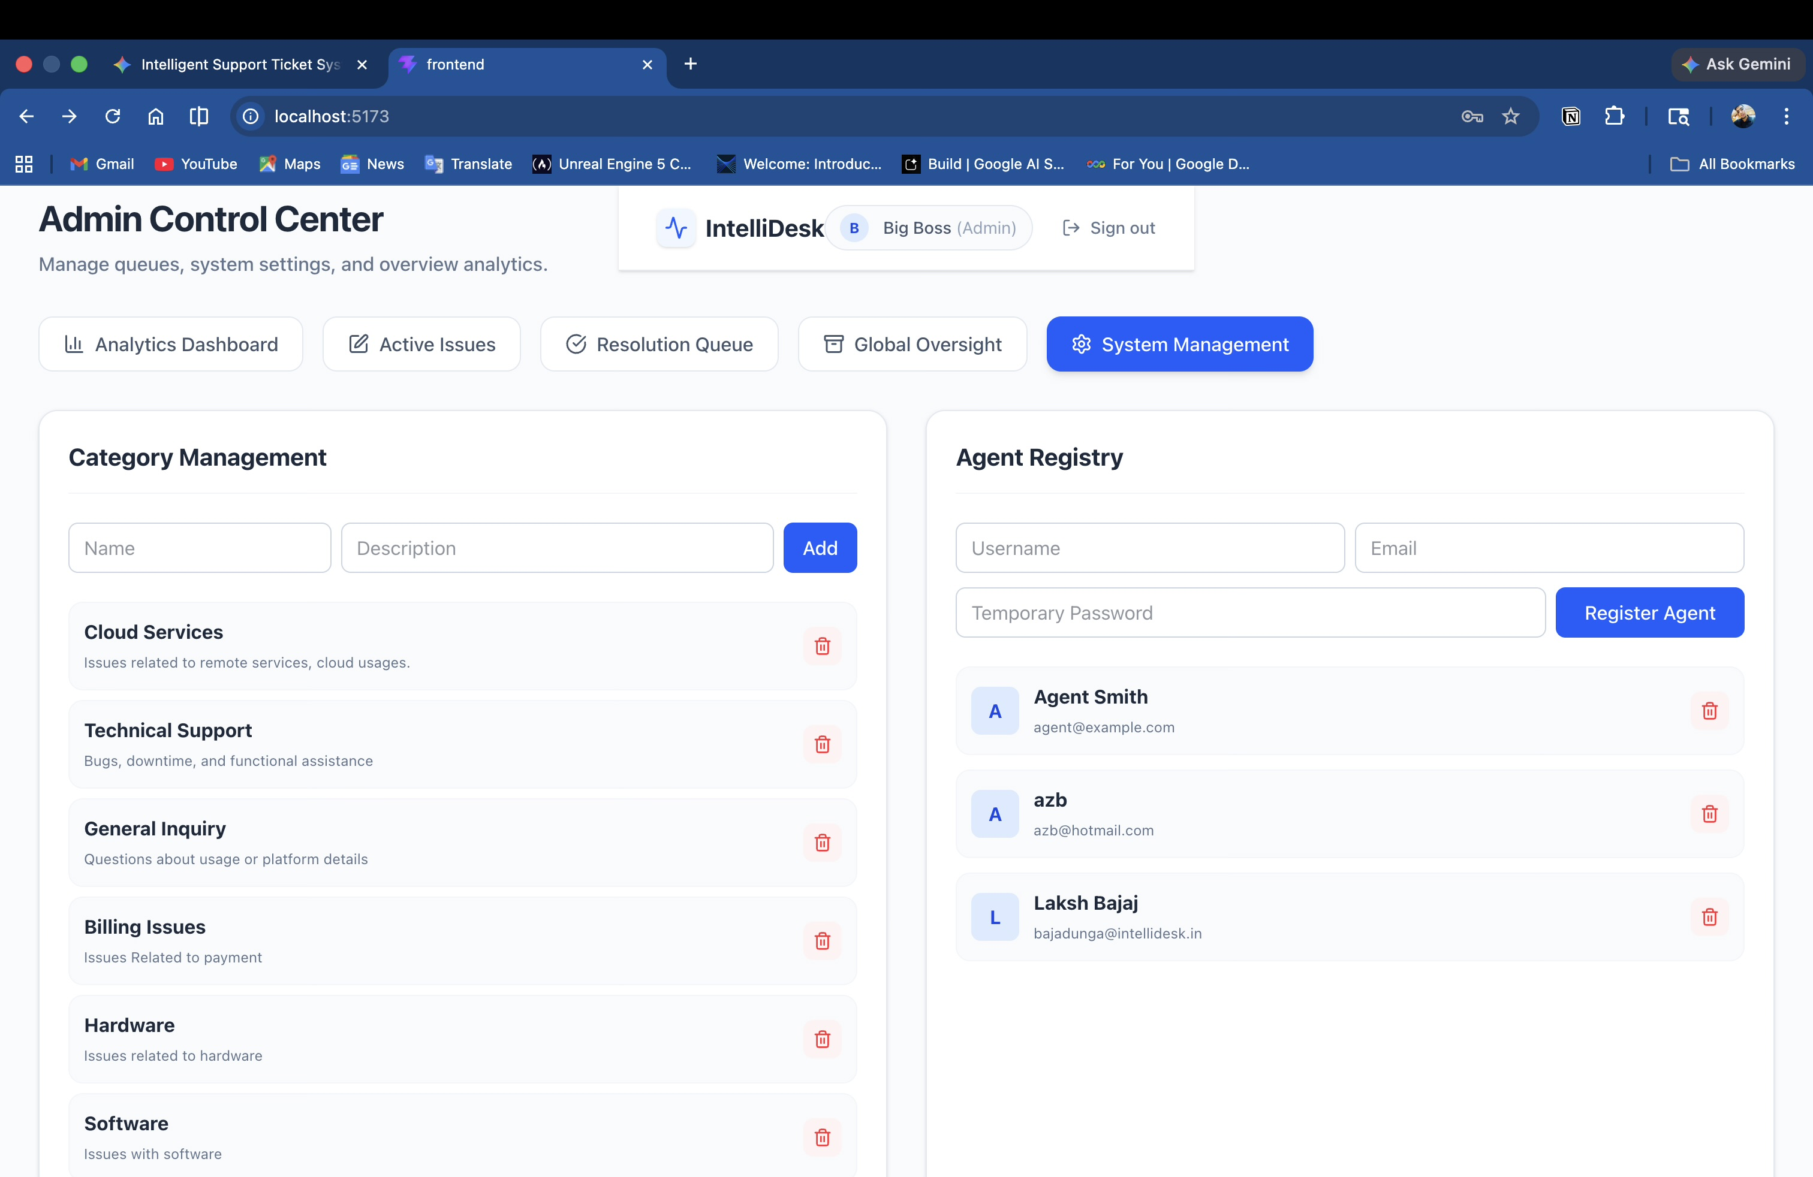
Screenshots Of Front-end
Fig.9 Admin Control Center

Slide 11
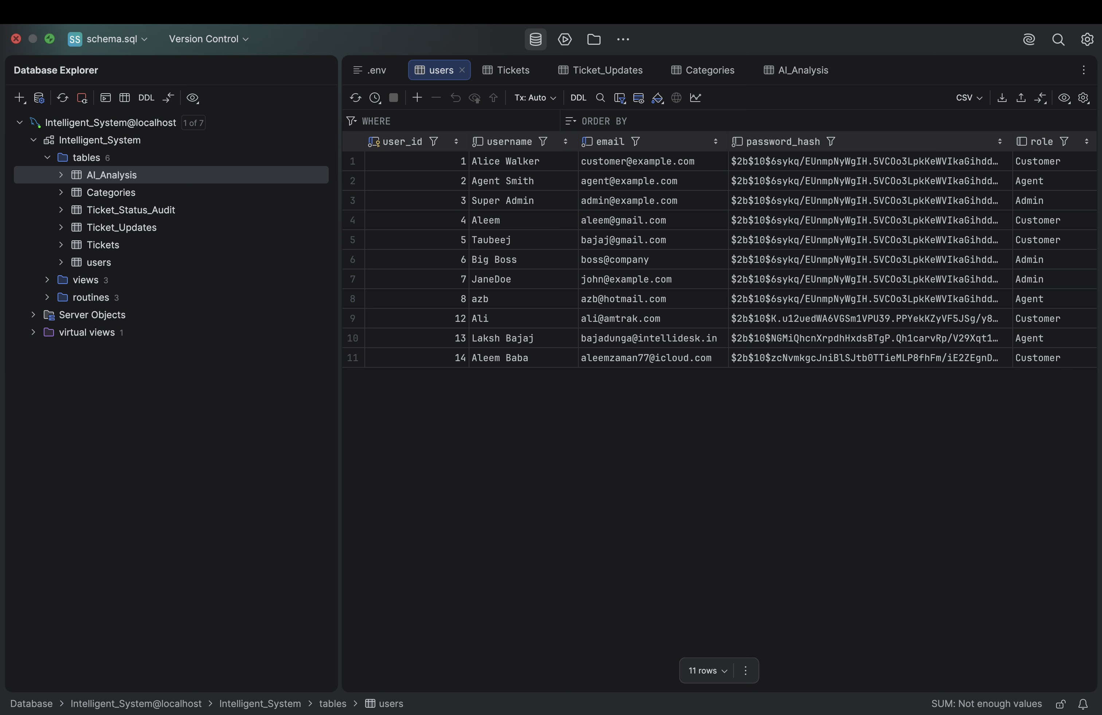
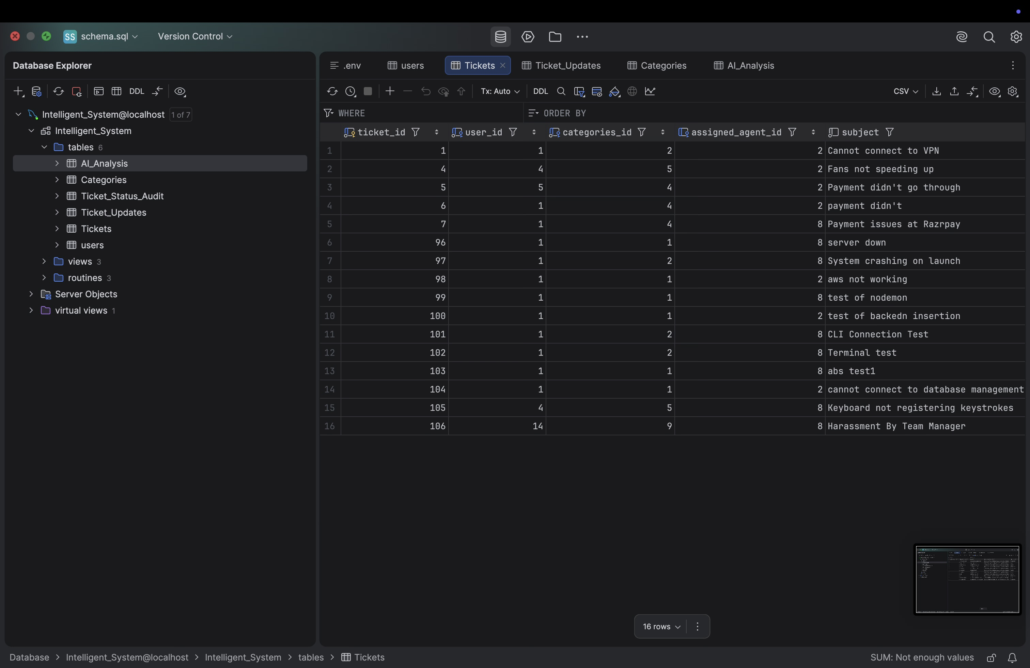
Screenshots Of Back-end
Fig.10 Users Table
Fig.11 Tickets Table

Slide 12
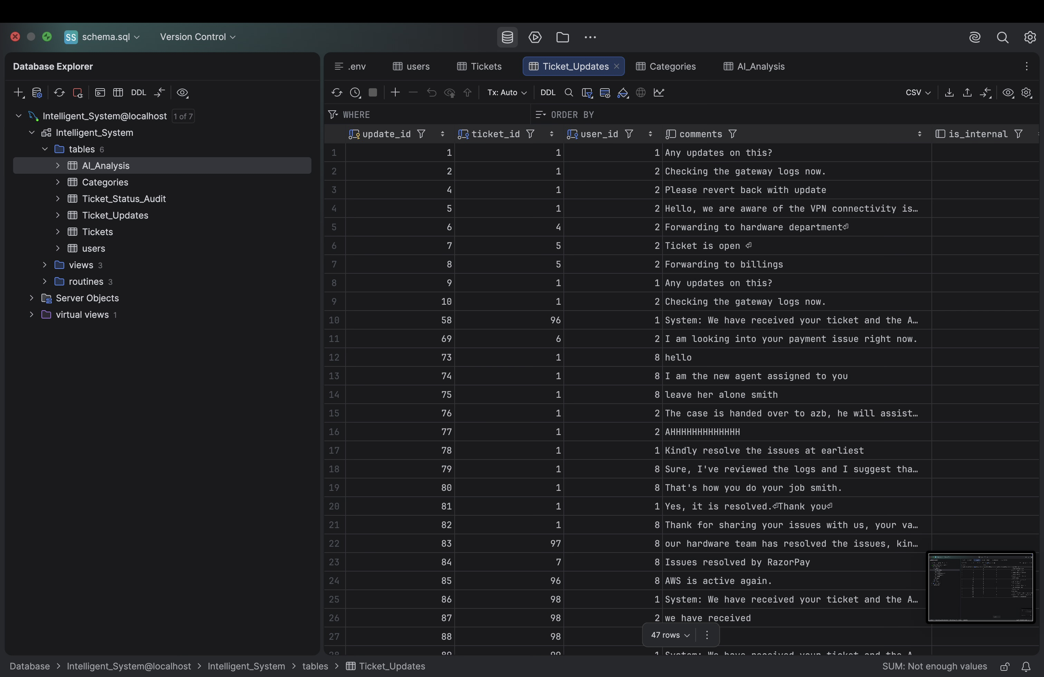
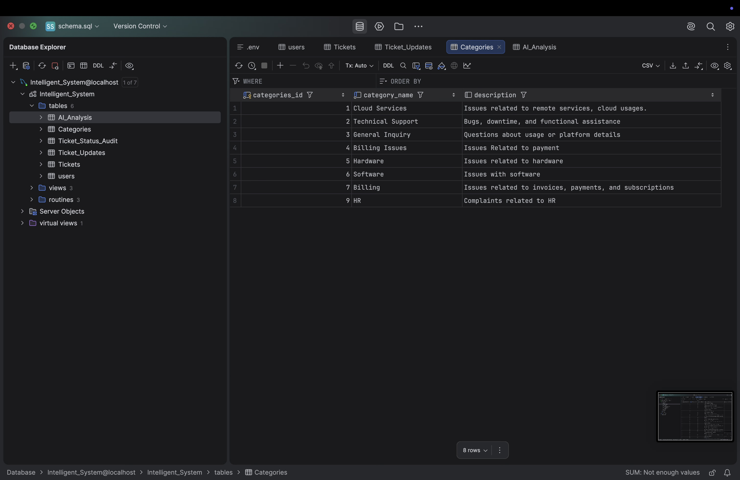
Screenshots Of Back-end
Fig.12 Tickets_Update Table
Fig.13 Categories Table

Slide 13
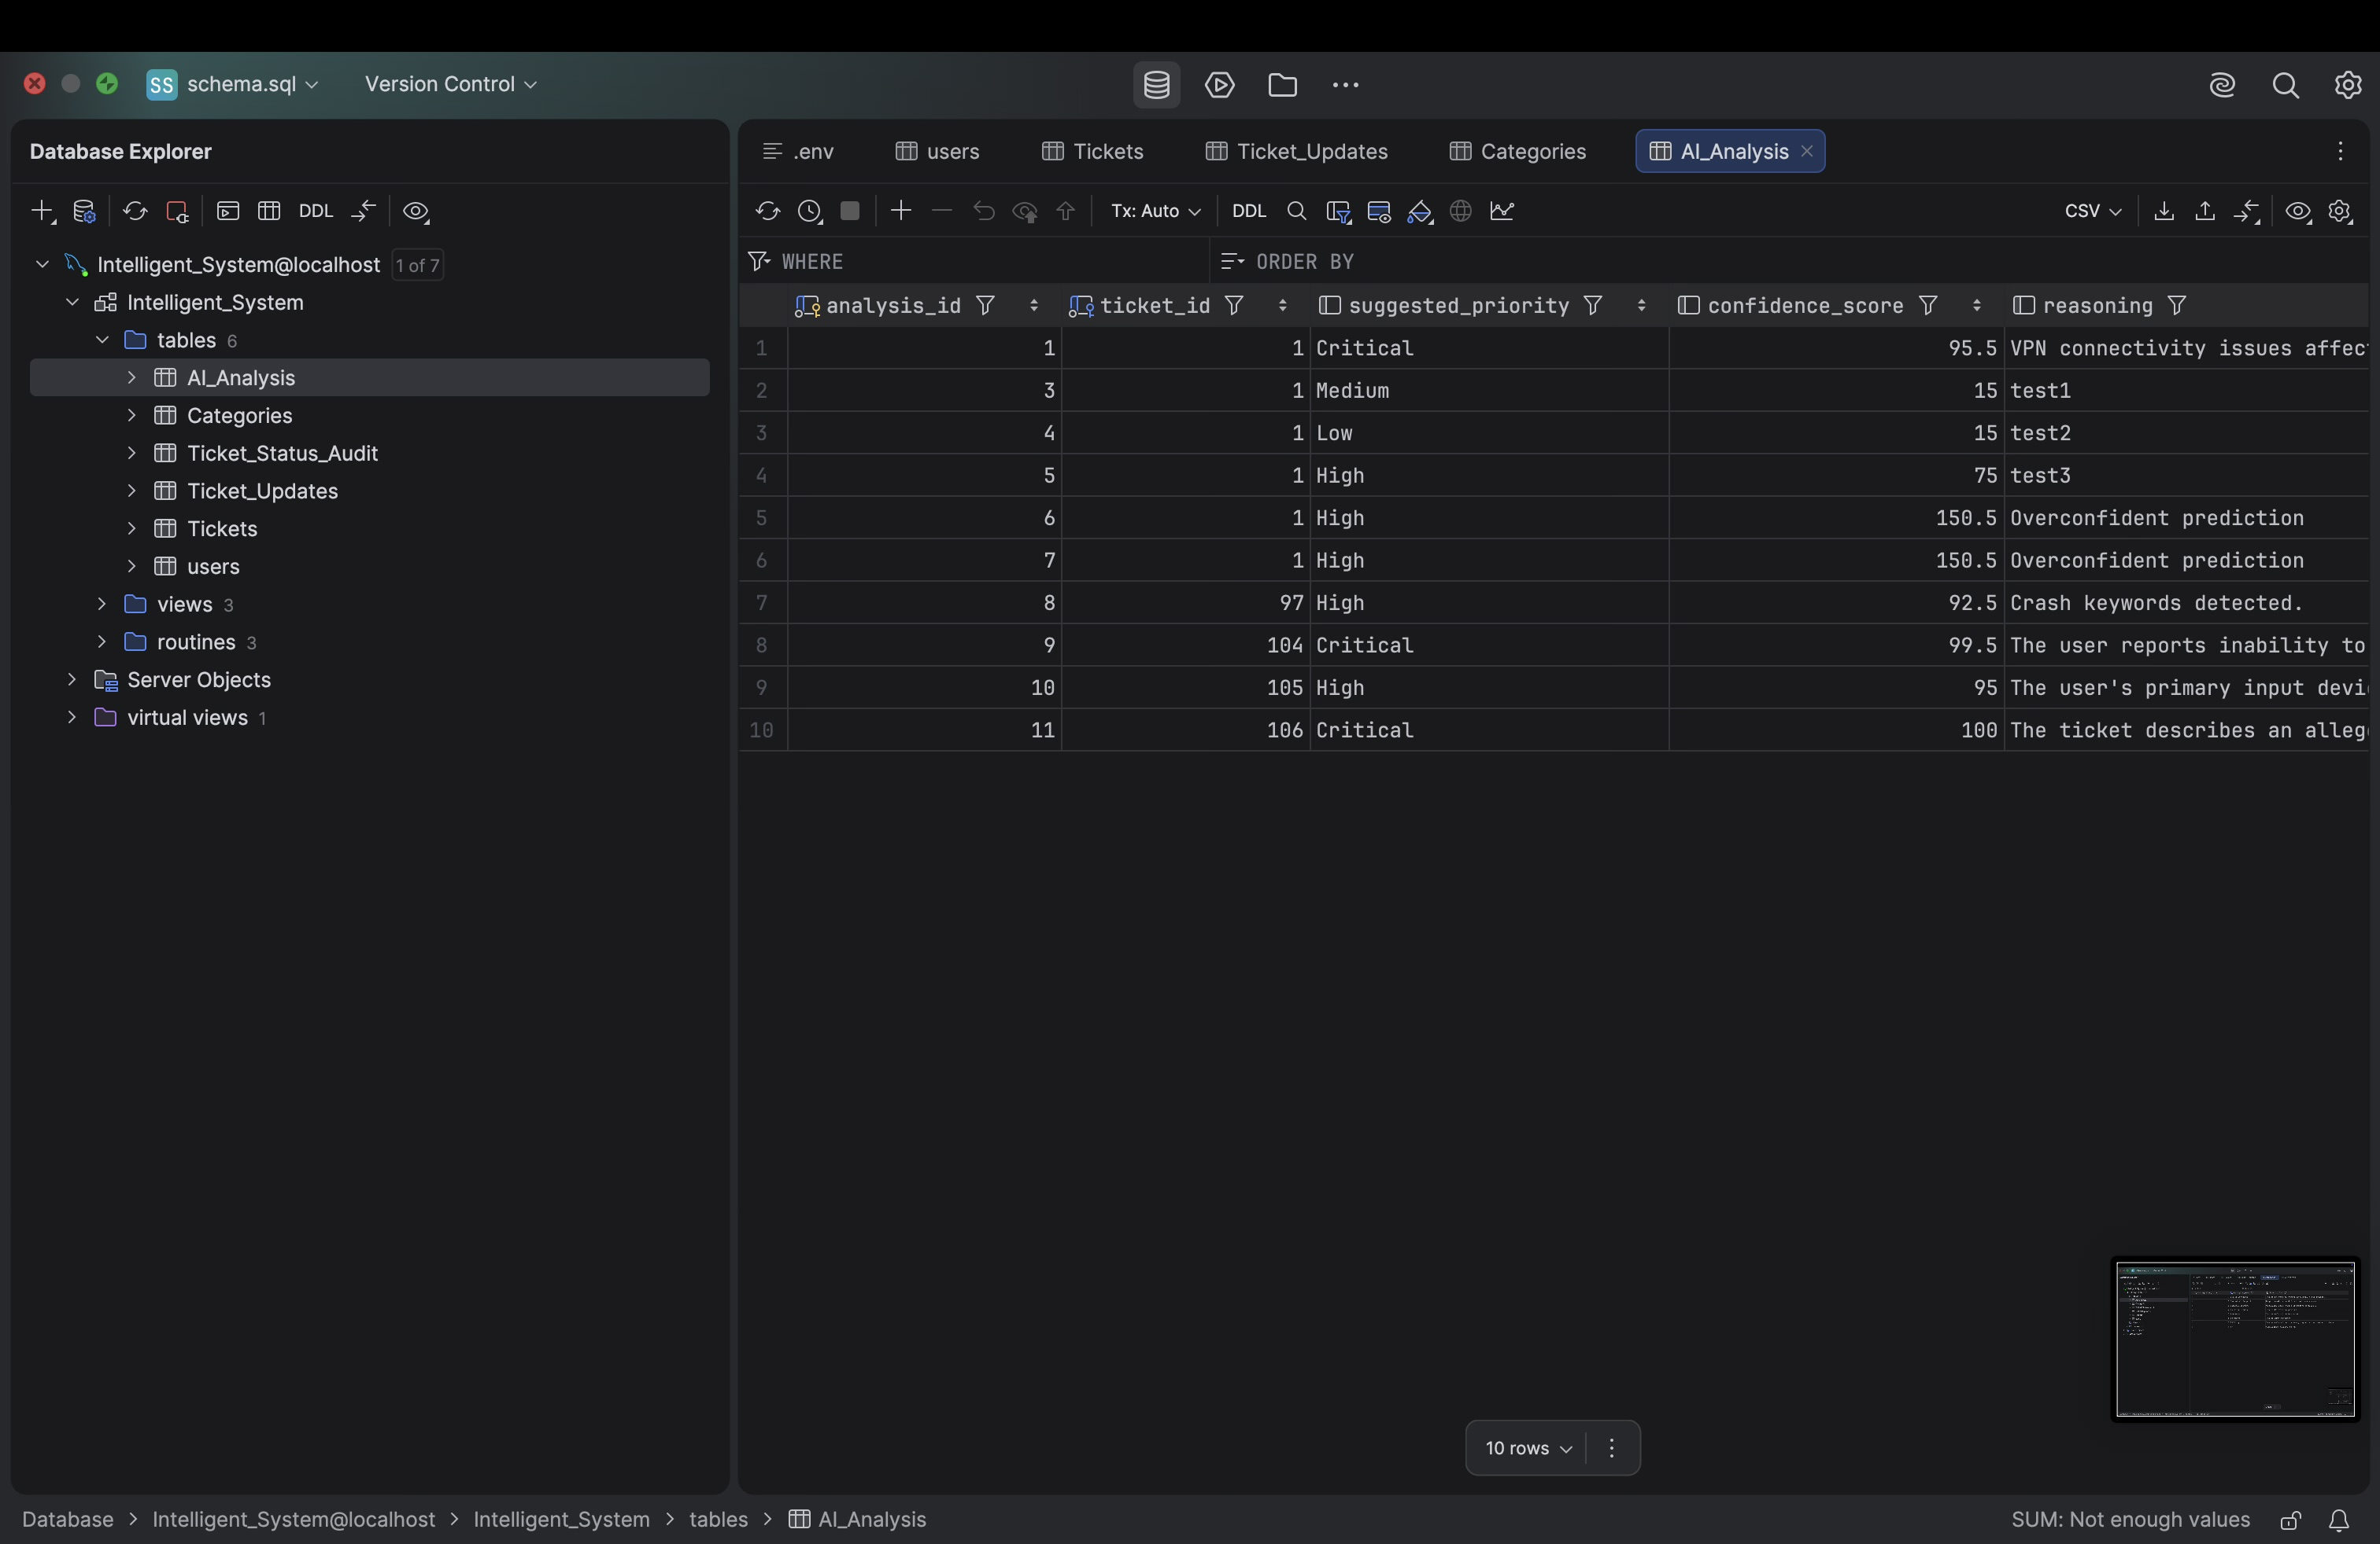
Screenshots Of Back-end
Fig.14 AI_Analysis Table

Slide 14
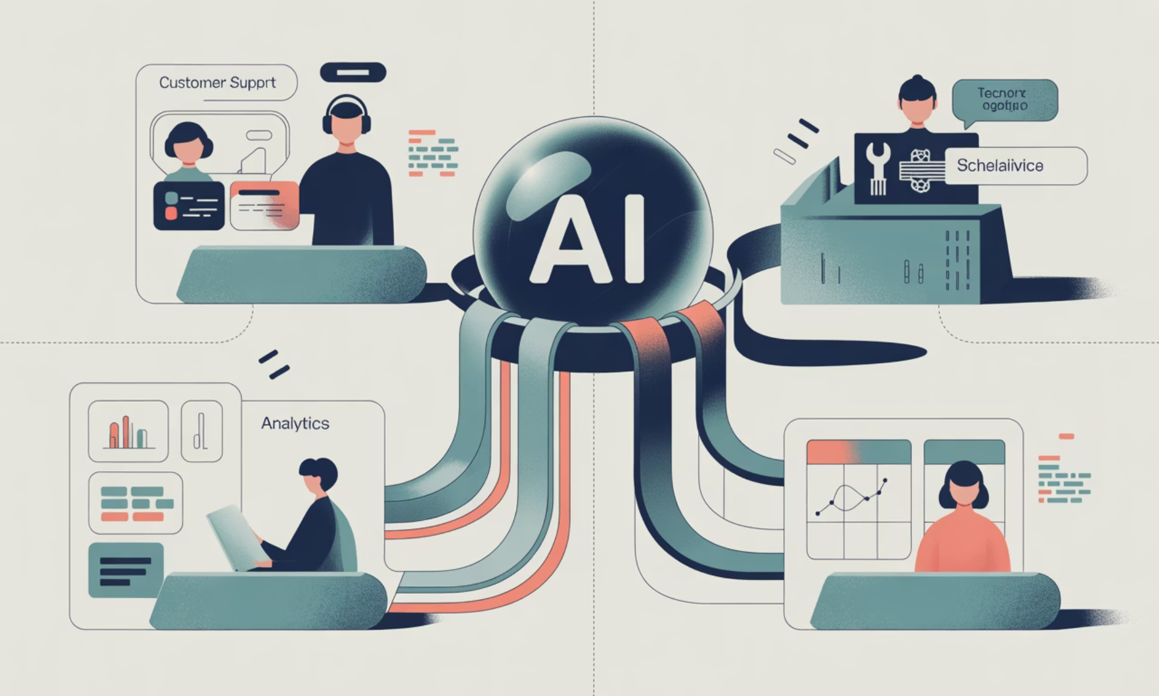
Conclusion & Path Forward
Future Possibilities
The collected data from the Agent Dashboard opens doors for even greater automation. In the future, we envision implementing fully automated routing of tickets directly to specific agents based on their expertise and past performance, further optimizing resource allocation and resolution speed.
Value Proposition
Our Intelligent Support Ticket System fundamentally shifts the agent workflow from "read-and-sort" to "view-and-solve." By automating the initial triage with AI-assisted classification, we significantly improve help desk efficiency, reduce response times, and allow skilled agents to focus on complex problem-solving. This translates to better service for users and higher job satisfaction for support teams.

Slide 15
Thank You
Presented By:
1.Aleem Ul Zaman Baba – RA2411026010520
2.Tawheed Sajad Bazaz –RA2411026010527

