Slide 1
Fundamentals of Testing
Testing Exam 2021 Tariq

Slide 2
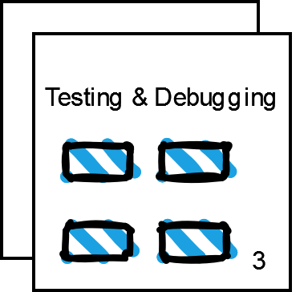
Why testing is necessary
What is testing?
Exploration of systems or components → Detect bugs / defects
Detection only
[ for more info, see next page ]
Why?
No software is bug free
Minimize risks that potential defects, bugs, hazards, etc. can bring
Deliver as bug-free software as possible
Reliability
Less maintenance in the long run
Cheaper
Early detection → Less damage (& cost)

Slide 3
Testing vs. Debugging
Testing | Debugging
Identify & detect bugs / errors Validate that system is not with bugs | Fix the bugs / errors Identify cause → Analyze → fix / remove bugs / errors
Ongoing → Errors at all stages of development | Ongoing → Errors at all stages of development
Can be automated & manual | Manual
Part of SDLC | Consequence of Testing

Slide 4
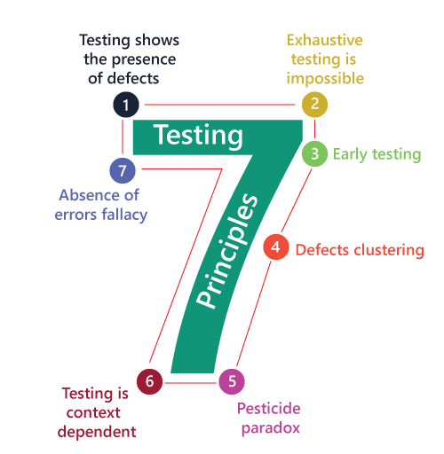
General Testing Principles
Context dependant
Different tests for different context
Absence of errors fallacy
Unusable system → Detecting & fixing defects are not helpful
7 testing principles:
Presence of defects
No proof of bug free code
Exhaustive testing != possible
Impossible to test all combinations
Early Testing
Start ASAP
Defect Clustering
Errors are not evenly delegated in code
80-20 rule
Pesticide Paradox
Regular review and update of test cases and test types

Slide 5
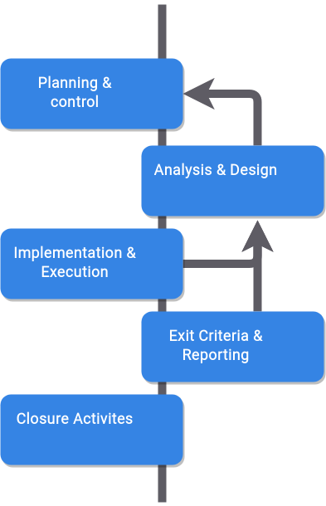
Fundamental Test Process
Iterative execution of test processes.
Needs to be well prepared, planned and evaluated prior to execution

Slide 6
Fundamental Test Process Planning & Control
Process of planning:
What needs to be sted ?
Who will test it ?
Exit criterias
Deadline
Control:
Progress monitoring
Is progress according to plan?
Redefine plan if necessary
An ongoing process

Slide 7
Fundamental Test Process
Analysis & design
What to test (in detail)
Combine test conditions → test cases
Evaluate Testability
Design Test Environment
Identify tools

Slide 8
Fundamental Test Process
Implementation & Execution
Develop & Prioritize
Create test data
Write test procedures
Create and automate test suites
Implement test environment
Produce testware
Most visible part of testing
Execute automated test suites
Test logs & compare to Expected results
Identify Incidents
Retest fixes

Slide 9
Fundamental Test Process
Exit Criteria & Reporting
Based on Risk Assessment during Planning Phase
‘Enough Testing’ when Exit Criteria are met
X% Coverage
Bug Rate below a level
Reached Deadline
Check Test Logs against Planned Exit Criteria
Assess Exit Criteria and Redefine if needed
Produce Test Summary Report for Stakeholders

Slide 10
Fundamental Test Process
Closure Activities
Checked planned deliverables are delivered
Incident reports are resolved
Finalize and archive TestWare
Handover to maintenance organization
Or include in CI/CD pipelines
Retrospective
lessons learned
improvements

Slide 11
Psychology of Testing
Testers find defects
Independent Perspective
Systematic Approach, more efficient
Might feel like a bottlence or conducting a destructive activity
Criticize with Tact, Communication Skills
Developers build features
Biased towards their code
With the right mindset they may test too
Separation of responsibilities is needed
Developers can focus on building
Collaboration vs. Battle
Common Goal is better Quality of the System
Empathy, communicate on facts, make sure we are on the same page

Slide 12
Thanks!

