Slide 1
Life Cycles & The V-Model
Testing Exam - December 2021
Tariq

Slide 2
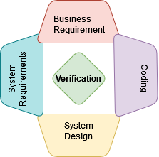

Verification vs. Validation
Verification Static Testing
Product → Requirements?
Ensures product is being built correctly
Quality assurance
Validation Dynamic Testing
Behaviour → Expectations?
Ensures that the right product has been developed
Quality control

Slide 3
SDLC (1/3) Software Development Life Cycles
Stages a software transitions through its lifetime. Goal → Develop and test high quality software
Types:
Waterfall
Early SDLC model
Sequential
Simple concept
(often) non-iterative
Late testing
Requirements Specification
Business Requirements
Functional Specification
System Requirements
Technical Specification
High Level Design
Program Specification
Low level Design
Coding
Test

Slide 4
SDLC (2 / 3) Software Development Life Cycles
V-Model
Extension of Waterfall model
Sequential
Verification & Validation
Design phases
Testing phases
Business Requirements
Requirements Specification
Acceptance Testing
System Requirements
Functional Specification
Test Planning
System Testing
High Level Design
Technical Specification
Integration Testing
Low Level Design
Program Specification
Unit Testing
Coding

Slide 5
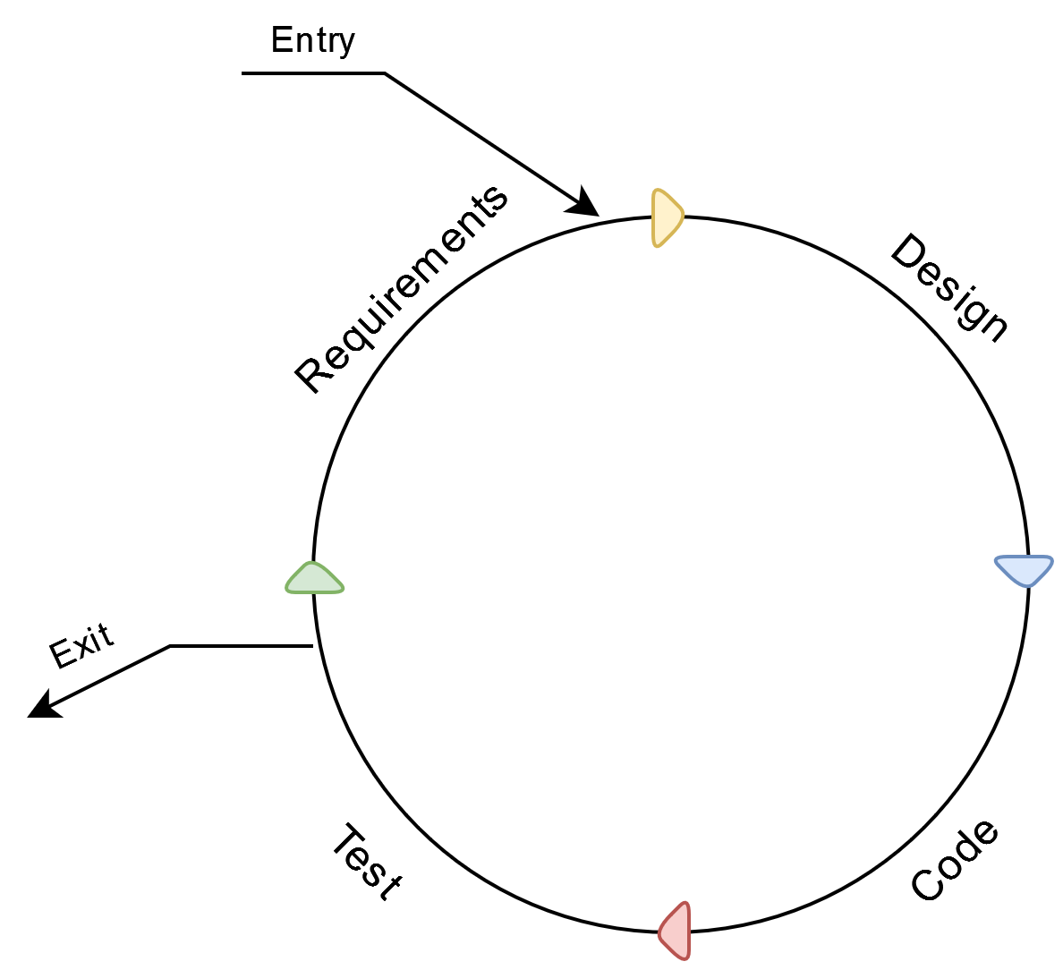
SDLC (3 / 3) Software Development Life Cycles
Iterative / Incremental Models
Representatives present → Add / modify requirements
Iterations / Cycles
Repeated until product is developed
Each cycle:
Time span
Cost est.
Requirements
Code produced
Post cycle:
Next product requirements

Slide 6
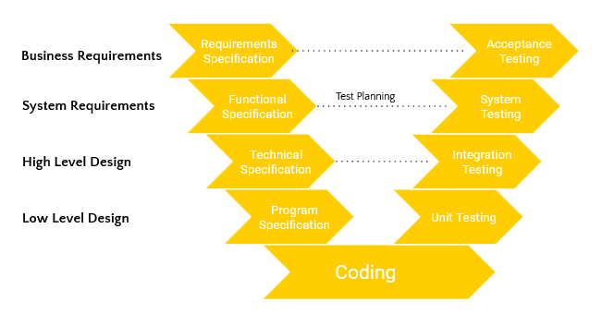
Test Levels (1/5)
Unit Testing
Small units / components of the software
2 types:
Manual
Automated
Coded in isolation from the rest of the software
Prior to integration testing
Testing a unit → Suitable for usage?
By developer
Potentially by Quality Assurance Engineers
Goals:
Verify the correctness of code
Test every function and procedure
Help in code reusability
Unit Testing Tools
JUnit
JTest
EMMA
Etc.
Test Objects:
Code components
DB modules
Data conversions / Migration Programs

Slide 7
Test Levels (2/5)
Integration Testing
Integrating the Units into one whole system
Goals:
Identify bugs / defects in interfaces and interactions between systems or components
Steps:
Decisions → How to put the system together prior to testing
Types of Integration testing:
Big Bang Integration
All units integrated at once
Top-down integration
Units put together in stages
Top → bottom
Bottom-up integration
Units put together in stages
Bottom → Top
Sandwich integration
Units put together in stages
Top & bottom → Middle
Integration Testing Tools
Citrus
Tessy
Rational Integration Tester

Slide 8
Test Levels (3/5)
System Testing
The process of testing the whole system from A - Z
Done after integration testing
Tested by a team (independent from DEV team) and in an environment similar to PROD
Goals:
Detect potential errors that might not have been caught in prior testings
Tests basis:
Software requirement specifications
System requirement specifications
Functional specifications
Non-functional requirements:
Performance
Stability
Load handling
Reliability
Etc.
Functional requirements:
Functions the system must perform
Security requirements
etc.

Slide 9
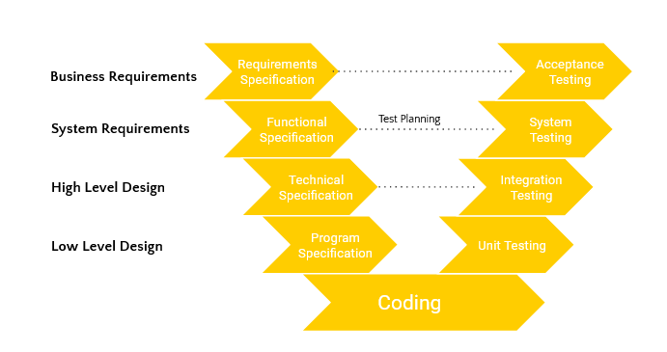
Test Levels (4/5)
Acceptance Testing
Ensures system expectations are met
Based on Requirement Specification
‘Is the product delivery acceptable?’
Often the responsibility of customers
Project members can also be involved
Some checks:
Functionality
Data quality
Performance
Compatibility
User interface
etc.
Types:
User Acceptance Testing (UAT)
Performed by user representative
Tests if product meets their business needs
Operational Acceptance Testing (OAT)
Checks if processes and procedures are correct → Does it allow maintainability?
Alpha & Beta Testing:
Alpha
Performed at developer’s site
Independent from DEV team
Beta
Performed at customer’s site
Feedback given to DEV team before release

Slide 10
Test Levels (5/5)
Maintenance Testing
The process of re-testing the system
On system changes / upgrades
Fx. new features, migrations, updates, migrations, etc.
Types:
Confirmation testing
Testing the changes
Regression Testing:
Ensures the maintenance work is not affected other parts of the product
Includes an Impact analysis:
Analysing the impact of changes to the deployed system
Which part of the system may get affected

Slide 11
Thanks!

