Slide 1
Integration Testing
Integration Testing
Testing Exam 20201
Tariq

Slide 2
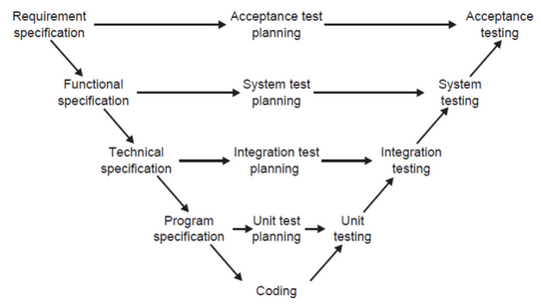
Integration Testing | Introduction
What is it?
The process of testing the interface between units / components.
Purpose → Expose defects during interactions between integrated units or components
Do the modules work together like they should?
When?
System interaction with Database / File systems
Testing API’s
How?
Units / components → Into a unified system
Tested to validate:
Performance
Reliability
Functionalities

Slide 3
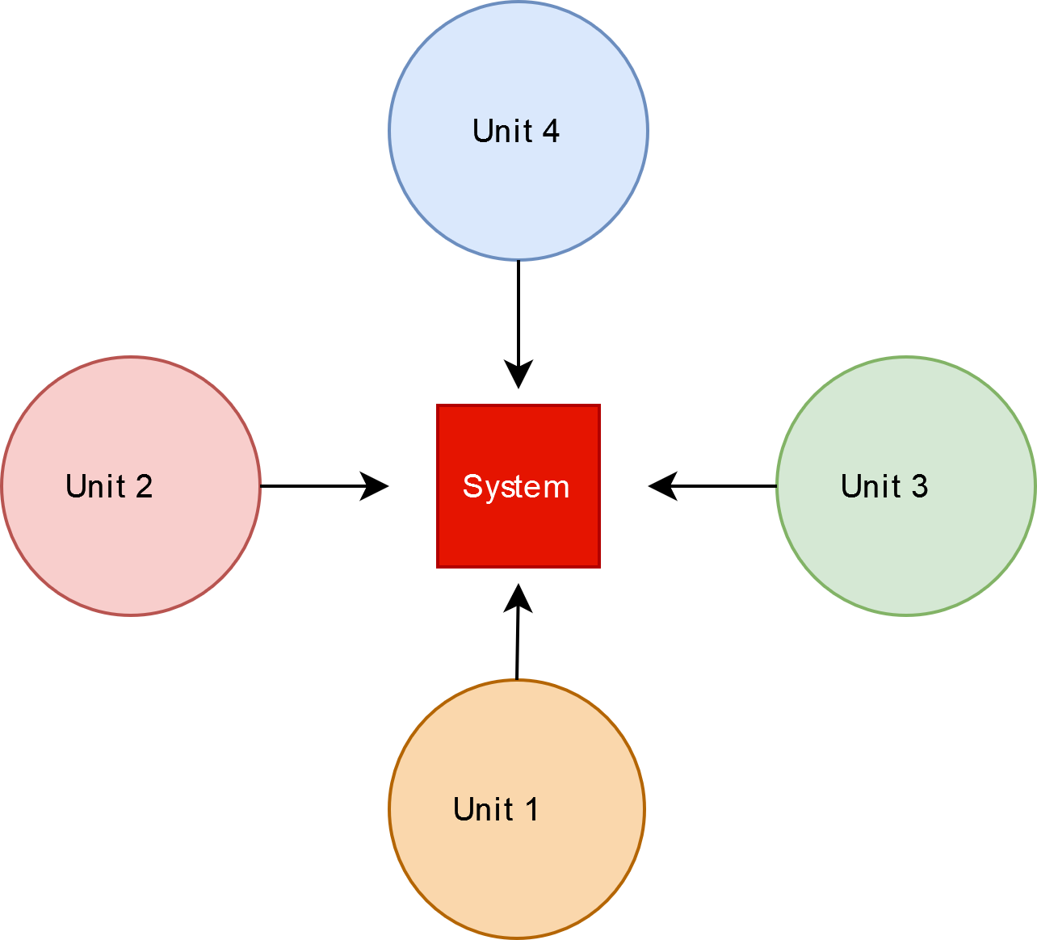
Strategies | Big Bang
Integration testing strategies:
Big Bang Strategy
All units / components → Integrated at the same time and tested
Efficient for small systems
Not recommended for larger systems
Difficulty identifying potential faulty unit / component

Slide 4
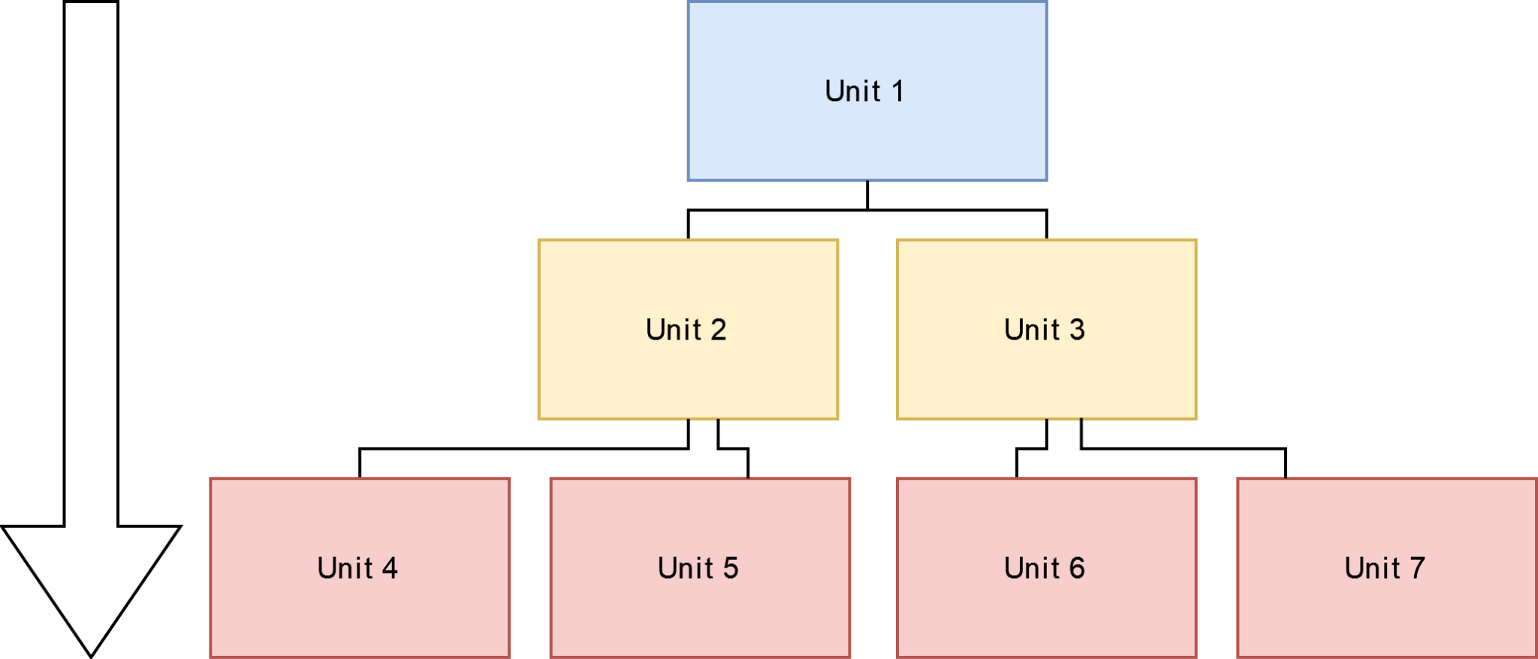
Strategies | Top-down Integration
Top-down integration strategy
Top → Bottom
Priority:
First high level-level components are tested
Then child components
Process continues until integration testing is complete
Units that doesn’t exist yet → Replaced with temp stubs
Benefits:
Consistency
Critical modules are tested first
Disadvantages:
Requires stubs
Basic functionalities are tested last

Slide 5
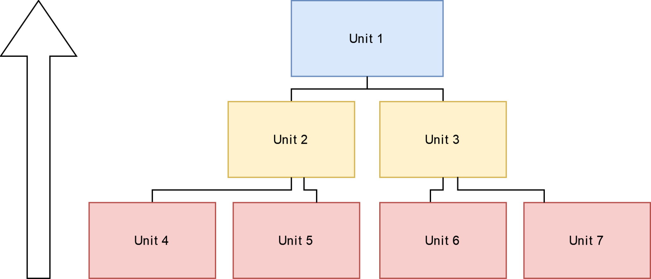
Strategies | Bottom-up Integration
Bottom-up integration strategy
Testing begins from the lower level and proceeds upwards
Testing and development → Simultaneously
Drivers are temporary replacement for high-level components
Benefits:
Less time wasted
Disadvantages:
High priority modules are tested lastly

Slide 6
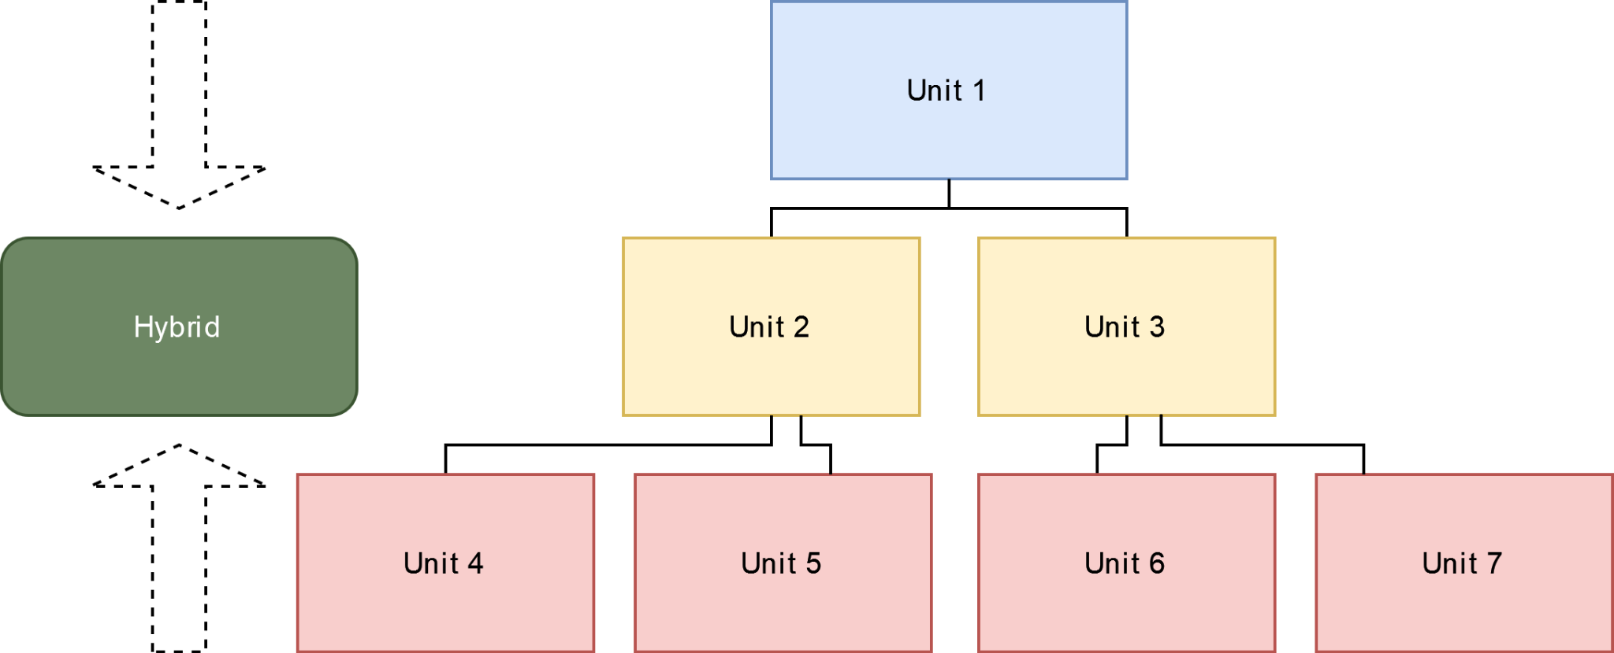
Strategies | Sandwich Integration
Sandwich / hybrid integration
Combination of Top-down & bottom-up
Parent units and child tests can be tested together
More efficient results

Slide 7
Code Repositories
What is it?
Form of location for source code and the dependencies for it.
Provides ease-of-access and storage
Why?
Allows version control
Branches (variations of code or other uses)
Usually one Main
Ability to pull (retrieve) the code on a new machine and build the product correctly
Repository tools:
CVS
Azure Repo
Subversion
Gitlab
Github
Bitbucket

Slide 8
Automated Builds
What is it?
Automatically build the necessary component / software on commit or wish
Not only for code, can also be DB schemas, test data, dependencies, etc.
Why?
Essential for CI/CD workflow
Time efficient
Developers can be used elsewhere
Automatic

Slide 9
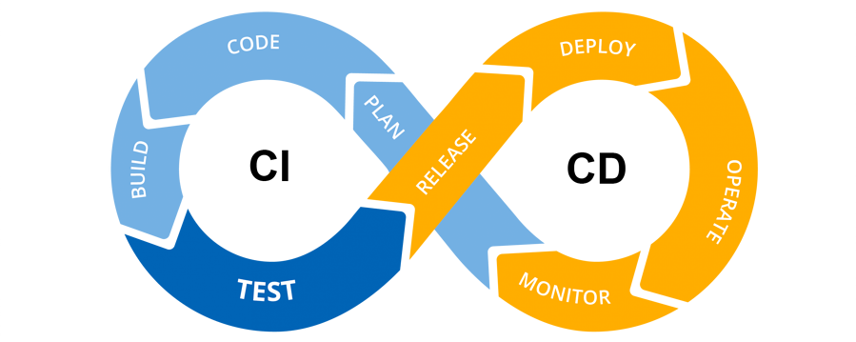
Continuous Integration Process
What is it?
The practice of automating the integration process.
Why?
Eliminates problems such as ‘Integration hell’
Better workflow and more efficient
Fast feedback
Allows seamless integration between multiple developers
Workflow:
Prerequisites:
Planning
Automated Builds
Repository
Process:
Developer creates a component / unit
Component and test is merged into a shared version control repository (often to a separate branch)
Developer requests for branch to be merged into main branch by creating a pull request
The pull request triggers an automated build system that builds, test and validate it.
Depending on the outcome of the build, the merge will be approved or rejected.
Possible issues need to be resolved before the PR can be confirmed
The process continues in the next merge

Slide 10
Continuous Integration Server & Integration Environment
Continuous Integration Server
Why?
Approaches:
Manual
Script for integration test
Manually triggered
CI-server
Manages a shared repo
Like a referee
Provides committer (and those with interest) with a message (email) with build results
Some CI servers:
GitLab CI
Jenkins
CircleCI
Atlassian Bamboo
Integration Environment
The environment in which the product is built
1:1 copy of the PROD environment

Slide 11
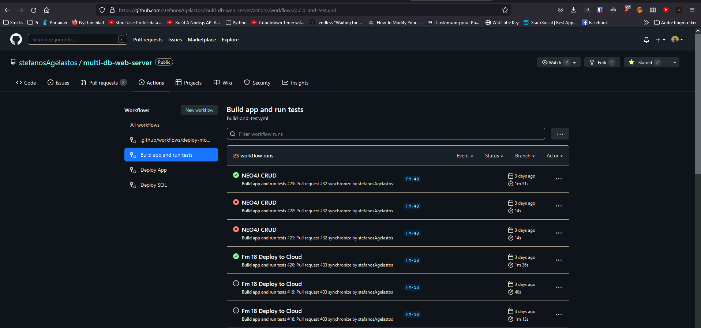
Demo of CI process with Github Actions

Slide 12
Thanks!

