Slide 1
Agile and Testing
Testing Exam 2021 Tariq

Slide 2
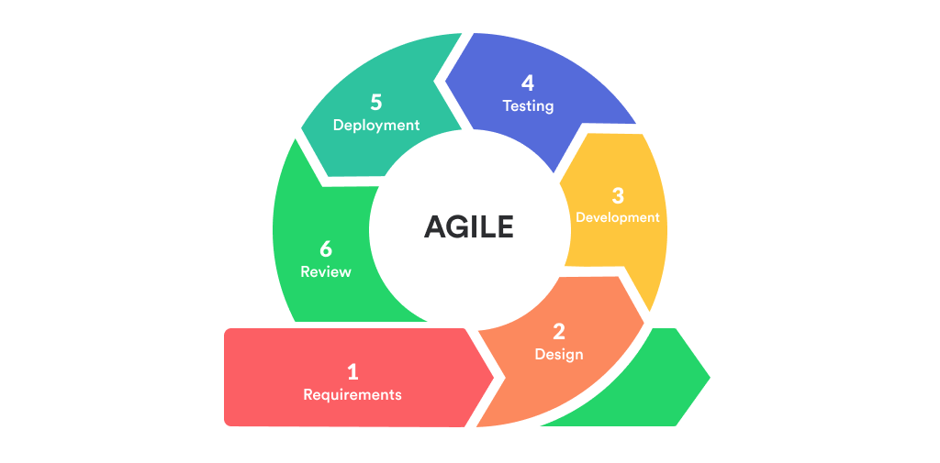
Introduction | Agile
Large project → Small chunks → Iterations = manageable
Iterations → Consistent time periods
No known limit but usually 1 week or 1 month
Product delivery at the end of every iteration
Next delivery will build on the previous one
‹#›

Slide 3
Agile testing
What is it?
Software testing practice → Agile principles
Continuous rather than sequential
Frequent iterations
Each iteration contains:
Test Analysis & design
Test implementation & execution
Evaluating Exit criteria & reporting
Test is not limited to a dedicated test team
Why?
Continuous feedback and communication
Ability to go back in phases / steps.
Usage of automated testing tools

Slide 4
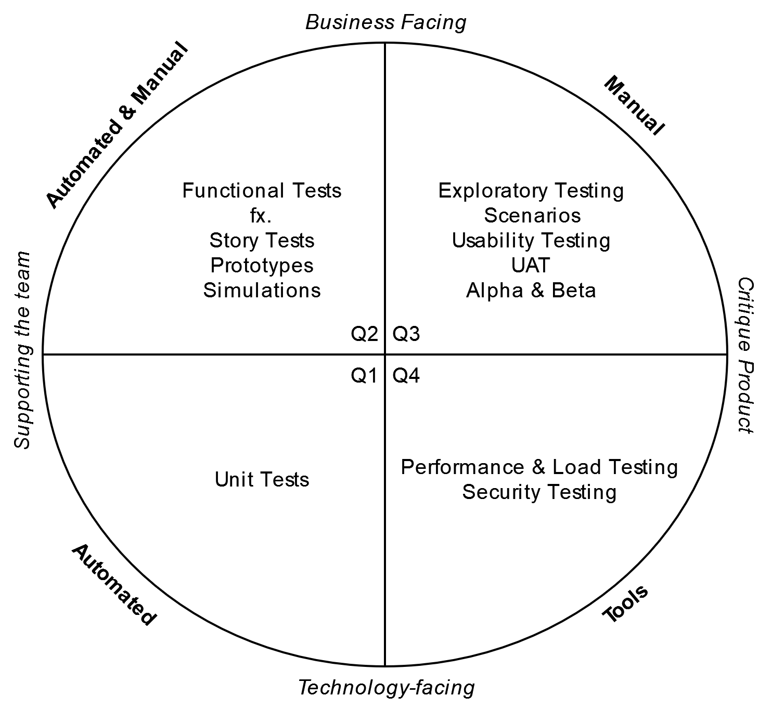
The Agile Testing Quadrants
Why?
Overview of the agile testing process
Should be used as check-mark for an effective project
What is it?
Agile testing delegated into four quadrants
Quadrant 2
Ensures the product does what it’s supposed to
Focus on requirements
Quadrant 3
- Ensures to gather feedback & improve product quality
Quadrant 1
- Usually automated
- Ensure internal code quality
- Ongoing feedback to devs about quality
Quadrant 4
- Tests performance, load & data security

Slide 5
Scrum & Testing
& the scrum tester
What is Scrum?
Self-organized & agile framework
Multiple Sprints with product delivery at the end
Efficient team collaborations
Roles:
Product Owner (PO)
Scrum Master
Development team
Usually overseen by customer.
Testing in scrum?
Methodology of Scrum
Ensure product quality → Non-functional testings
Usability, performance, security, etc.
Who does it?
Scrum tester
Dev team
When does it happen?
In every iteration
What is a scrum tester?
Acts on behalf of customer
Responsible for:
Detecting bugs, issues & defects
Preparation of testing documentation
Before end of each sprint
Ability to:
Determine if a sprint is ‘Done’
Organize the sprint demo
Scrum sprint
Acceptance testing → Not IN the sprint, but at the end.

Slide 6
Test Driven Development (TDD)
& Refactoring
TDD
What is it?
The process of developing while testing
Each unit → Predefined test case
How (the process)?
Write a unit test describing a section / component of the program
Run a test with the intent of failure (since the program lacks that functionality)
Write the absolute minimum code to make the test pass
Refactor the code
Repeat the process
Refactoring
Process of rewriting and improving code
Internal, not external behaviour

Slide 7
Thanks!

