Slide 1
Test Strategy & Management
Testing Exam 2021
Tariq

Slide 2
Test Approaches | Introduction
What is it?
Test approaches are:
Certain strategies
Forms the starting point for:
Test planning
Selection of design Techniques
Test types
Entry criterias
Exit criterias
Why?
To determine and define how many and what tests are needed.
How?
Based on:
Project goals
Objectives
What is the goal?
Only handle most critical risks?
Risk assessment
Risk of failure
What is the type of project?
Two Techniques:
Preventative (V-model approach)
Project design → As early as possible
Risks caught ASAP
Reactive (Waterfall approach)
Testing is implemented later
Usually after Project design and coding

Slide 3
Test Approaches
Analytical
Risk based testing → directed towards areas of great risk
Model based
Stochastic Testing → Testing using statistical information about failure rates
Standard-compliant
Testing following industry specific standards
Dynamic and heuristic
Exploratory testing → Testing is done as a reactive measure rather than pre-planned. Execution and evaluation happens simultaneously.
Consultative
Expert-based testing → Testing is done with major influence from technology and / or business domain experts (can be internal as well as external experts).
Regression-averse
Extensive automation, standard test suites, reuse of existing test materials.
One project can implement a combination of different approaches.

Slide 4
Test Estimation
Management strategy for measuring factors needed for test execution
Factors:
Skill level
Resources
Cost
Time
2 types:
Metrics based
Relies on data collected from similar or previous projects
Fx.
Amount of test conditions
Amount of test cases written
Amount of test cases executed
etc.
Expert based
Relies on experience of experts
Expert types:
Developers
Business experts
Analyst & designers
Etc.

Slide 5

Test Progress Monitoring & Control
Test Progress Monitoring (TPM)
What is it?
Continuous monitoring and reviewing the activities of the system.
Result → Compared to actual system behaviour
Why?
Track current progress of testing activities
Detecting and tracking test metrics → Estimate future actions based on metrics
Feedback to team, stakeholders, etc.
How?
Manually
With Tools
Automatically
Test metrics - directly related to exit criteria.
Some metrics:
Percentage of test cases prepared
Percentage of work done in test environment preparation
Number of test cases executed/not executed and passed/failed
Testing costs compared to benefits
Test coverage (risks, code or requirements)
Test control:
What is it?
Actions need in case of delay / hold ups
Some actions:
Make decisions based on the data from test progress monitoring
Reprioritisation of tests in case of risks
Review the risks to project and potentially change the risk ratings in order to meet the goal
Adjust the scope of testing to adapt for late change requests

Slide 6
Incident Management
What is it?
Detecting, investigating, reacting & solving incidents
Track incidents from its detection → it is resolved
Why?
Update developers & other interested parties with feedback
General
Managed by an Incident Manager
Documented in incident report
How:
Incidents can be raised with tools, management systems or electronically.
Incident reports can contain
Number of incidents
Priority
Status
Date of discovery
etc.

Slide 7
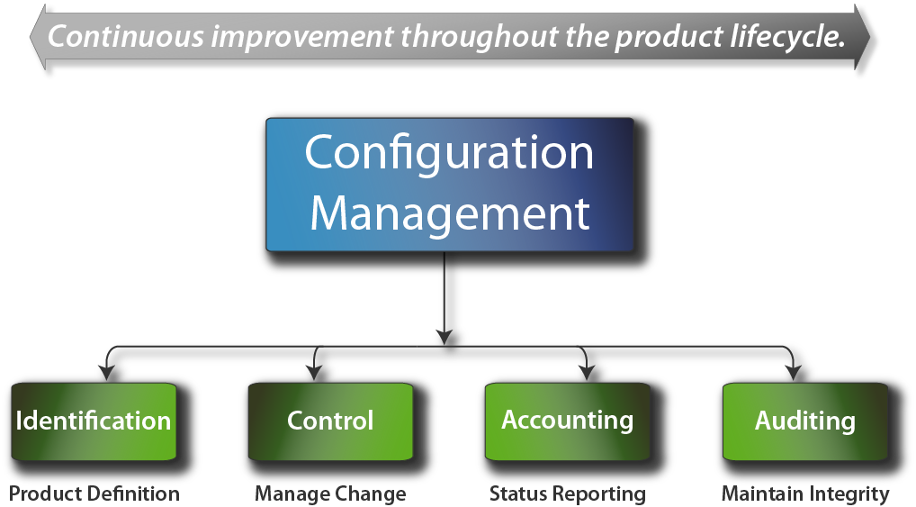
Configuration Management
What is it?
Management of:
Facilities
Processes
Products
Version Control
How?
Managing information about them
Ensure they perform as expected
Why?
Ensure traceability through test process
Save time

Slide 8
Test Management | Risk (1/2)
What is it?
Management of tests in a project → General overview
Risks
Independence levels
Roles
Planning
Control
Two types of Risks:
Project Risk
Risks that may occur in a project
Supplier issues
Organisational factors
Technical issues
Product Risk
Risks in product quality
Faulty
Poor functionality
Poor data integrity
etc.
What is a risk?
Unwanted factors - event, thread, hazard, etc - at that could appear in the future and leave a negative impact

Slide 9
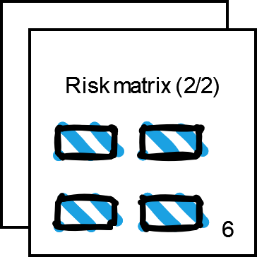
Test Management | Risk (2/3)
Risk factor:
What is it?
Measurement of risk impact & likelihood
How?
likelihood 𝑥 impact = risk factor
Risk Management:
What is it?
Risk changes → Need frequent monitoring & evaluation
Identifying, assessing & controlling risks
Calculate risk factor
Act accordingly
Risk Matrix?
What is it?
Visualisation of risk
Low
Medium
High
(Extreme)
[ Continued in next page ]

Slide 10
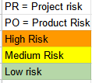
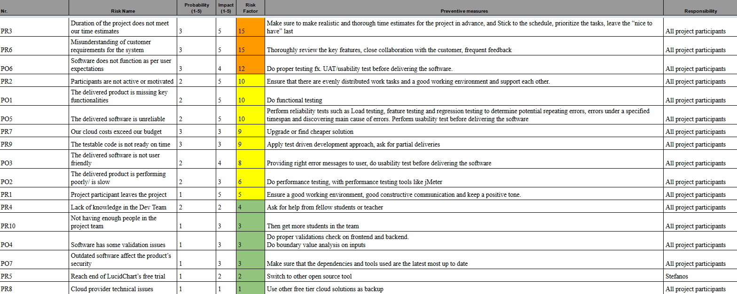
Test Management | Risk (3/3)

Slide 11
Thanks!

