Slide 1
Systems Integration exam presentation

Slide 2
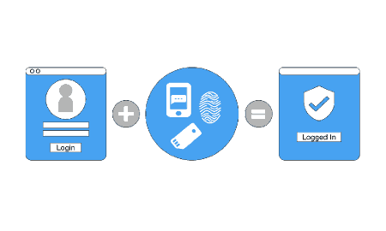
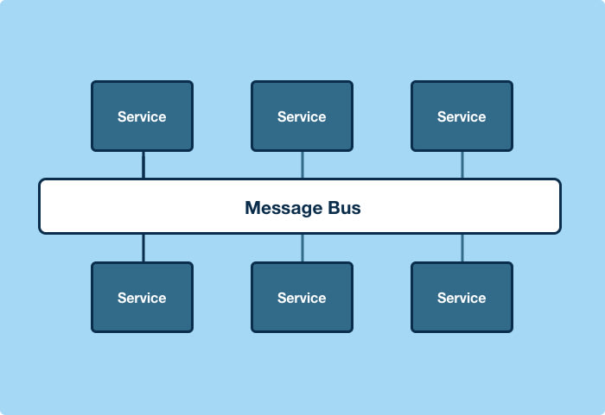
Exam Project
MFA authentication using stubs
Custom ESB & message broker

Slide 3
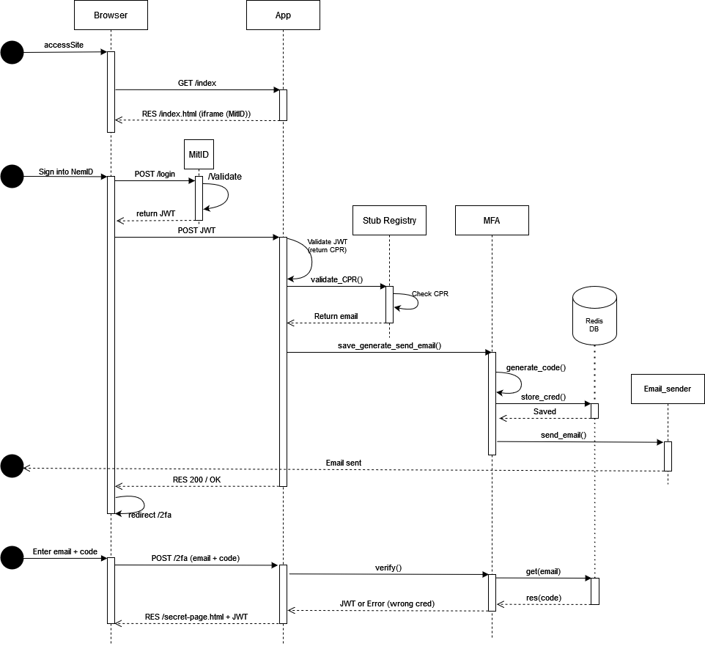
MFA Authentication
The client uses a browser
Logs in using a trusted authentication provider (mitid stub)
Once authenticated:
  a token is send to their email as a second factor authentication
Once the token and email are confirmed:
  A provider UUID is generated
  The provider UUID is encoded in a JWT
  The JWT is presented to the client

Slide 4
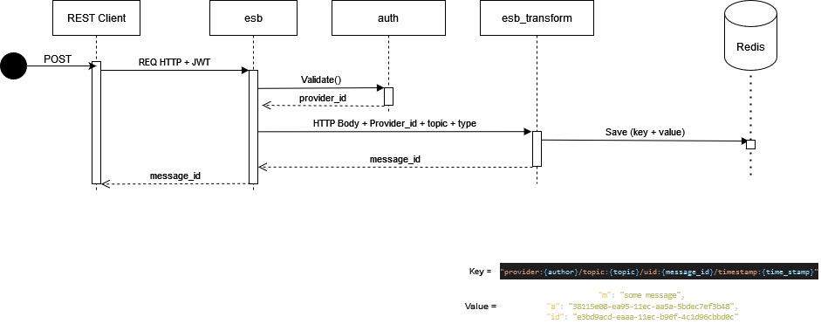
Simple ESB & message broker
Messages consist of a string, limit 512MB
Providers are authenticated by a JWT
Providers post messages to a topic (in JSON/XML or YAML)
Providers can poll messages from a topic (in any of the above formats)
Providers can delete messages they have posted
Messages expire after 5 minutes

Slide 5
Topic: Observability Patterns
Log Aggregation
  Invidual service instances post logs to a centralised logging service (big volume of logs)
Application Metrics:
  Statistics for individual operations
  Centralised metrics service, push or pull fashion
Audit Logs:
  Troubleshoot/track user/resource activity
Distributed tracing:
  Track request as it travels through each service via UUID
  Performance monitoring
  Requires instrumentation
Exception tracking
  Log, deduplicate and alert devs
Healthcheck endpoint
Log deployments and changes

Slide 6
Topic: Deployment Strategies
One service per host
  Isolation of services
  No dependency conflicts
  No resource consumption conflicts
  Easy to monitor and redeploy
  Less efficient resource utilisation (one OS per service, over provisioning)
Multiple services per host
  More efficient resource utilization
  Conflicting resource requierements
  Services competing on resource consumption
  Dificult to monitor individula service resource utilization

